Slide 1
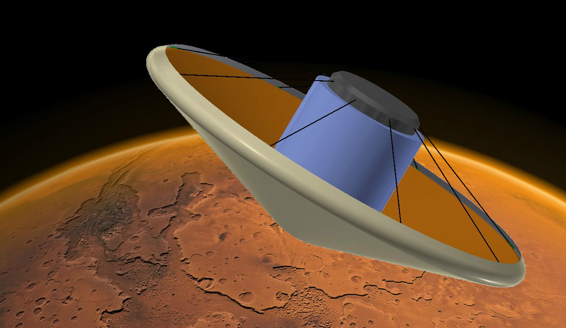
Cable-Controlled Aeroshell Deceleration System
Sashank Gummella, Sophomore, Aerospace Engineering
Steven Kosvick, Sophomore, Aerospace Engineering
Austin Scott, Sophomore, Aerospace Engineering
Jose Tuason, Senior, Aerospace Engineering
Samuel Wywrot, Sophomore, Aerospace Engineering
Faculty Advisor:
Dr. Zachary Putnam, Aerospace Engineering
Notes:
“Thank you for your time and for allowing us to present our design concept in the BIG Idea Challenge.”
Introduce yourselves, your year, and your major.
Acknowledge Prof. Putnam if he is not standing up with us.
He was instrumental in helping us throughout

Slide 2
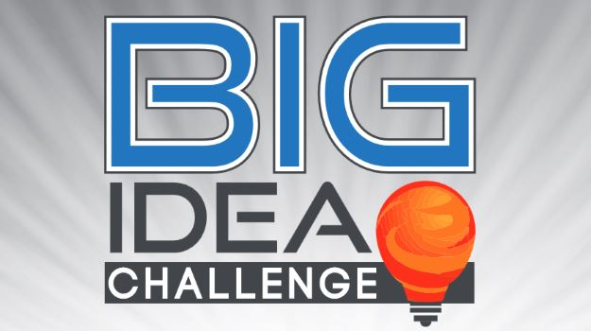
The Challenge
A vehicle capable of carrying 15-30 tonnes is necessary in order to land on and return humans safely from Mars
Beyond the limits of 1960s-1970s technology
Newly developed HIAD technology has great potential due to its efficient storage
HIAD vehicles can mitigate deceleration forces on crew, loft and extend EDL events, and enable precision landing via generation of lift
Big Idea Challenge hosted by the NIA
Notes:
The challenge posed to us last Fall was something we all felt was fascinating
We found that the BIG Idea Challenge allowed us to solve engineering problems that would accompany the early phases of an expedition to Mars
In the 1960s and 1970s (blunt bodies), entry techniques for Mars probe and rover missions successively landed payloads under only 5 tonnes
To land more than 15 tonnes, a more ambitious and complex entry vehicle based on HIAD technology would have to be designed to support Mars expeditionary missions
HIAD Technology has the potential to deliver to deliver 15 tonnes or greater to Martian surface because it’s able to be packed efficiently and inflate to large diameters necessary for delivering massive payloads.
To maximize the potential for HIAD technology, we augmented it by devising a method of controlling lift for various purposes. We intended to built upon its low system mass and simplistic structure.

Slide 3
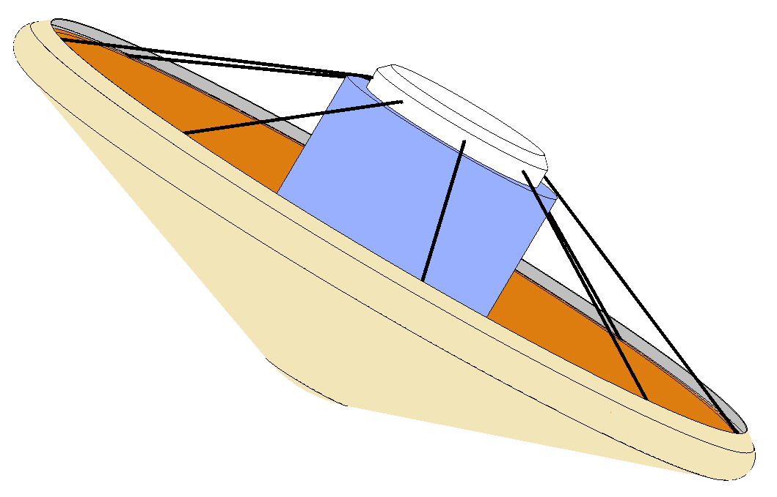
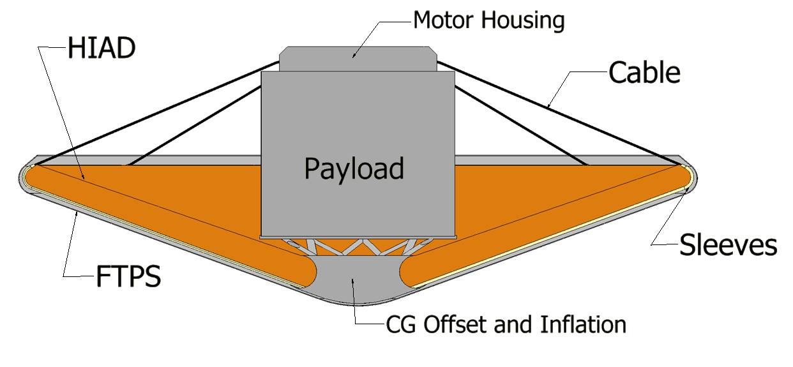
CCADS - Design Overview
The Cable Controlled Aeroshell Deceleration System (CCADS) undergoes aeroshell shape morphing via tension applied through cables (fine control) and CG offsetting (coarse control) to control its lift vector.
Key components:
HIAD aeroshell
Cables
Electric Motor
CG offsetting mechanism
Notes:
WHOEVER IS PRESENTING THIS SLIDE HAVE THE DESCRIPTION COMPLETELY MEMORIZED
The HIAD’s versatility opens up the potential for new applications. It is possible to use shape morphing to change its aerodynamic properties into what is more desirable for the situation.
Recite the definition of CCADS
The CCADS encompasses the HIAD aeroshell, as well as cables and an electric motor housing.
Since the beginning of the preliminary design process in October, the goal has always been to keep the method of controlling the L/D of the entry vehicle as simple and as efficient as possible.
We sought to design a simple, low-mass HIAD vehicle. For this reason, we opted to use technology that did not require propellant.
Mention disadvantages of RCS thrusters
The structure of the aeroshell is morphable and, for this reason, CCADS provides an effective method of control.
CCADS relies on readily available technology that could be easily implemented into an entry vehicle.

Slide 4
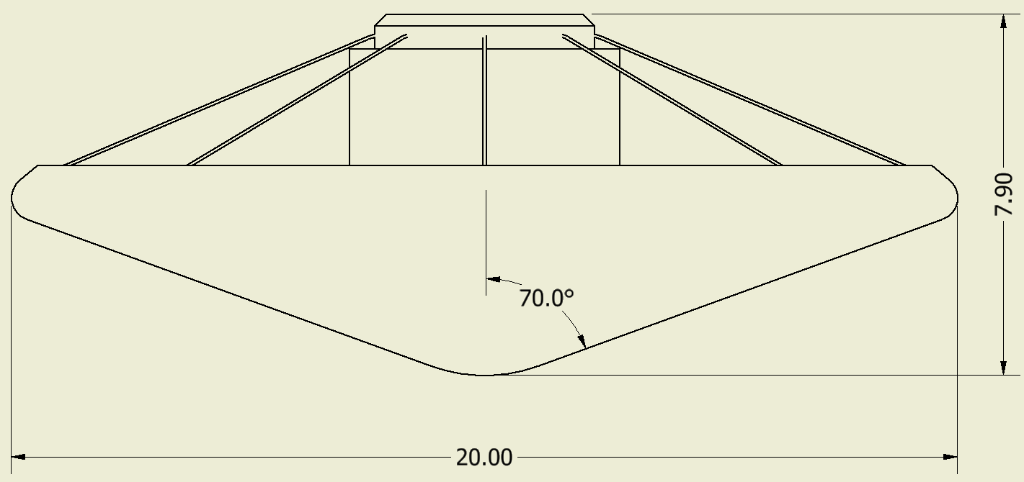
Design Specifications
Entry Vehicle
Height: 7.9 m
Mass: 50 tonnes (estimated)
Components
HIAD Aeroshell
Diameter: 20 m at 70° half-cone angle
BLDC electric motors
Density (FTPS): 940 kg (estimation based on 3 kg/m²)
Cables
Length: 25 m
*units in meters
Notes:
To maximize the amount of drag and lift generated during descent, we chose maximize the diameter of the aeroshell.
Similarly, a 70deg half-cone angle is utilized like previous Martian EDL vehicles.
Several of the specifications are estimated, including the cable diameter and length. The issue of determining the amount of tensile force per cable for shape-morphing is complex, we estimated the length of each cable based on the geometry of the vehicle. Note how the cable extends form the motor housing to the aeroshell edge, and then to a hard attachment point at the bottom of the forebody (point with your finger!!!!)
The mass of the FTPS is expected to be at least 940 kg. In addition, the motor and cable system is expected to be less than 20% of the system mass. The mass of the delivery system without payload is expected to be under 25 tonnes.
The baseline FTPS layer configuration is based on that of the IRVE-3. Since our vehicle experiences a higher heat flux than that experienced the IRVE-3, we decided to replace the outer layer of Nextel with a layer Nicalon, which is a denser material. Thus, we anticipate that the density of the FTPS for the entry vehicle is at least 3 kg/m², and it is estimated that the mass of the FTPS, itself, will be slightly greater than 940 kg.

Slide 5
Cables
Temperature range 350°C-450°C
Material
Carbon-based composite (CFCC, C-C)
Graphite fiber-phthalonitrile
Thermal resistant fabrics
Gutters/Sleeves
Protect and guide cables during morphing
Made of heat resistant and low-friction material
Three Torus Configuration Options
Notes:
The cables will be specifically used to morph the aeroshell, and will be moved and tensed by the electric motor housing on top of the entry vehicle payload compartment.
Throughout the design process, several materials were considered to be used in the cables.
High operational temperature, low thermal expansion coefficient, and high tensile strength were some of the criteria used to determine the best cable material for the mission concept.
While Kevlar and titanium provide high tensile strength in cable or wire-rope configuration, kevlar and titanium have a relatively low operational temperature and large mass, respectively, in cable configurations.
Carbon fiber composite cables, which have numerous applications to aerospace technology, have a high strength to weight ratio
Industrial applications of carbon fiber have demonstrated that about between 7 strands of carbon cables, with the diameter of each strand ranging from 5 to 18 mm, yield breaking loads of 18 and 280 kN
In terms of operational temperatures, both carbon-based composites and graphite fiber-phthalonitrile have operational temperatures in the 350-450 degrees Celsius range
Though the design currently features 8 cables that could allow for shape morphing, adding more cables would increase maneuverability, but also increase the overall system mass.
http://waset.org/publications/13726/applications-of-carbon-fibers-produced-from-polyacrylonitrile-fibers
http://www.wtec.org/loyola/compce/03_03.htm
http://www.virginiadot.org/business/resources/materials/2013Conference/bridge/3%20-%20Celik%20CFCC%20030813.pdf

Slide 6
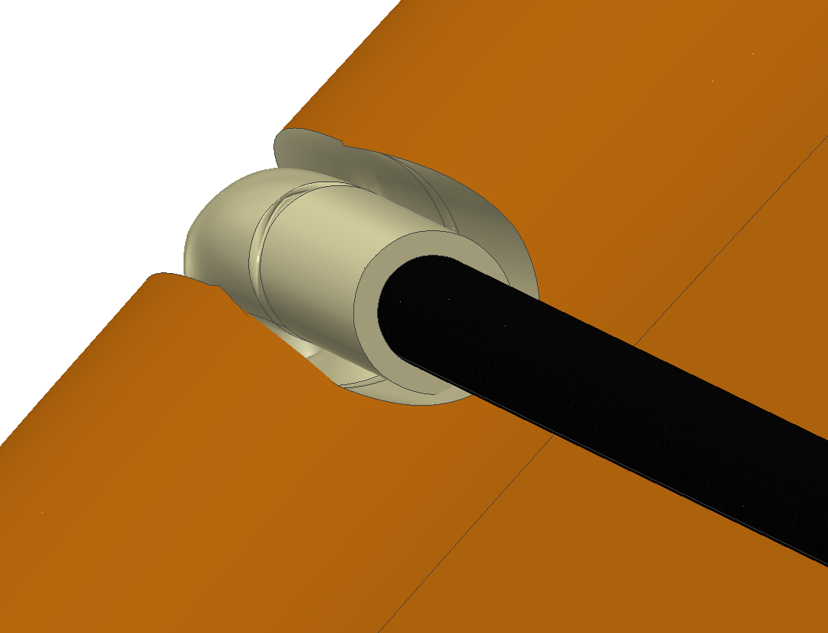
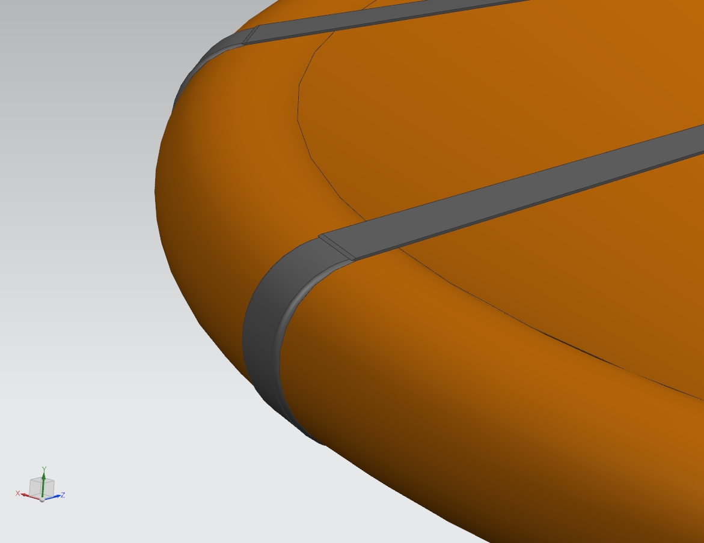
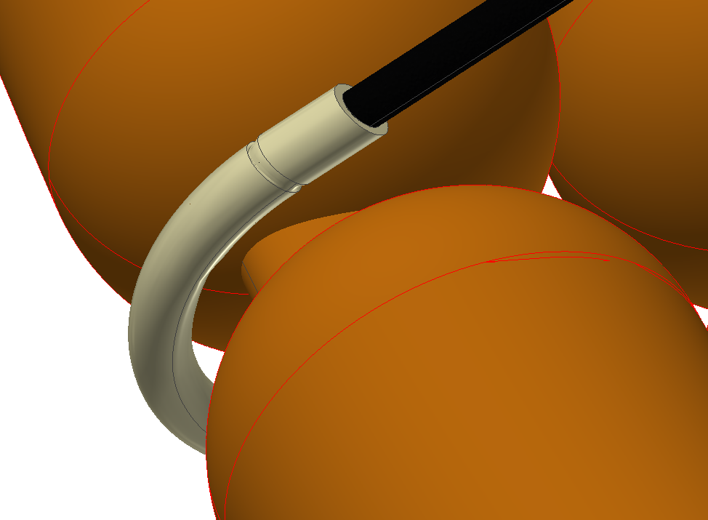
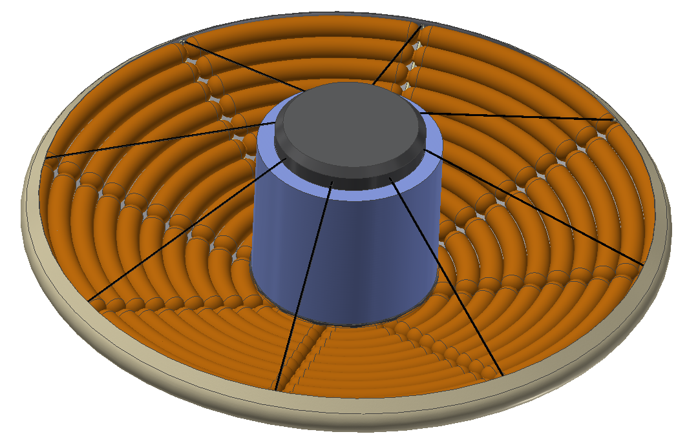
Torus Configuration Options
Valley Cable Arrangement reduces protrusion of sleeves/gutters
Strap-Stitch Arrangement reduces protrusions of cable system and more evenly distributes tension load on torus
Segmented Toroidal Arrangement decreases likelihood of buckling while also helping to prevent protrusions
Notes:
Buckling in the aeroshell and wrinkling in the FTPS present major challenges to shape-morphing.
Accordingly, three Torus Configuration Options were each devised to feature a different type of cable attachment point and, subsequently, to provide a unique solution to the issues of buckling and wrinkling.
Though the basis of CCADS is a cable-controlled mechanism, and that gutters and cables are generally required to allow CCADS to operate effectively, these Options more specifically address the problems associated with the general design cable-controlled mechanism.
Valley Cable
The Valley Cable Arrangement mitigates the amount of protrusion from the cable attachment point into the FTPS. As the aeroshell is morphed, the FTPS is stretched tightly over the forebody of the vehicle, making protrusion of any non-toroid components or structures a potential risk.
In this arrangement, the cables that are attached to the aeroshell rest inside valleys, which are created by hollowing out a long section of the aeroshell. That is, along the radius of the HIAD forebody, a thin section of the aeroshell, with a diameter slightly greater than that of the cable itself, is hollowed out in a valley form.
This valley allows the cable to rest inside the toroid essentially and almost completely eliminates bulky, rigid cable attachment points and the cable position on the aeroshell. Since the FTPS will stretch over the valleys and protect the cables inside those valleys, the FTPS can stretch without virtually any wrinkling as a result of protrusion from the cable or the cable attachment points.
Strap-Stitch
To address about buckling, the Strap Stitch arrangement was designed to distribute the tension acting on the aeroshell over a larger surface area.
The straps also, in turn, distributes and ultimately reduces the pressure applied to any single section of the aeroshell.
In this arrangement, the flat straps, which are designed to be almost completely flush with the HIAD forebody, reduce the amount of protrusion into the FTPS during shape-morphing as well.
Segmented Toroidal
Similarly to the Valley Cable Arrangement, the Segmented Toroidal Arrangement is based off of a structural alteration to the aeroshell. However, while the Valley Cable and Strap-Stitch Arrangements utilize a single inflatable torus, the Segmented Toroidal Arrangement uses several sets of stacked tori.
Elastic tethers, which would be capable of bending under the tension of cables, connect each set of stacked tori. The cables are designed to pull on these tethers in a perpendicular fashion. In this way, the aeroshell structure itself will not be bending or folding, but the bending tethers connecting the sets of tori together will pull on the aeroshell itself. That is the aeroshell is not directly being deformed.
The Segmented Toroidal Arrangement reduces the aeroshell’s tendency to buckle
The fact that the elastic tethers create valleys between each set of tori, means that the cables do not protrude into the FTPS and wrinkling is largely avoided.
These adaptations come with their own tradeoffs, such as higher mass and perhaps more difficulty in packing. However, the shortcomings of these specific configurations may be outweighed by their effectiveness or mitigated by simple solutions.
Inflation of the Segmented Toroidal Arrangement is questionable and would most likely require an inflation system more complex and powerful than those that have previously been designed by NASA.

Slide 7
Electric Motor
One electric motor housing on top of upper section of payload compartment
Applies tension to cables to morph the aeroshell
Increases maneuverability
BLDC motors must be tailored to mission concept
Structural analysis and testing of aeroshell loads
Effect of tensile forces on shape-morphing
Power and mass of BLDC motor per cable
Notes:
In-depth structural analyses of the vehicle we have designed would be required to determine the effect of various tensions applied by the motor to the cables.
Last about 30 mins
An electric motor housing on the top of the payload compartment contains the motors that apply tension to the cables, which then morph the aeroshell.
BLDC motors, in contrast to AC, brushed DC (BDC), and stepper motors, are capable of operating at very high velocities and producing at least twice as much output torque as a BDC motor of the same size. In terms of mechanical simplicity, several small BLDC motors could be implemented to operate as many cables, individually. Can produce at least twice as much output torque as an AC motor of the same size.
Despite its advantages over other types of electric motors in terms of strength to weight ratio, implementing a BLDC motor for the mission concept would be difficult to accomplish. It is anticipated that an electric motor tailored to the vehicle concept would be more reliable during a potential mission.
Therefore, we are not sure about the mass or power requirements of the electric motor housing.
Placement of the motor’s mass allows the craft to be amply “unstable” enough to perform control maneuvers

Slide 8
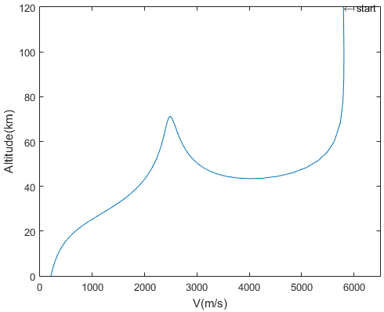
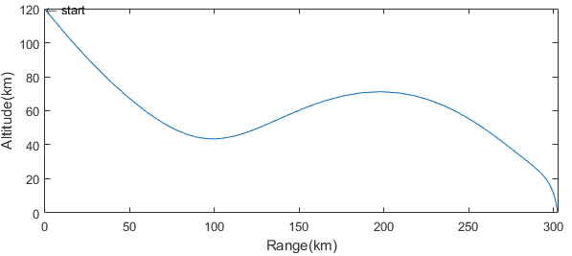
Mission Profile
Deployment and configuration
Aeroshell inflation occurs prior to atmospheric entry
Nominal aeroshell configuration is defined by a 70° half-cone angle
Flight path angle: -11° (simulation)
L/D: .24 (simulation)
Point 1: 70 km, initialize control
Point 2: 50 km, start of vehicle loft
Point 3: 70 km, suspension of control to conserve energy
Point 4: 70 km, re-initialize control
Point 5: 11 km, terminal descent phase
4
3
1
2
5
1
3
4
2
5
Notes:
Formulating the mission profile for the entry vehicle began early in the design process of the CCADS
The mission profile of the vehicle, itself, became increasingly accurate over the course of the past several months as more information was gained related to the vehicle’s ballistic coefficient, entry angle, and L/D.
Based on the velocity and range profiles depicted in the graphs, we identified several trajectory checkpoints, at which the entry vehicle would enter different phases of the mission profile. Two key parameters that dictate the specific data above are the vehicle’s flight path angle and L/D, which are -11° and .24, respectively.
As seen above, the vehicle descends from an initial altitude of 120 km and velocity of 5800 m/s.
The vehicle follows a conventional downward trajectory, in which the cable-control mechanism does not deform the aeroshell. Between 120 km and 70 km altitude, the air density is too low to allow for effective lift control of the vehicle.
At Point 1, the vehicle can initialize control with the cable-control mechanism as the air density is high enough to allow for effective lift control and L/D alterations.
At Point 2, the vehicle is at a 50 km altitude, at which point the ballistic coast or “loft” begins.
The vehicle continues to follow the loft trajectory from point 2 to point 3, where the vehicle reaches a 70 km altitude.
The vehicle reaches an apogee, and begins to descend through point 4, at 70 km altitude. From point 4 to point 5, the vehicle finishes the hypersonic descent phase.
The terminal descent phase of the vehicle begins at point 5, at an altitude of 11 km.

Slide 9
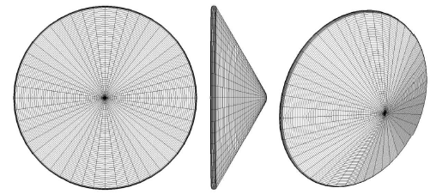
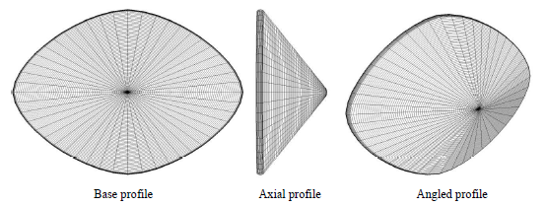
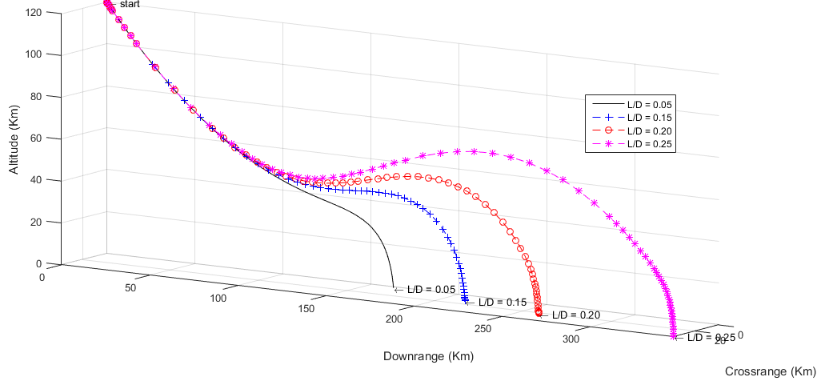
Control
Coarse control → CG shifting
Large adjustments to L/D
Fine control → cable-controlled aeroshell morphing
Small adjustments to L/D
Even small changes in L/D yield noticeable changes in range
Above Images credited to Justin Green
Notes:
There are two main methods of control, the first of which is the CG offset mechanism since it is the simplest method to maintain or modify the angle of attack. The CG offset mechanism gives us the most efficient way to shift or hold the current L/D. This is what will be use as our coarse control.
Shape morphing via tension in the cables is a method of modifying the vehicle’s L/D without altering the angle of attack. A paper on shape morphing HIADS showed that by modifying that aeroshell into a more elliptical shape could shift the L/D by around. The more eccentric the ellipse became, the more greater the L/D shift became. The paper recommended an eccentricity of 0.6 which is shown as the shape on the right as it would be possible to reach and yielded a change in L/D of 0.05 at 15deg angle of attack compared to the spherically blunted aeroshell.
A change in L/D on the order of hundredths may not seem impressive, but trajectory simulations show that even a change of 0.01 L/D equates to dozens of kilometers of difference at L/D’s greater than 0.2. It is for this purpose that the shape morphing is used as the CCADS’ fine control.
In order to land equipment and crew within kilometers of their target landing zone, this extra precision in L/D is going to be necessary.
Therefore the CCADs is able to both make large adjustments in range via the CG shifting and increase accuracy by using shape morphing to further refine its trajectory.

Slide 10
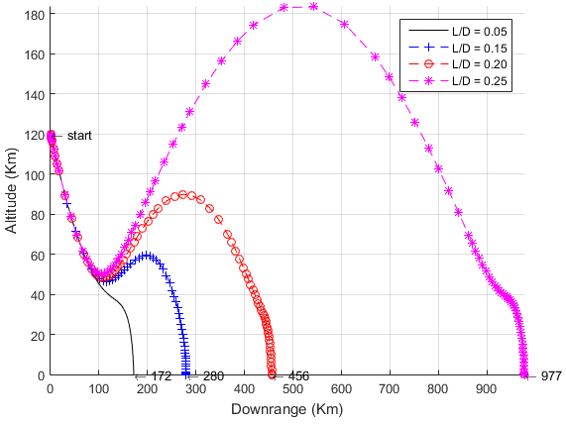
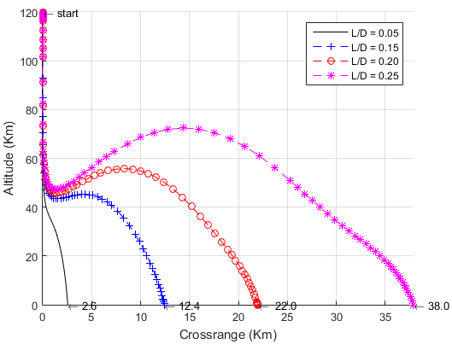
Downrange and Crossrange Control
Simulation initial conditions
Velocity: 5800 m/s
Flight Path Angle: -10°
Ballistic Coefficient: 99 kg/m²
Bank angle:
0° for downrange simulation
45° bank angle for crossrange simulation
Downrange Δkm of 800 km between 0.05 to 0.25 L/D at 0° bank angle
Δkm of 590 km between 0.25 to 0.30 L/D
Crossrange Δkm of 35 km over same L/D at 45° bank angle
Δkm 33 km between 0.25 to 0.30 L/D
Substantial reduction in downrange capability with banks greater than 25°
Fine tuning via Shape Morphing allows for increased landing accuracy
Notes:
-To quantify the maximum amount of crossrange and downrange control, we used a trajectory simulation. The simulation takes into account Mars’ atmosphere and and plots for us the estimated landing point after being given some initial conditions such as entry velocity and entry path angle. A starting altitude of 120km was chosen because this is where the highest section of the Martian atmosphere is believed to be.
-Seen in the slide are the plots are downrange and crossrange trajectories with different L/D cases shown for comparison.
-With an L/D of 0.2 a downrange of 456km can be reached while a downrange of 977km can be reached with 0.25 L/D
-The difference in range grows rapidly the higher the L/D becomes as there is a difference of 590km between 0.25 and 0.30 L/D
-The maximum altitude reached during the loft or ballistic coast also rapidly increases with greater L/D. Similarly, the flight time or time period for EDL events also gets extended significantly.
- For the maximum crossrange case, we assumed that the vehicle’s lift vector was at a constant 45 deg bank angle.
-With an L/D of 0.2 a crossrange of 22km can be reached while a crossrange of 38km can be reached with 0.25 L/D
-Again, difference in crossrange grows rapidly the higher the L/D becomes as there is a difference of 33km between 0.25 and 0.30 L/D
-One caveat of note is that the the downrange reached by the vehicle at 45deg bank was significantly reduced as the range was only 330km at 0.25 L/D. This is ⅓ of maximum downrage reached without any crossrange This indicates that the downrage capacity is sacrificed with increasing crossrange capacity.
- To drive home the main advantage of pairing shape morphing with CG shifting again, small changes in L/D equate to significant changes in range. By allowing fine control of the L/D the CCADS is able to attain increased landing accuracy.

Slide 11
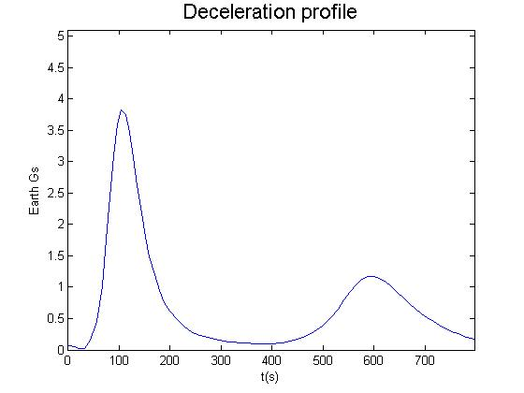
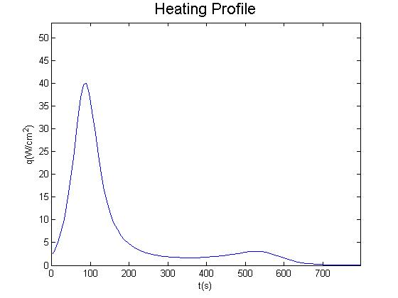
Heating and G-forces
Baseline entry initial conditions:
Velocity: 5800 m/s
Flight Path Angle: -11゜
L/D: 0.24
Bank Angle: 0゜
Ballistic Coefficient: 99 kg/m²
Entry vehicle experiences a maximum of 3.9 G’s at baseline conditions
NASA’s limit for sustained G-forces on crew is 4 G’s
Maximum heat flux is approximately 40 W/cm²
2nd Generation FTPS materials such as Nicalon SiC can withstand up to 50 W/cm²
Integrated heat loading is 4640 J/cm²
Average heat flux of 6 W/cm²
Duration is 800 s
Notes:
Various trajectories of the vehicle were simulated by varying L/D, and we were also able to estimate maximum expected heating on the forebody of the vehicle
It was found that the maximum heat concentration that the FTPS of the entry vehicle can withstand is 50W/cm^2, based on the 2nd gen materials we will be using. This is greater than the maximum heat concentration that the vehicle would experience,40W/cm^2, given the baseline entry initial conditions.
The trajectories of the vehicle using the control mechanism mitigate the effective heat concentration and g-loading.
The deceleration profile shows that the vehicle will experience g-loading well within the NASA safety limit for crewed missions.
The overall integrated heat loading comes out to 4640 J/cm^2 over 800 sec

Slide 12
Testing and Future Development
Test alternative cable types, materials, configurations
Limitations of shape morphing
Buckling and creasing detection
FTPS wrinkling
Aeroshell inflation pressure
Future Mission Concepts
Crewed and uncrewed mission potential
Low-altitude geographic surveyance
Recyclable parts (explorers could reuse motors/cables)
Notes:
Any design presented here today will have its challenges. As we improved the CCADS design throughout the past several months, it was found that extensive testing of the vehicle’s subsystems would be required to validate the feasibility of the vehicle design.
The extent to which variables such as limits of buckling, inflation pressure, and heat concentration from wrinkling will affect operation of the CCADS is not known, but extensive testing, as well as thermal and structural analysis/simulations would allow for improvement of the overall design.
For instance, determining how much the aeroshell can be morphed, given its current dimensions, without buckling or creasing would provide information on the structural limitations of shape-morphing and, ultimately, prevent loss of stability in-flight. Developing mission-specific pressure sensors for the aeroshell would also be integral in constantly monitoring aeroshell loads and stresses. The guidance and control system would then use this information to appropriate control of the vehicle using the cable-control mechanism and the CG-offset mechanism.
FTPS wrinkling is a risk that is inherent in the cable-control method, since the aeroshell will be morphed in ways that will cause the FTPS to fold and overlap upon itself. Each of the Torus Configurations Options that were devised mitigate the potential for FTPS wrinkling, but it is not known substantively whether any of the options sufficiently addresses this issue. These options show promise in their simplicity and ease of installation or attachment. That is, they do depend on unique HIAD configurations or designs and each would work for a conventional HIAD aeroshell.
Inflation pressure will determine how much tension is required to deform and manipulate certain sections of the aeroshell. The more pressurized the aeroshell, the stiffer it will be and, therefore, the more torque and electric motor mass will be needed to morph the aeroshell. By determining the motor parameters, subsequently, it is possible to estimate quite accurately the amount of payload that could be transported from deployment and initial entry phases to the terminal descent phase.
CCADS works because it is simple, easy to implement, modify, and tailor to mission specific
Capable of crewed and uncrewed missions, tailoring profiles
Possible future concepts

Slide 13
Summary
CCADS is able to deliver 25 or higher tonne payloads to Mars using HIAD technology
Scalable and relatively lightweight system
Provides coarse and fine L/D shifting in order to accurately change and refine course
Is able to loft and extend EDL time frame to reduce deceleration forces and heat flux
Notes:
CCADS’s simple, lightweight design offers plenty of flexibility for NASA engineers to create the perfect EDL vehicle for the martian atmosphere
Lightweight design leaves room for larger payloads
Simplicity leaves room for modification that may be required for higher mass, more complex mission profiles, or scaled versions of the design.
Simple control mechanisms leave less room for error, and alleviating any errors that occurs.
Simplicity, in this case, breeds cost effectiveness, as the mission-enabling technologies of CCADS are relatively mature and readily available

Slide 14
Acknowledgements
Judges
Neil Cheatwood
Anthony Calomino
Michelle Munk
Dick Powell
Steve Sandford
Mary Beth Wusk
NIA
Stacy Dees
Victoria O’Leary
Carolyn Sager
NASA Langley Research Center

