Slide 2
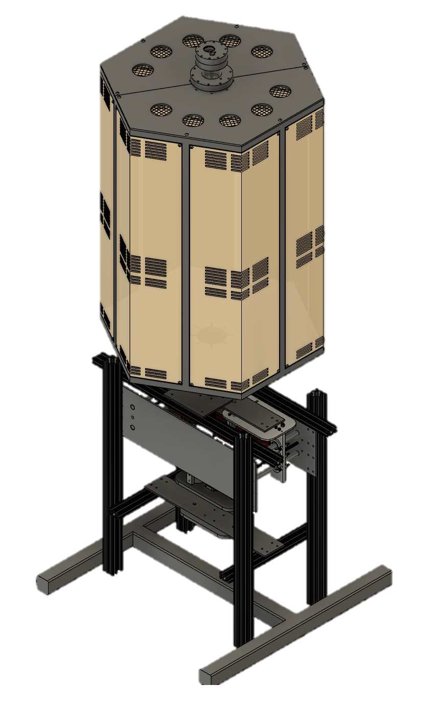
MASSACHUSETTS INSTITUTE OF TECHNOLOGY X HONEYBEE ROBOTICS
Co-Leads: Palak B Patel, Jose Soto, Team Members: Zachary K Adams, Derek Chan, Amber Cooper, Jonatan Fontanez, Laman Jalil, Christopher Kwon, Kir Latyshev, Beverly Ma, Lanie McKinney, Cesar Meza, Kristoff Misquitta, Hyein Na, Tom Nguyen, Hezekiah Pendley, Lokesh Sangabattula, Helena Usey, Alice Zehner, Advisors: Lead Advisor: Jeffrey Hoffman, Co-advisors: Antoine Allanore, Martin Culpepper, Olivier de Weck, George Lordos
Notes:
Palak

Slide 3








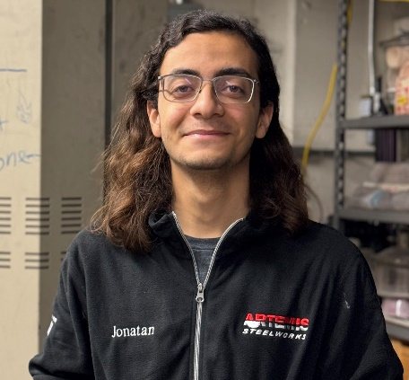






T E A M M E M B E R S I N A T T E N D A N C E
Jose Soto
Team Lead
Palak Patel
Team Lead
Zachary Adams
MRE Reactor Lead
Derek Chan
MRE Reactor
Amber Cooper
MRE Reactor
Jeffrey Hoffman
Advisor
Kristoff Misquitta
MRE Reactor
Tom Nguyen
MRE Reactor
Jonatan Fontanez
Sonicator
Beverly Ma
Sonicator
Helena Usey
Sonicator
Team Members not attending Forum:
Laman Jalil, Kir Latyshev, Lanie McKinney, Cesar Meza, Hezekiah Pendley
Advisors not attending:
Prof. Antoine Allanore, Prof. Martin Culpepper, Prof. Olivier de Weck, George Lordos
Chrisopher Kwon
Characterization and Testing
Hyein Na
Characterization and Testing
Lokesh Sangabattula
Characterization and Testing
Alice Zehner
Characterization and Testing

Slide 4

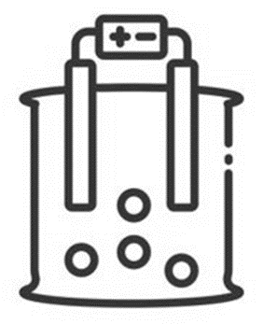

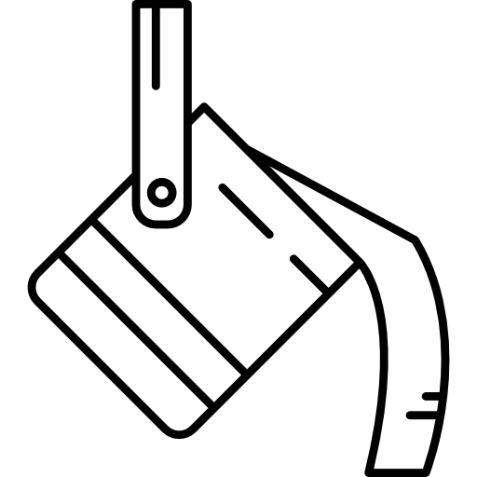
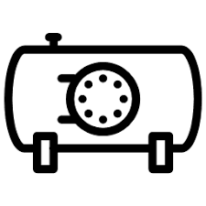
Executive Summary
Extraction of Steel via Electrolysis
Lunar Environment Technology Development
Steel Manufacturing
Characterization & Testing
Pressure Vessel Analysis

Slide 5
Presentation Roadmap
Molten Regolith Electrolysis
Lunar Environment Technology Development
Steel Characterization and Testing
MRE Reactor Build and Testing
Concluding Thoughts

Slide 6











Metal Production Pipeline
COLLECTION
BENEFICIATION
ELECTROLYSIS
CAST STEEL PARTS
ALLOYING
STEEL & SLAG COLLECTION
OXYGEN VALUE CHAIN
STEEL
MANUFACTURING
SLAG VALUE STREAM
PRESSURE VESSEL

Slide 7
ARTEMIS STEELWORKS
COLLECTION
BENEFICIATION
ELECTROLYSIS
CAST STEEL PARTS
ALLOYING
STEEL & SLAG COLLECTION
OXYGEN VALUE CHAIN
STEEL
MANUFACTURING
SLAG VALUE STREAM
PRESSURE VESSEL

Slide 8
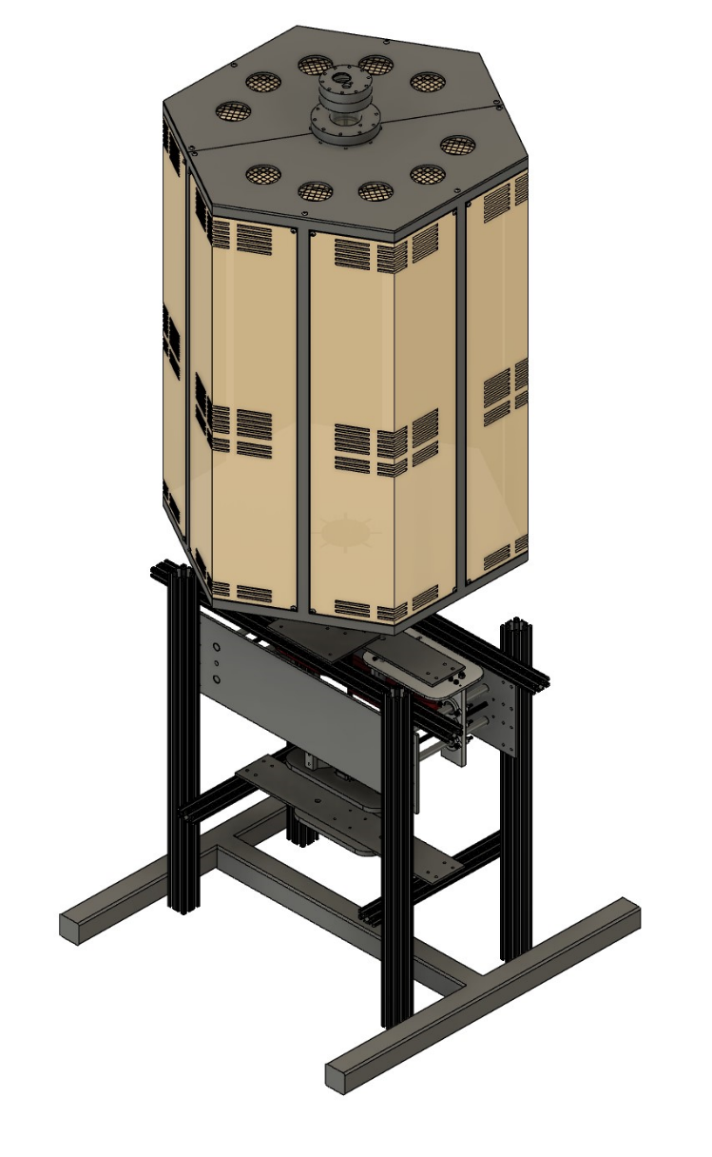
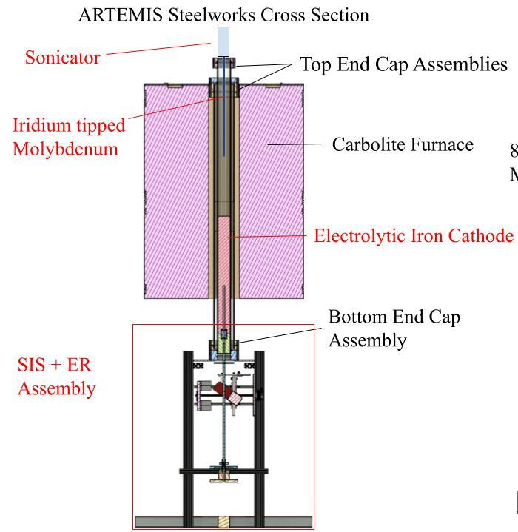
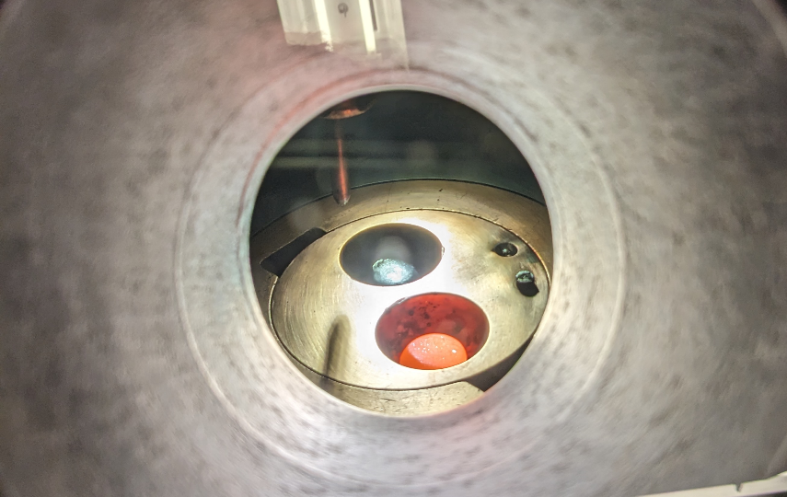
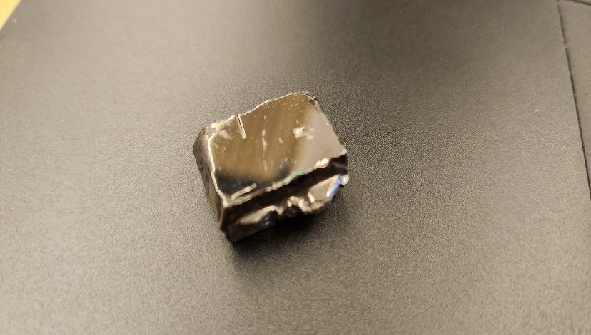
ARTEMIS STEELWORKS
ELECTROLYSIS
STEEL & SLAG COLLECTION
STEEL
MANUFACTURING

Slide 9
Molten Regolith Electrolysis

Slide 10
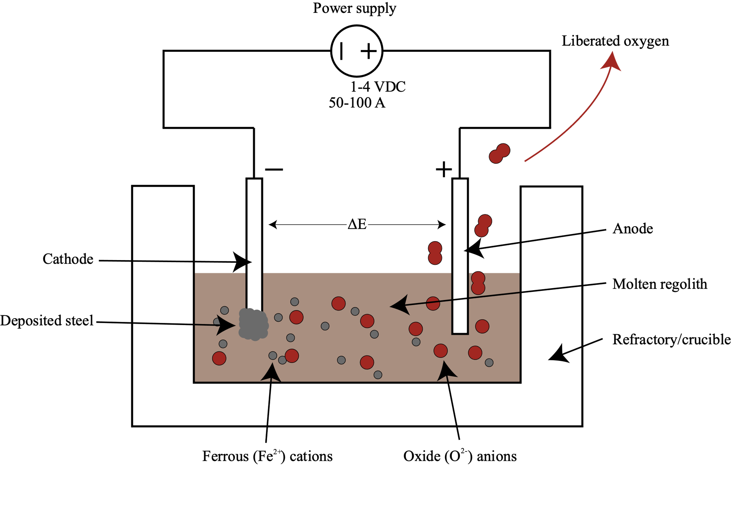
Molten Regolith Electrolysis (MRE) Fundamentals
Hold regolith around 1600°C
Apply voltage, ions migrate according to charge
  Fe²⁺ ions to cathode (-), O²⁻ to anode (+)
Electron pulled off oxide, forms oxygen
  Electron travels through wire to cathode
Fe²⁺ reduced to metal at cathode

Slide 11
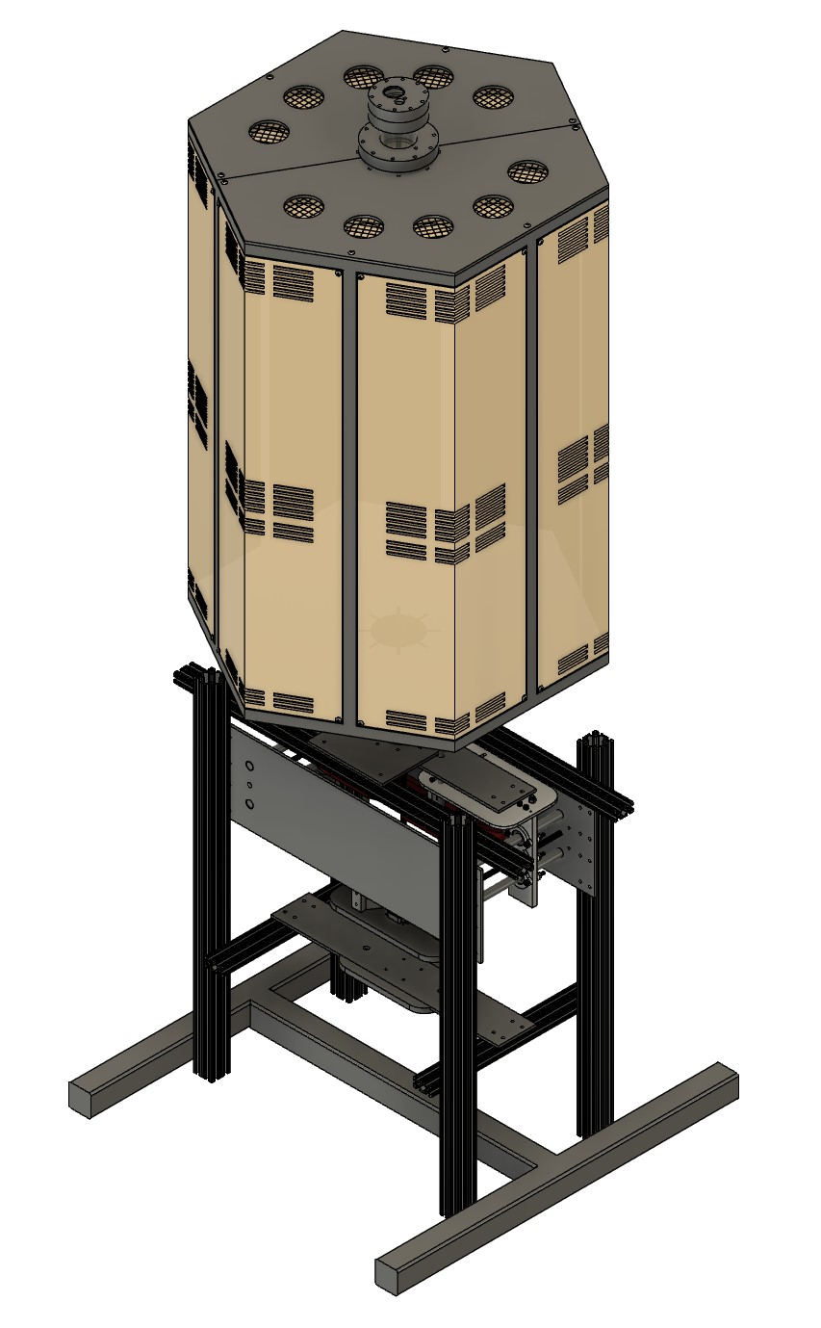
MRE Reactor Design

Slide 12
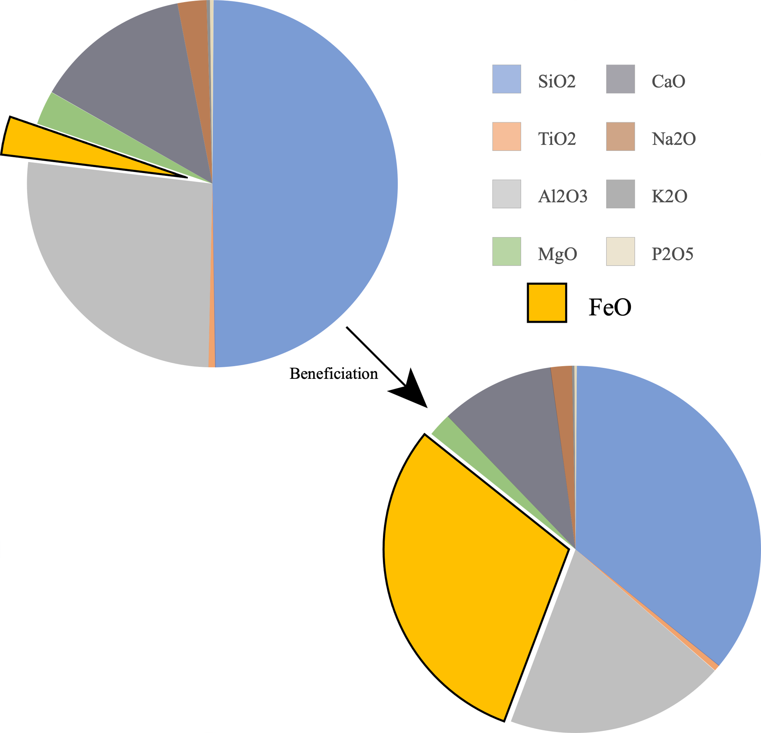
Simulations and Calculations aided Development
Beneficiation essential
  LHS-1 too low in FeO
Metal composition and thermodynamic voltage calculated
Estimation of power consumption
  100g, ~3x thermodynamic voltage: 7.30kW
The change in composition of the regolith after a theoretical beneficiation step

Slide 13
Lunar Environment Technology Development

Slide 14
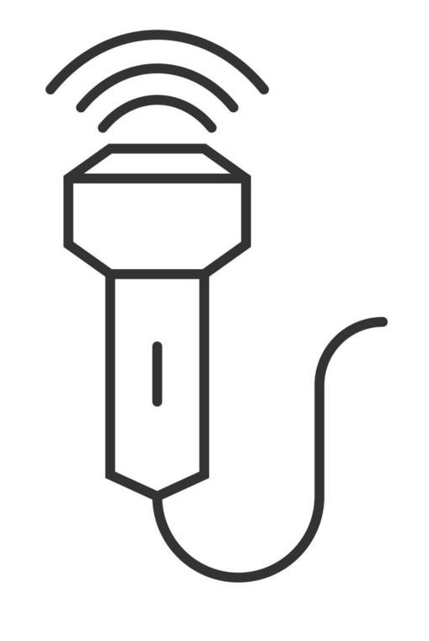


Lunar Environment Technology
Extraction of Steel in a Vacuum Environment
Extraction of Steel without Beneficiation or Varying Beneficiation
Electrolysis Efficiency Increase for Low Gravity via Sonication
Automation of Steel and Slag Collection
Steel Manufacturing in a Vacuum Environment

Slide 15
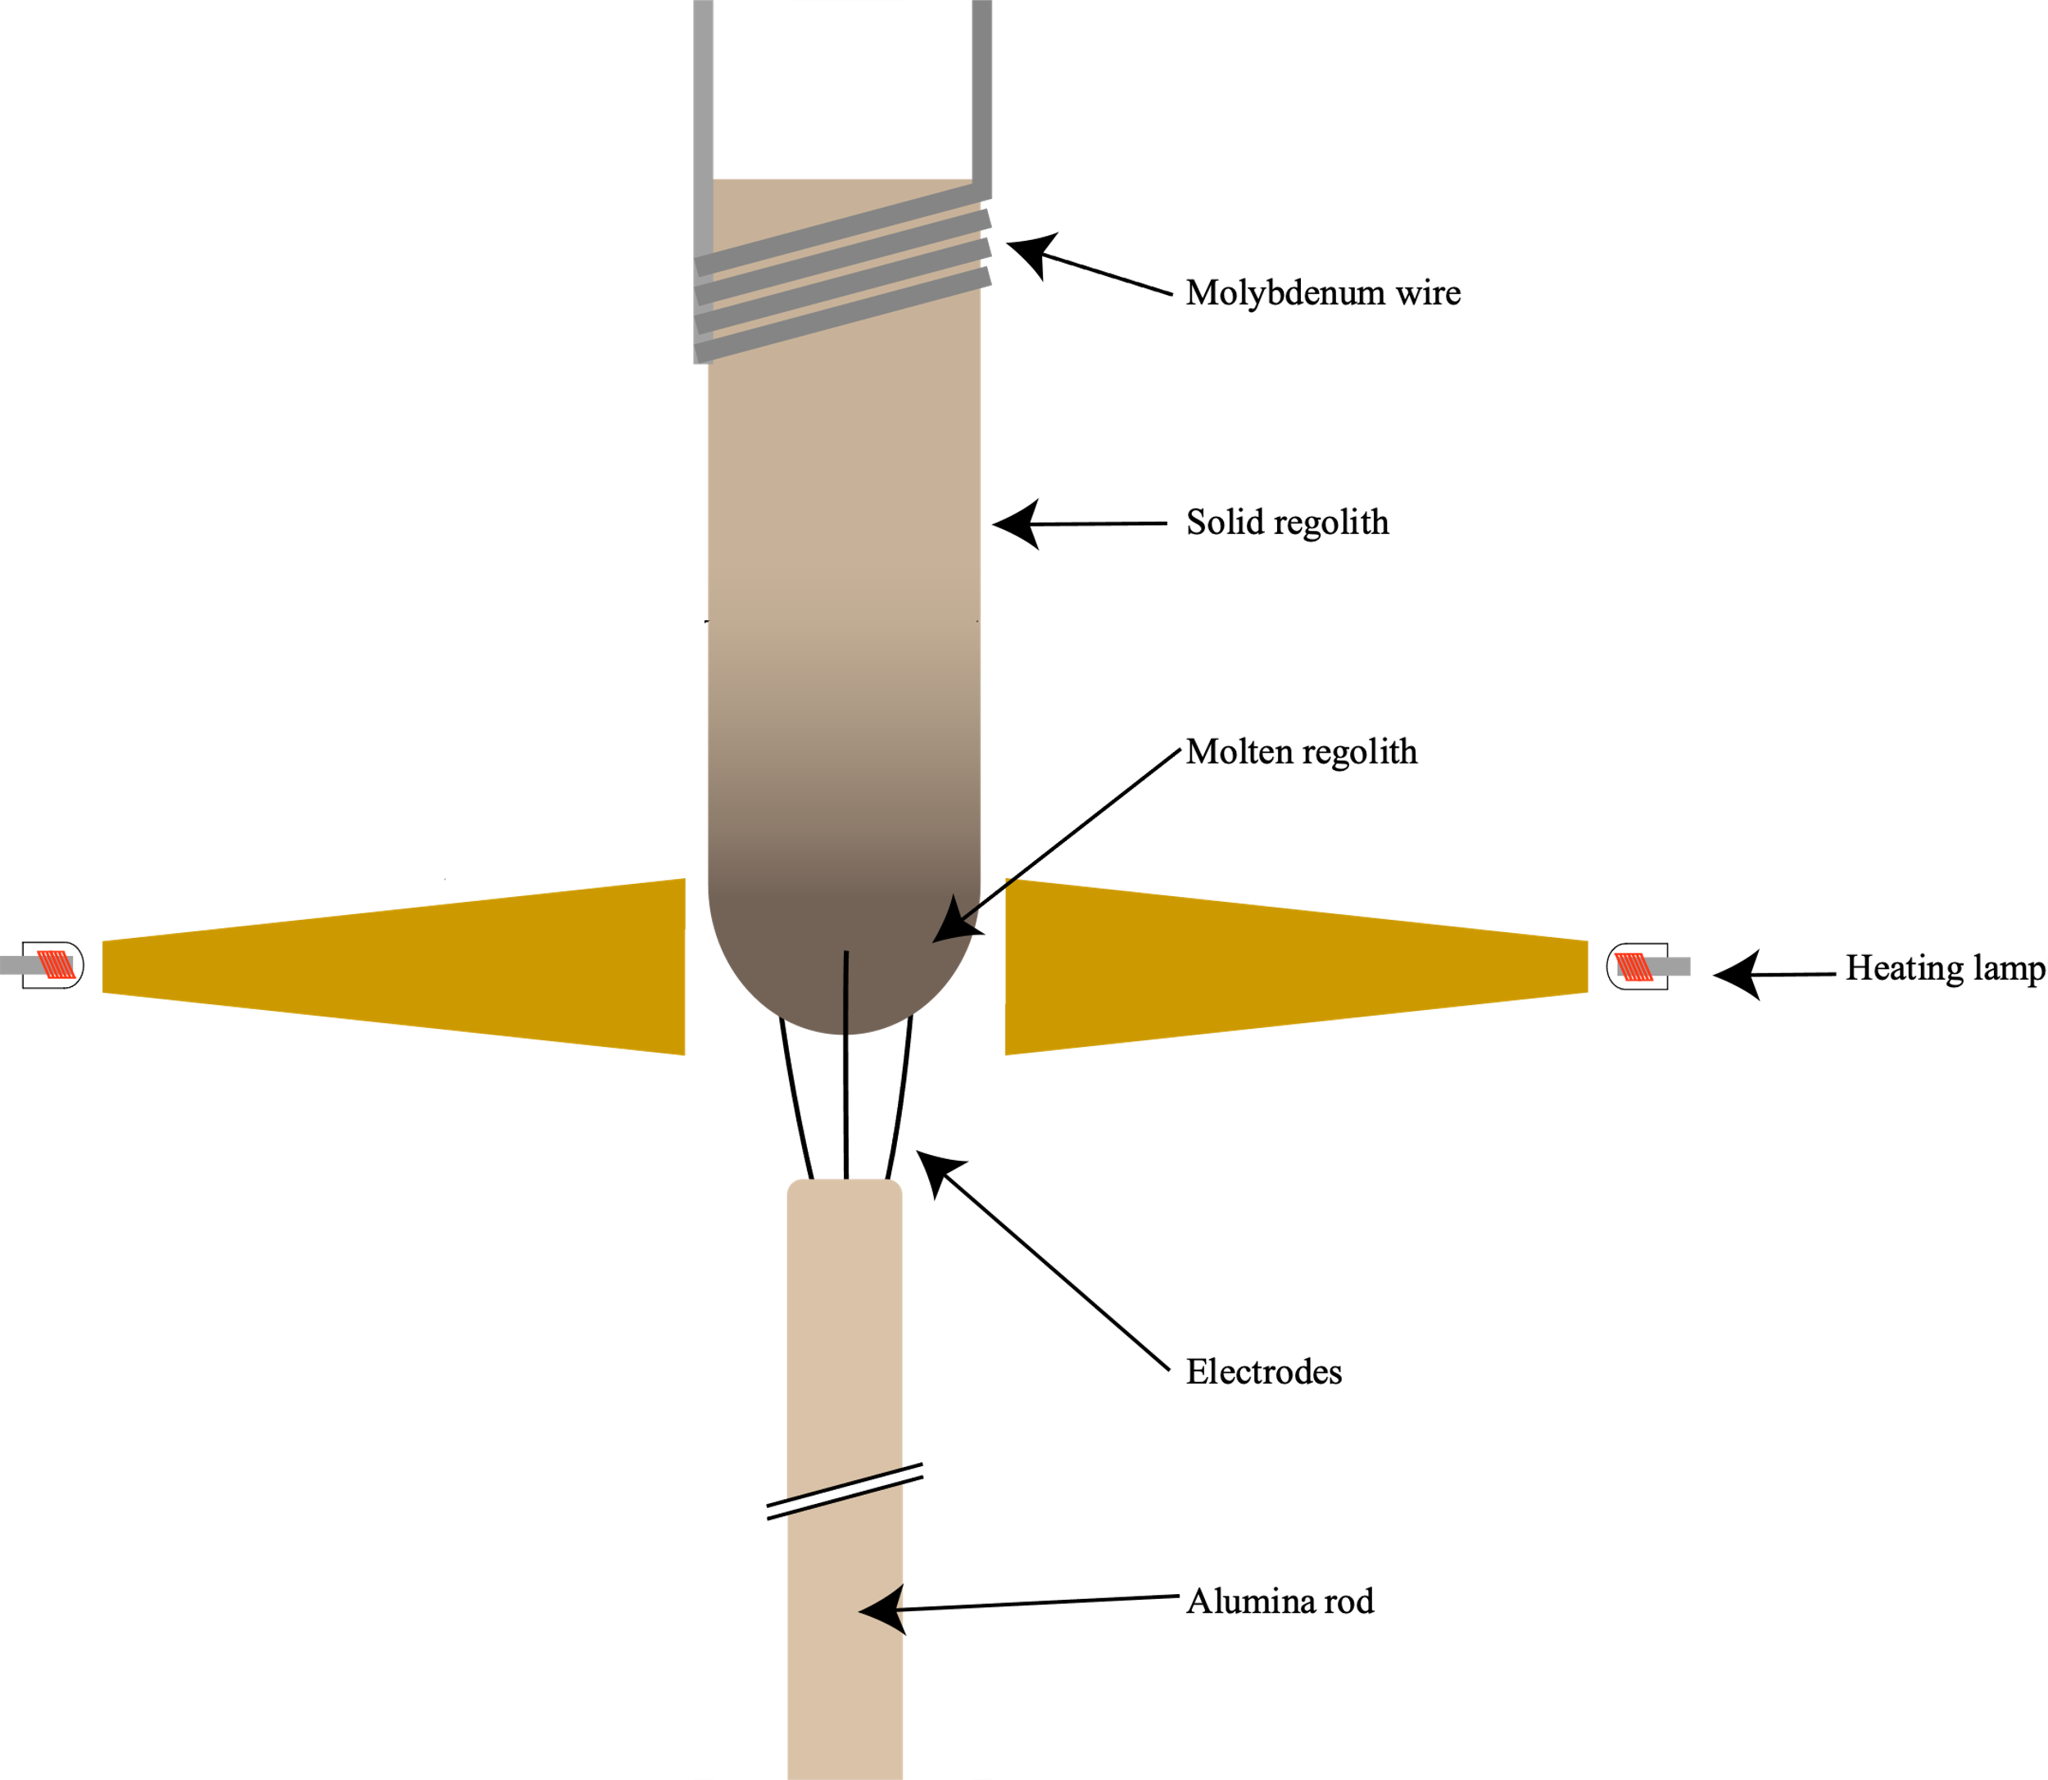
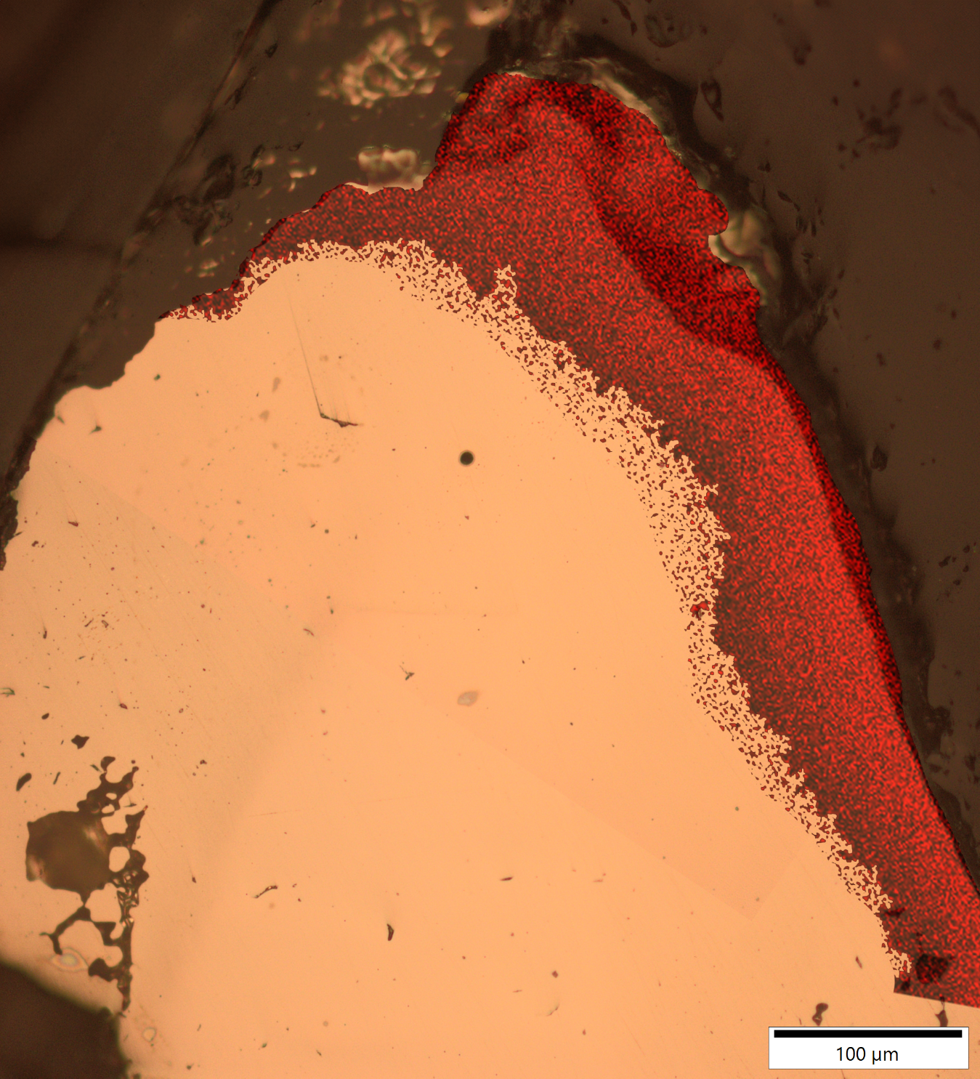
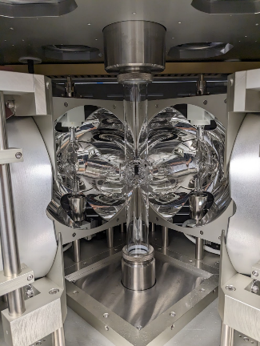
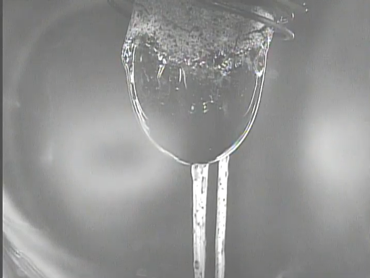
Steel Extraction in Vacuum Environment
Iridium wire with an iron deposit shown via overlayed EDS data

Slide 16
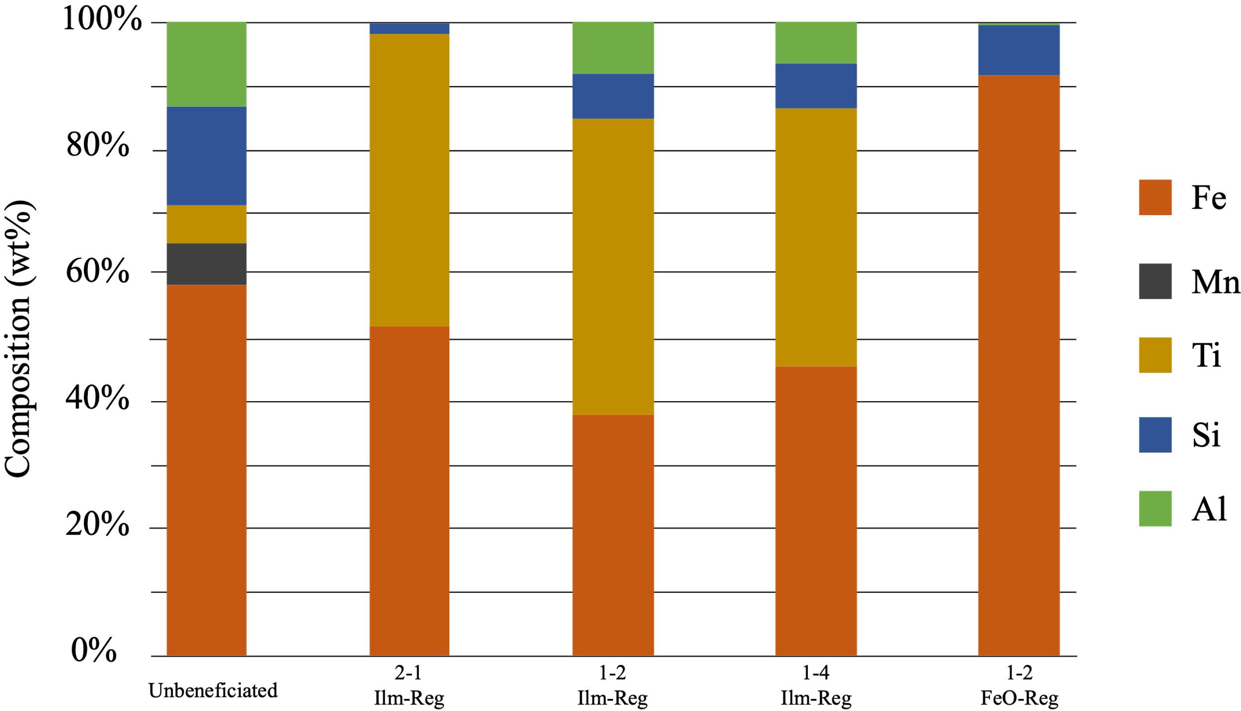
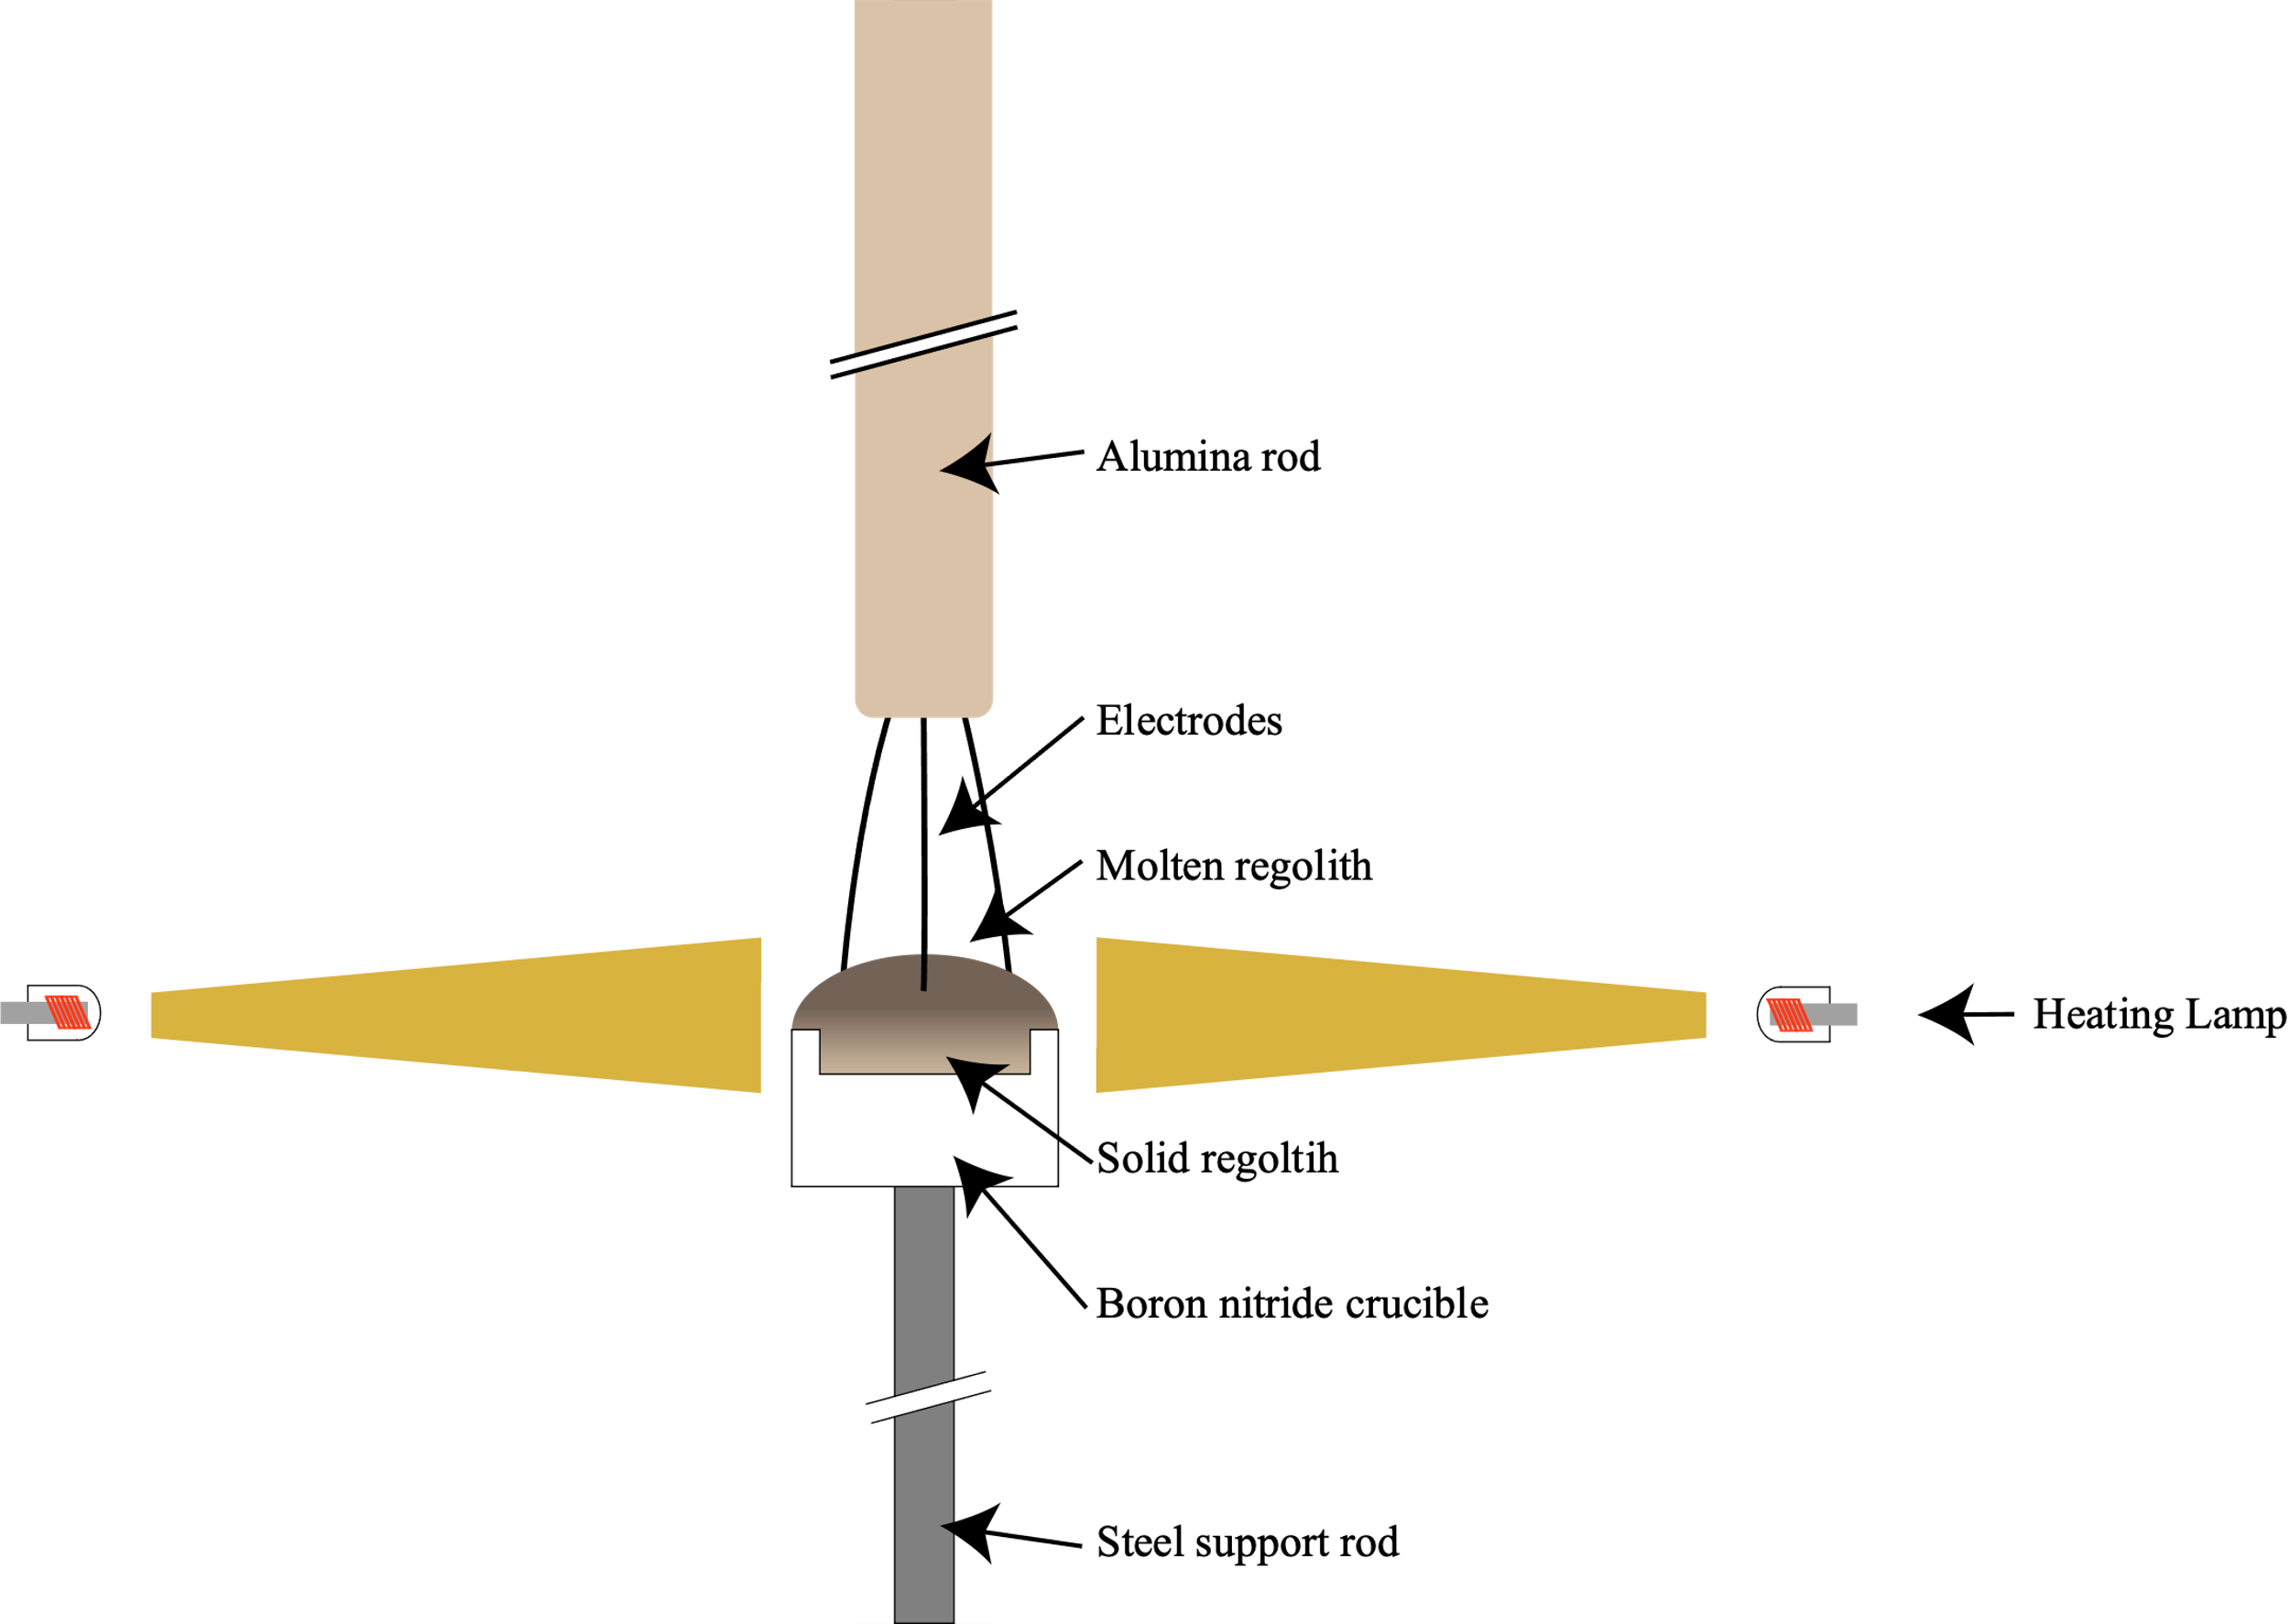
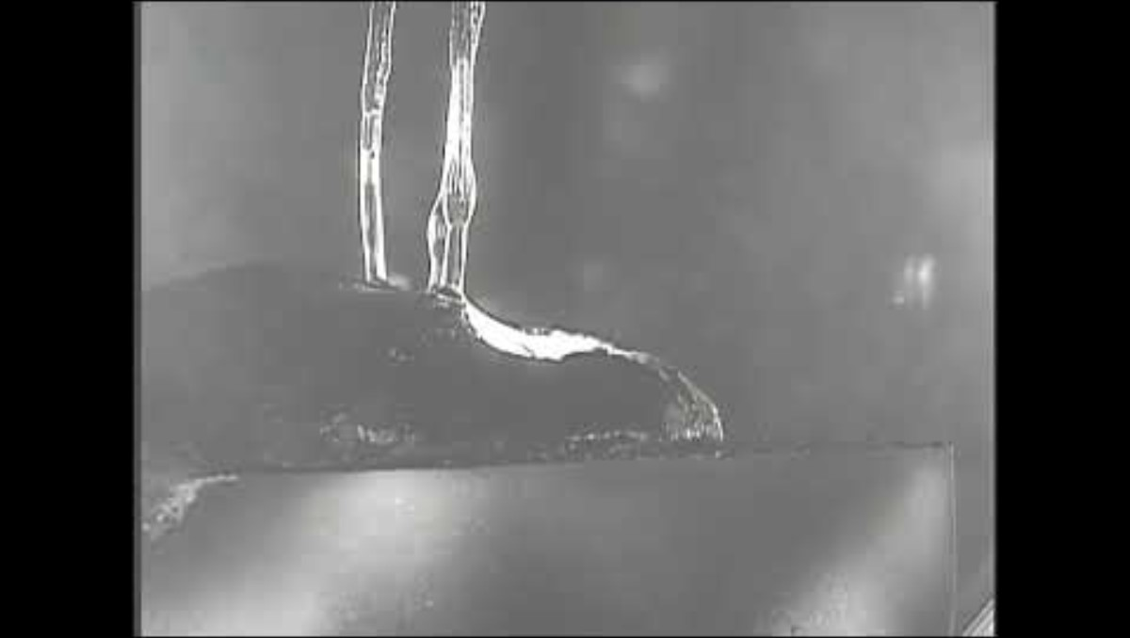
Steel Extraction at Various Beneficiation Levels
Stacked bar plot showing the composition of different metals produced in small scale testing. The final composition was determined via thermodynamic modelling

Slide 17
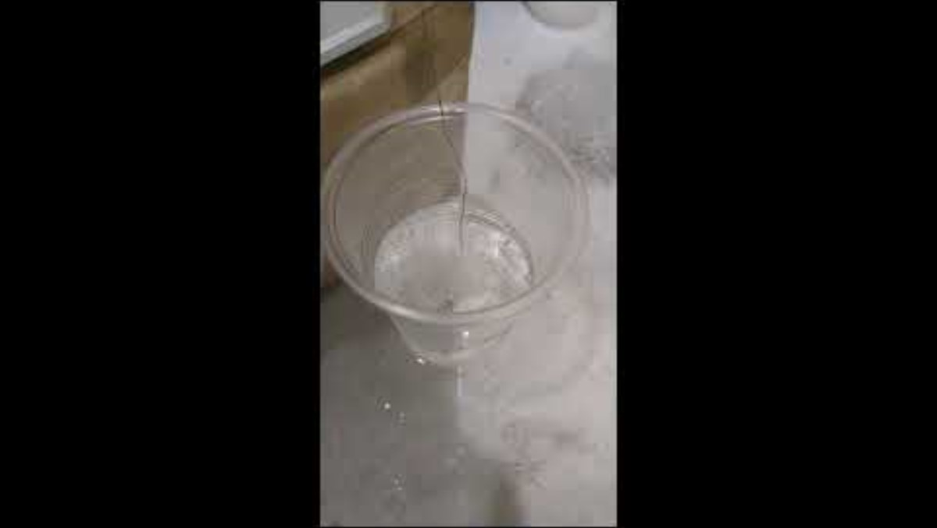
Electrolysis Efficiency Improvement
On the moon, buoyancy force is reduced to 1/6th.
Consequently, the bubbles could expand and take longer to detach from the anode, inhibiting the electrolysis reaction and shortening the lifespan of the electrodes due to corrosion.
We incorporated a sonicator on the anode to induce vibrations that detach the bubbles while they are still small.

Slide 18
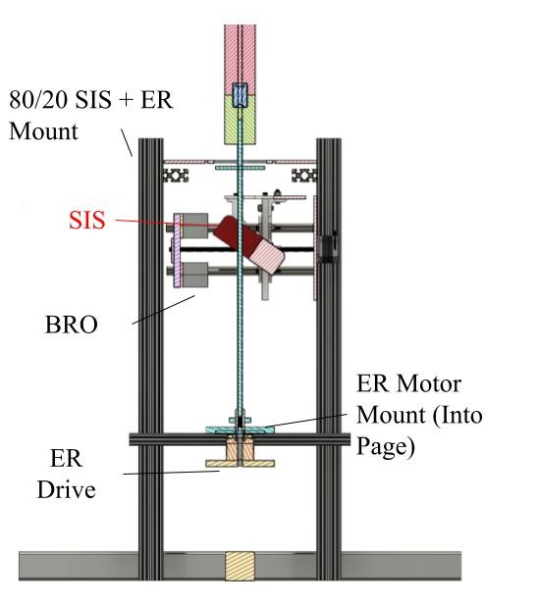
SIS+ER to Demonstrate Automation
ARTEMIS Steelworks incorporates a Slag-and-Iron-Slicer (SIS) and (+) Extraction Rod (ER) setup.
The ER pulls out the electrolysis products.
The SIS will then saw through the resultant iron and slag for collection.
Back Rod Opposer (BRO) used to mitigate shear forces on motor.

Slide 19
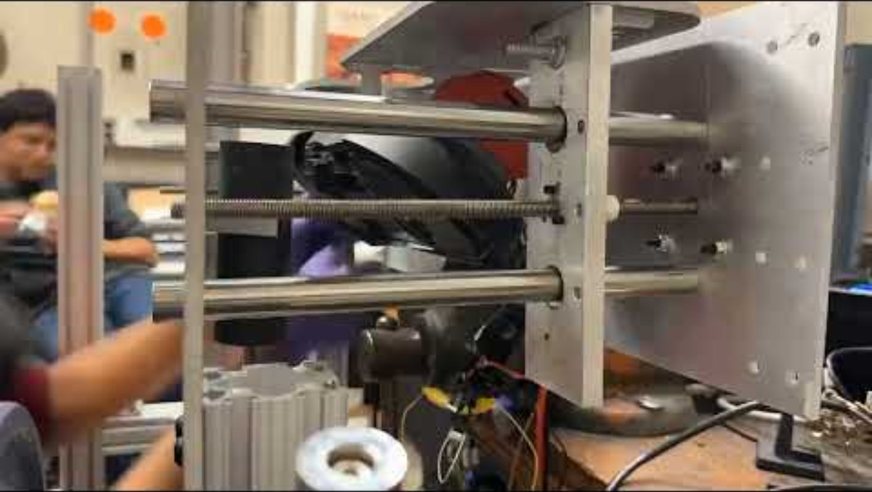
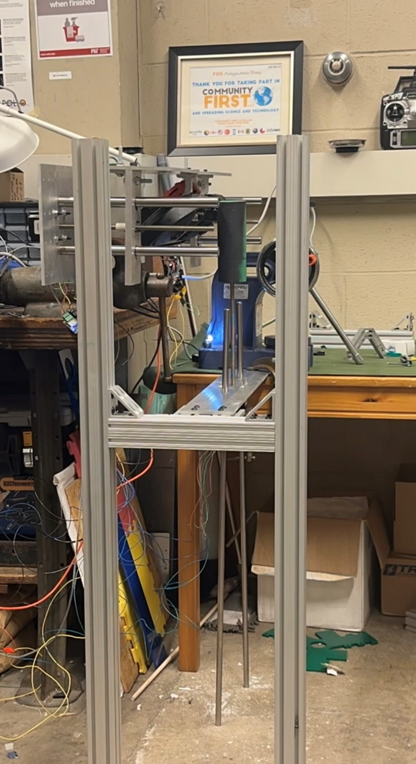
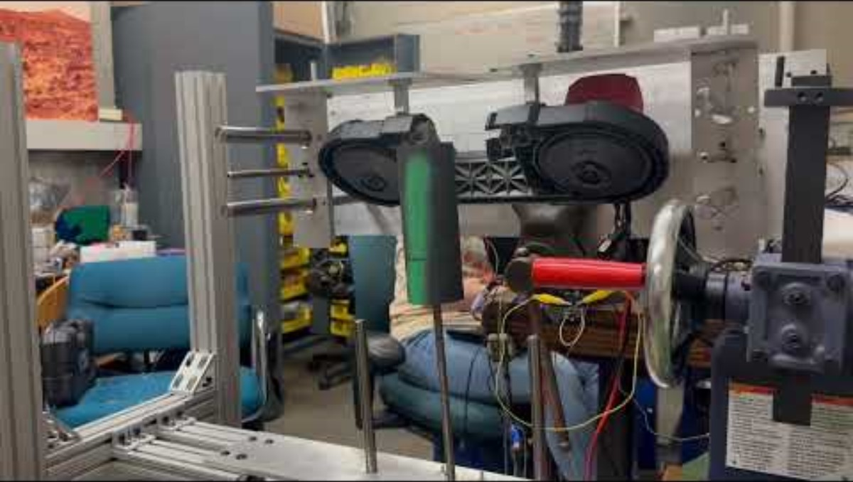
Automation Tests
SIS+ER low risk tests.
  Created a SIS+ER test mount.
Attached a cast iron rod
  Pure Fe Hardness (Vickers Scale): 150
  Pure Cast Iron Hardness (Vickers Scale): 246
ER actuated and tested resistance against cutting test.
Video of our SIS in action
SIS+ER Testing Mount
Video of our ER in action

Slide 20
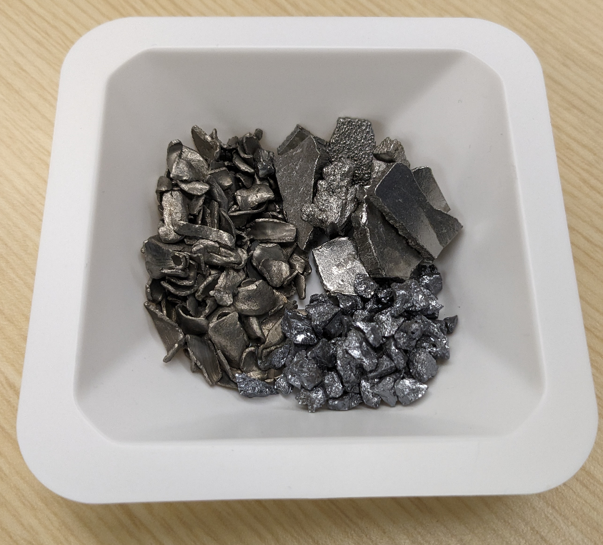
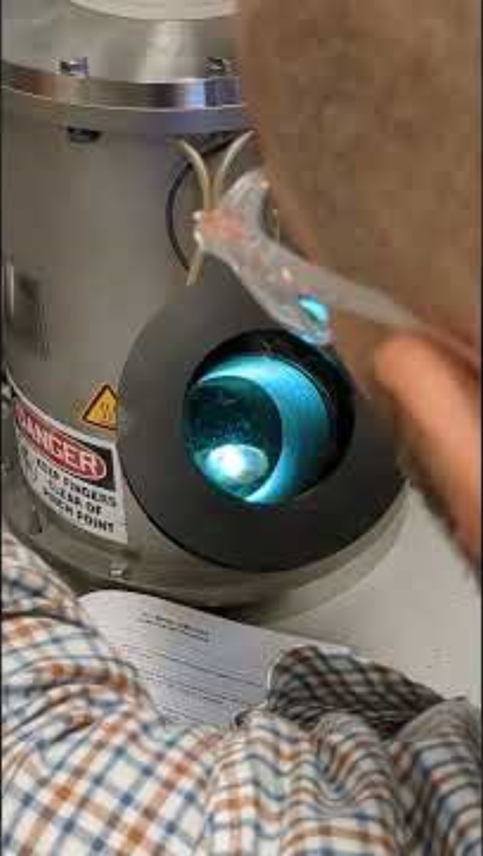
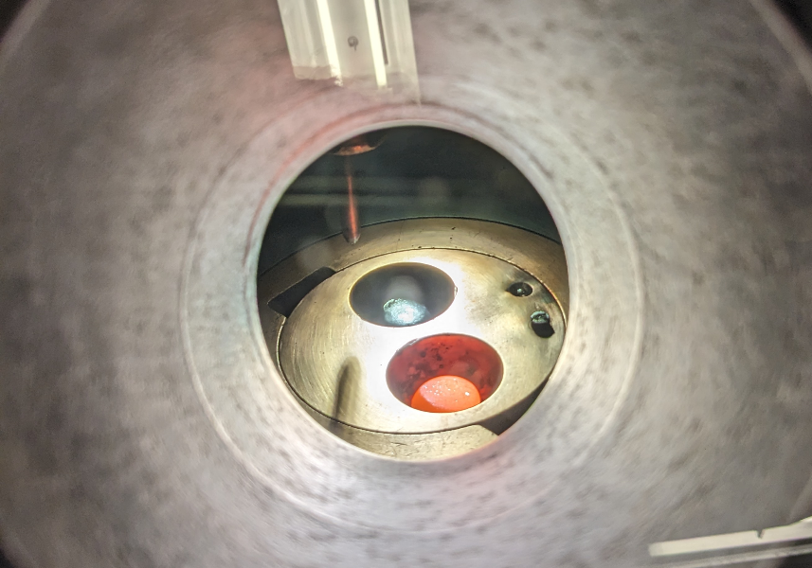
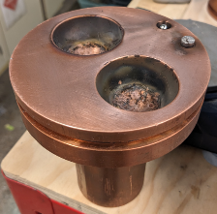
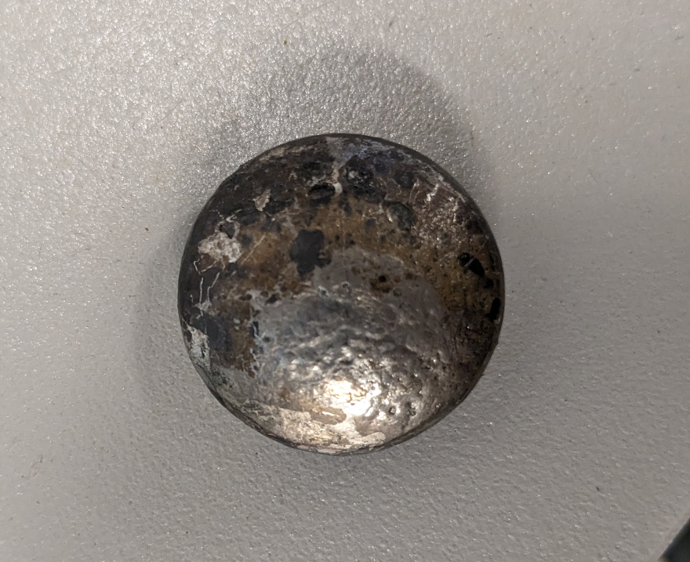
Steel Manufacturing in Vacuum Environment
Titanium
Iron
Mixing Steel Simulant by Reheating
Casting with Liquid Cooling
Silicon
Polishing Samples
Grain Imaging and Hardness Testing
___
1cm
Arc Melting in a Vacuum Environment

Slide 21
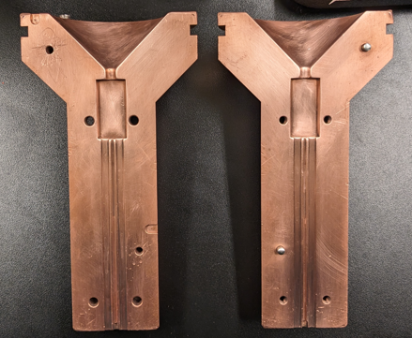
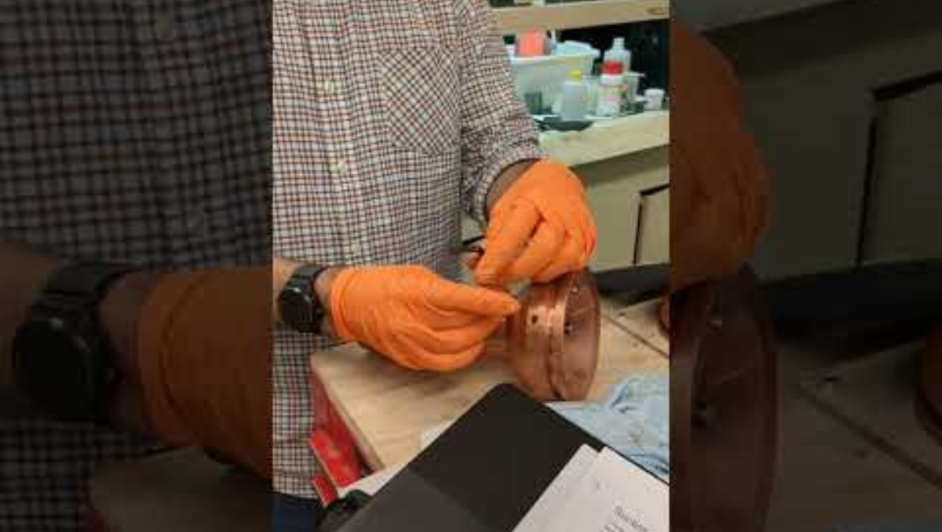
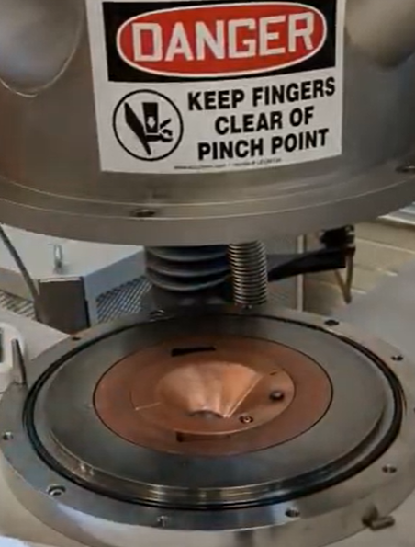
Steel Manufacturing in Vacuum Environment
Mixing Steel Simulant by Reheating
TOM REMEMBER TO ADD THIS VIDEO :3
Casting with Liquid Cooling
Polishing Samples
Grain Imaging and Hardness Testing
Suction Casting in a Vacuum Environment

Slide 22
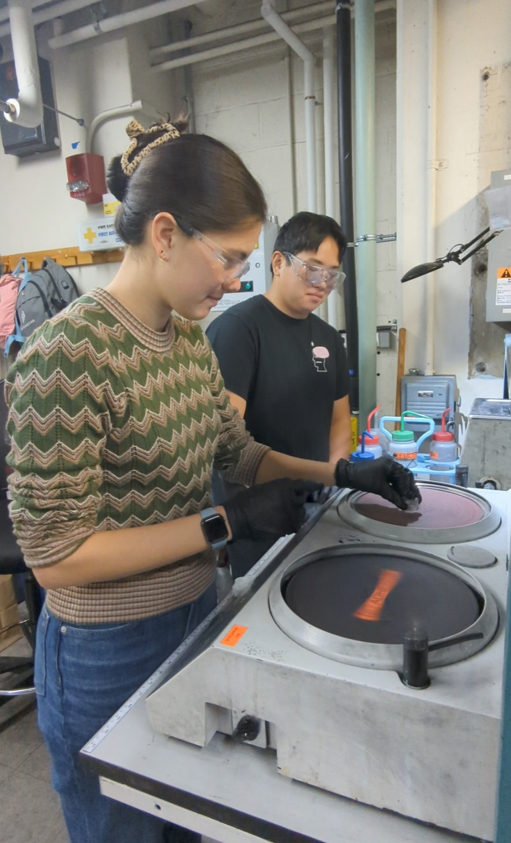
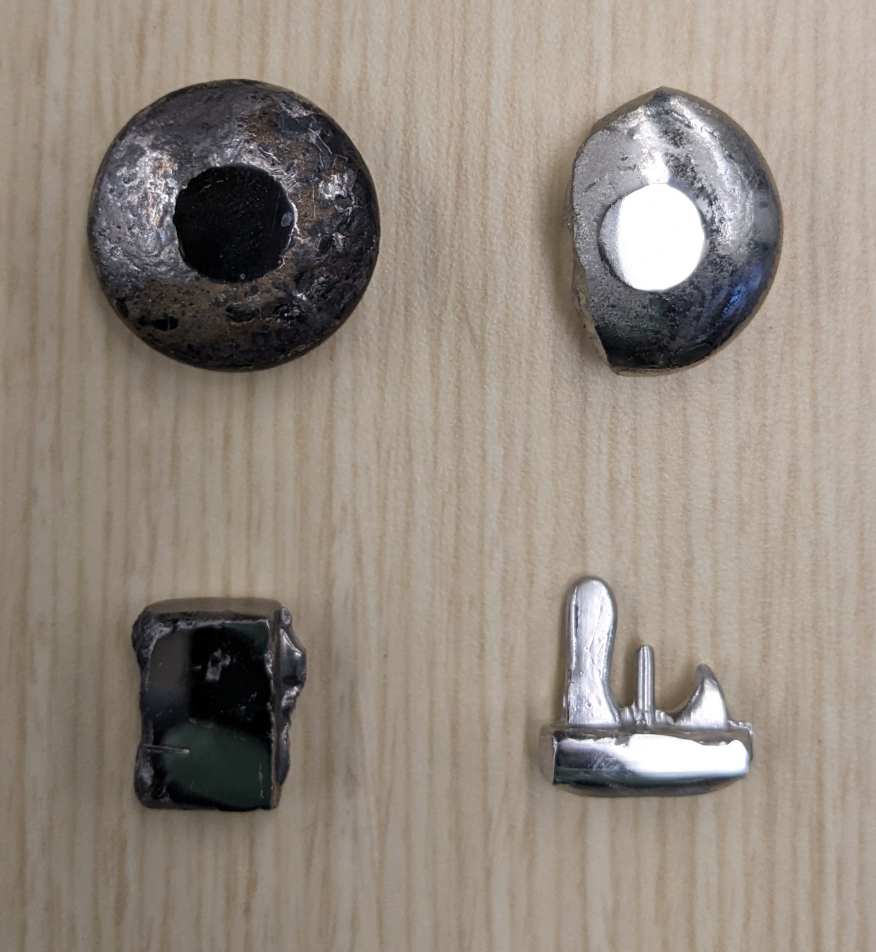
Steel Manufacturing in Vacuum Environment
SST-2, Slow cooled
Mixing Steel Simulant by Reheating
Casting with Liquid Cooling
SST-1, Slow cooled
SST-2, Fast cooled
Polishing Samples
Grain Imaging and Hardness Testing
SST-1, Fast cooled
Polishing samples for testing

Slide 23
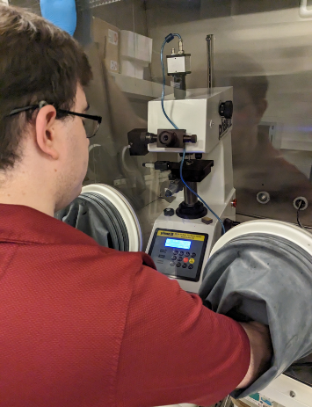
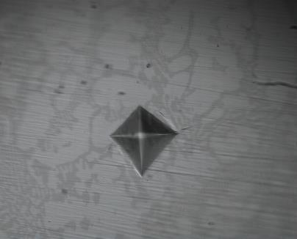
Steel Manufacturing in Vacuum Environment
Test Parameters:
Load: 10kgf = 98 N
5 Indentations per sample
Inert Environment
Mixing Steel Simulant by Reheating
Casting with Liquid Cooling
Polishing Samples
Grain Imaging and Hardness Testing
Hardness testing

Slide 24
Steel Characterization and Testing

Slide 25
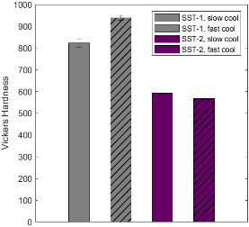
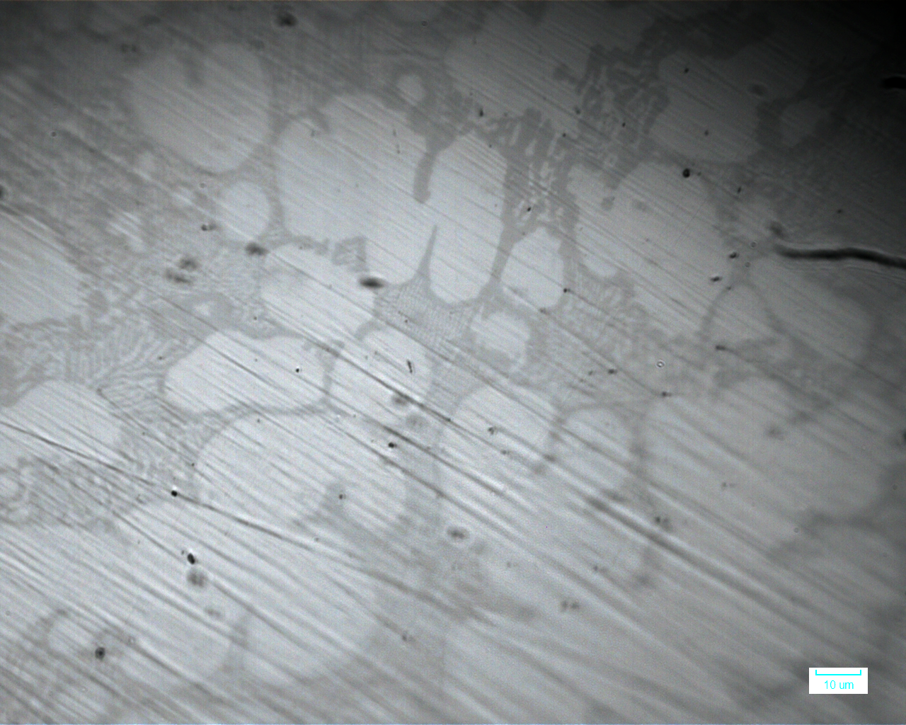
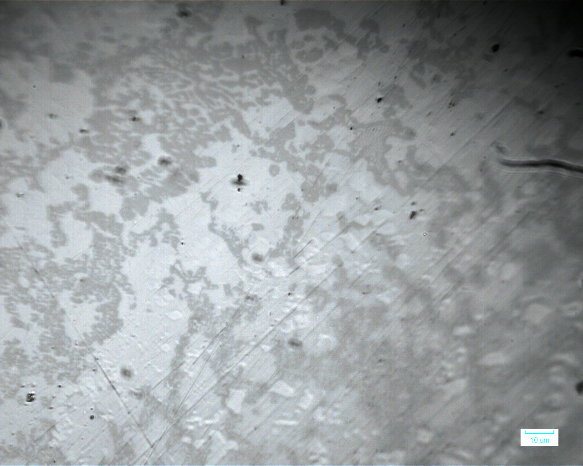
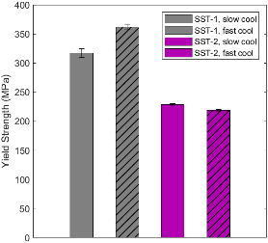
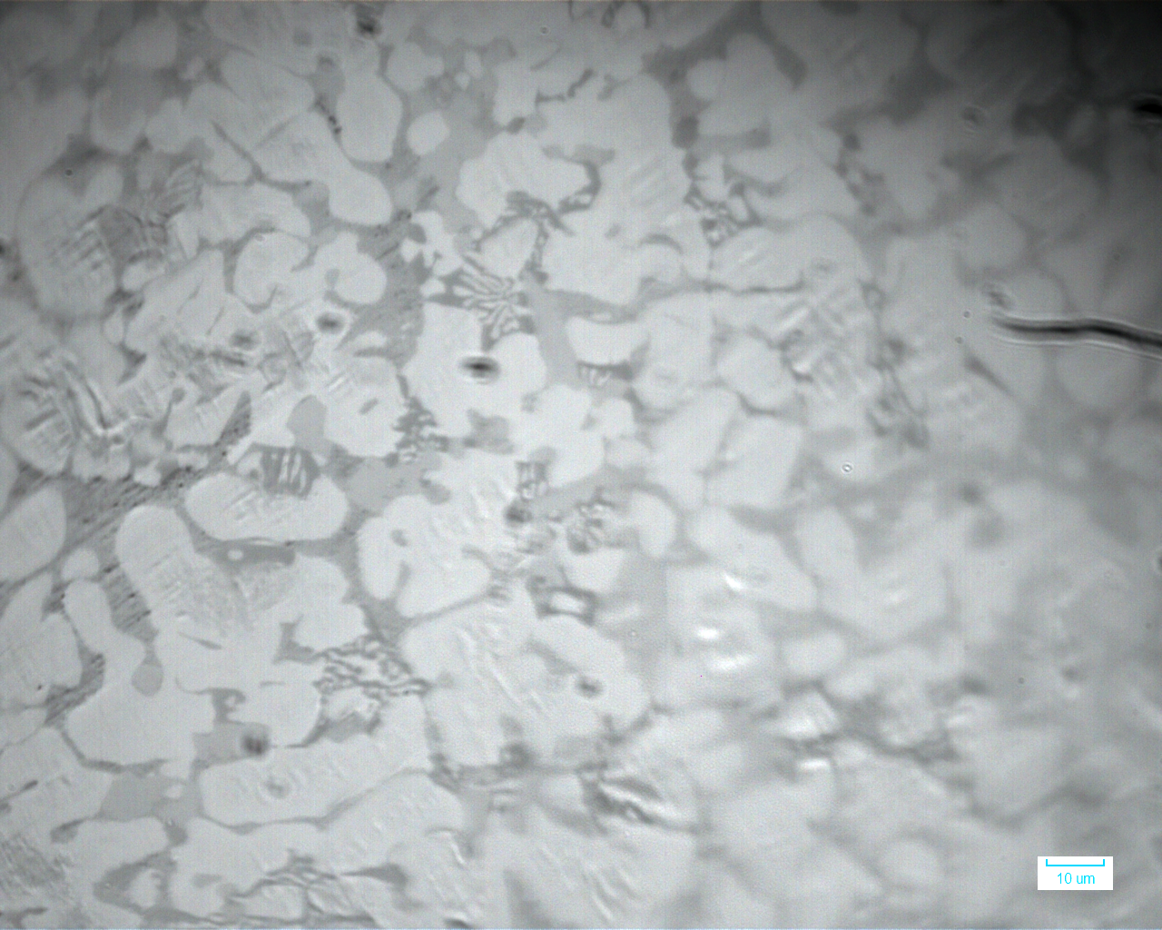
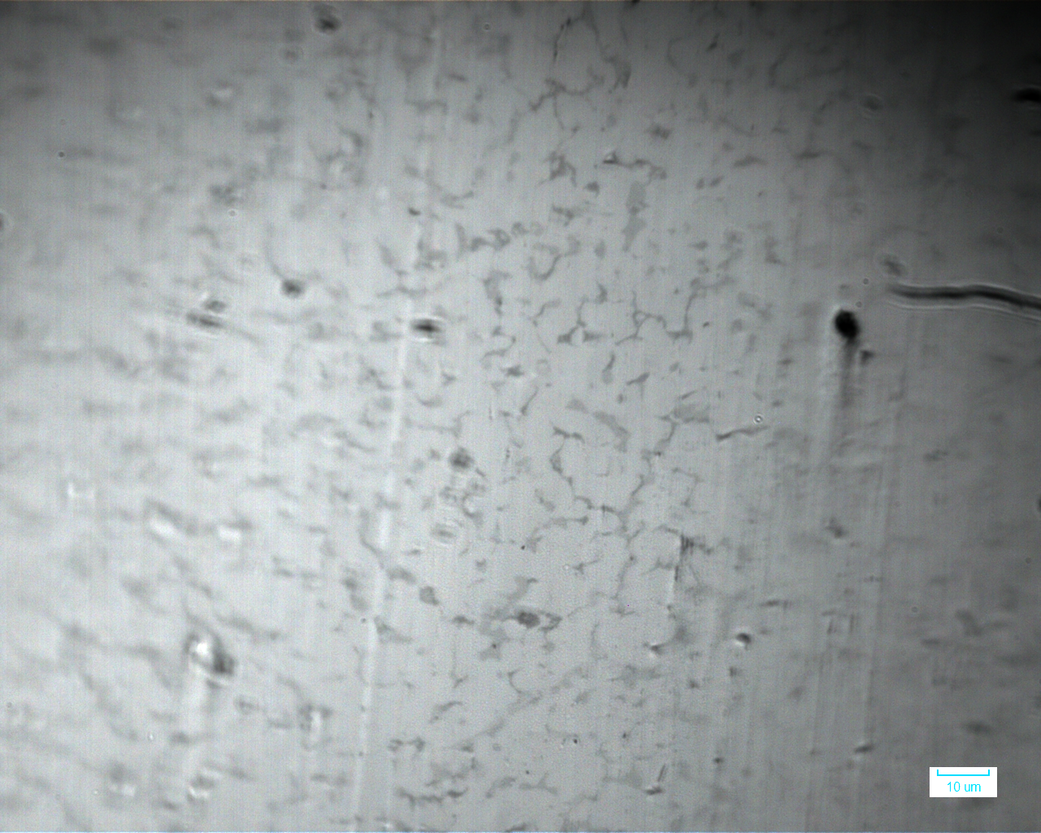
Steel Characterization and Testing
Hardness
100 µm
100 µm
YS (MPa) = HV/2.596
SST-1, Slow cooled
SST-1, Fast cooled
Yield Strength
Sample​ | Composition​
SST-1​ | 73Fe-20Si-7Ti​
SST-2​ | 52Fe-2Si-46Ti​
100 µm
100 µm
SST-2 , Slow cooled
SST-2, Fast cooled
Notes:
Average Yield Strength across all samples: 225 – 360 MPa
Average Vickers Hardness across all samples: 570 – 820 HV
scale: 200 um each
Micrographs explaining the reason for hardness:
Slag characterization
Metal mfg and strength results etc. Yay lunar steel from MRE reactor!
Manufactured metal simulant of two composition : SST-1 (73Fe-20Si-7Ti) and SST-2 (52Fe-2Si-46Ti)
Both simulants were subjected to two different cooling rates : slow cooling and fast cooling
Characterized the mechanical property (hardness) using Vickers hardness test and observed the microstructure through optical microscopy
Yield strength was evaluated by typical Tabor factor which will eventually have the same trend as hardness
The hardness of SST-1 was higher than that of SST-2
The effect of cooling rate was obvious in SST-1 that faster cooling rate increased its hardness while it was unclear in SST-2
Microstructure of SST-1 supports the hardness difference due to different cooling rate

Slide 26
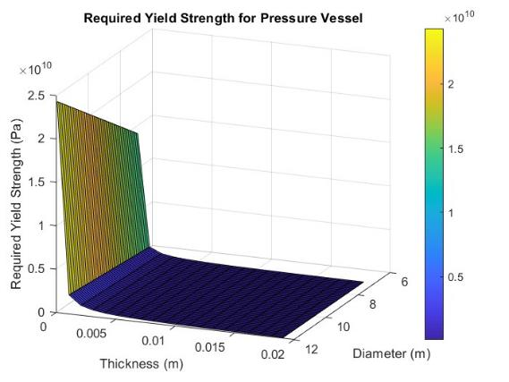
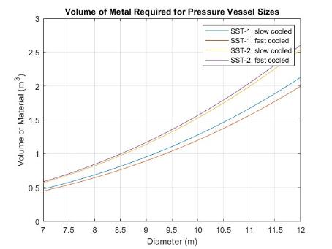
Pressure Vessel Analysis
Using cylinder design with hemisphere ends
Habitat pressure difference = 101,325 Pa
Factor of safety = 2
Notes:
Using cylinder design with hemisphere ends
Ambient pressure = to Earths, 101325 Pa
Factor of safety = 2
To get the largest vessel for smallest amount of metal, results show unenriched, fast cooled regolith was better [diameter 7m and thickness of 0.0098 m or diameter of 12 m and thickness 0.0017 m]
Study done with habitats in mind, could also be produced for fuel storage

Slide 27
MRE Reactor Build and Testing

Slide 28
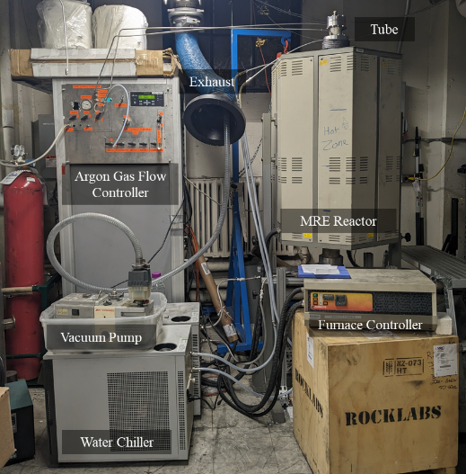
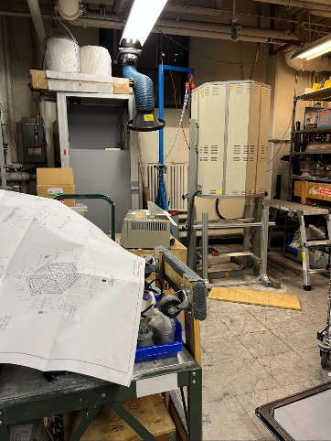
Building the MRE Reactor
Prof. Allanore's lab at MIT
~10 students
~ 200 hours per person

Slide 29

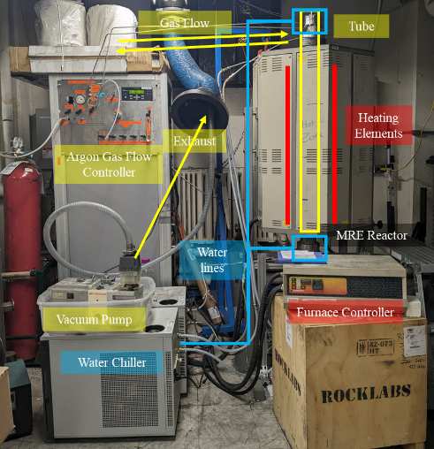
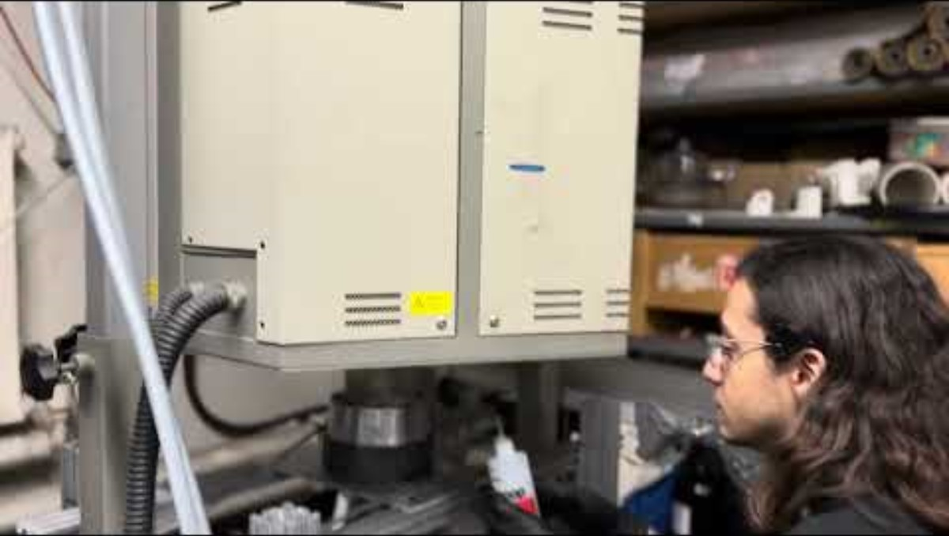
Subsystem Verification Testing
Argon Gas Leak Test

Slide 30
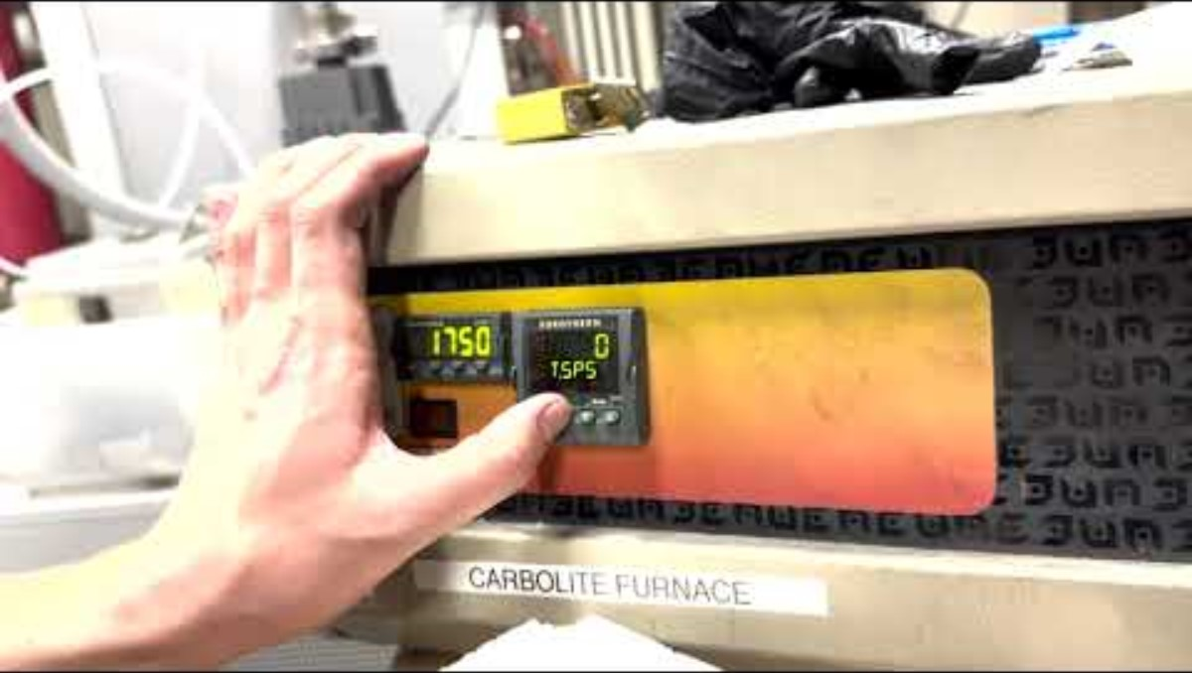
Subsystem Verification Testing
Heating Element Test

Slide 31

Subsystem Verification Testing
Endcap Cooling Water Leak Test

Slide 32

MRE Reactor Process

Slide 33


System Verification Testing
Step 1: Place regolith inside tube

Slide 34

System Verification Testing
Step 2: Vacuum and purge with Argon

Slide 35

System Verification Testing
Step 3: Turn the furnace on

Slide 36

System Verification Testing
The system is running!

Slide 37


System Verification Testing
Bubbles
Molten regolith
Old heating elements (couldn't be replaced due to lead time) and low insulation led to inability to reach operation temperature of 1550°C
Broken Inner tube

Slide 38
Concluding Thoughts

Slide 39

Conclusion
Extraction of Steel via Electrolysis

Slide 40






Conclusion
Extraction of Steel in a Vacuum Environment
Extraction of Steel without Beneficiation or Varying Beneficiation
Electrolysis Efficiency Increase for Low Gravity via Sonication
Automation of Steel and Slag Collection
Steel Manufacturing in a Vacuum Environment
Extraction of Steel via Electrolysis
Lunar Environment Technology Development

Slide 41



Conclusion
Extraction of Steel via Electrolysis
Lunar Environment Technology Development
Steel Manufacturing

Slide 42


Conclusion
Extraction of Steel via Electrolysis
Lunar Environment Technology Development
Steel Manufacturing
Characterization & Testing

Slide 43

Conclusion
Extraction of Steel via Electrolysis
Lunar Environment Technology Development
Steel Manufacturing
Characterization & Testing
Pressure Vessel Analysis

Slide 44
Path to Flight
Required System Capability | Analysis Required | Test Plan
1/6 Gravity | Sonicator Tests in 1/6 Gravity | Sonicator Parabolic Flight Tests
Full Automation Integration | Automated Inlet and Outlet | Hopper and Magnetic Extractor Design
Vacuum Temperature Regulation | Design + Verification Testing for vacuum operation | Thermal Vacuum Testing + Temperature Mitigation Design
Dust Resistance | SIS+ER verification testing w/ dust deposition | Long-term SIS+ER testing with lunar dust + saw particles generation
Long Term Sustainability | ARTEMIS Steelworks Longevity verification | Tests proving long-term operational capability

Slide 45

Future Work
Run the reactor with new heating elements and beneficiation
Test the reactor with the sonicator to see the improvement in efficiency
Test the reactor in a TVAC
Steel manufacturing with hot rolling and cold rolling
Test steel in tensile testing

Slide 46


Thank you for your attention

