Slide 1
.

Slide 2
Smelting with Microwave Energy for Lunar Technologies (SMELT) The Pennsylvania State University
Faculty Advisors Dr. Sven Bilén Dr. Aleksandra Radlińska
Additional Advisors
Michael R. Fiske (Jacobs/NASA MSFC)
SMELT Team Leaders (Undergraduates) Jack Pierce (Team Lead) Alex Baumgartle (Section Lead) Patrick Moore (Section Lead) SMELT Team Members
James Connelly
Avimukta Dokuparthi
Samuel Highfield
Jason Oh
Craig Olouch
Chiranjeev Singh
Marisa Tommarello
Colton Washburn
Notes:
Hello, and welcome to the project presentation of SMELT: Smelting with Microwave Energy for Lunar Technologies. My name is Jack Pierce, the project lead, and I am joined today by members of the Student Space Programs Laboratory at Pennsylvania State University. Together, we would delve into the fabrication and design of the SMELT system.

Slide 3
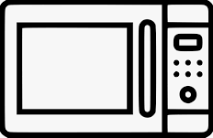
Presentation Roadmap
Project Description
SMELT Design
Chamber Analysis
Crucible Design
Insulation Casing
Conveyance System
Verification Testing on Earth
Testing Process
Results
Introduction and Design Concept
Lunar Microwave Economy
SMELT as a Solution
System Overview
Operation Overview
Conclusion
Path-to-Flight
Summary
Questions

Slide 4
What is Meant by Lunar “Microwave Economy”?
Microwave power has many potential uses on the Moon
High-power microwave for the construction of habitats, roads, landing pads, and other infrastructure
Microwave sintering of regolith for construction
Enhanced curing of regolith-based concrete
Remote powering of rovers and sensor systems
Beamed microwave for propulsion from the lunar surface
Microwave heating of regolith to release water and other chemicals and chemical precursors
Microwave plasma–based sterilization and air-filter regeneration
Cooking
Microwave sintering of regolith-derived metals for manufacturing
Preparation of lunar regolith to support plant growth
And many others, some perhaps yet to be discovered and researched
Application areas
Construction
Mining
Transit
Energy
Agriculture
Medicine
Robotics
Life sustainment
Experiments

Slide 5
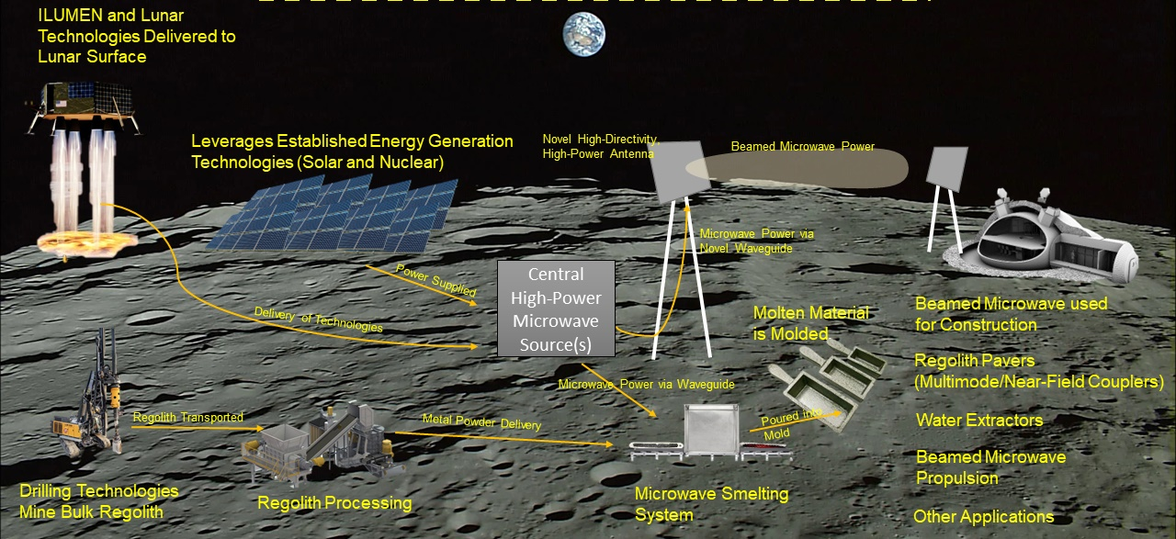
SMELT fits within Infrastructure for Lunar Utilization of Microwave Energy (ILUMEN)

Slide 6
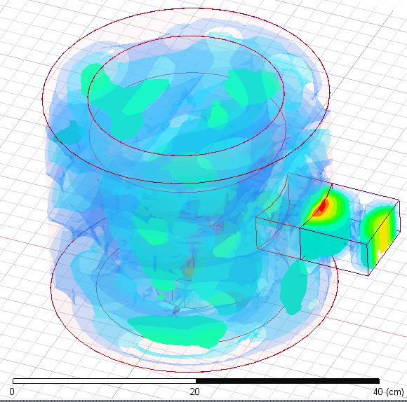
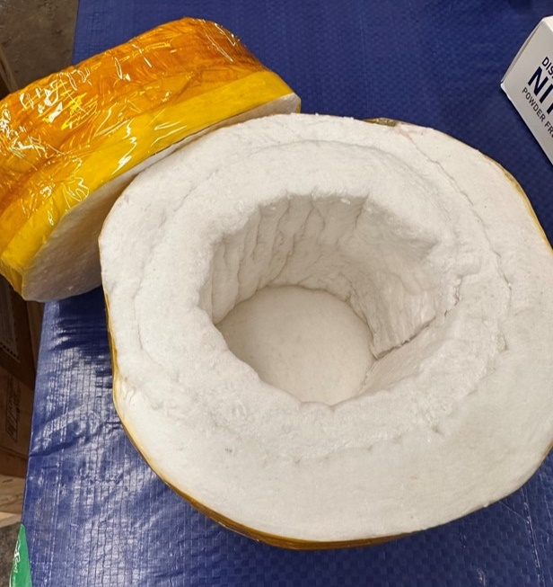
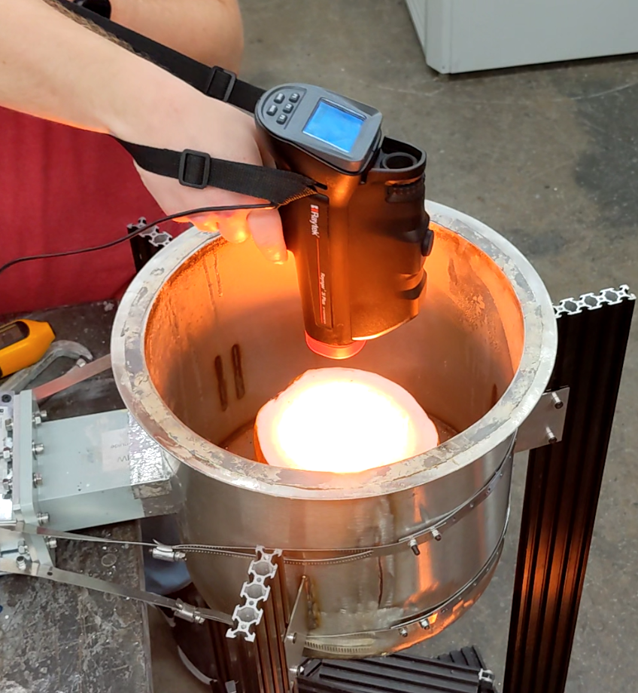
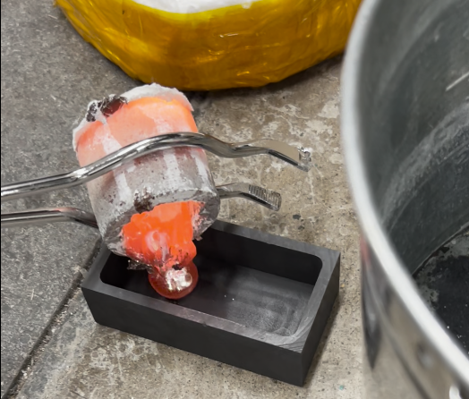
SMELT as a heating solution
SMELT delivers a novel solution for heating in-situ materials using microwave energy that emphasizes lightweight design, compact dimensions, and low power requirements

Slide 7
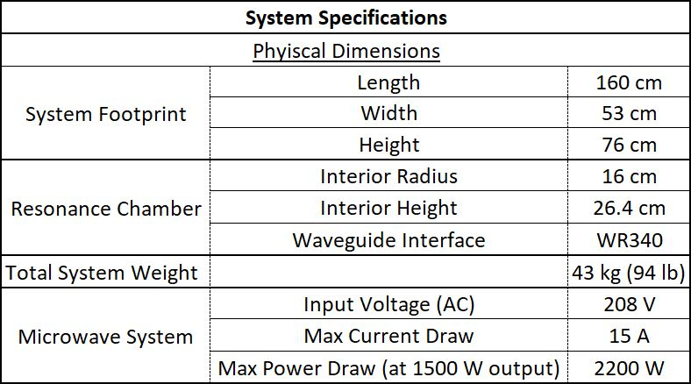
SMELT System Overview
Microwave Network
Resonance Chamber
Conveyance System
Crucible

Slide 8
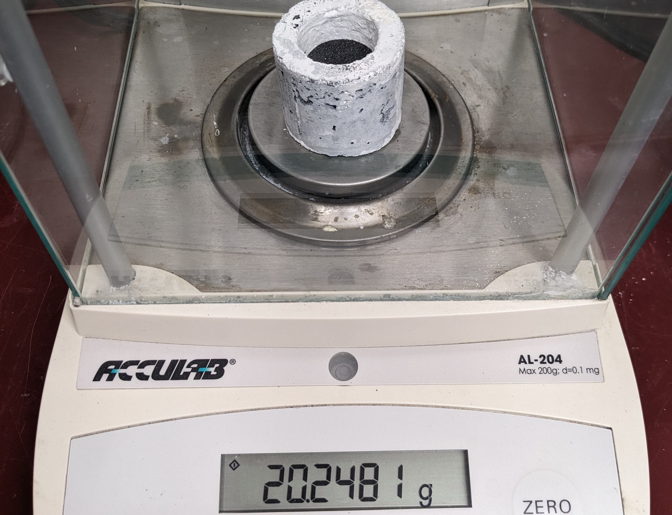
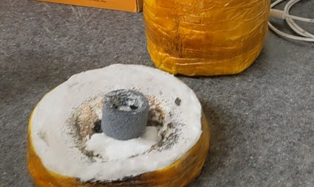
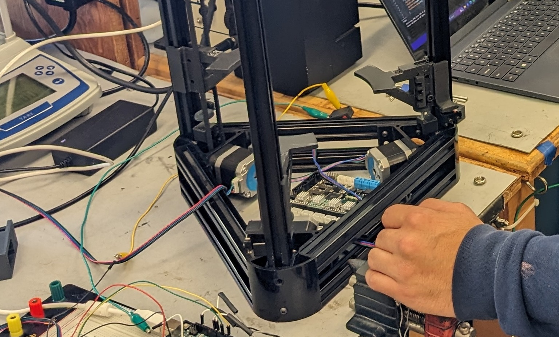
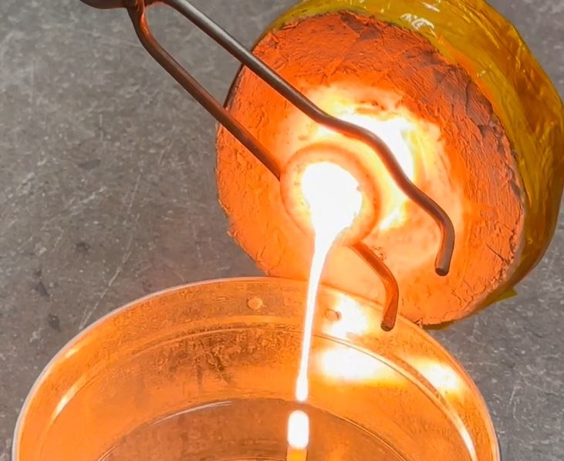
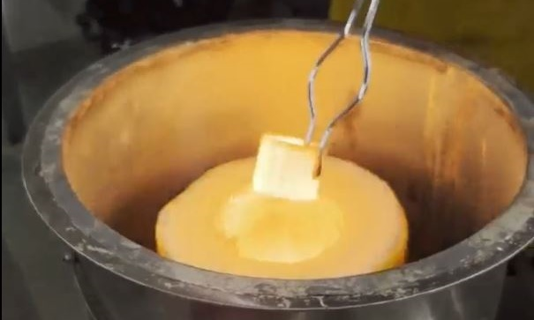
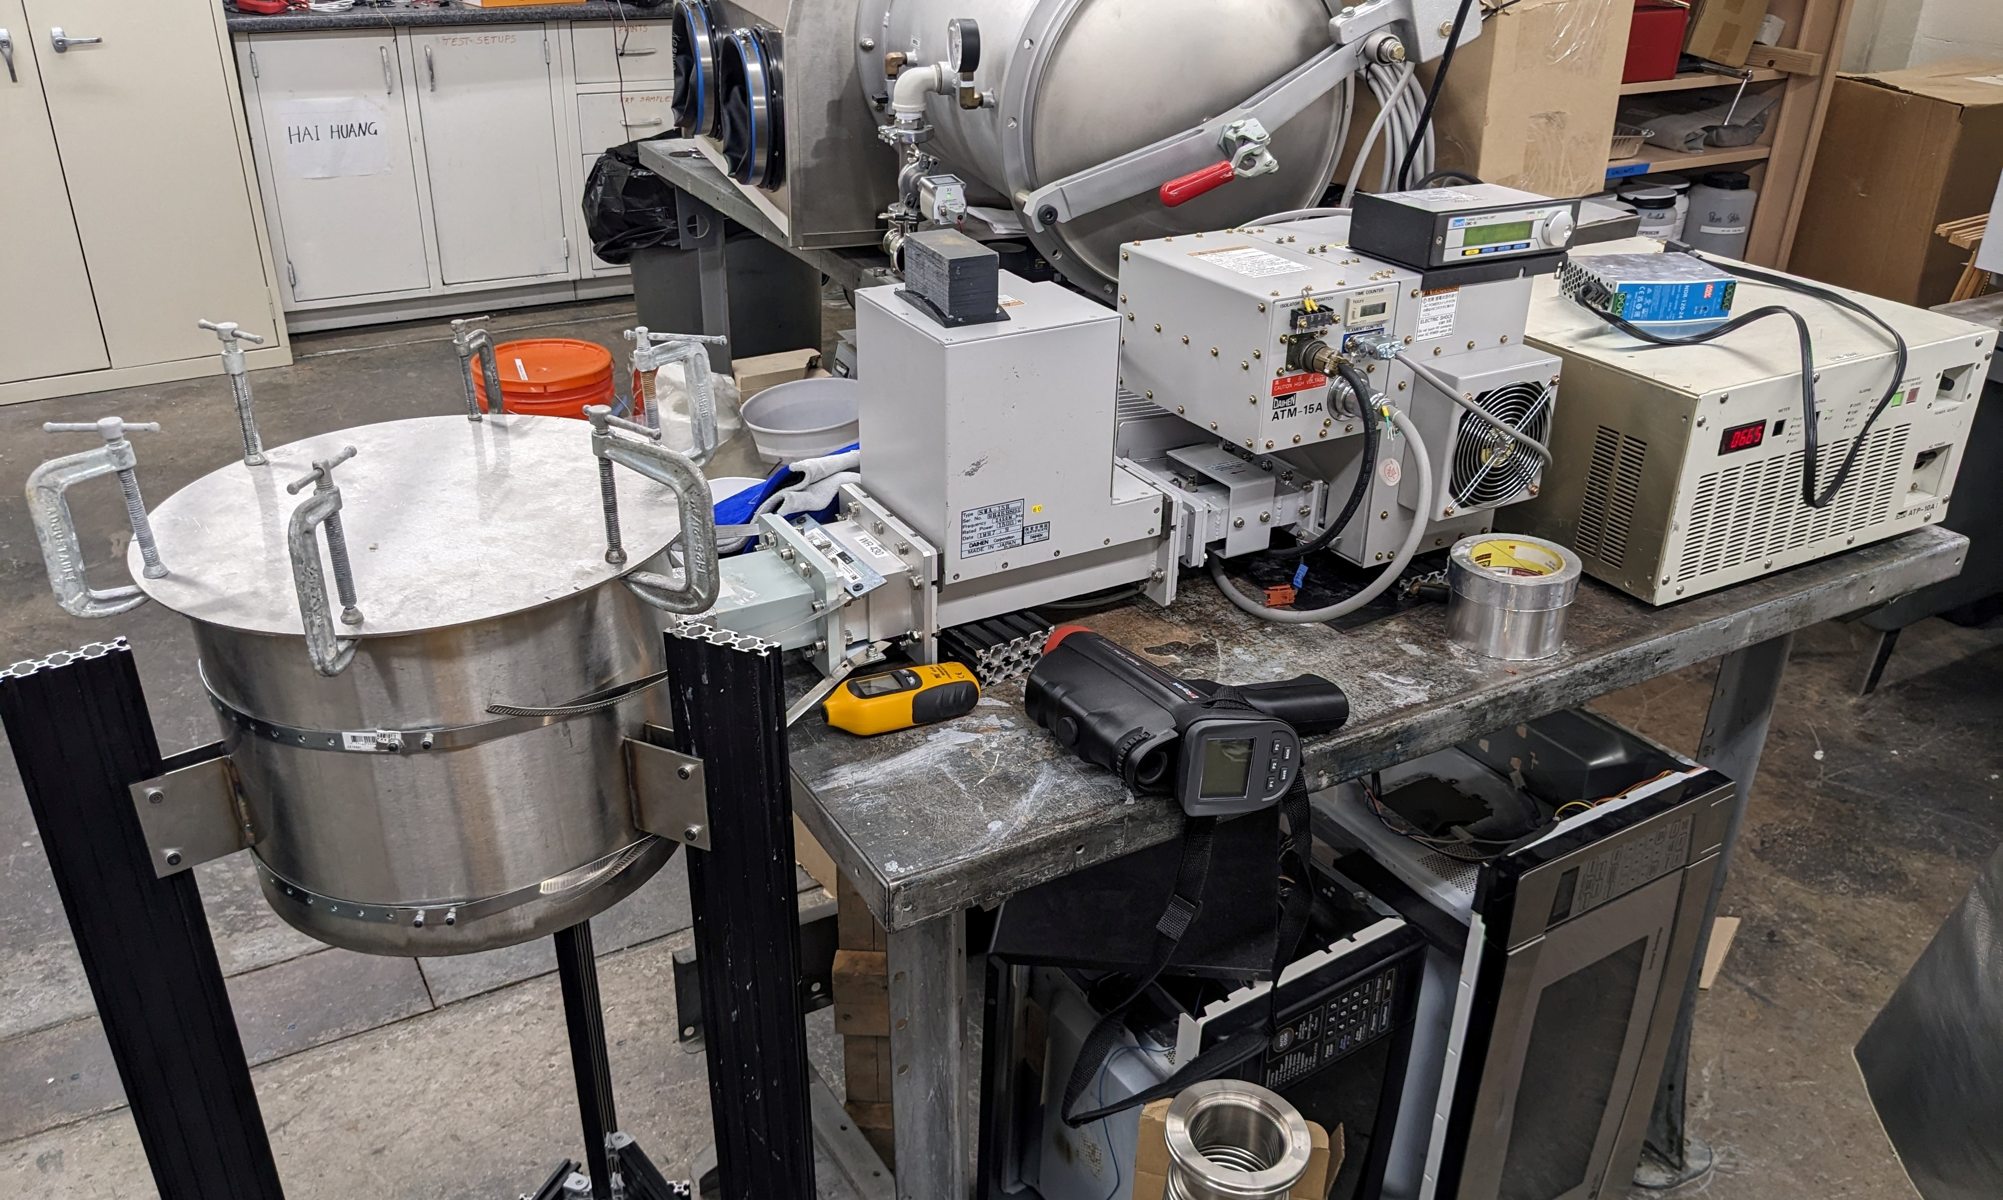
SMELT Operation Overview
Load Crucible
Measure mass
Calculate cycle time & power level
Insulation Casing
Place crucible inside of insulation casing
Conveyance System
Move insulation & crucible into resonance chamber
Material Processing
Remove crucible from insulation casing and start further processing
Conveyance System
Move insulation & crucible out of the resonance chamber
Heat Cycle
Run the heat cycle for the calculated duration and power level
Notes:
Why we chose SiC: we chose SiC because it efficiently absorbs microwave waves and rapidly becomes heated
Our crucible weighed about 20 grams which was a vital measurement for our data along with deciding what power and time we choose
We carefully place the SiC crucible in the ceramic fiber insulator chamber we made covered in captain tape
Place the insulator with the crucible and ilmenite in it into our conveyance system
We power on the system and test between a variation of times usually between 5-30 minutes with a power system that goes up to 1600W
Taking the chamber out of the system consisted of someone taking it out with heat protected gloves and removing the top then another person used tongs to pick up the crucible and see if we got a successful melt by pouring it into a bucket of water
Finally we took data on time, temperature, and power and continued this process

Slide 9
Microwave Network
To Chamber
A) Daihen ATM15a 1.5-kW magnetron connected to a Daihen CMC-10A Automatic Microwave Tuning Control Unit, B) WR340 Isolator, C) Daihen SMA-15B tuner

Slide 10
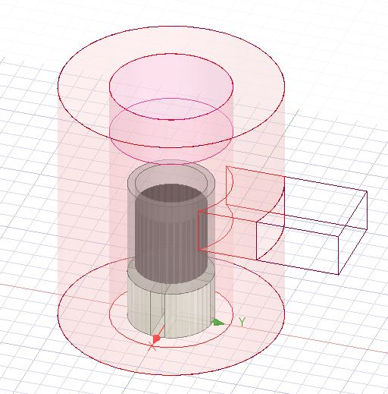
Chamber Optimization
Optimization Parameters:
Average E-field magnitude inside of crucible
S-parameters
Variables
Chamber Radius
Chamber Height
Insulation Thickness
Bottom Insulation Thickness
*Crucible Thickness
*Port Location
Notes:
Radius Ranges: 11cm – 22cm (1 cm step)
Chamber Height: 20cm - 30 cm (1 cm step)
Bot Insulation: 2.5 cm – 7.5 cm (2.5 cm step) 5 cm optimal
Wall Insulation: 2.5 cm – 5 cm (2.5 cm step) 2.5 cm optimal

Slide 11
Optimization Results
12-5/8″ diameter – ~16 cm radius
10-3/8″ height – ~26.4 cm height
Cavity Radius (cm)

Slide 12
Impact of Insulation
Insulation Walls
Insulation Capsule
No Insulation

Slide 13
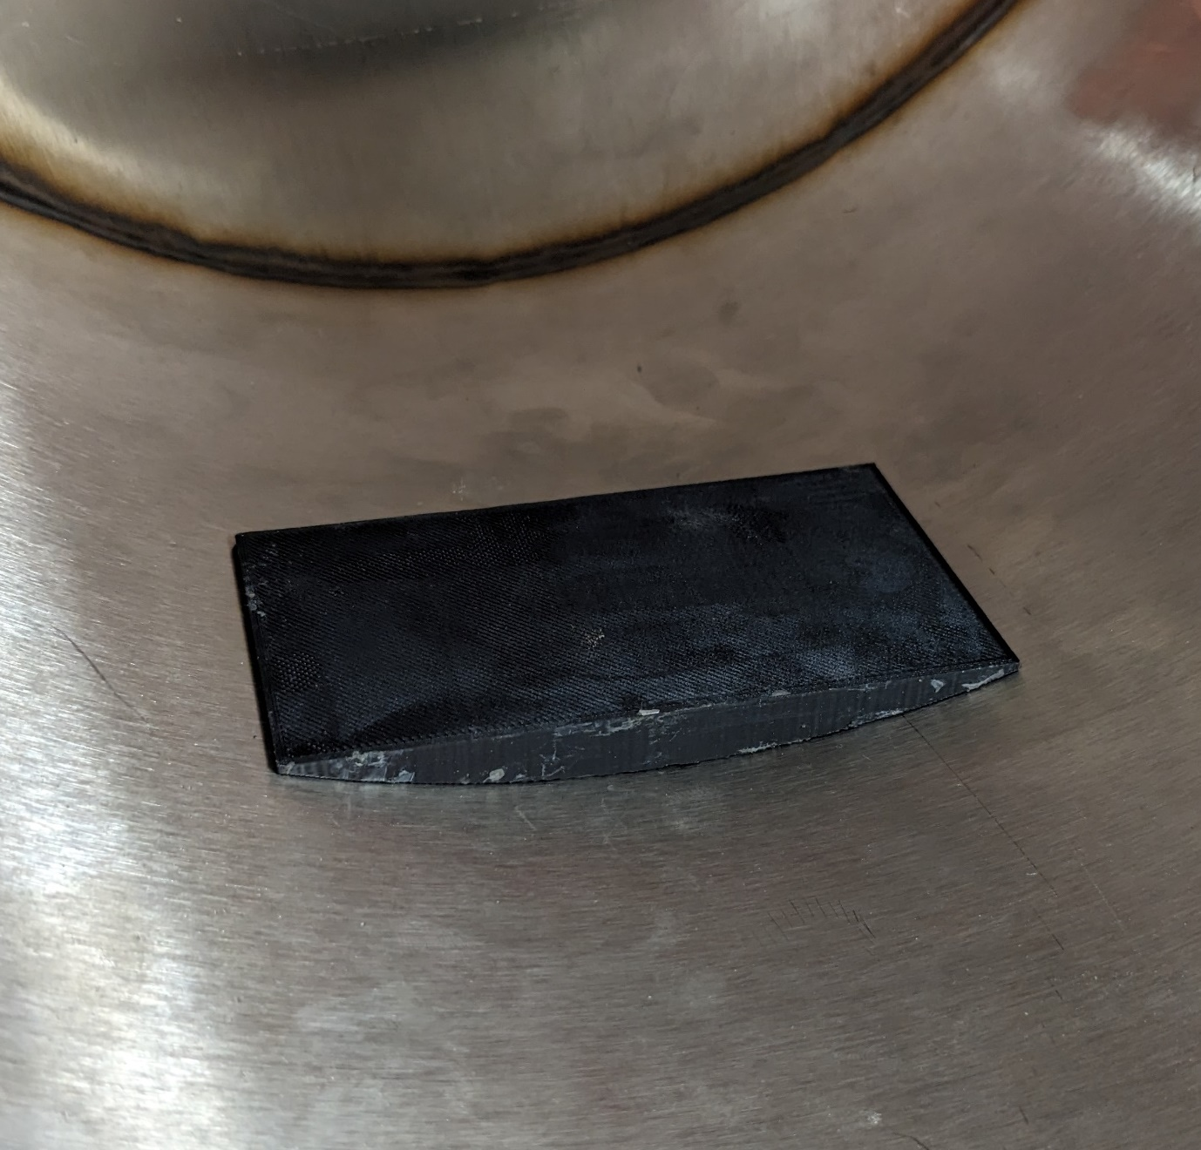
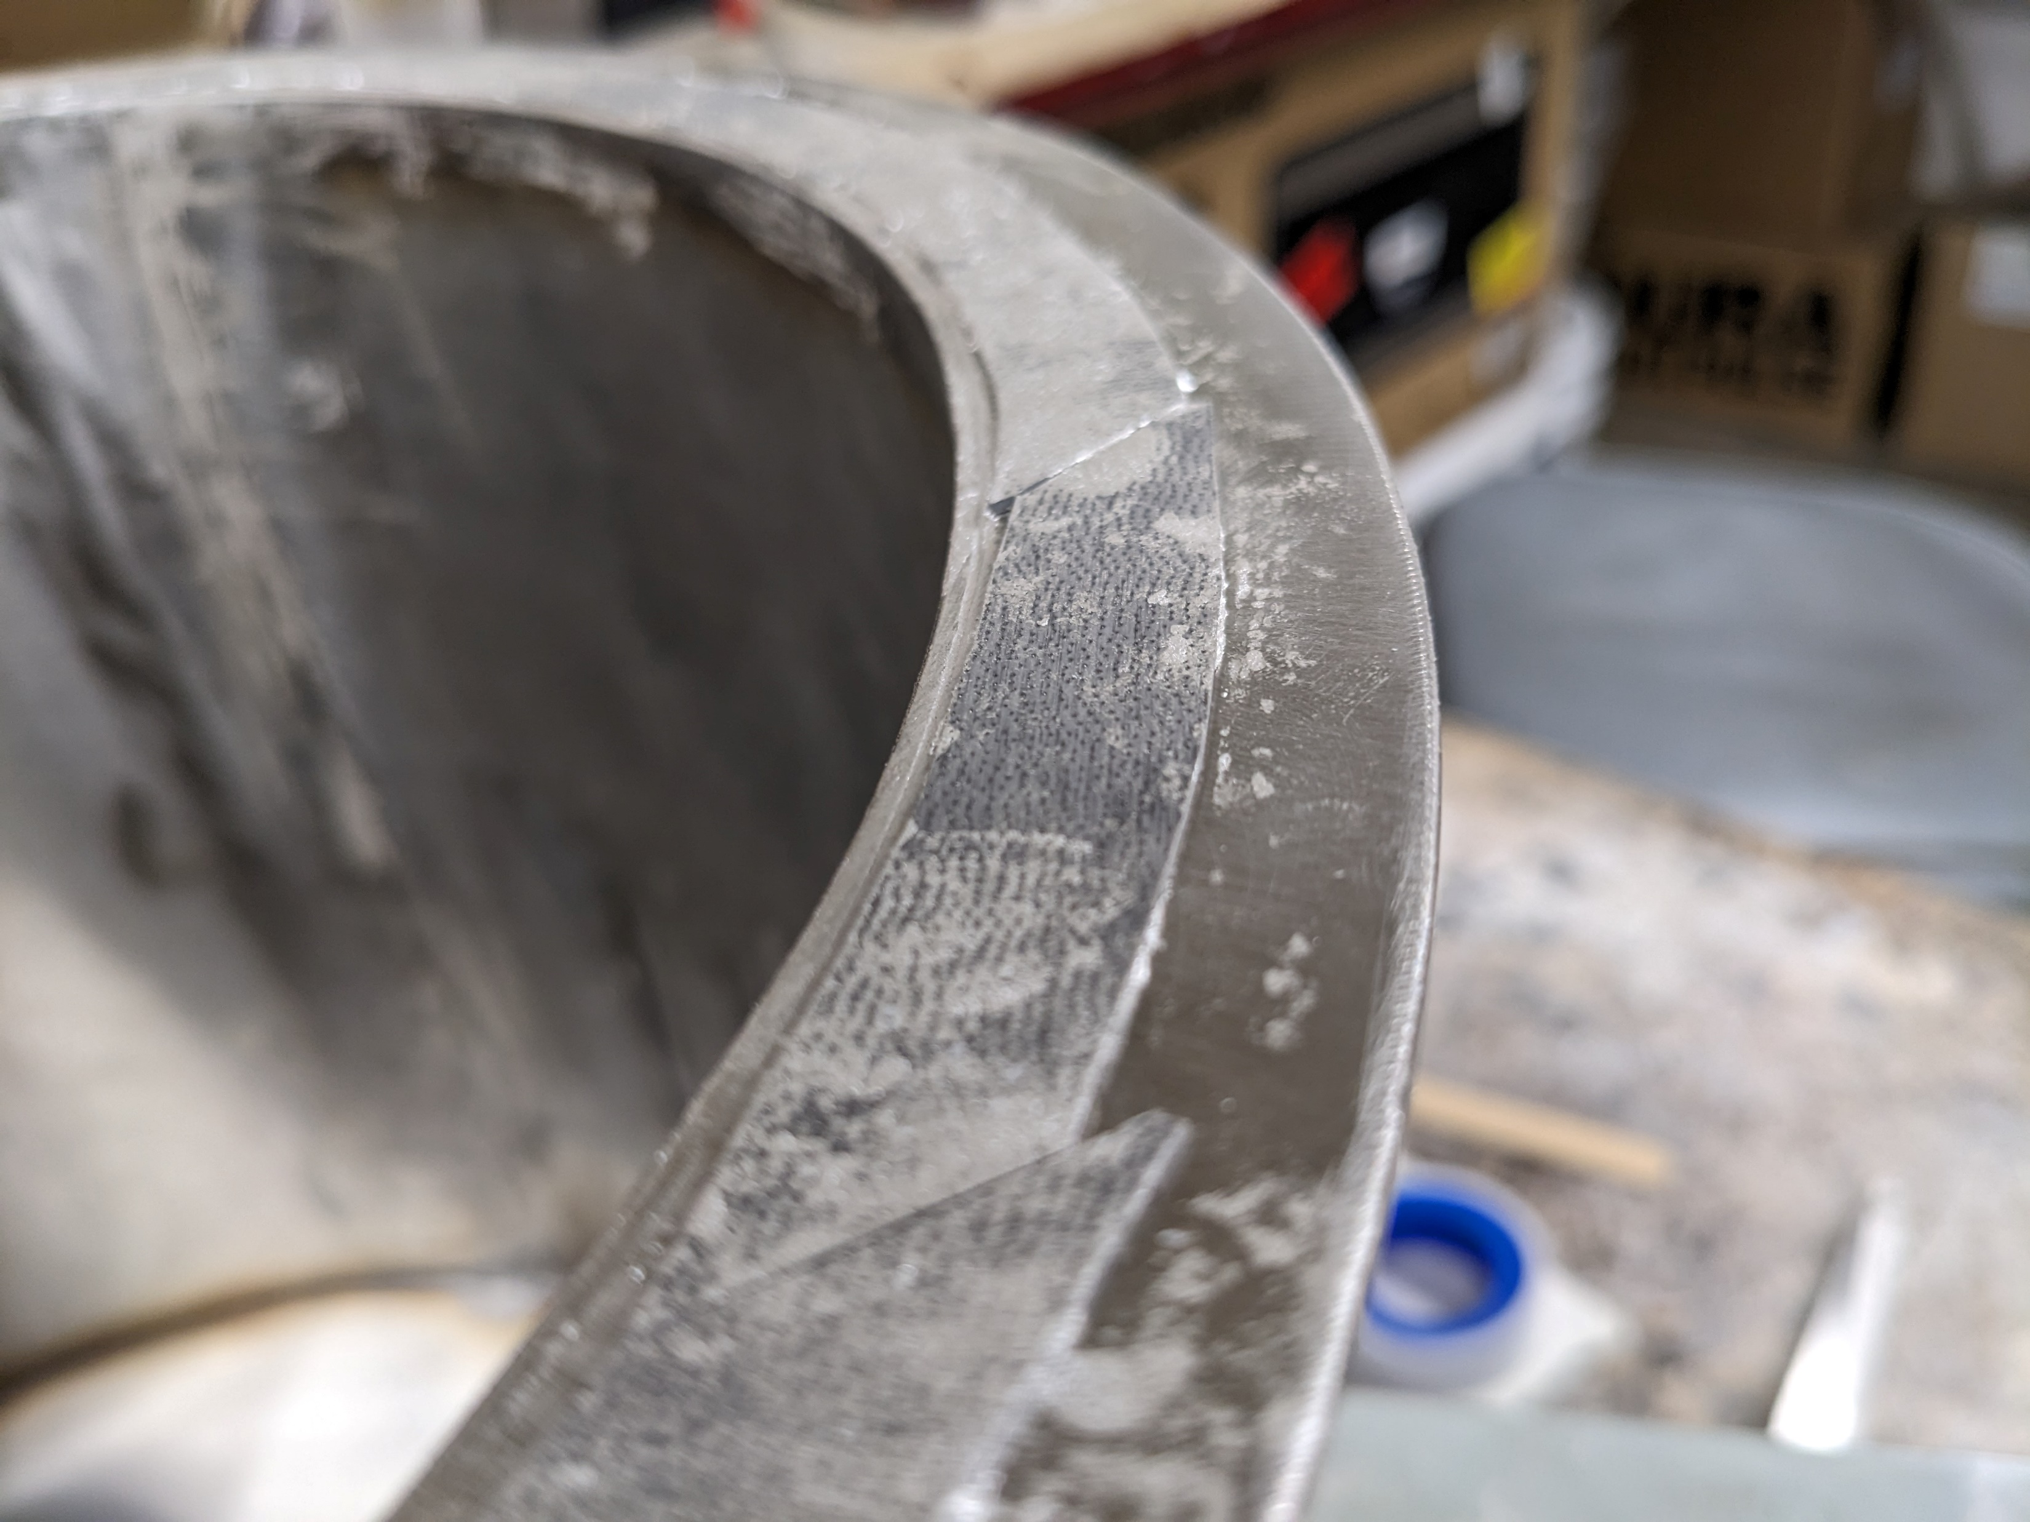
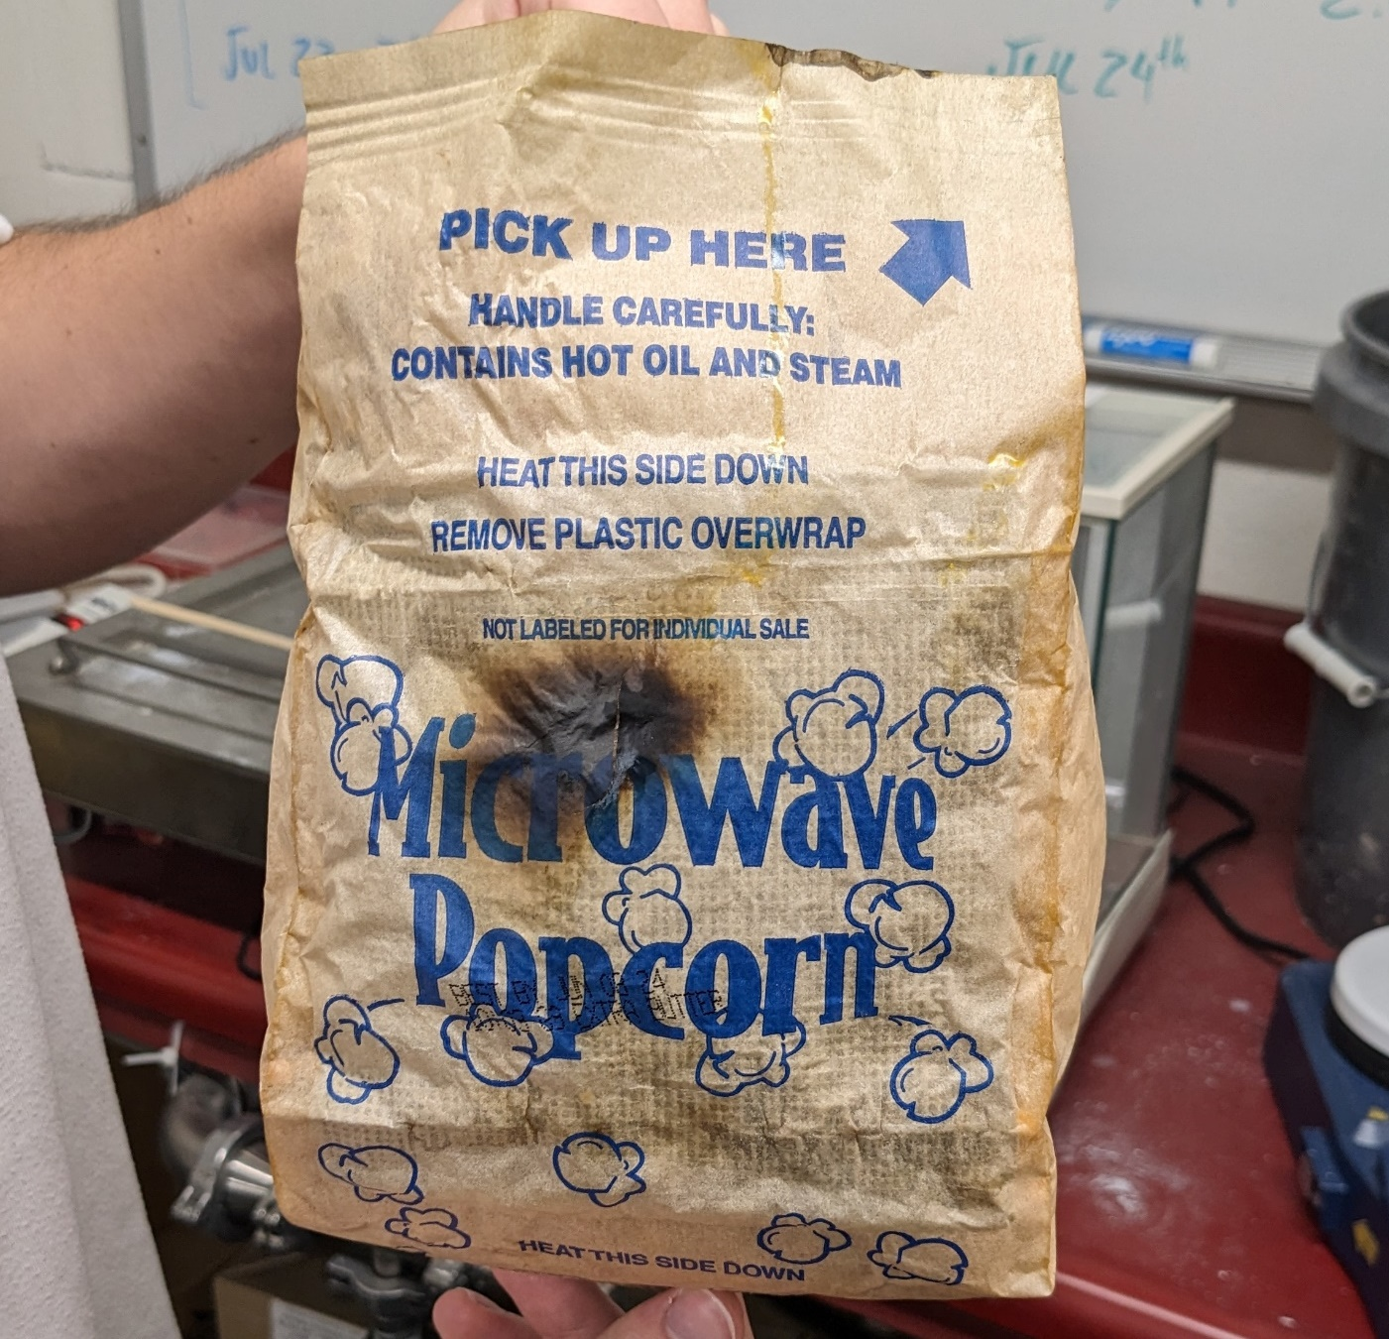
Finished Chamber
Waveguide Attached
Waveguide Jig
RF Gasket
Focused Power

Slide 14
Crucible Design
Silicon Carbide (SiC)
Rapidly heats in presence of microwaves
1 cm thick
Balance between strength, energy absorption, thermal mass
Alumina Coating
Thin coat
Prevent reactions with SiC
In-situ Material
Heated by conduction from the SiC
Even materials not normally heated by microwaves can be heated
Notes:
Ceramic, Graphite, and Graphite-Silicon Carbide also used

Slide 15
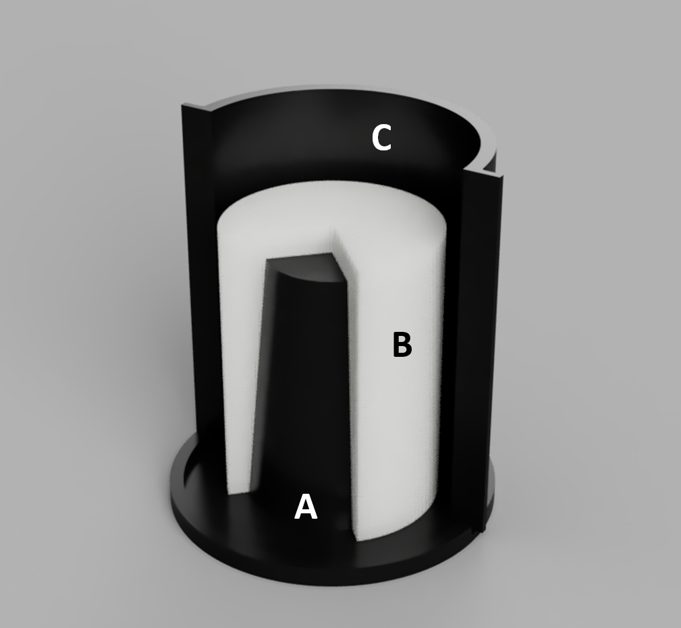
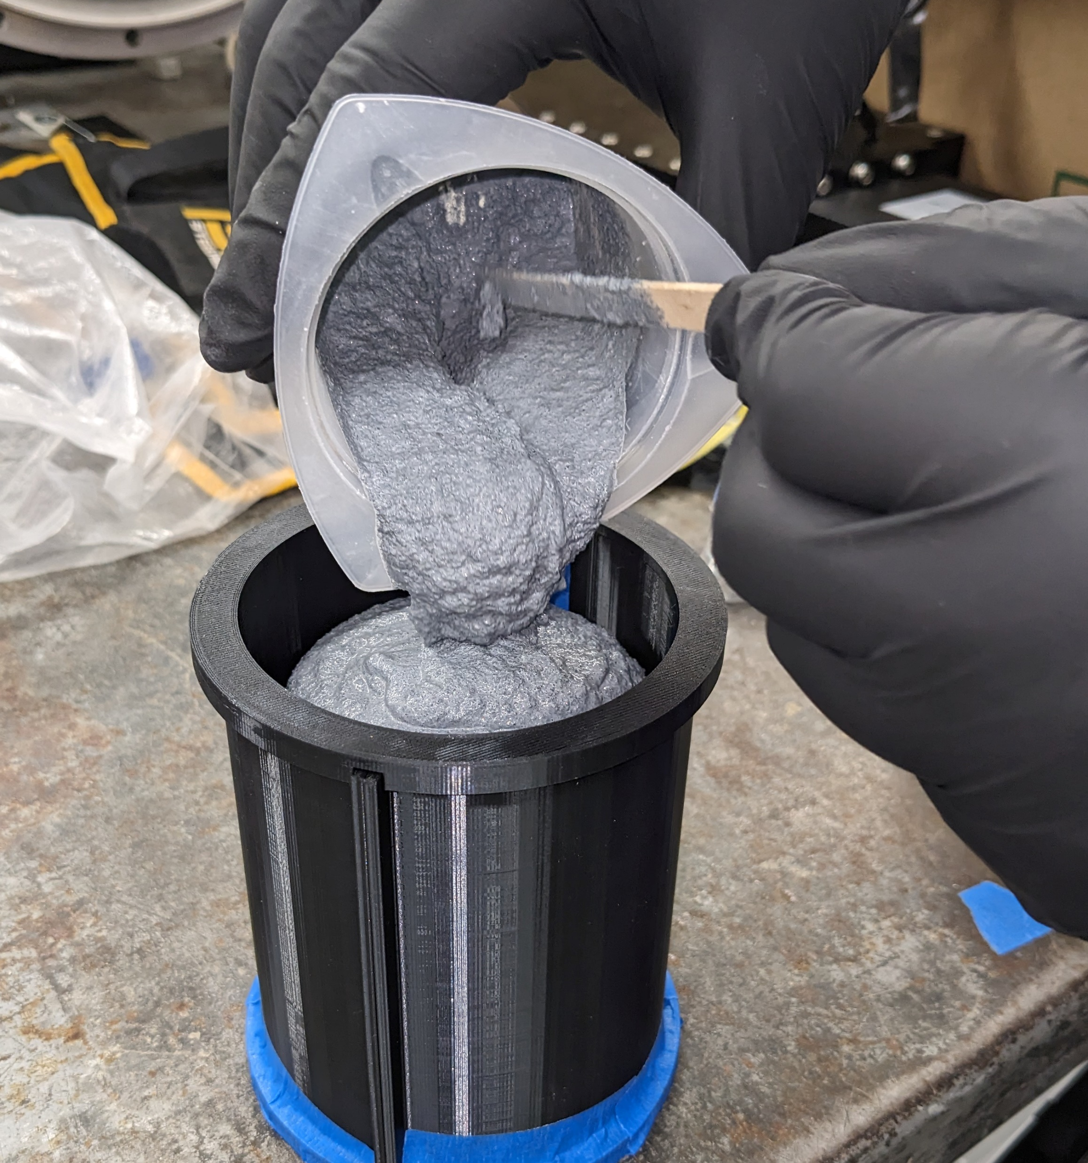
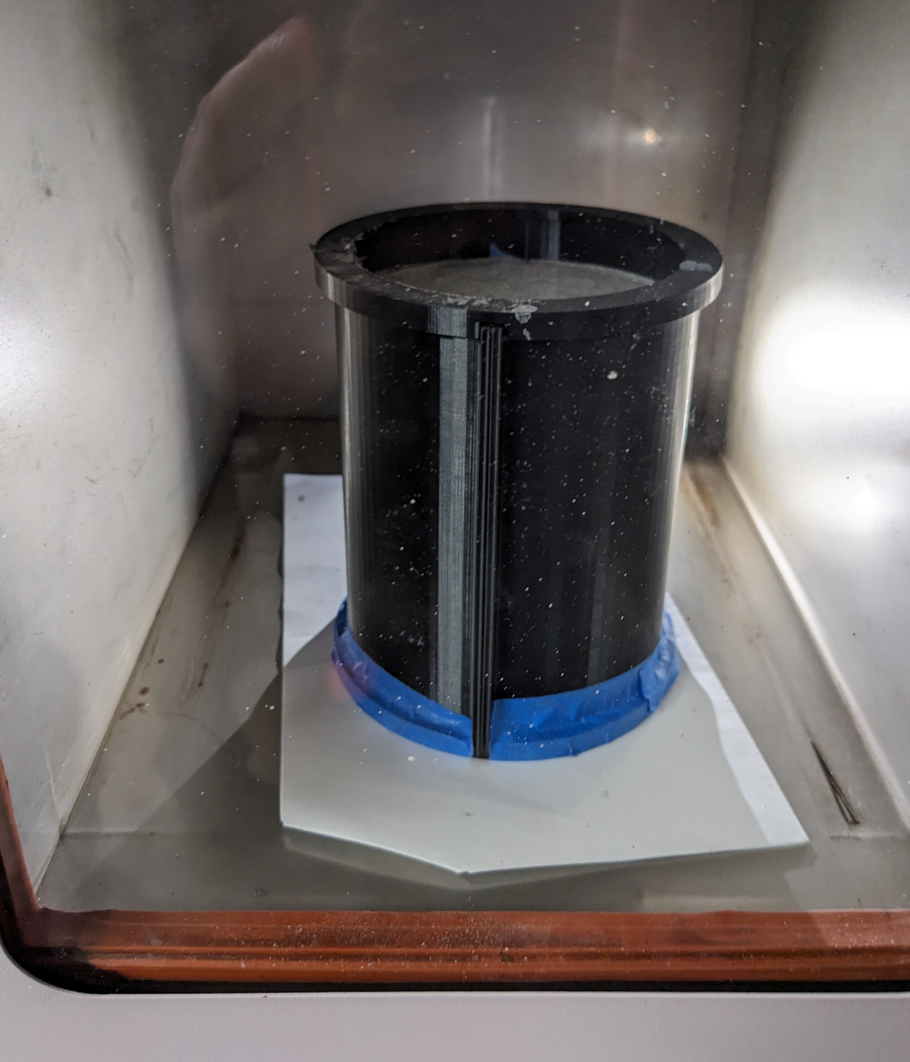
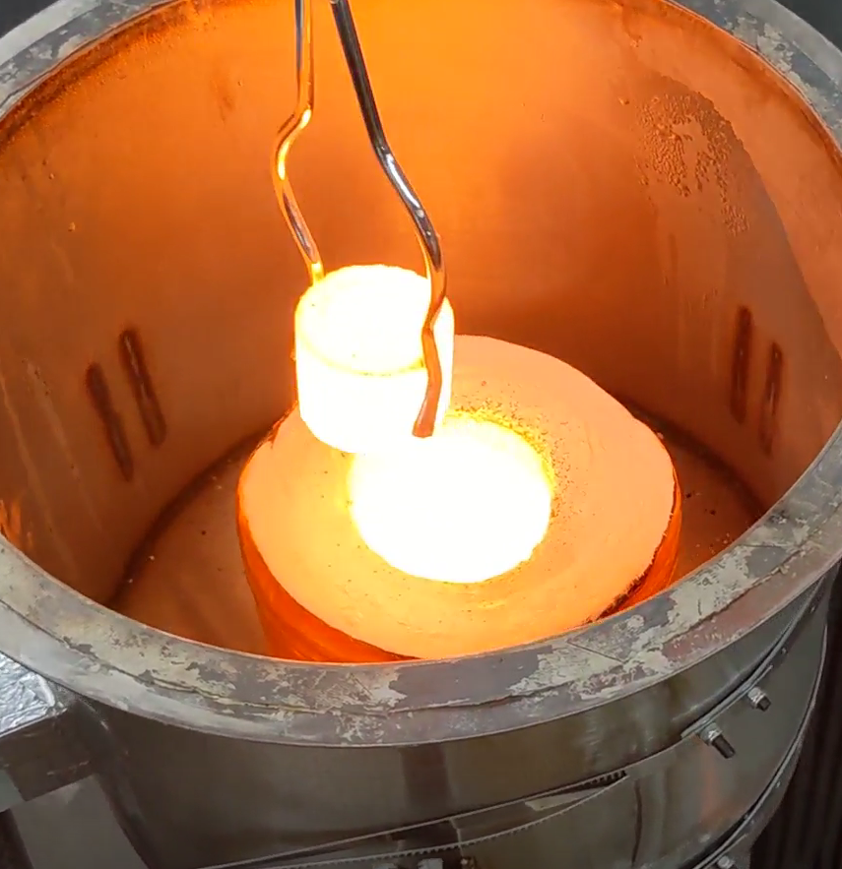
Crucible Fabrication
3D Print Mold
Cast
Notable Features
3-piece 3D-printed mold (A,C) with silicone rubber center (B) mitigates risk of demolding failure
Final curing in microwave
No additional devices required
Advantages
Cost
Small crucible: $4
20-g payload
Large crucible: $27
1.5-kg payload
Rapid Prototyping
72-hour turnaround
Customized Shape
Future development
Cure
Smelt
Notes:
3D printed molds using a silicon insert
Curing can be done in the microwave system itself
Testing was used to improve the shape, ratio of curing agent, molding methods

Slide 16
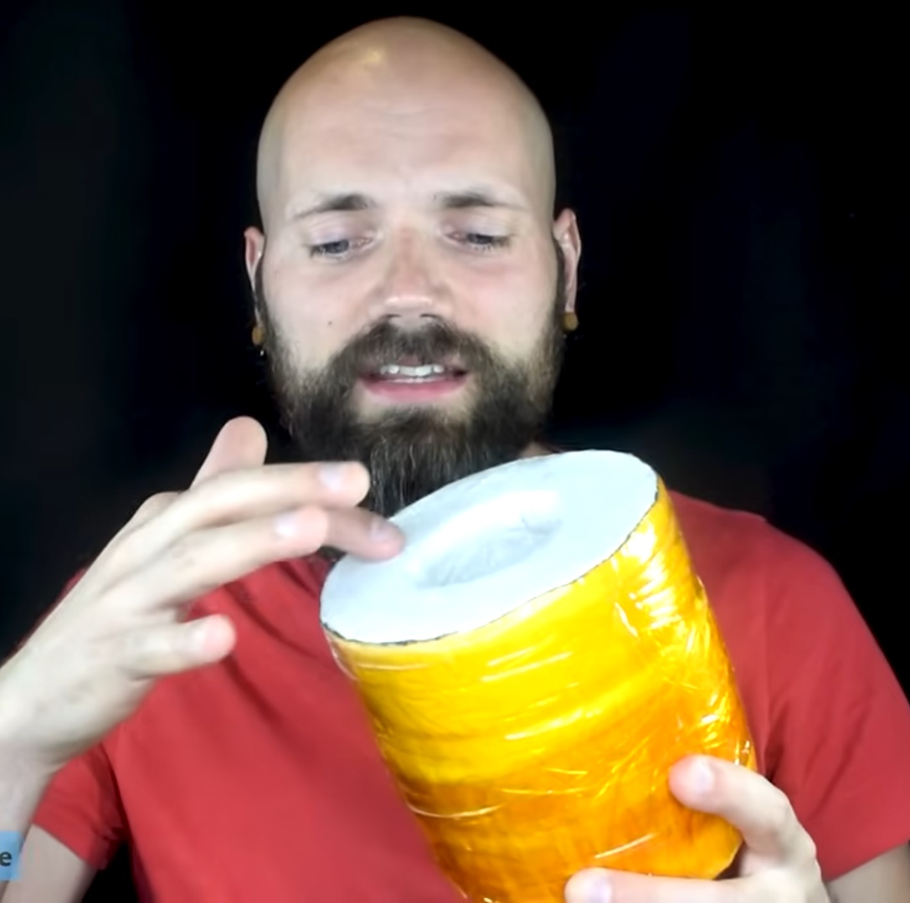
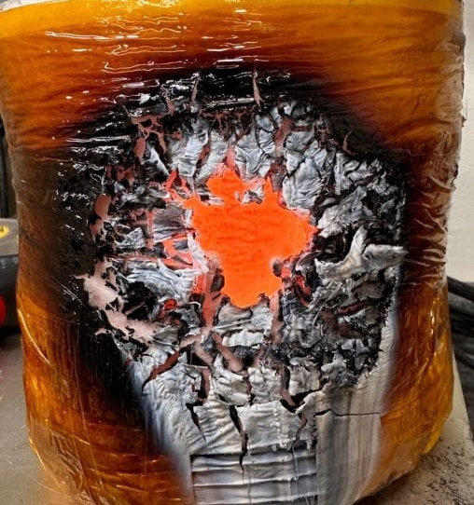
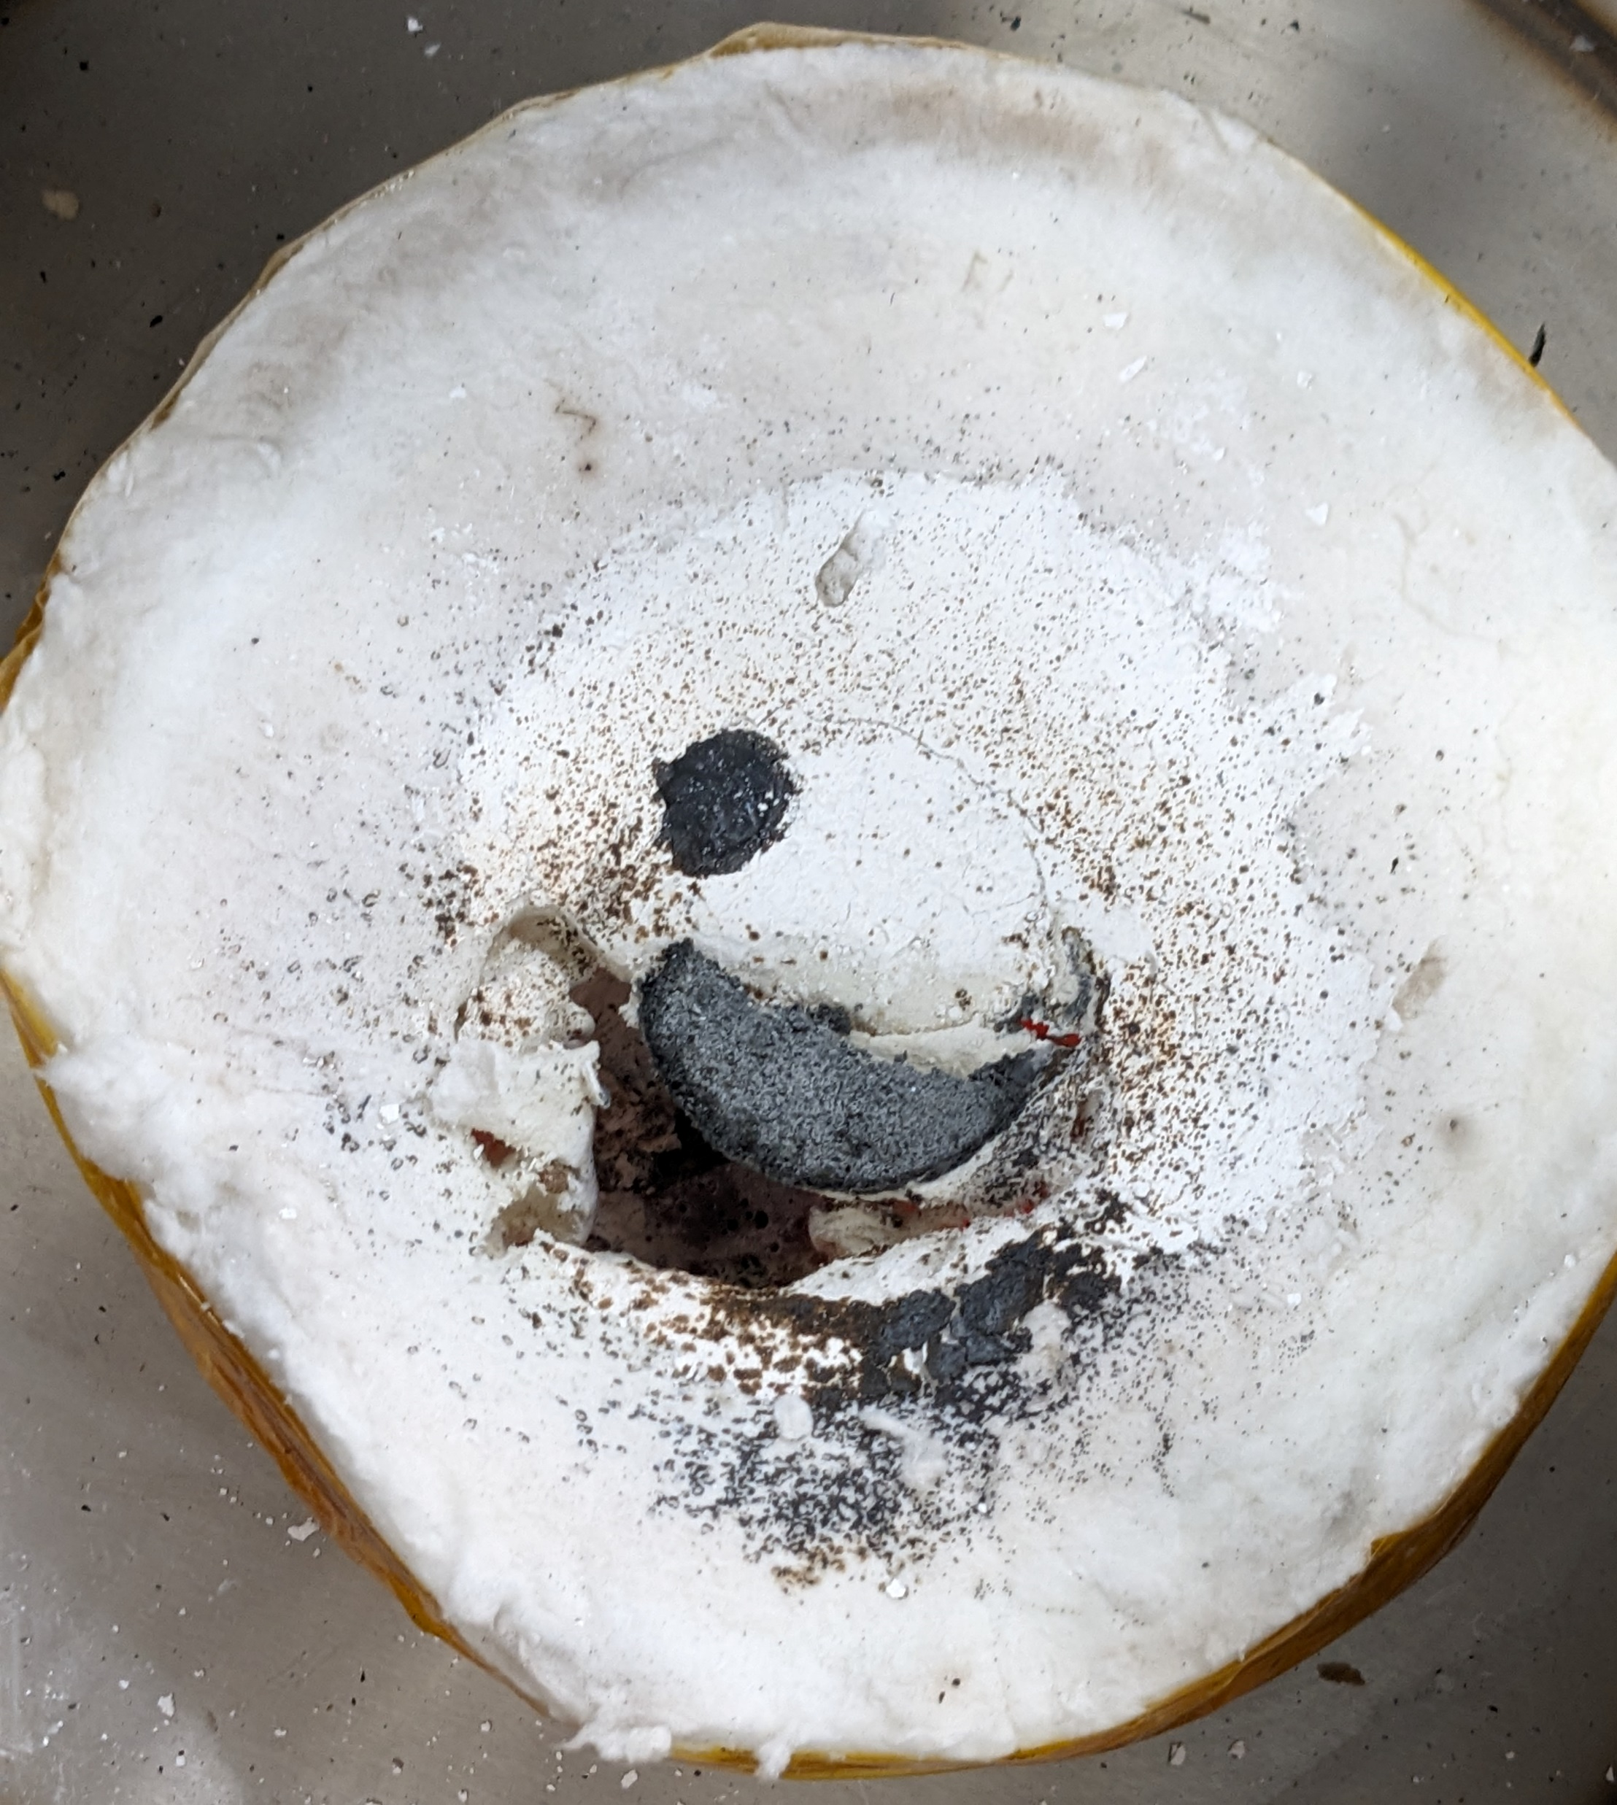
Insulation Casing
Insulation Casing
Based on design by YouTuber ShakeTheFuture [1]
Ceramic fiber held in place with dielectric tape
Largely transparent to microwaves
Hardened with boric acid
Alumina minimizes sticking
Inexpensive to make
$35 each
Improvements
Higher temperature rating
1650°C
Improved anti-sticking
Solid bottom
Both increase price
Estimated $700 each
(ShakeTheFuture 2023)

Slide 17
Conveyance System
Flexibility
Adaptable to wide range of applications
Accessible
System Specifications
Maximum Load: 15 kg
Powered via stepper motors and pulley system
12-V, 6-A DC power supply
Aluminum extrusions and 3D-printed components
Notes:
Flow chart for logic.
Weight calculated lifted by steppers. How much do they weigh. - 15kg
Power drawn (12v, 6A) - Consumes 34.5W power under maximum load
Adaptability. Flexibility. Low Power. Low Cost. - Ours was designed with Accessibility in mind
Weight of entire system. -

Slide 18
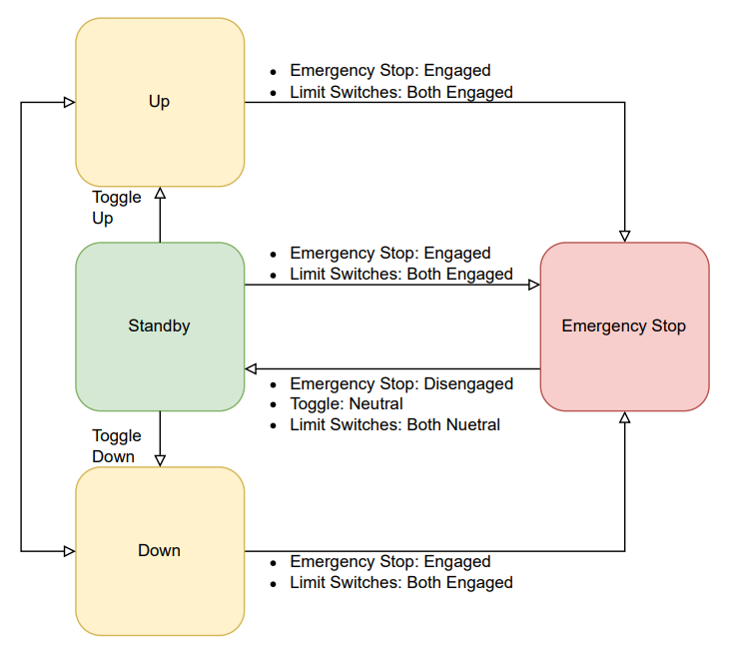
Conveyance System
System Logic
Toggle switch and Emergency stop button for control
Arduino state-based logic

Slide 19
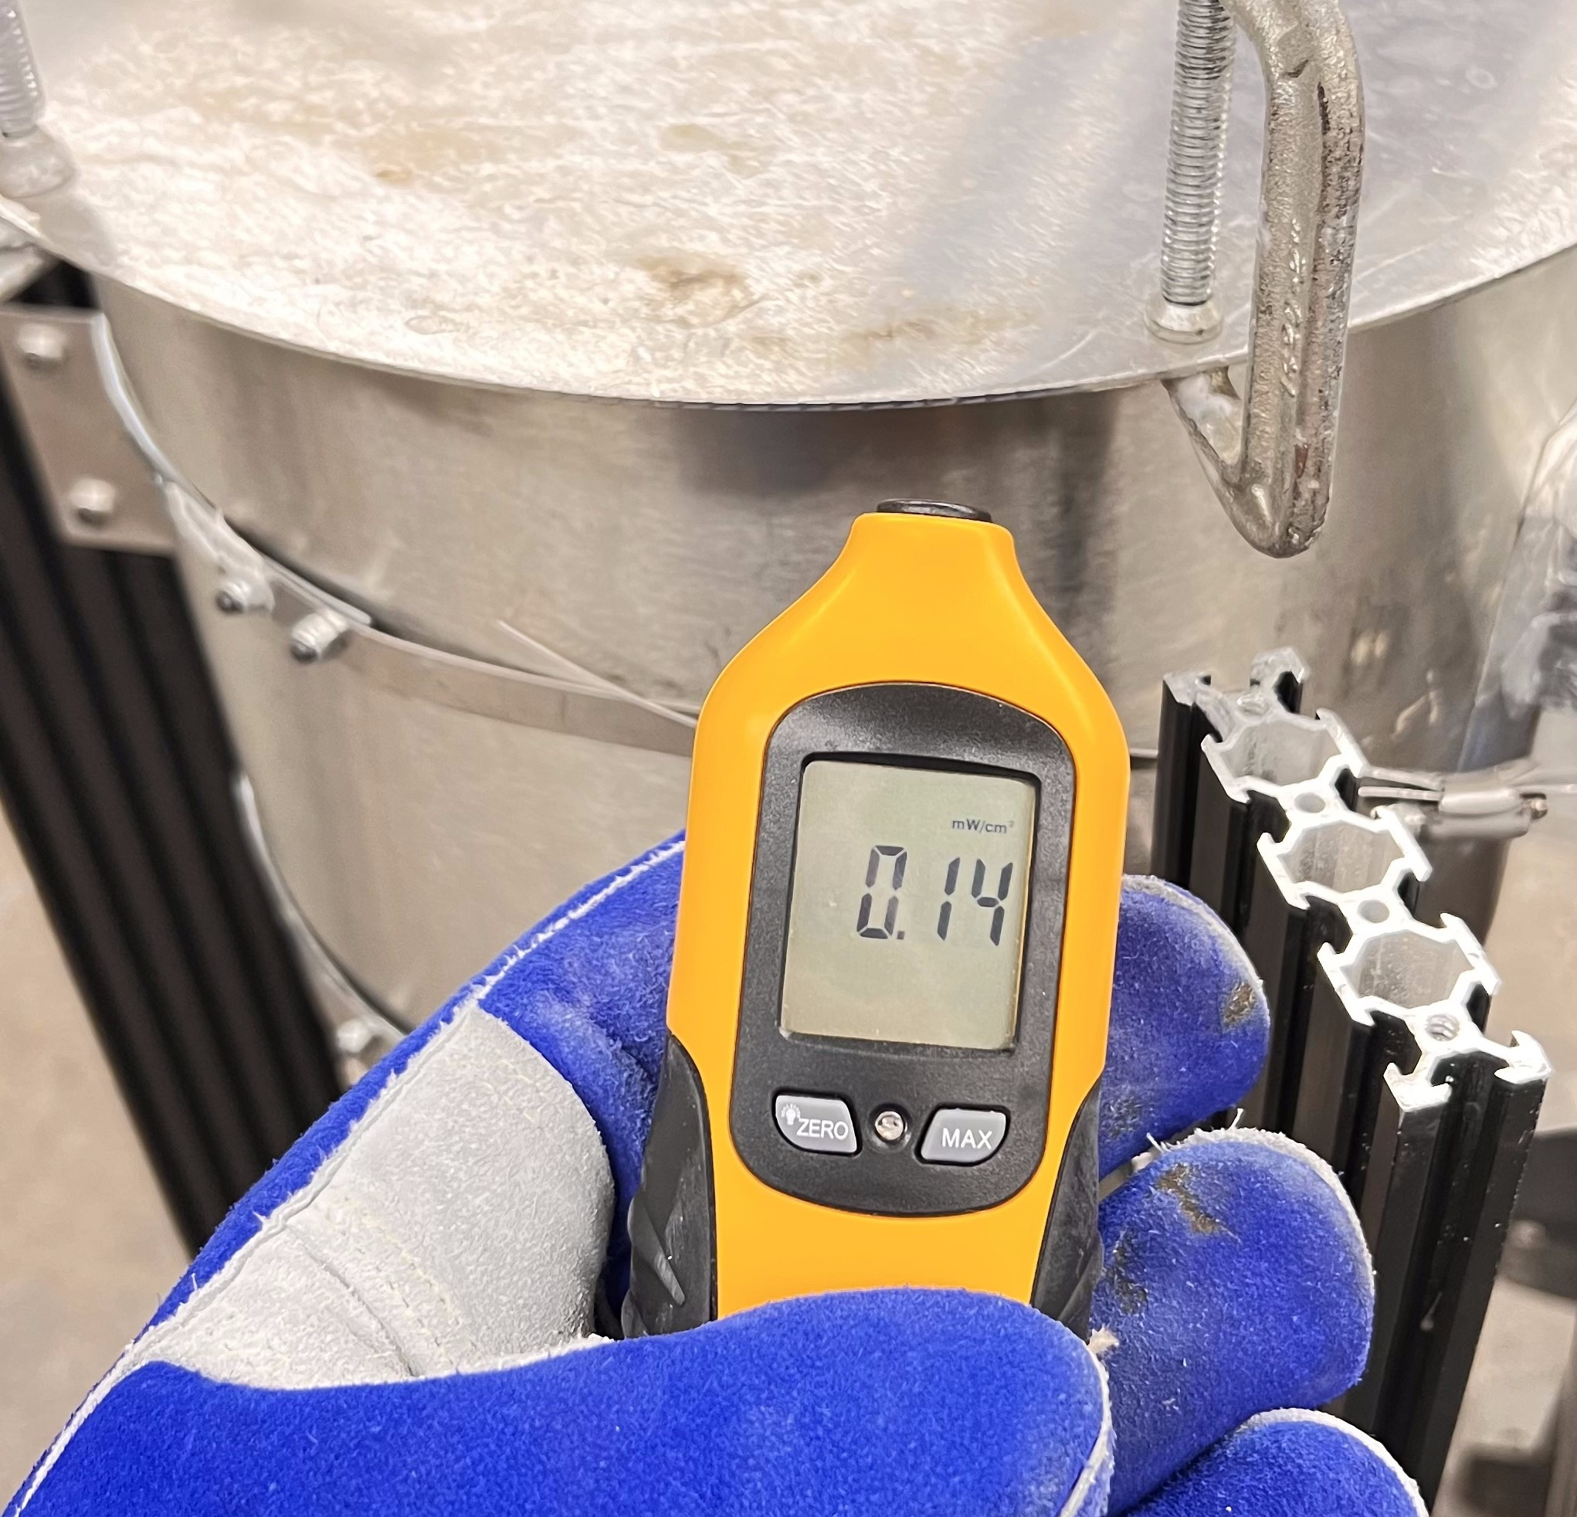
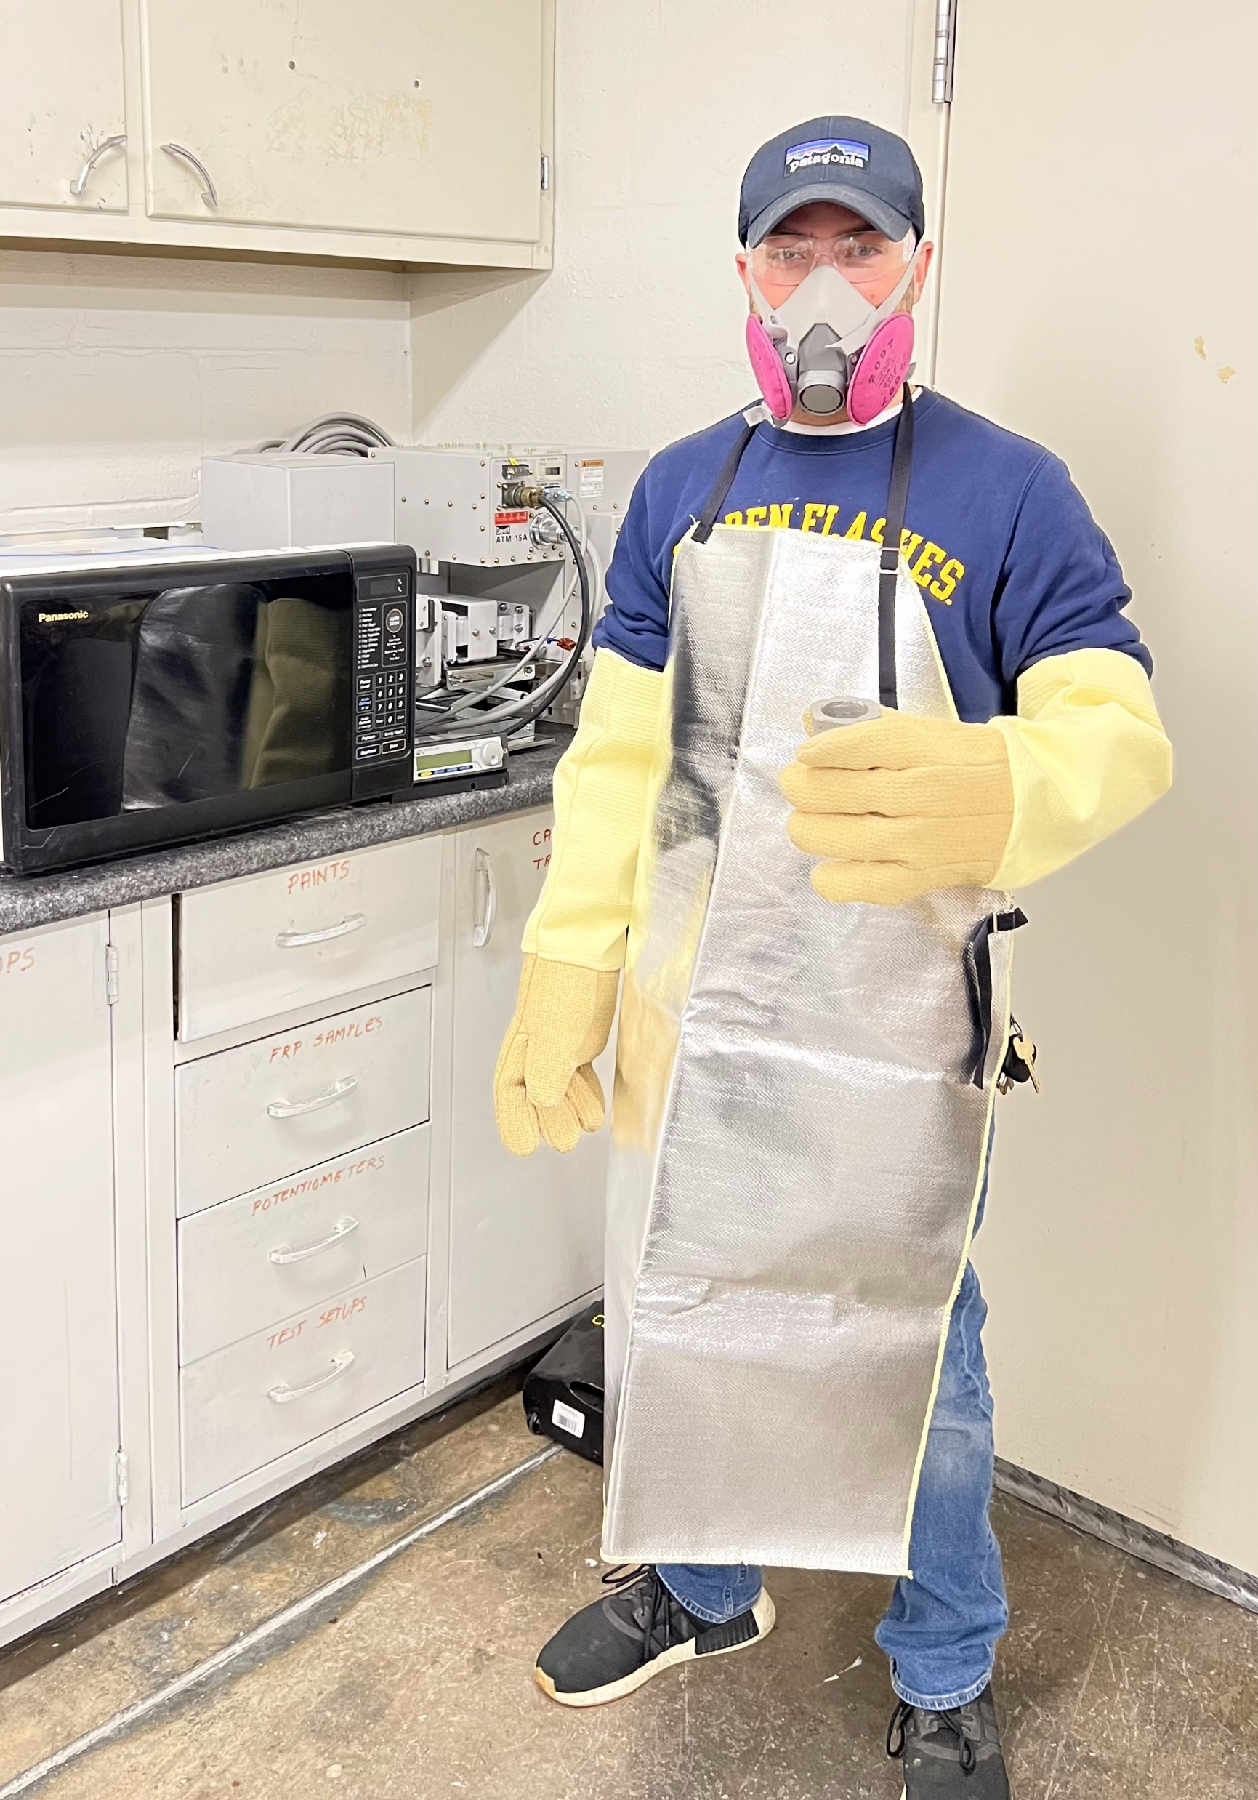
Testing Process: Preliminary Safety Check
Equipment
PPE – high-temperature gloves and aprons, safety glasses
Microwave leakage detector
Pre-Test Safety Check Procedure
Run MW source at low power (500 W)
Check for reflectance
Turn off, file down any heat-induced imperfections in conductive epoxy adhesion
Repeat until reflectance is minimized
Ensure leakage is at safe levels
Proceed to testing
Notes:
Safety prepping:
PPE – aprons, hi temp gloves, safety glasses
Run empty chamber test to check for reflection and/or leakage
File WG inside to make it calm down
Clamp top w c clamps to ensure no leakage
- measure crucible mass beforehand
- measure sample mass
- record starting temp
- run test for desired time for given mass
check for leakage in beginning
make sure reflectance is down
continually run the MW detector so we don’t get boiled inside
- take temperature immediately after we uncover it
If it can pour out, we measure recovered mass

Slide 20
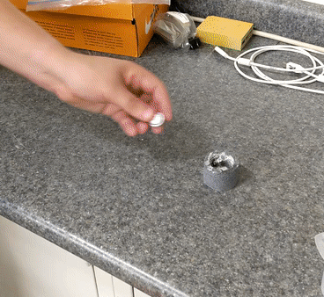
Testing Process: General Procedure
Sample and crucible are weighed
Crucible temperature is measured
Sample is placed in crucible
Crucible is positioned in insulation casing
Insulation casing is centered in resonance chamber
Chamber is closed & clamped
Notes:
Safety prepping:
PPE – aprons, hi temp gloves, safety glasses
Run empty chamber test to check for reflection and/or leakage
File WG inside to make it calm down
Clamp top w c clamps to ensure no leakage
- measure crucible mass beforehand
- measure sample mass
- record starting temp
- run test for desired time for given mass
check for leakage in beginning
make sure reflectance is down
continually run the MW detector so we don’t get boiled inside
- take temperature immediately after we uncover it
If it can pour out, we measure recovered mass

Slide 21
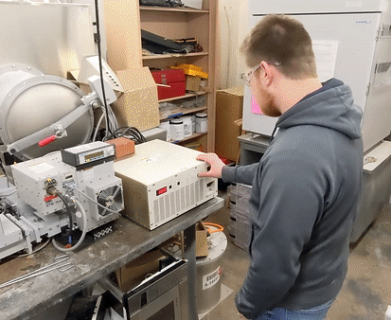
Testing Process: General Procedure
Sample is run at a given power level for a given time
Leakage is checked periodically using microwave leakage detector
At the end of cycle time, chamber lid and insulation top are removed
Sample’s temperature is measured using a Raynger 3i Plus IR Thermometer
Notes:
Safety prepping:
PPE – aprons, hi temp gloves, safety glasses
Run empty chamber test to check for reflection and/or leakage
File WG inside to make it calm down
Clamp top w c clamps to ensure no leakage
- measure crucible mass beforehand
- measure sample mass
- record starting temp
- run test for desired time for given mass
check for leakage in beginning
make sure reflectance is down
continually run the MW detector so we don’t get boiled inside
- take temperature immediately after we uncover it
If it can pour out, we measure recovered mass

Slide 22
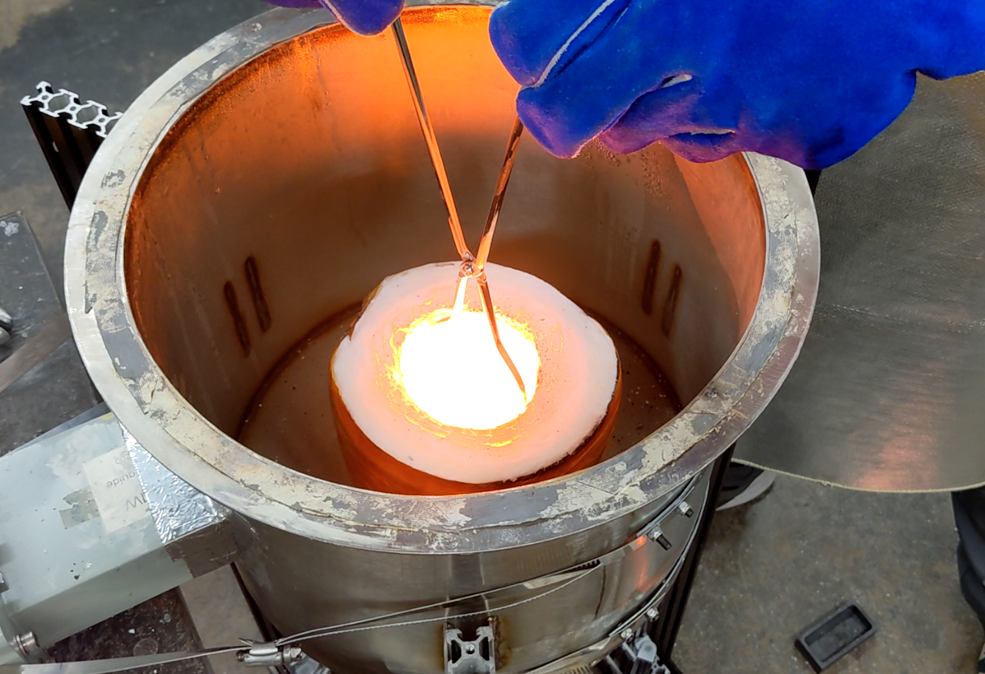
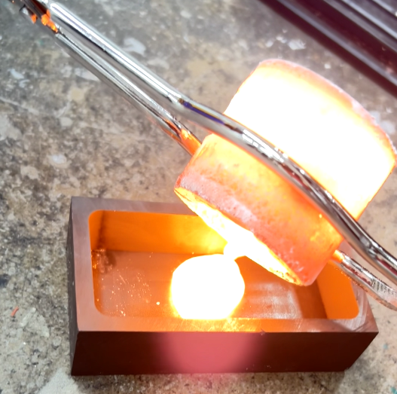
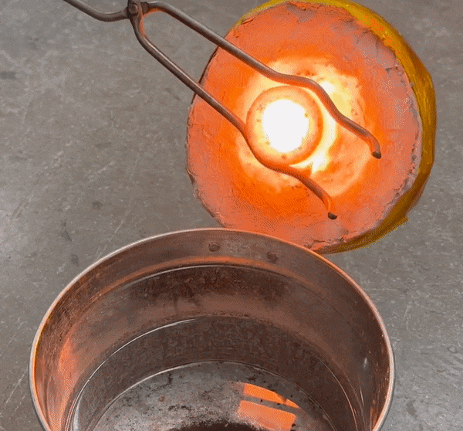
Testing Process: General Procedure
Molten sample is poured into water or graphite mold to cool
Once cool, recovered material is weighed
Used crucible is set aside to cool
Using multiple crucibles enabled constant testing
Notes:
In case delete:
Sample is placed into insulation
Chamber is closed
Sample is run at a given power level for a given time
Consistently checking for microwave leakage
MW source is shut off
Chamber lid is quickly removed, followed by the insulation
Temperature is taken and recorded
Melted sample is poured – left to cool
Upon cooling, recovered mass is measured and recorded
Repeat, rotating crucibles to avoid wear

Slide 23
Testing Process: Test Variables
Power–Duration combinations tested
 | 1000 | 1200 | 1500
2:30 | Al | Al
5:00 | Al, Ilm | Al, Ilm | Al, Ilm
7:30 | Al | Al | Al, Ilm
10:00 | Ilm | Ilm | Al, Ilm(2)
15:00 | Ilm(2) | Ilm
Duration (mm:ss)
Power (W)
Notes:
Safety prepping:
PPE – aprons, hi temp gloves, safety glasses
Run empty chamber test to check for reflection and/or leakage
File WG inside to make it calm down
Clamp top w c clamps to ensure no leakage
- measure crucible mass beforehand
- measure sample mass
- record starting temp
- run test for desired time for given mass
check for leakage in beginning
make sure reflectance is down
continually run the MW detector so we don’t get boiled inside
- take temperature immediately after we uncover it
If it can pour out, we measure recovered mass

Slide 24
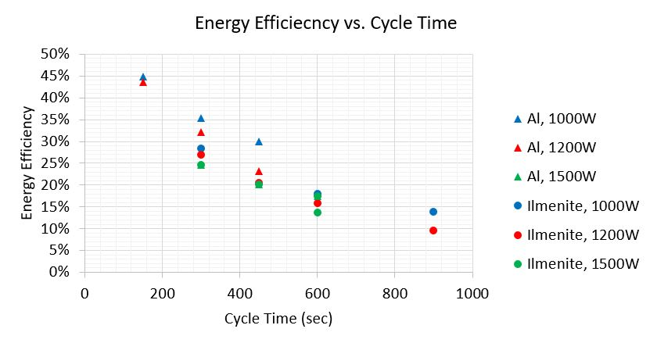
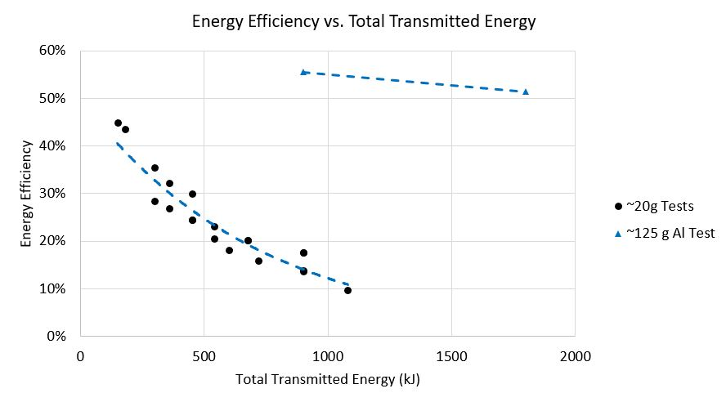
Results: System Efficiency
A
Energy Efficiency vs. Cycle Time (A)
Energy Efficiency vs. Transmitted Energy (B)
Note the differences between the 20-g and 125-g tests
Energy Efficiency vs. Cycle Power (C)
Aluminum performed better at lower power level
C
B
Notes:
C makes sense because with ilmenite, we need as much power as we can get, but with aluminum, the longer but slower cycles gave more time for the crucible to conduct heat into the material

Slide 25
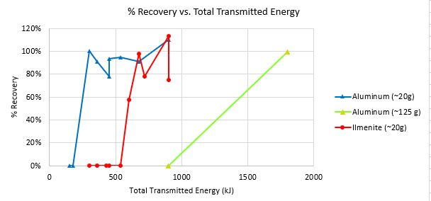
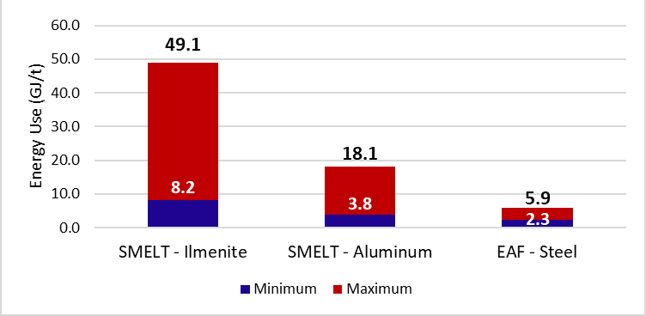
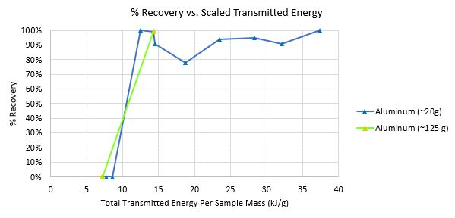
Results: Time-to-melt
% Recovery vs. Transmitted Energy (A)
Can approximate cycle times
% Recovery vs. Transmitted Energy Per Mass (B)
Controlling for mass supports feasibility of scaling
Energy to Melt: SMELT vs. Electric Arc Furnace (C)
Comparable with room for further improvement
A
C
B
*EAF data (Cappel, 2021)
Notes:
Specific Heats:
Steel: 0.466 J/g/K
Aluminum: 0.89 J/g/K
Ilmenite: 0.76 J/g/K
For C The max for us is when our crucible is much heavier than the load, minimum assumes no crucible at all (actual value when scaling will be closer to the minimum, but not reach it). This number is also skewed due to our shorter cycle times with smaller samples. A longer cycle time with a larger sample will allow more uniform conduction of the energy.
NOTE: If you control for the specific heat of the materials, we actually outperform the EAF

Slide 26
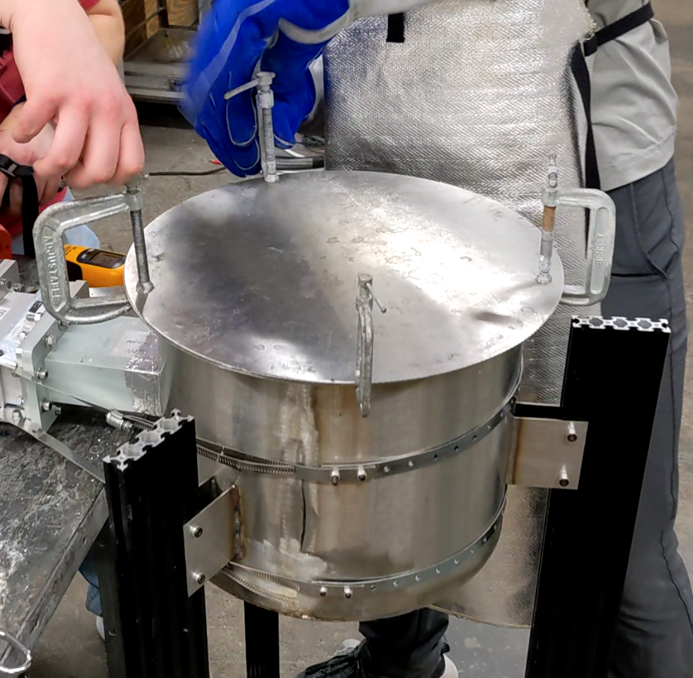
Path-to-Flight
Removing Insulation
Decrease material requirements
Chamber Material
Change to aluminum
Conveyance System
Integrating with other systems
Lunar Environment Testing
External temperature testing
Lunar environment hardening
RF Gasket and leakage Safety System
Current gasket insufficient
RF leakage safety system not developed

Slide 27
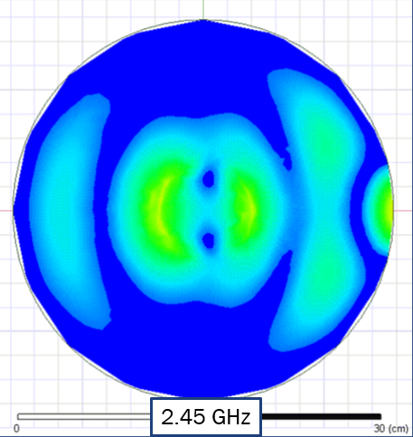
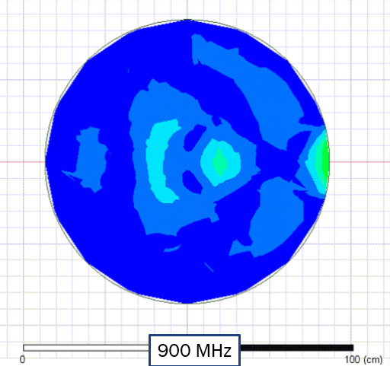
Scalability Option – Lower Frequency
Lower frequency may offer better scaling due to longer wavelength
2.45 GHz in 30-cm chamber behaves similarly to 900 MHz in 90-cm chamber

Slide 28
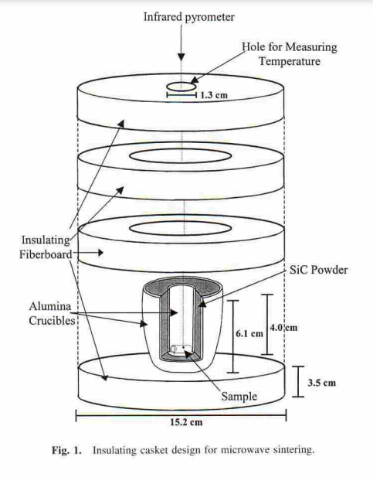
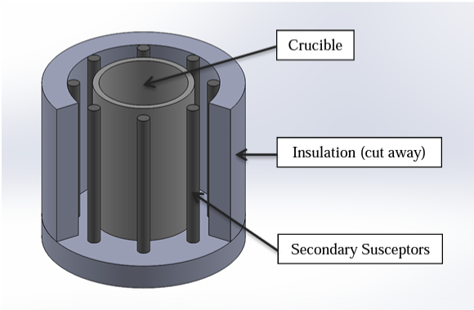
Crucible Development
Alternative methods have been tested by others
Surrounding a traditional crucible with SiC
Different arrangements of SiC and insulation
May increase crucible efficiency and longevity
Crucibles utilizing eccentric bottom tapping might enable continuous smelter operation
(Kirby 2017)
(Kirby 2017)

Slide 29
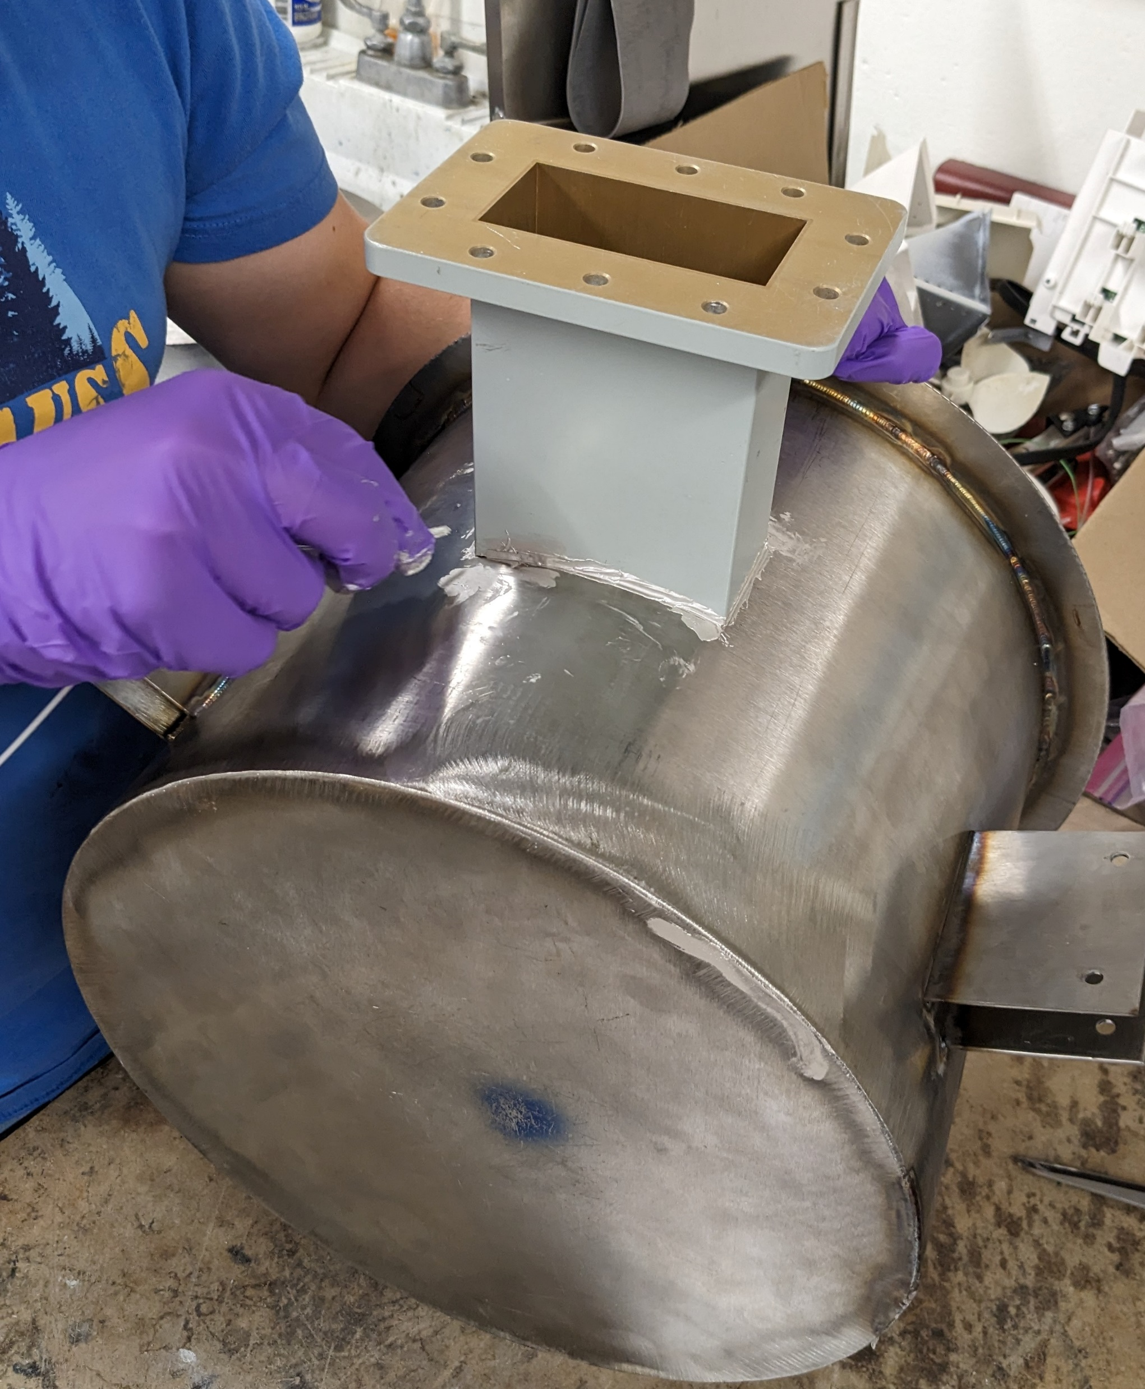
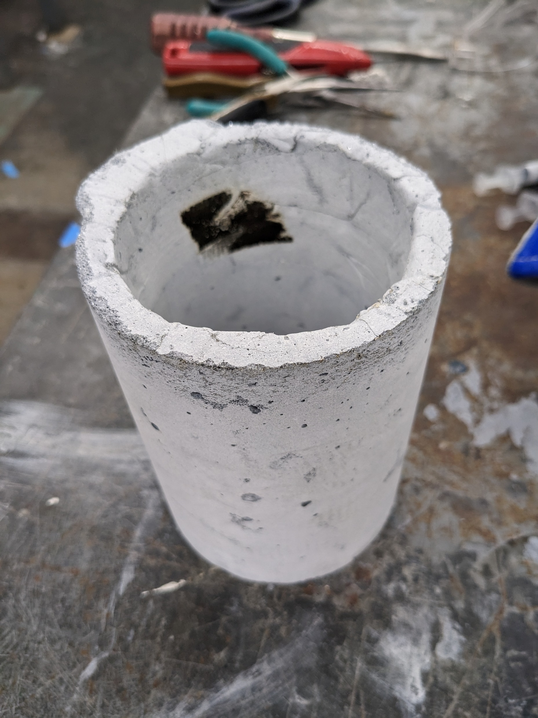
Summary
SMELT system is feasible alternative to electric-arc furnaces
Lightweight, compact, and low power
Scalability likely to be beneficial to performance
Integrates with broader lunar microwave infrastructure via ILUMEN

Slide 30
Discussion & Questions

Slide 31
Citations
[1] Denny, “Melt metals in the microwave | the ultimate guide,” YouTube, https://www.youtube.com/watch?v=P1VmIYheuU4&list=PLTOwAQHoaVgvl7fC2xK6O843JXv4Zg9CH&index=2&t=313s (accessed May. 17, 2023).
[2] B. W. Kirby, Alternative crucibles for U-Mo microwave melting - PNNL, https://www.pnnl.gov/main/publications/external/technical_reports/PNNL-26479.pdf (accessed Nov. 11, 2023).
[3] J. Cappel, “EAF Efficiency.” Cappel Stahl Consulting GmbH, Meerbusch, Nov. 2021

