Slide 2
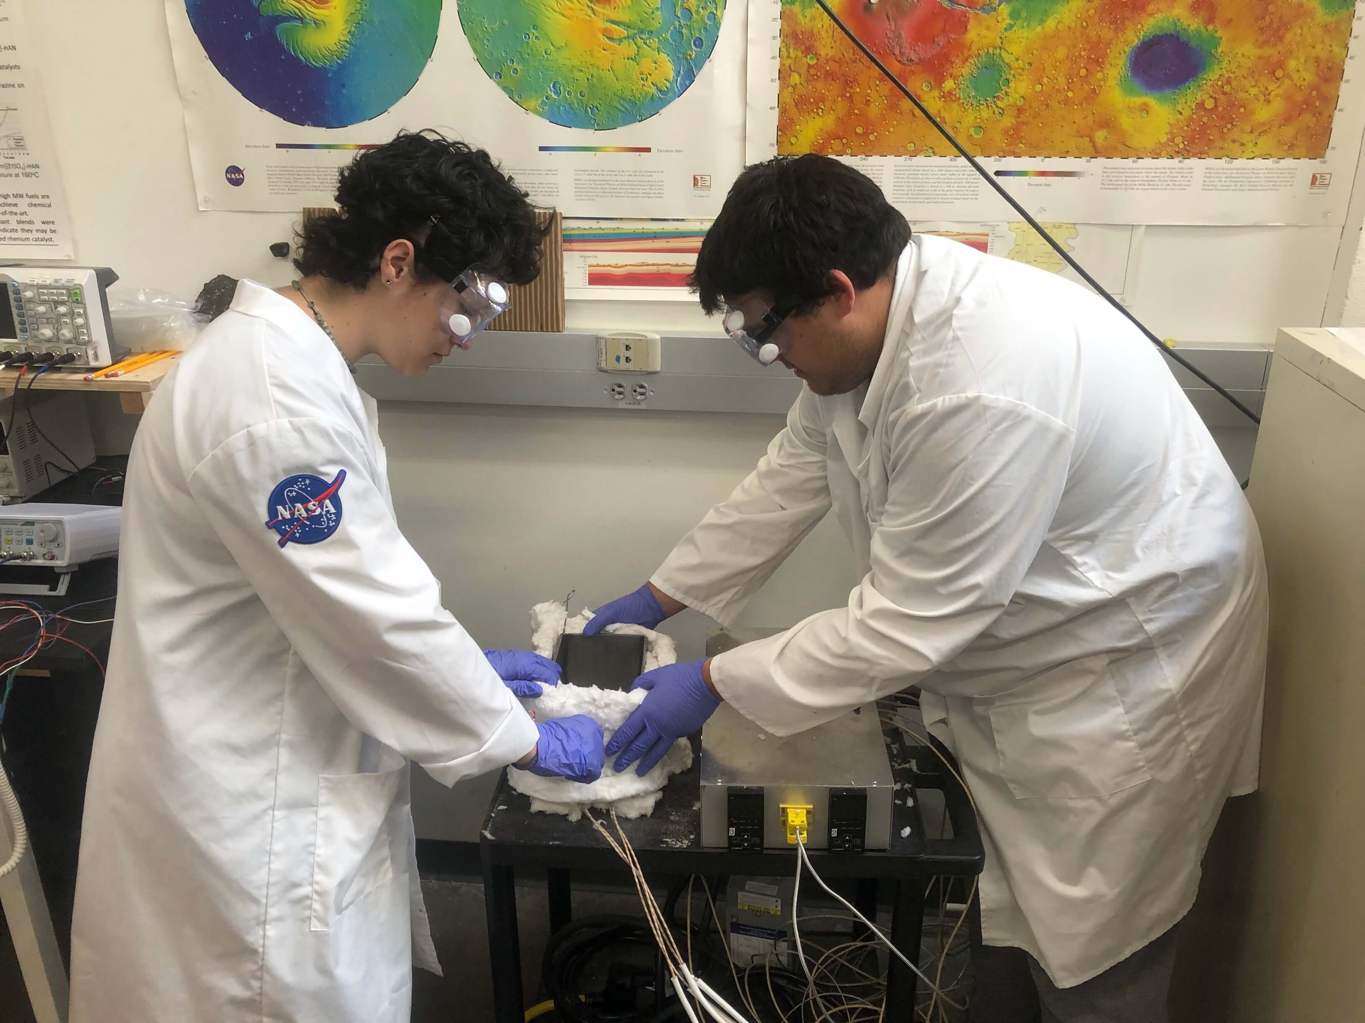
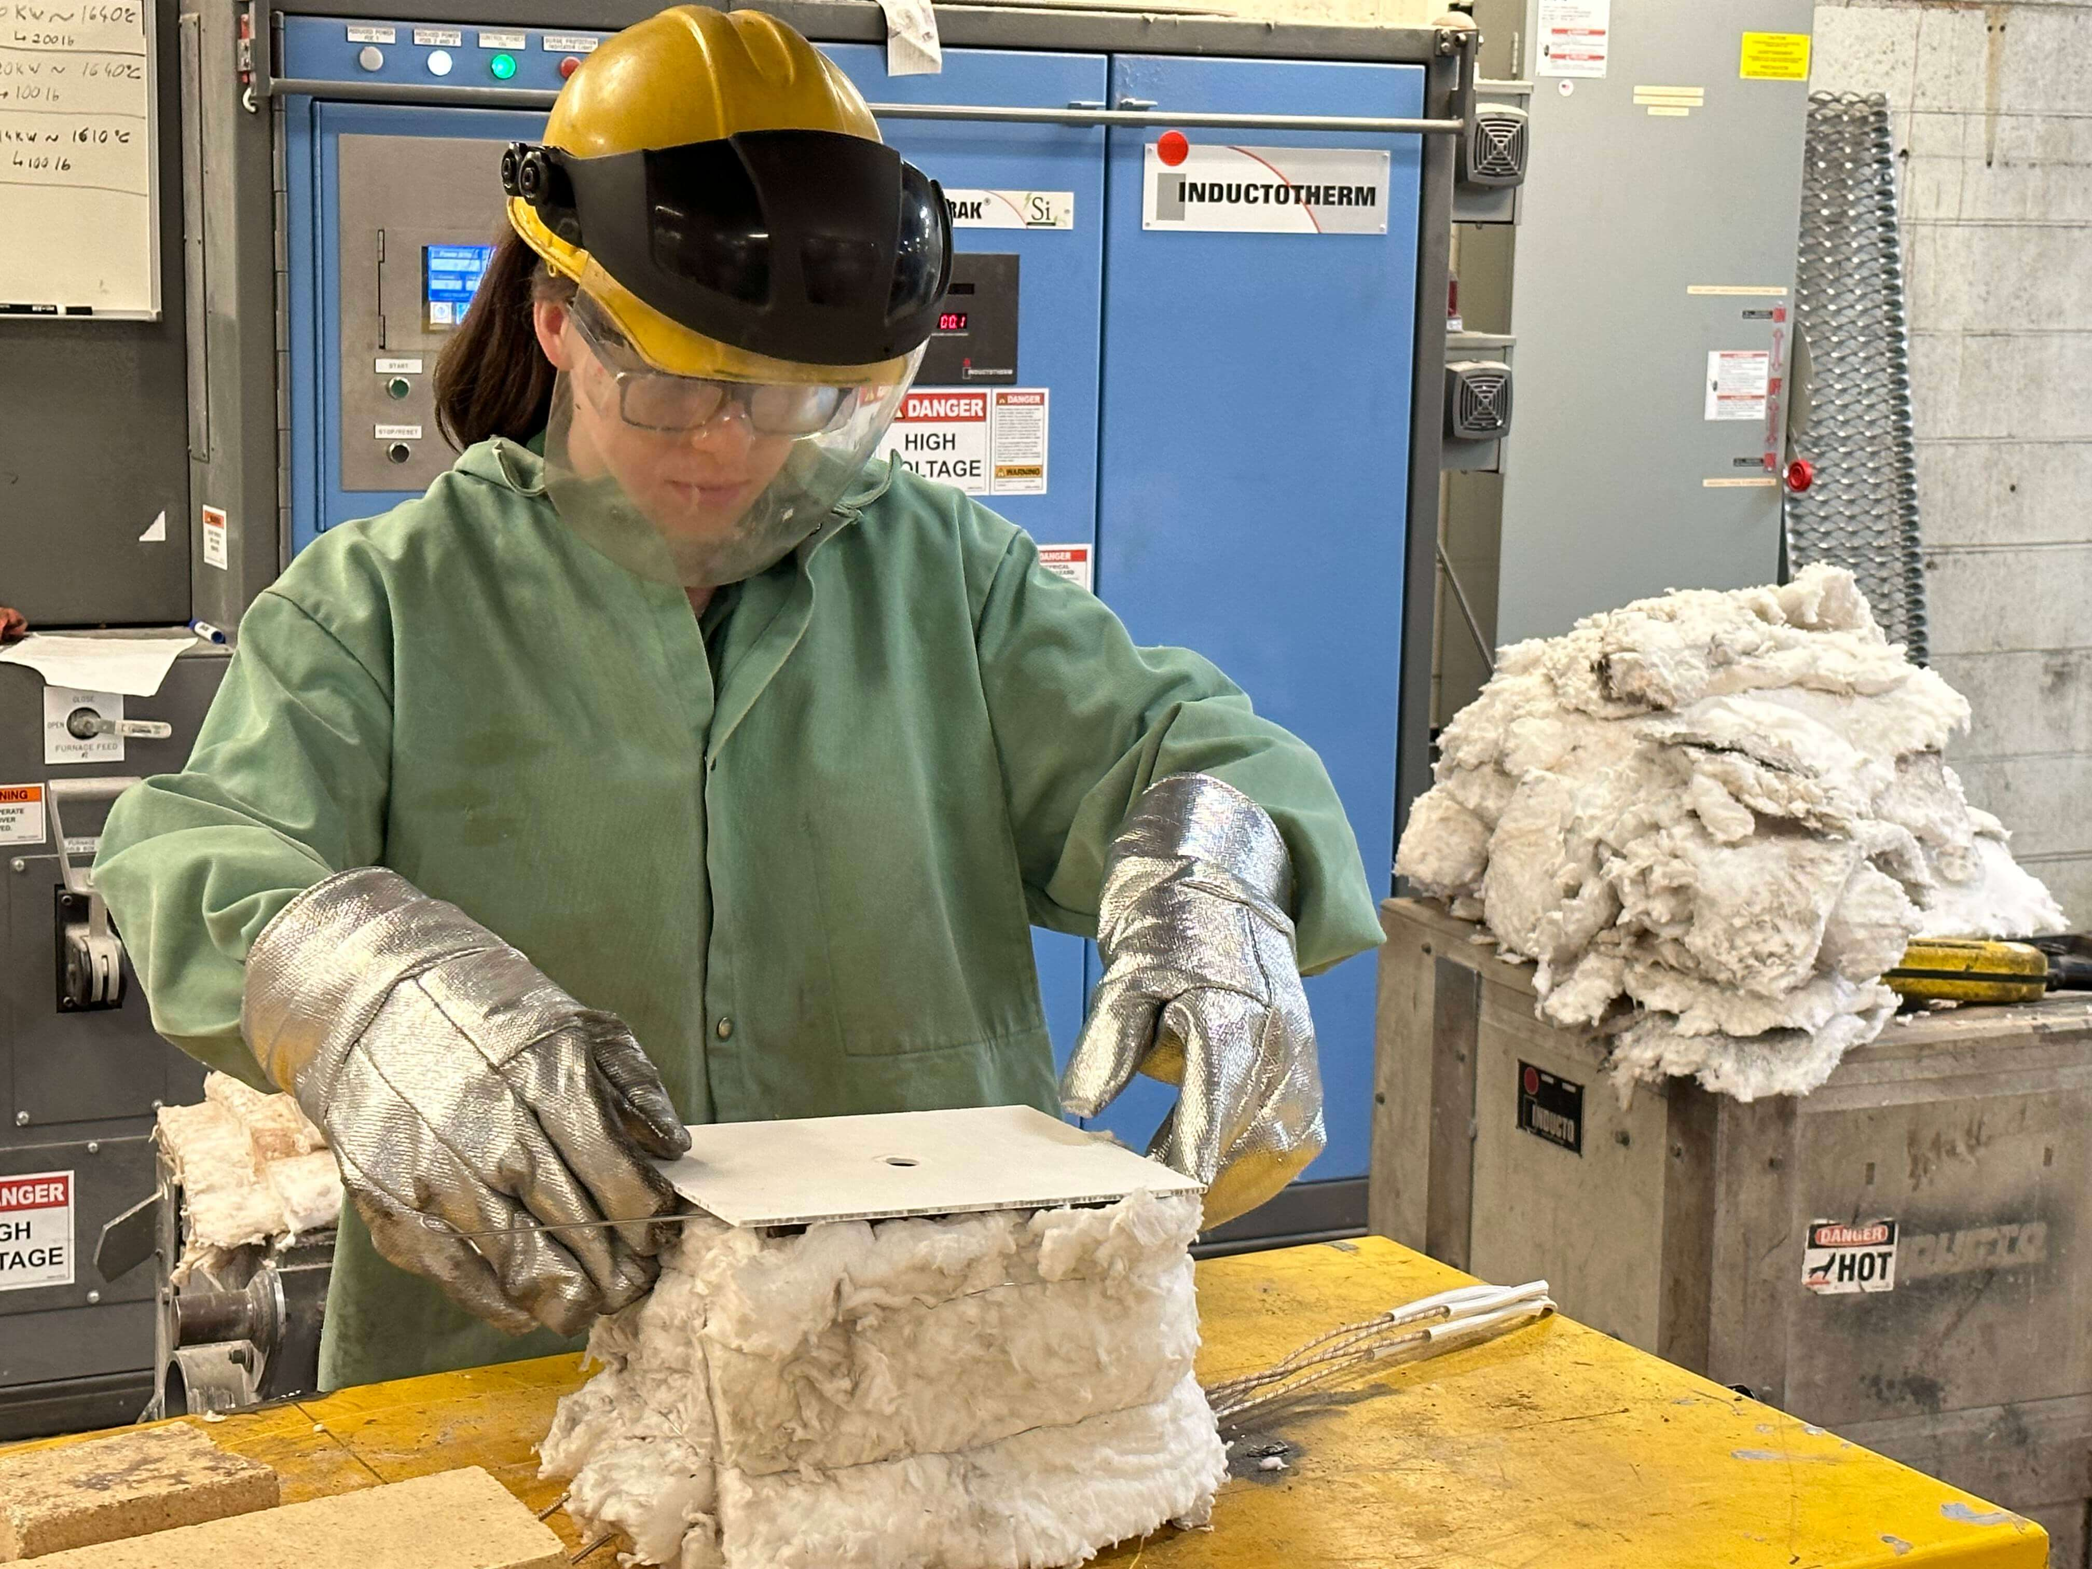
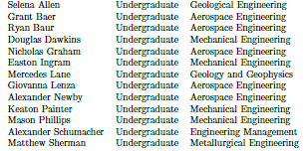
Lunar In-Situ Aluminum Production through Molten Salt Electrolysis
(LISAP-MSE)
J. N. Ortega, J. Smith, F. Rezaei, D. Bayless, W. Schonberg, D. Stutts, and D. Han (handao@mst.edu)
Missouri University of Science and Technology, Rolla, MO 65409
Undergrad Team Members:

Slide 3
Outline
Motivation
Background
LISAP-MSE Method Overview
LISAP-MSE Phase 1
LISAP-MSE Phase 2
Conclusions
Future Work

Slide 4
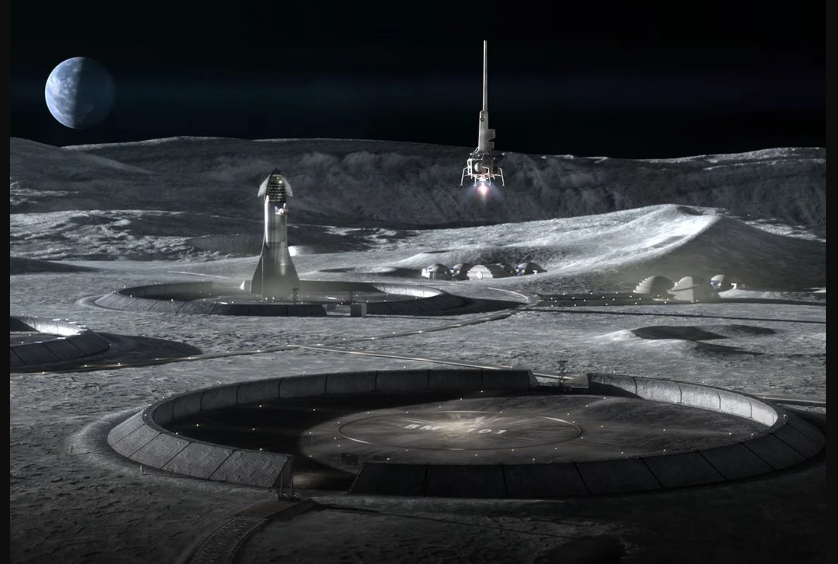
Motivation
Artemis Base Camp (ABC)
Additive Manufacturing
100% ISRU
Source: ICON/SEArch+

Slide 5
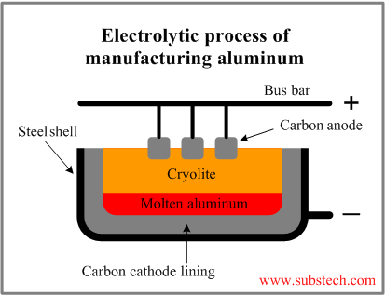
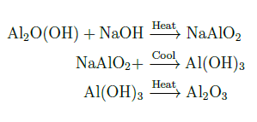
Terrestrial Methods
Current State of the Art
Bauxite (Al2O(OH))
Sodium aluminate (NaAlO2)
Aluminum hydroxide (Al(OH)3)
Alumina (Al2O3)
Cryolite (Na3AlF6)

Slide 6
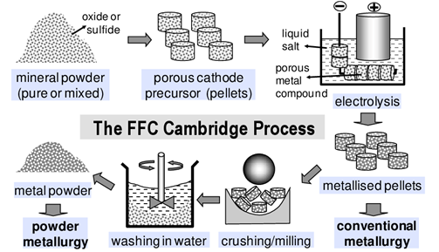
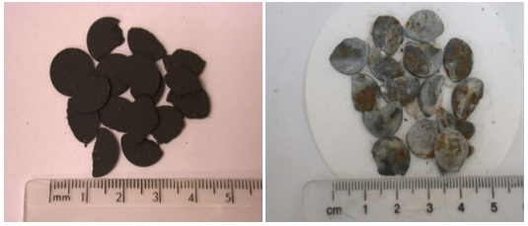
FFC Cambridge Method
Starting Point
Tested for Many Metallic Oxides
Chen et. al., 2013 [1]
Kilby et. al., 2006 [2]

Slide 7
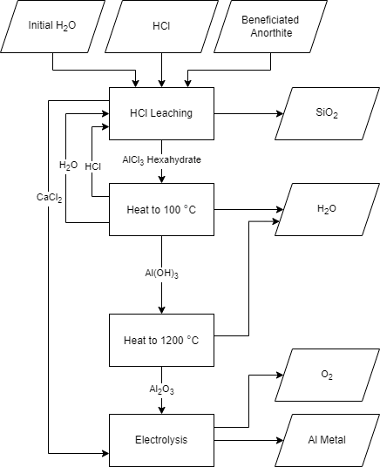
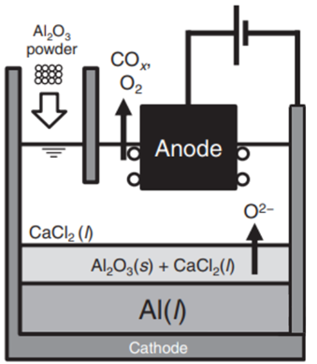
LISAP-MSE Method
Phase 1
Adapted from Kadowaki et. al., 2018 [3]
Phase 2

Slide 8
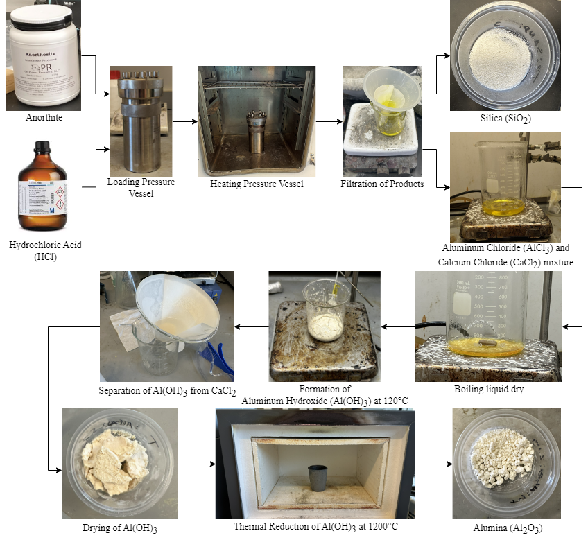
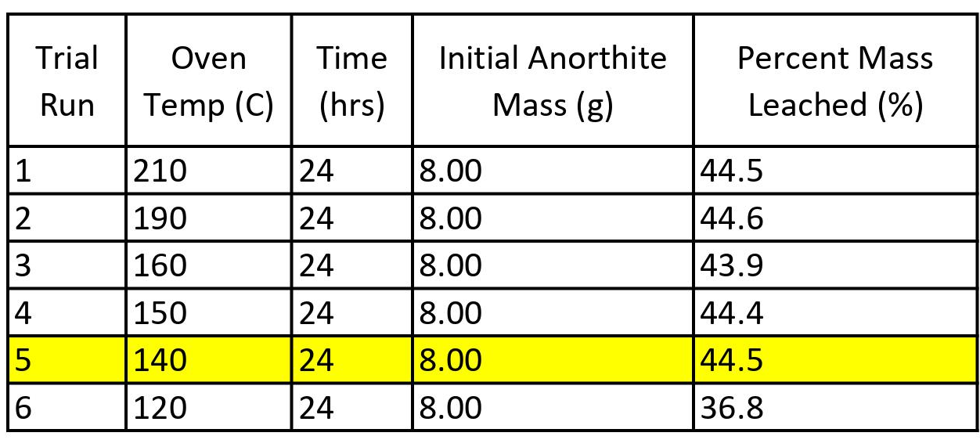
Leaching & Thermal Reduction Process (LISAP-MSE Phase 1)

Slide 9
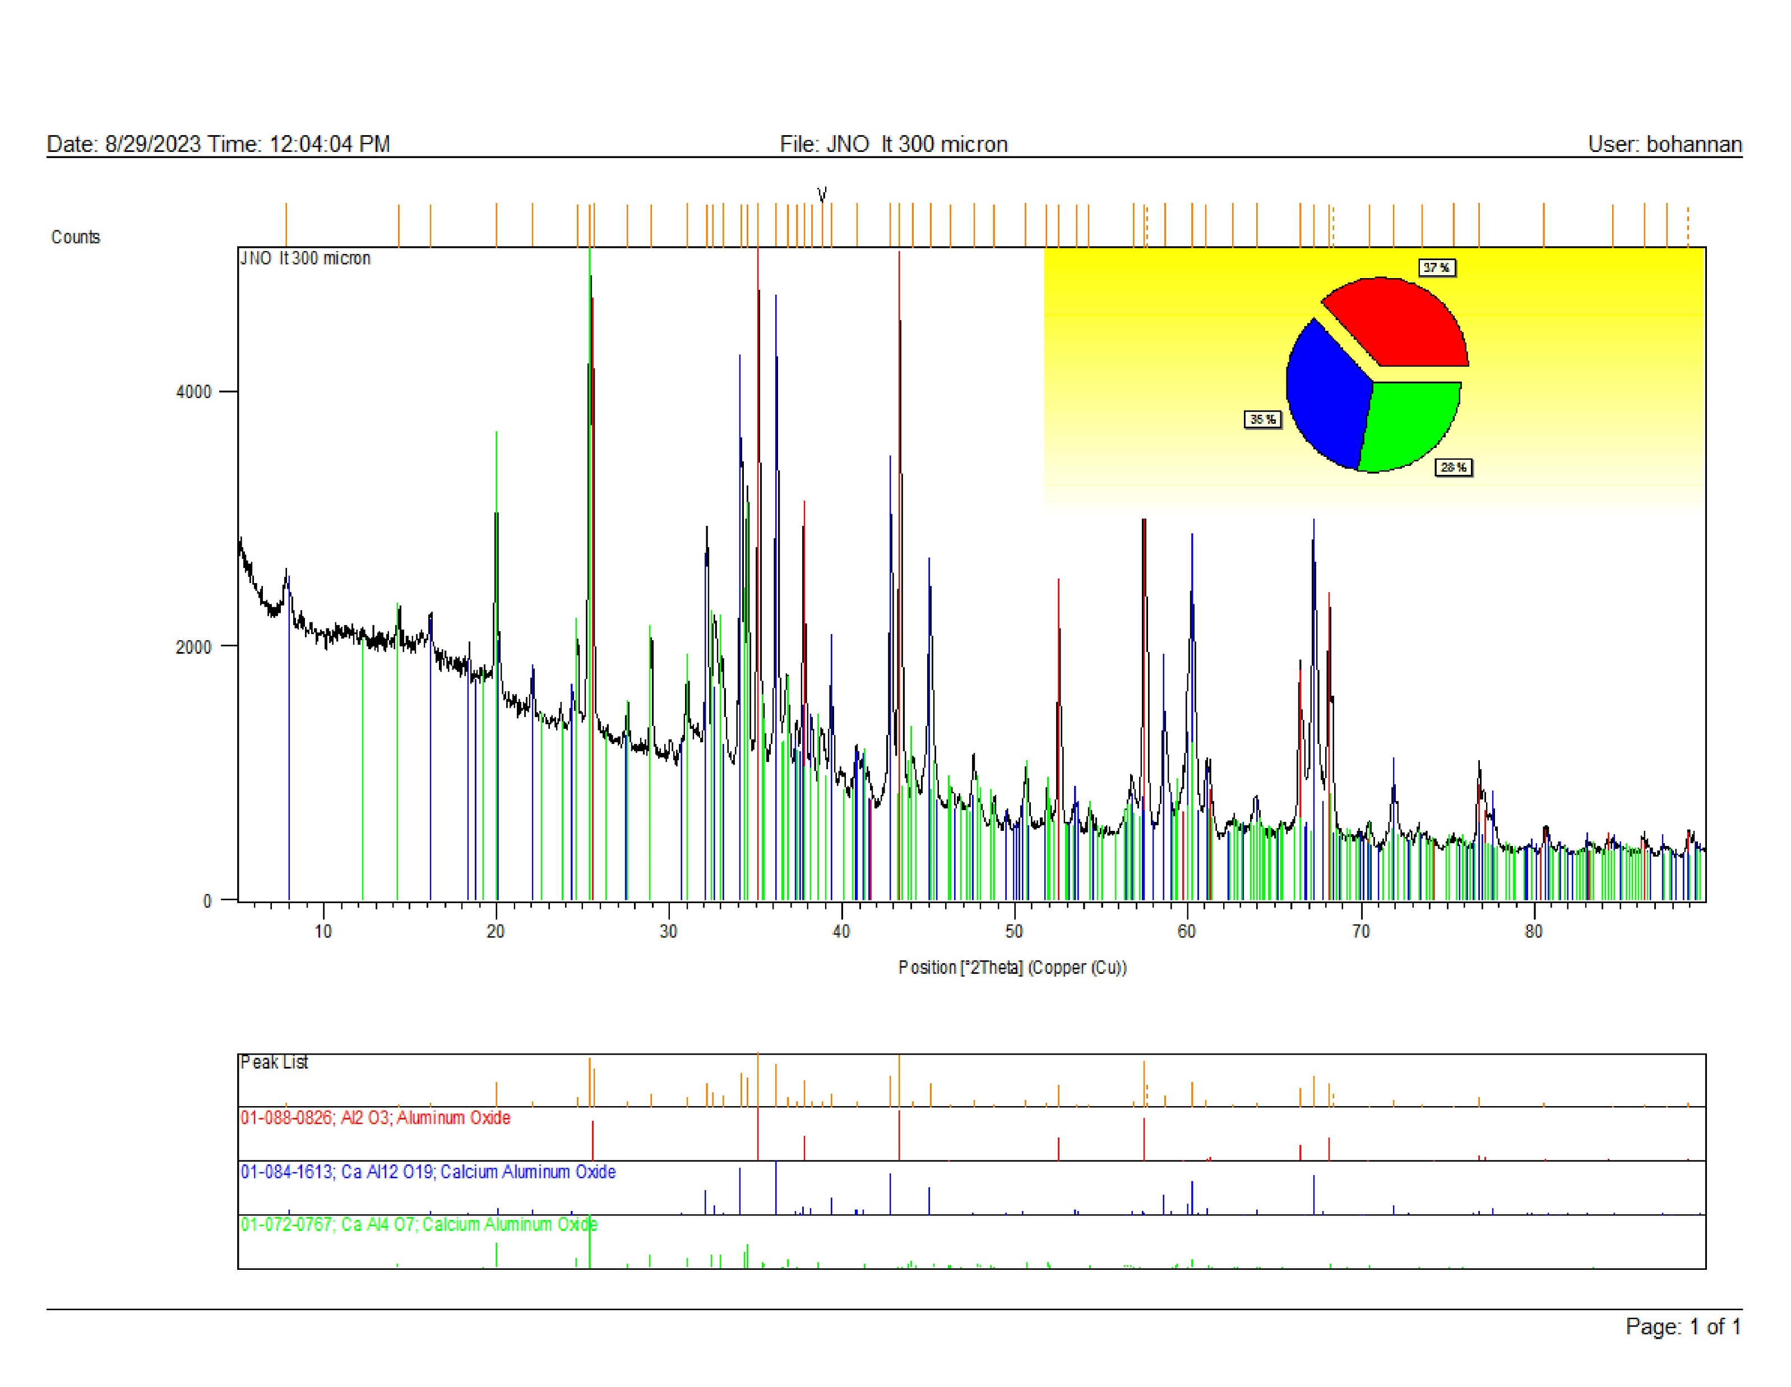

Leaching Characterization Data (Success)
7% Ca by Mass
35 %
* Hibonite: CaAl₁₂O₁₉
** Grossite: CaAl₄O₇

Slide 10
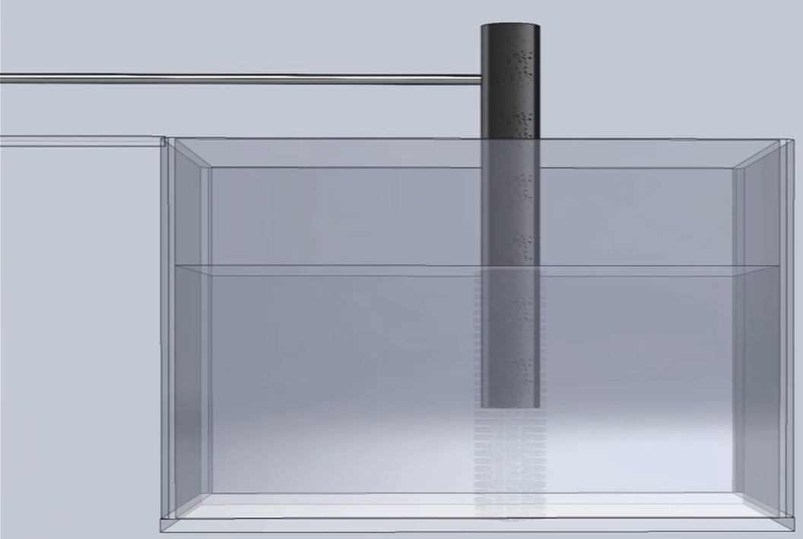
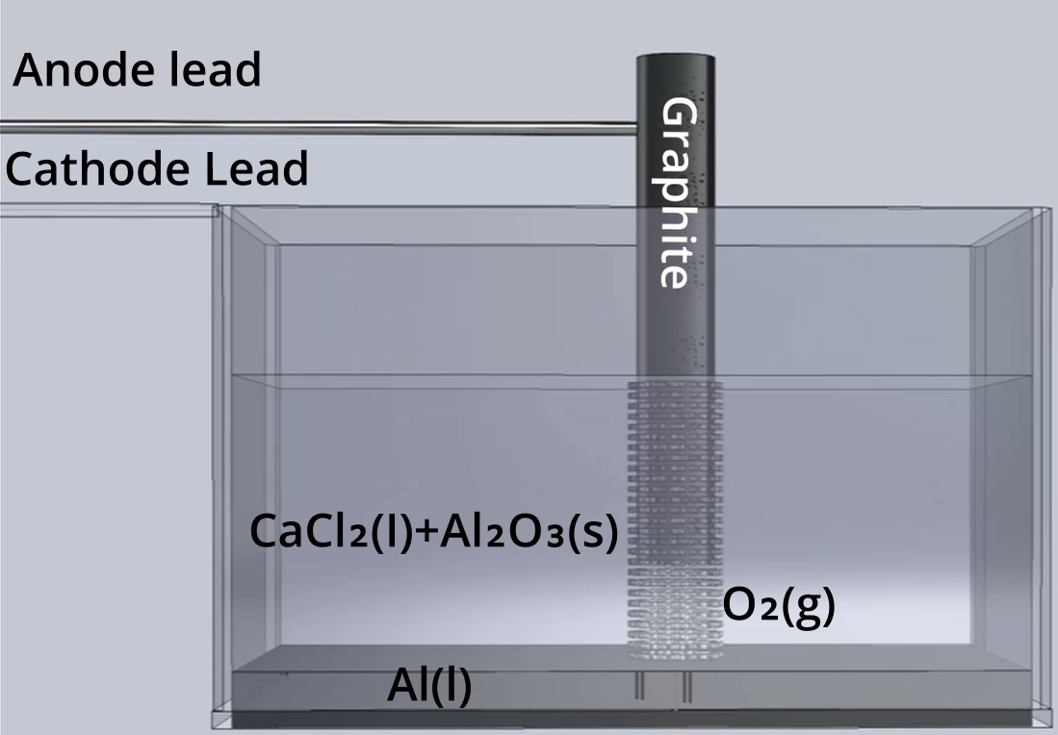
Electro-deoxidation Process (LISAP-MSE Phase 2)
Design validation
Test runs
Alternate test setups

Slide 11
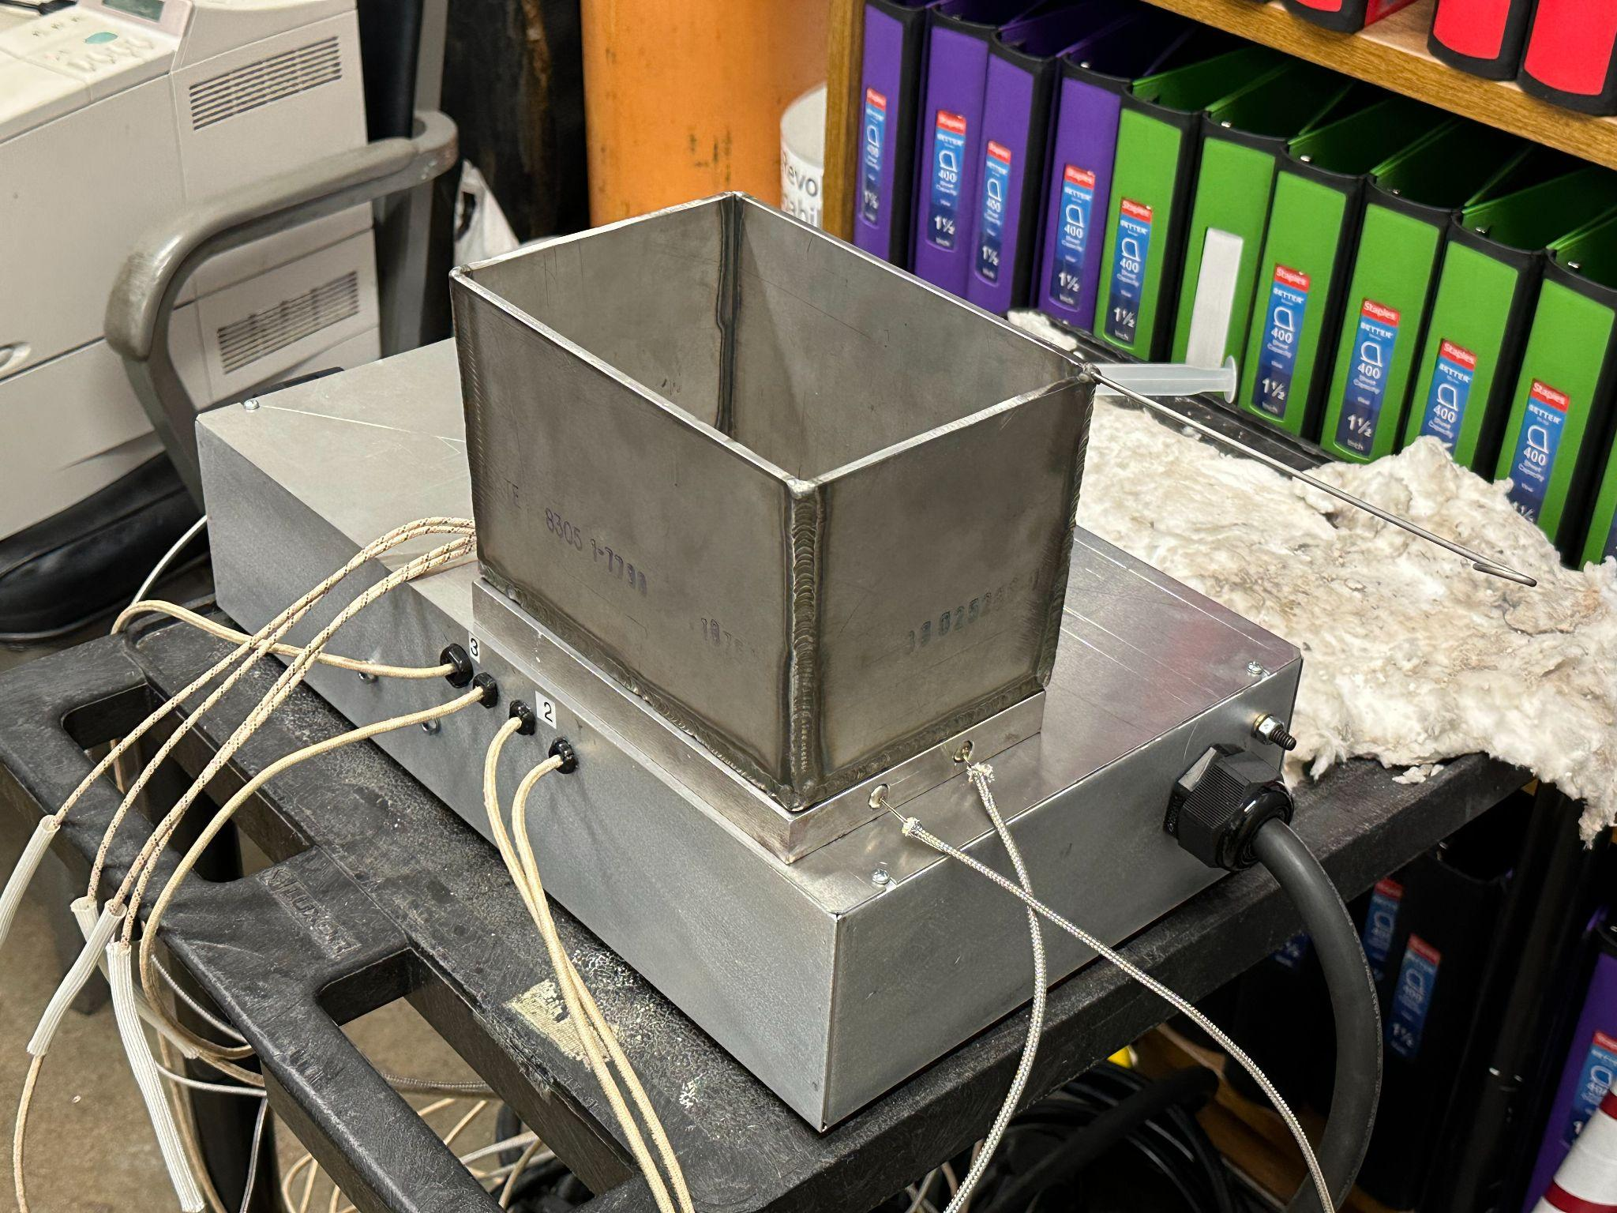
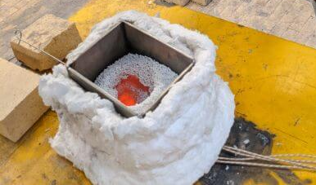
Basin Design & Heat Test

Slide 12
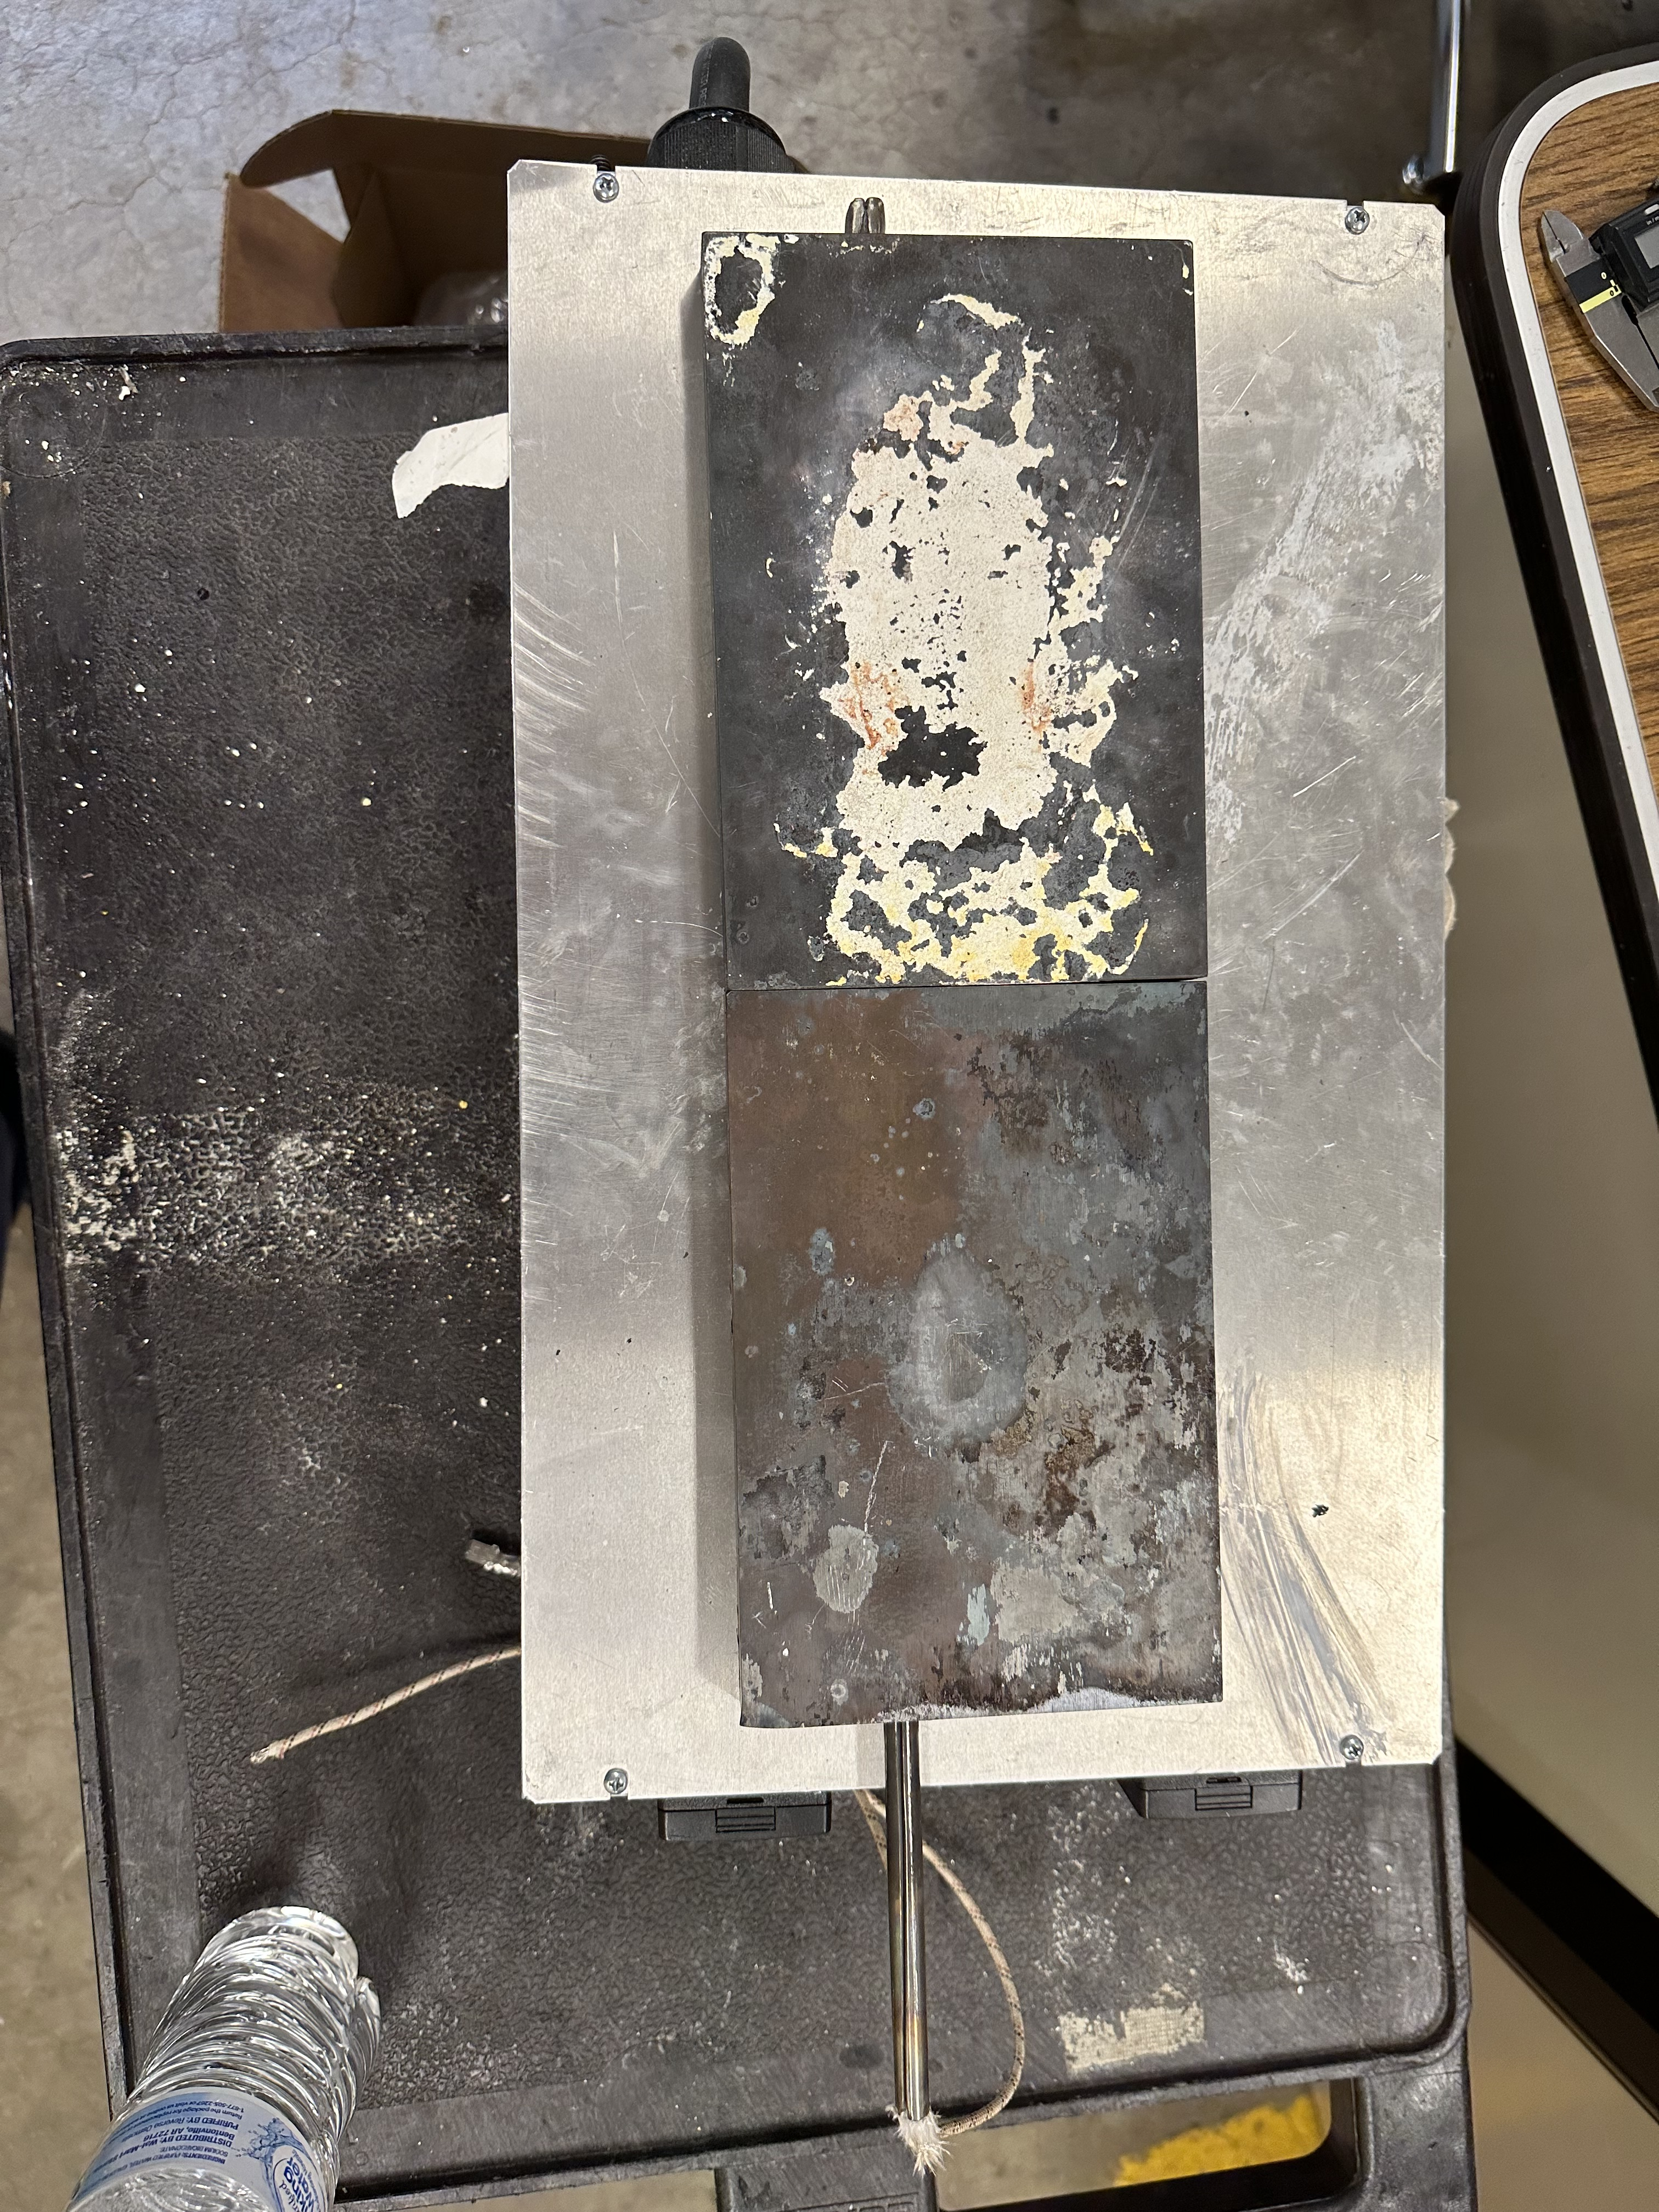
Heat Test Result

Slide 13
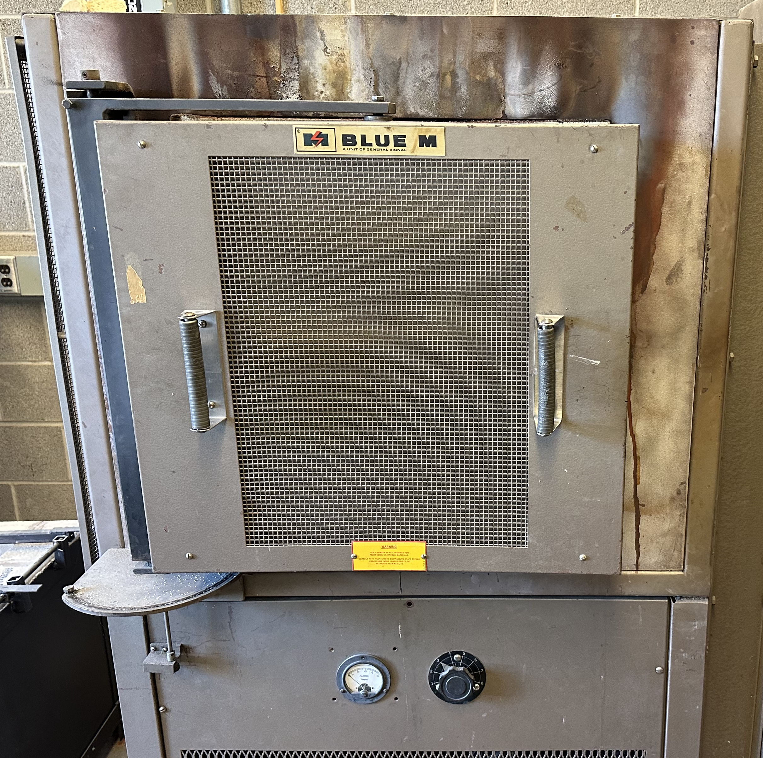
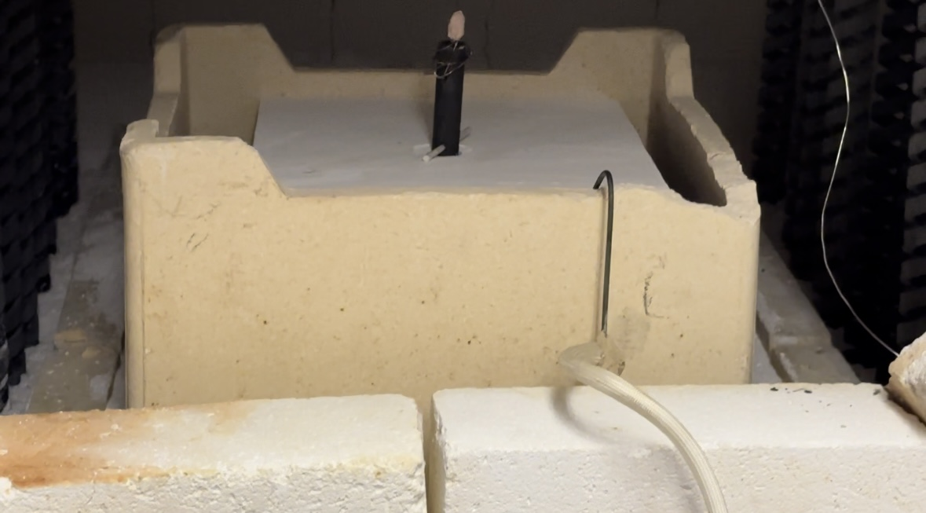
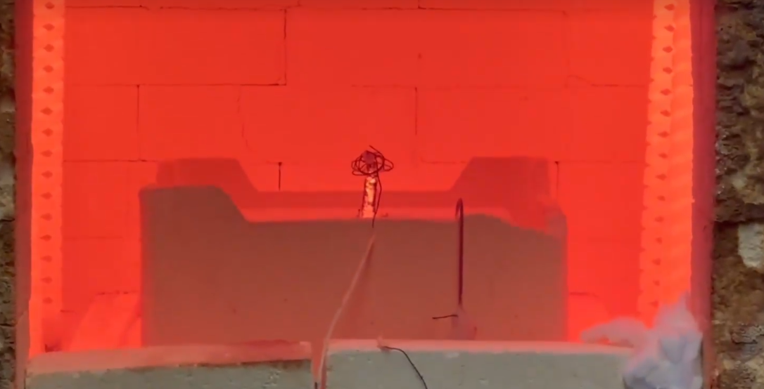
Furnace Testing

Slide 14
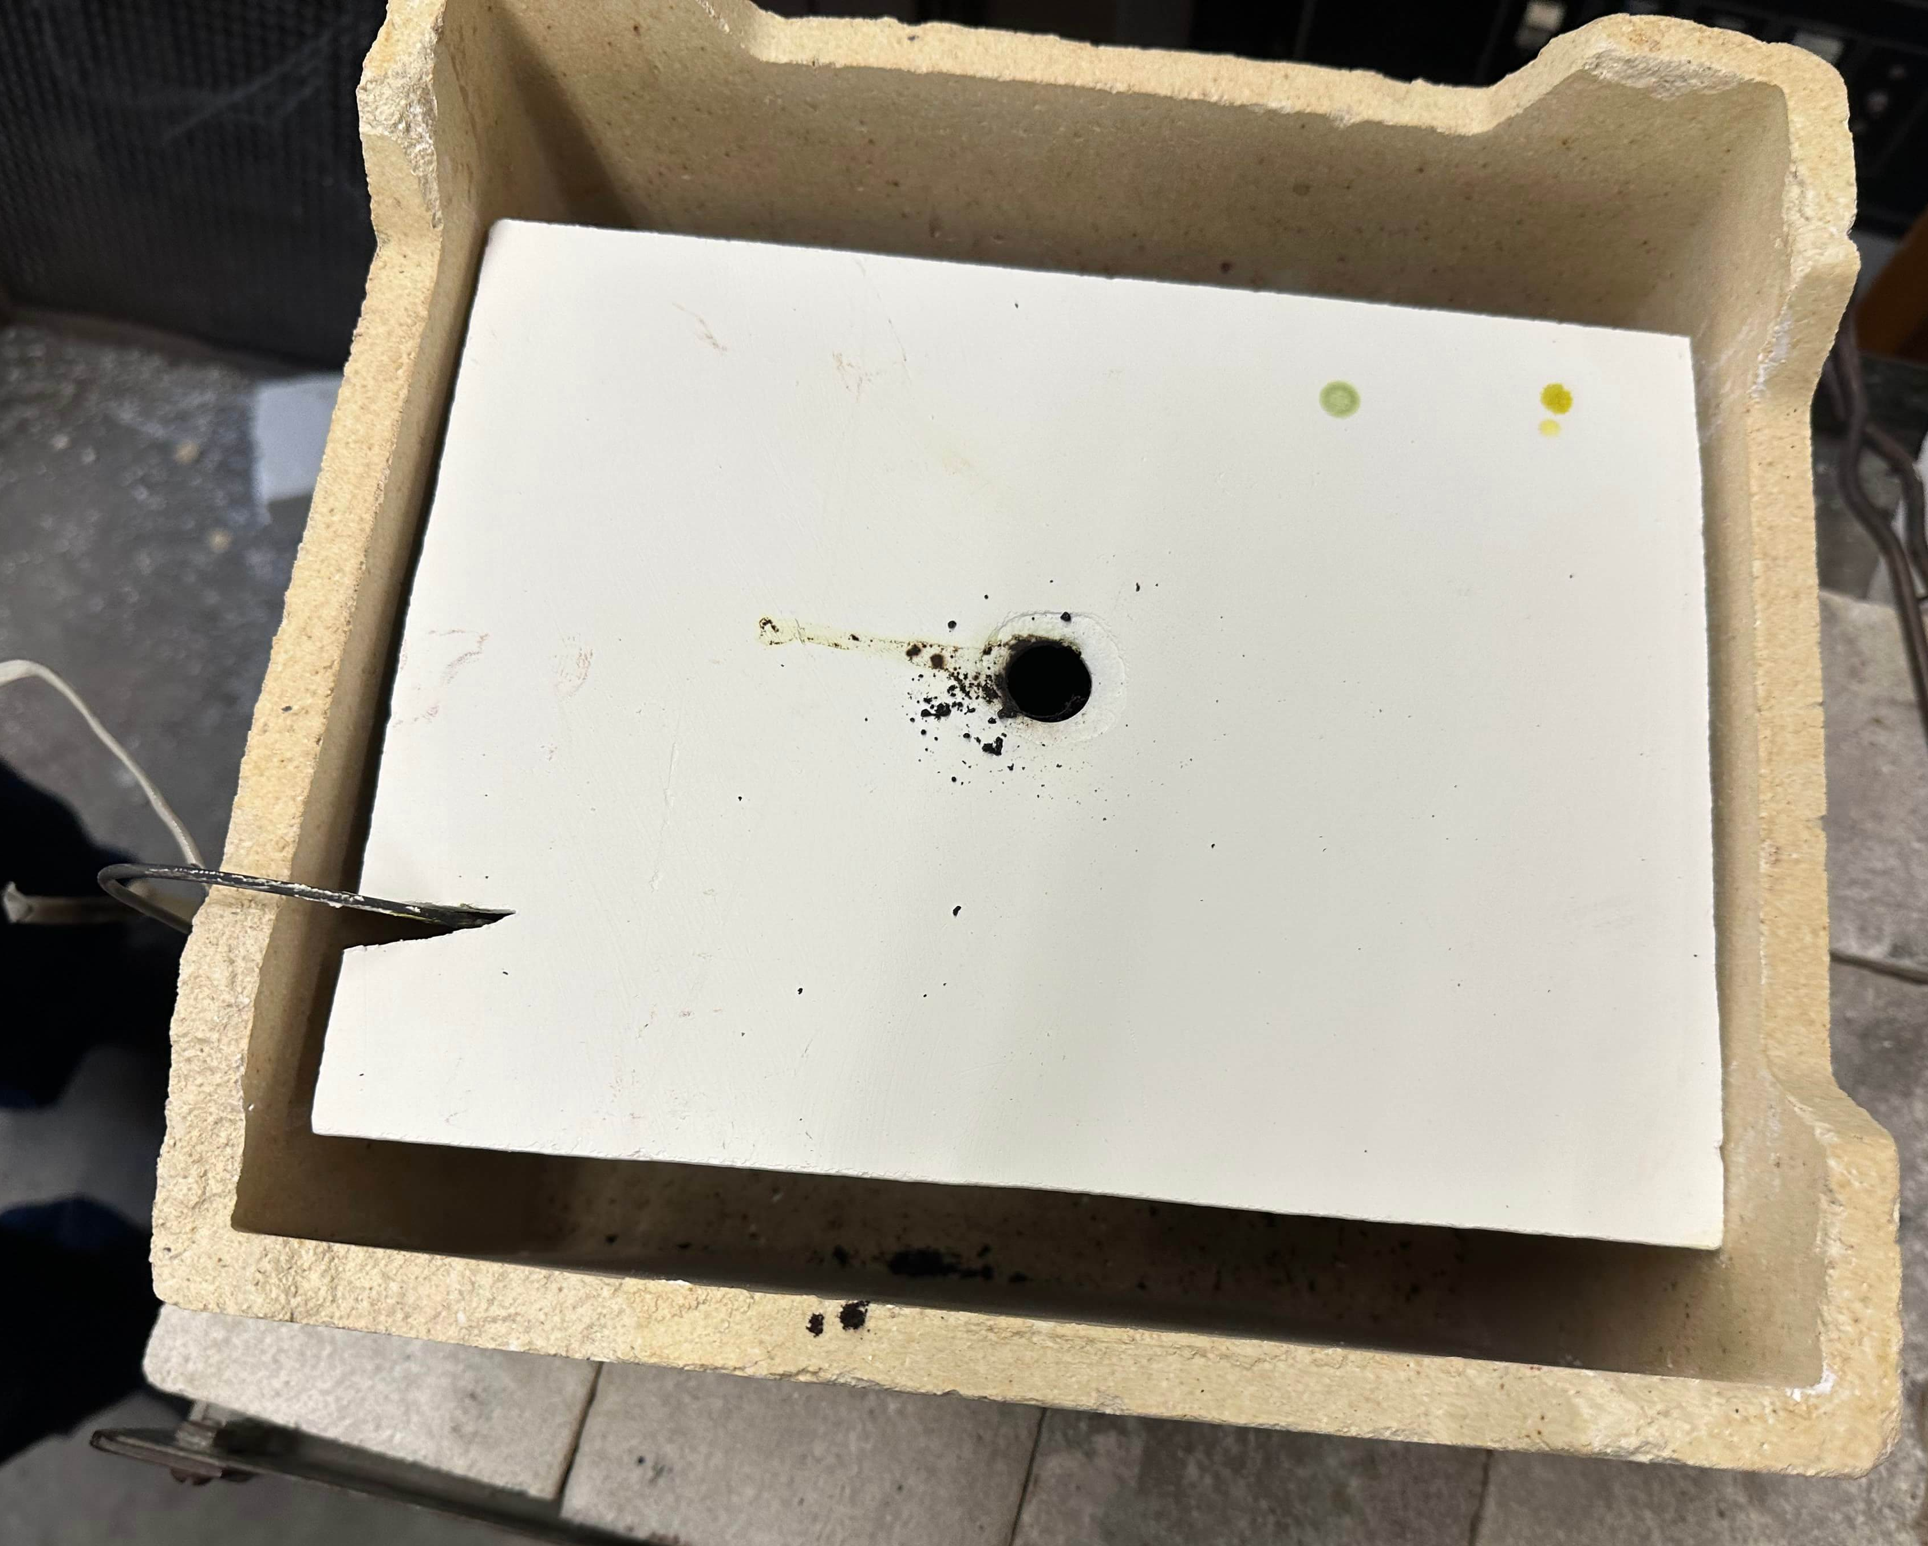
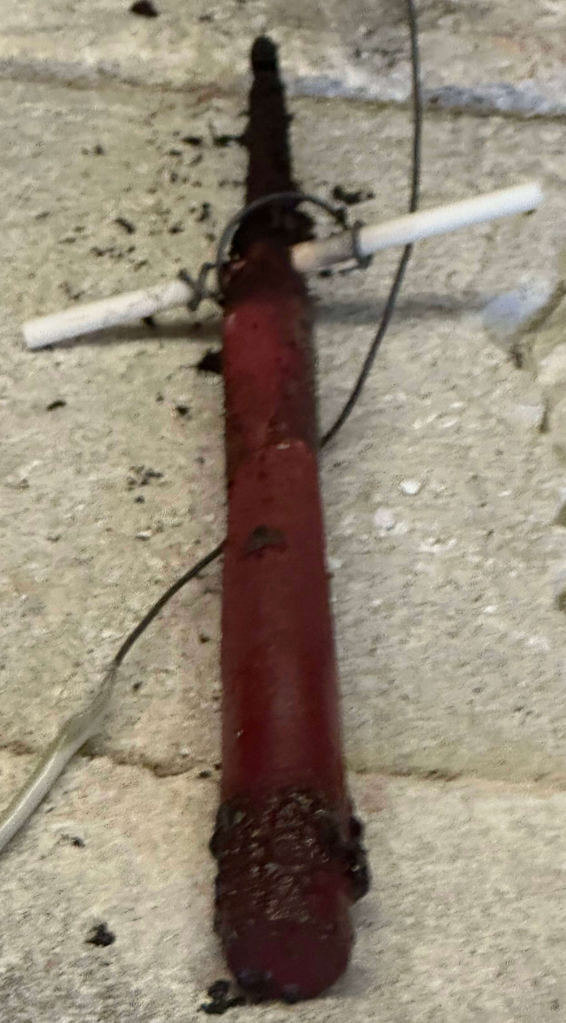
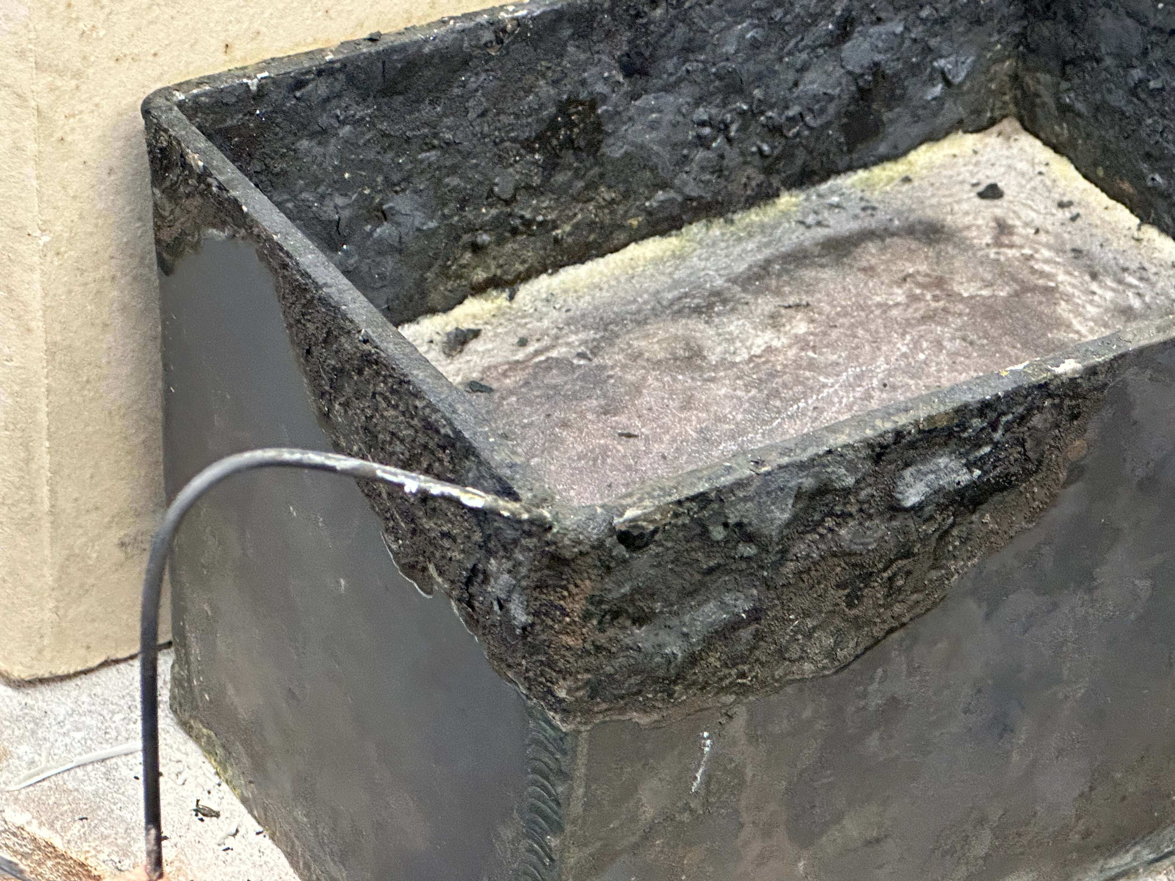
Furnace Testing Aftermath

Slide 15
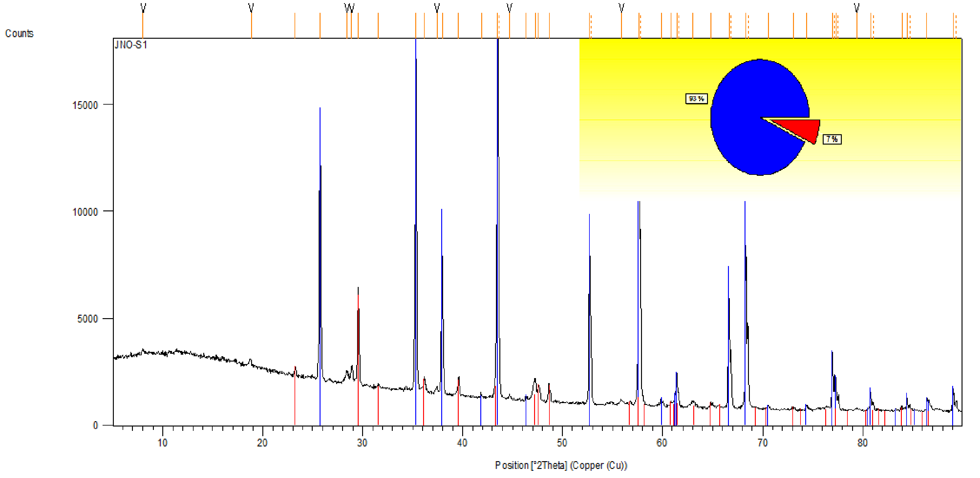
Furnace Testing Results (Unsuccessful)
7 %

Slide 16
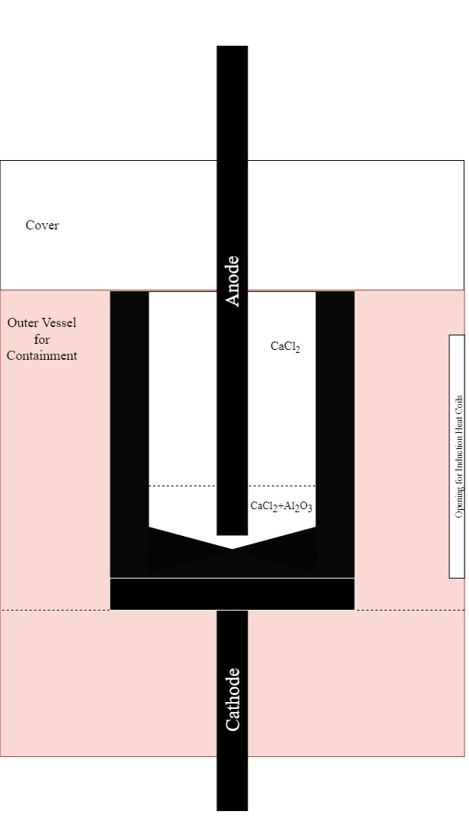
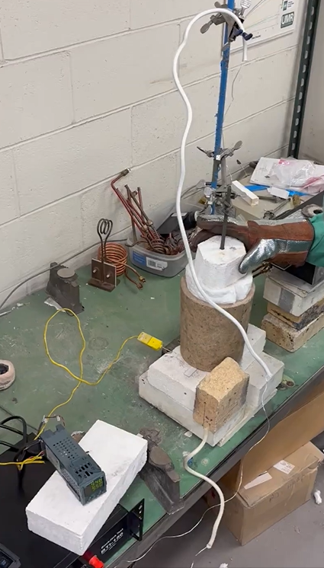
Graphite Cell Test Setup

Slide 17
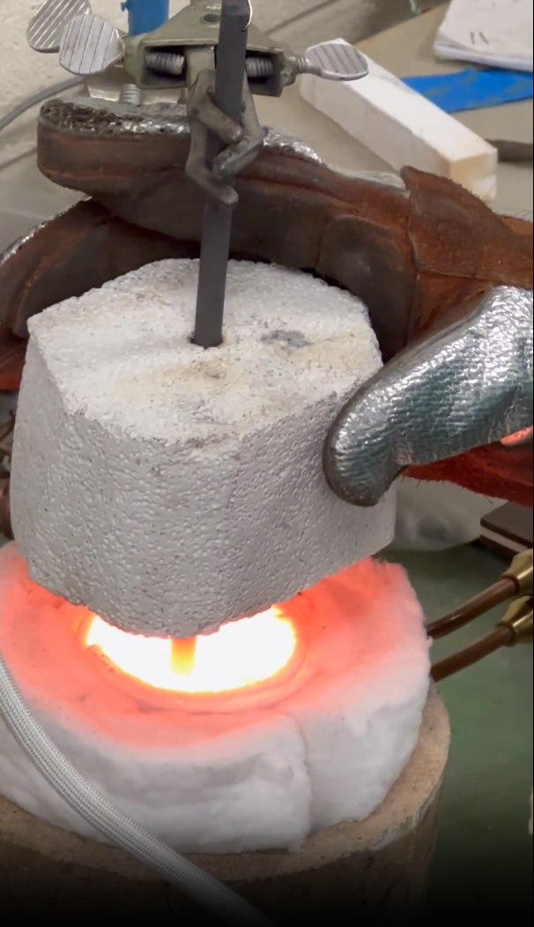
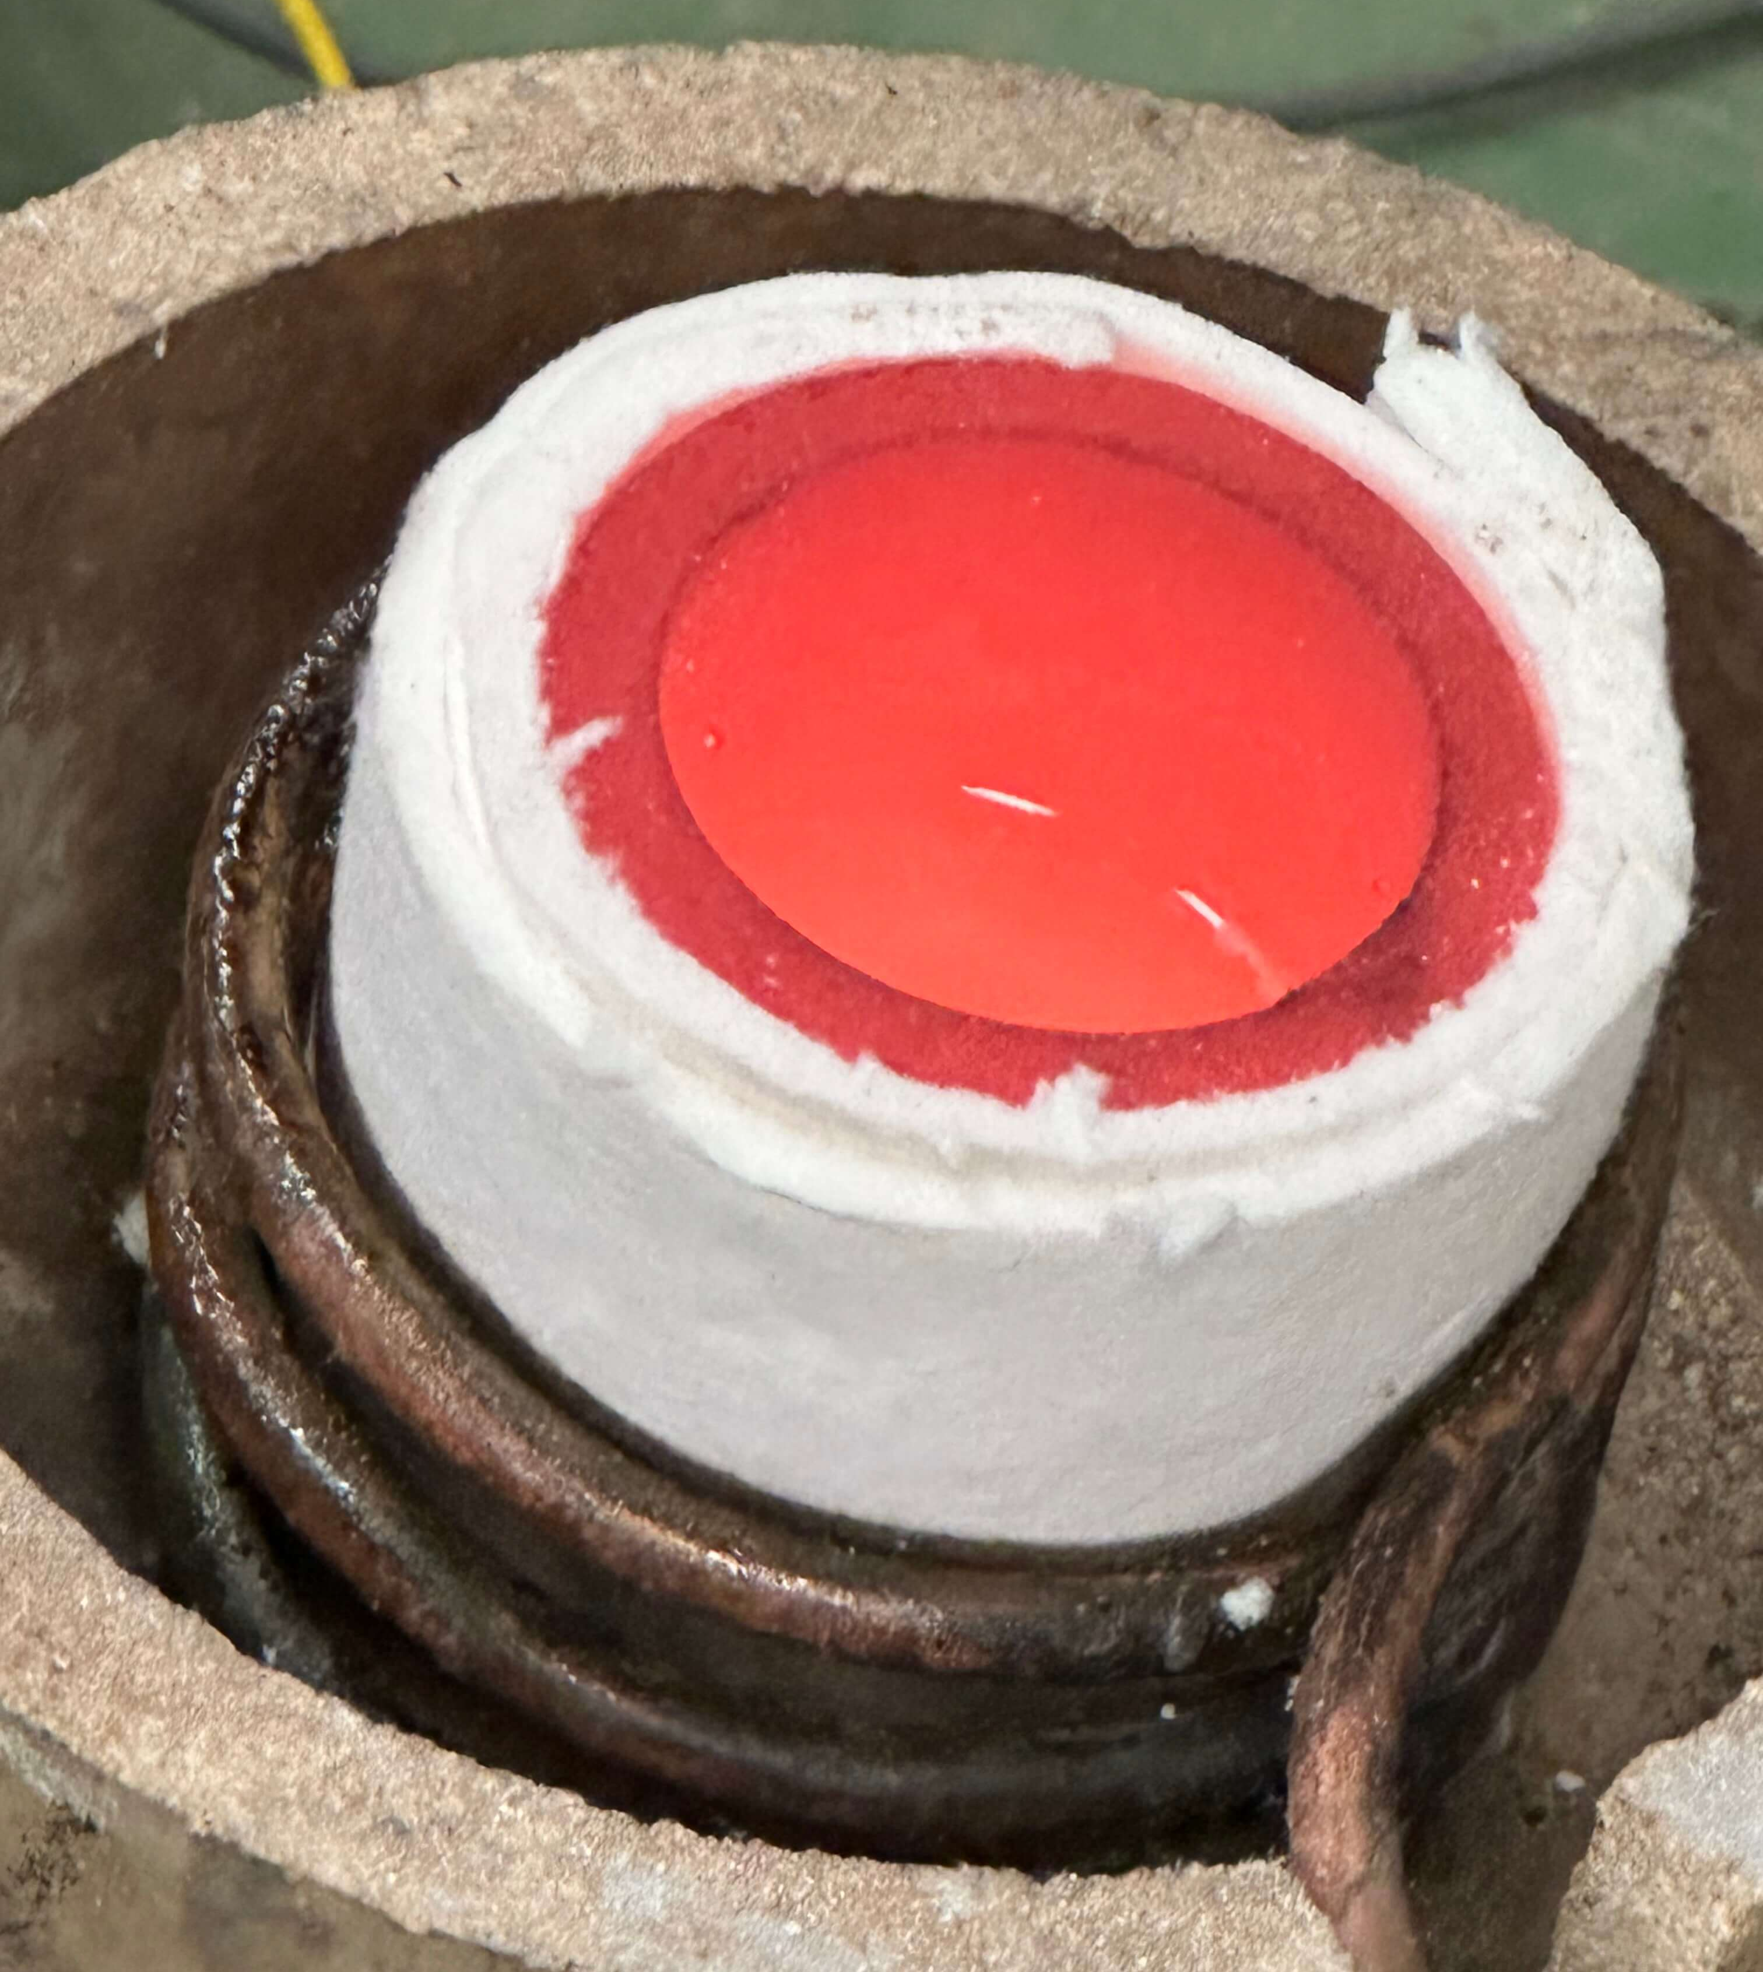
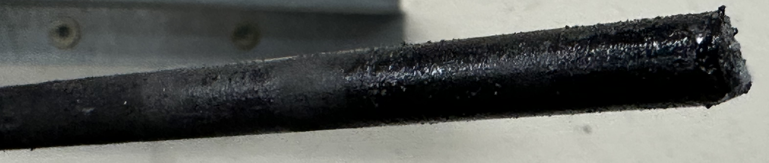
Graphite Cell Testing

Slide 18
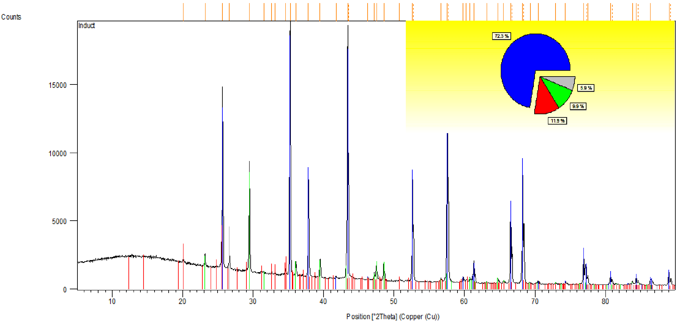
Graphite Cell Results (Unsuccessful)
5.9%

Slide 19
Conclusions
Phase 1 Successful but Not Optimized
Phase 2 Needs Work
(Some Funds Remaining)

Slide 20
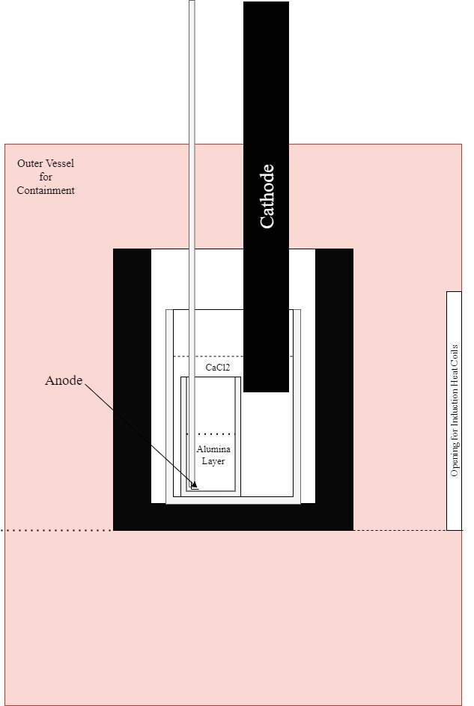
Future Work
Optimizing the Leaching Process
Redesign of Electrolysis Setup

Slide 21
Acknowledgements
NASA BIG Idea Challenge 2023
Missouri S&T’s Kummer Innovation and Entruepreneural Fellowship
Missouri Space Grant Consortium
Dr’s Daoru Han, Jeffrey Smith, Fateme Rezaei, David Bayless, William Schonberg, and Daniel Stutts
Todd Sanders and Many Undergraduate Researchers

Slide 22
References
G. Z. Chen. The FFC Cambridge Process for Metal Production: Principle, Practice, and Prospect. In Proceedings of the Third International Slag Valorisation Symposium, March 2013.
K. C. T. Kilby, L. Centeno, G. Doughty, S. Mucklejohn, and D. Fray. The Electrochemical Production of Oxygen and Metal via the FFC-Cambridge Process. Space Resources Roundtable, 8:64–65, 01 2006
H. Kadowaki, Y. Katasho, K. Yasuda, and T. Nohira. Electrolytic Reduction of Solid Al2O3 to Liquid Al in Molten CaCl2. Journal of The Electrochemical Society, 165(2), 2018.

Slide 23
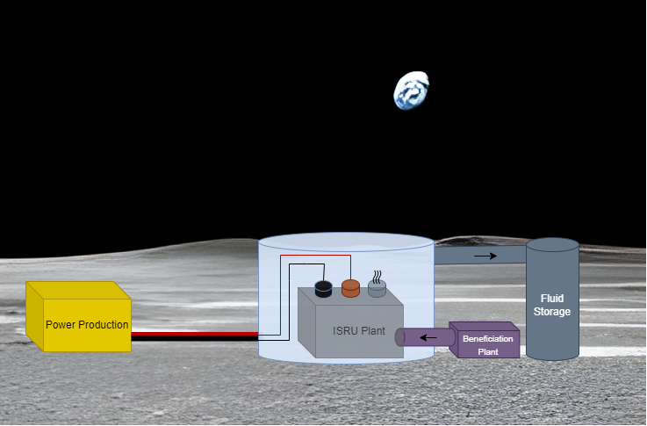
Questions?

