Slide 1
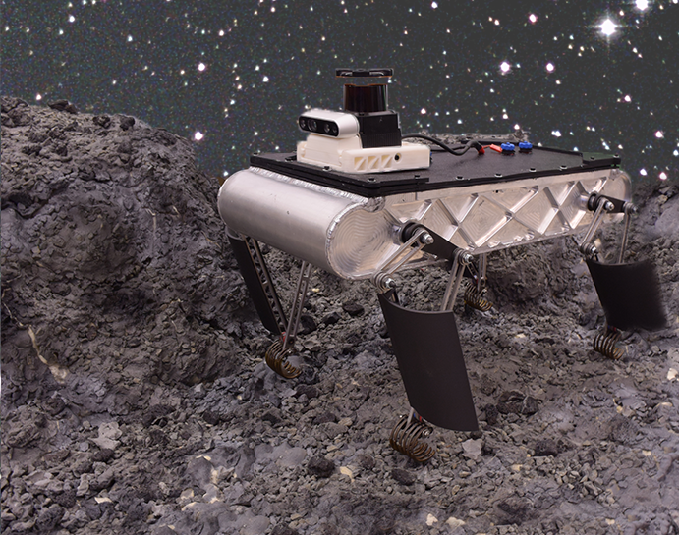
Extreme Terrain Quadruped
(ET-Quad)
For Traversing Rocks, Regolith, and Rough Terrain
Florida A&M University and Florida State University
FAMU-FSU College of Engineering
Presenters: Derek Vasquez, David Jay, and Michael Dina
Team members: Hamza Asif, Max Austin, Dominic Bellocchio, Jonathan Boylan, Andrew Burkhardt, Ashley Chase, Justin Cheesborough, Alejandro Chong-Garcia, Jayson Dickinson, Michael Dina, William Hochstedler, David Jay, Geraina Johnson, Benjamin Labiner, Francisco Lopez, Joseph Lupton, Gissel Reynoso, Cameron Ryals, Carlos Sanchez-Sarmiento, Dane Seal, Zaid Shah, Brian Van Stratum, Derek Vasquez, Jason White
Faculty advisors: Jonathan Clark, Christian Hubicki, Camilo Ordonez, Shane McConomy, Juan Ordonez

Slide 2
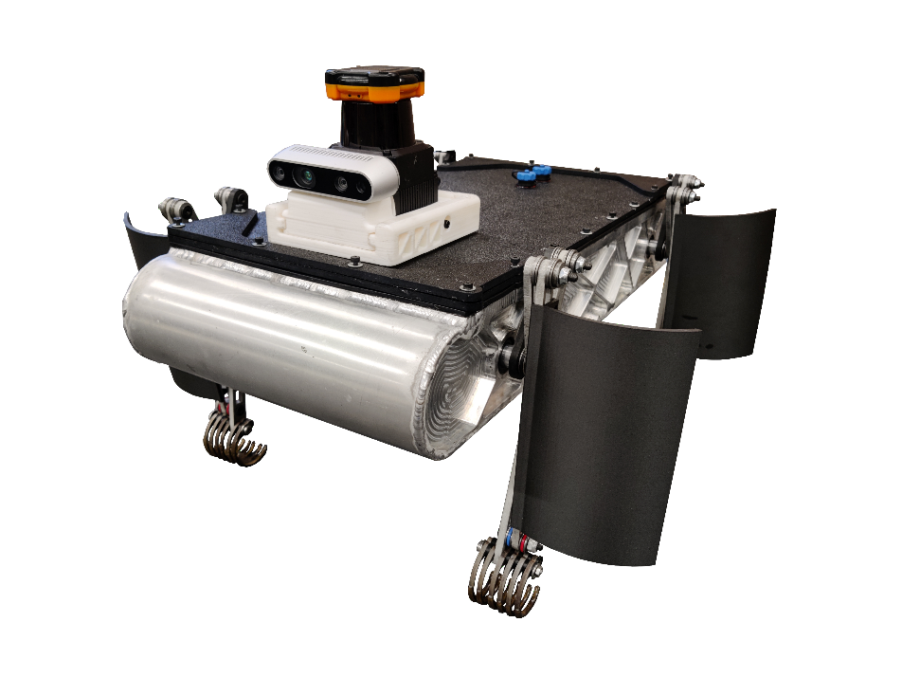
ET-Quad Abstract
First legged robot capable of walking, climbing vertical surfaces, and traversing resistive media (water, regolith)
Novel leg design integrates capabilities and lessons from biology and previous single mode robots
2 new planning algorithms for multimodal lunar locomotion

Slide 3
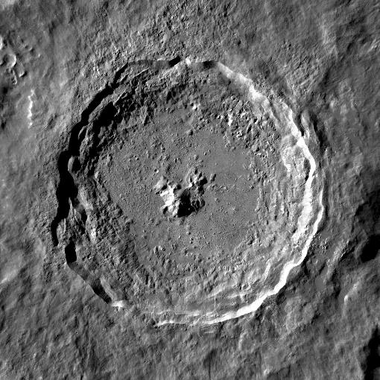
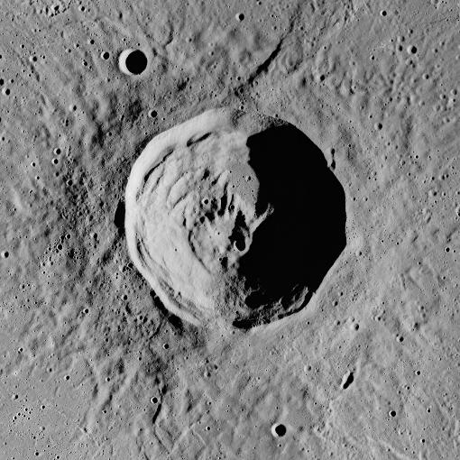
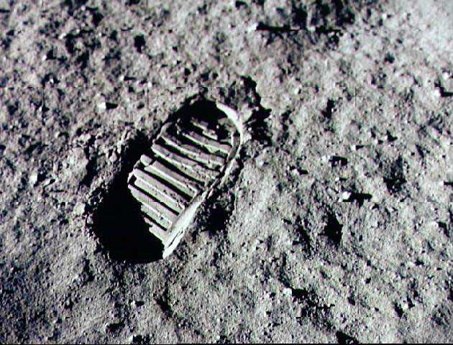
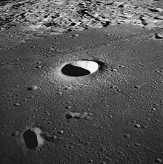
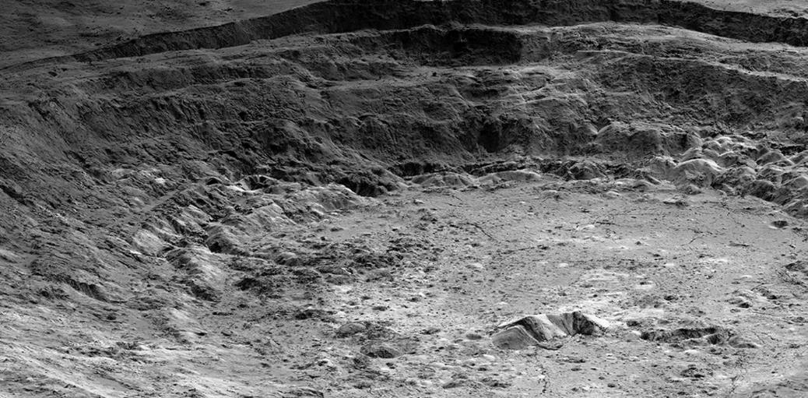
Notes:
Avoid causation language

Slide 4
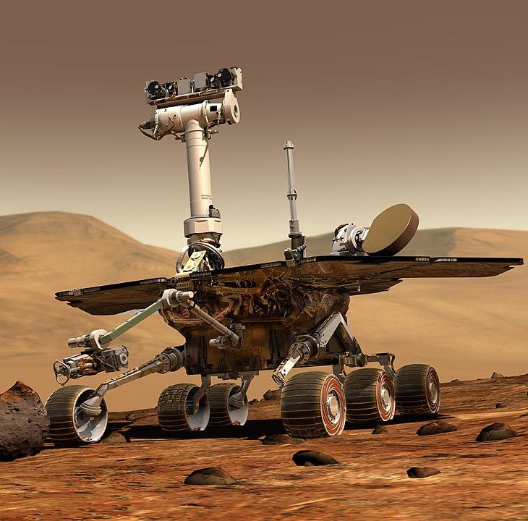
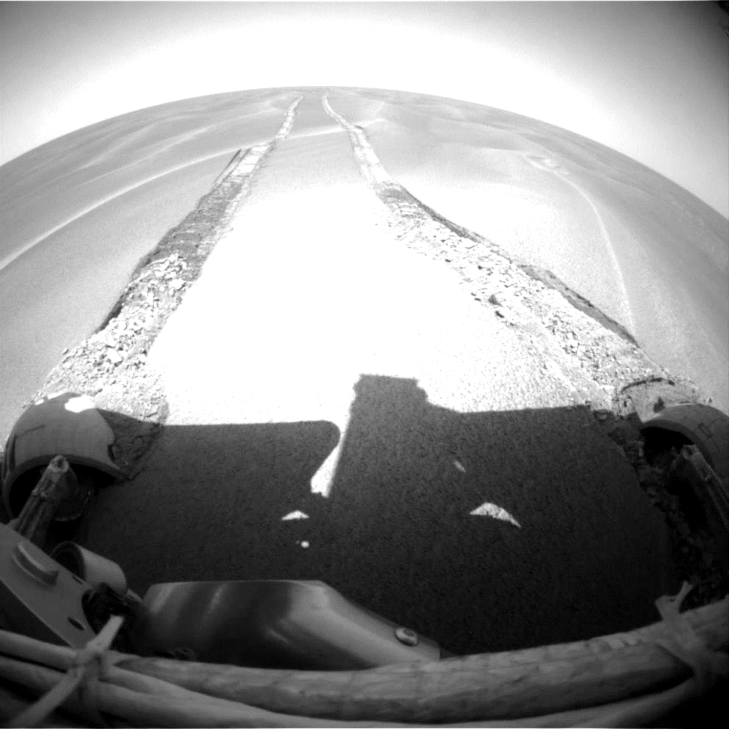

Slide 5
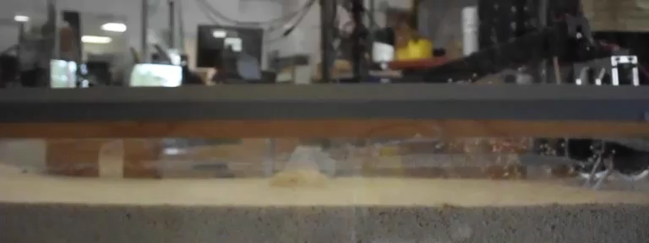
M. Austin et al., "Optimizing Dynamic Legged Locomotion in Mixed, Resistive Media," 2022 IEEE/ASME International Conference on Advanced Intelligent Mechatronics (AIM), 2022, pp. 1482-1488, doi: 10.1109/AIM52237.2022.9863276.

Slide 6
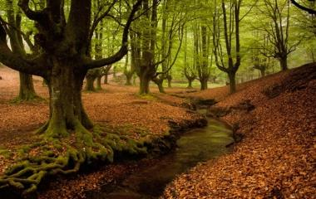
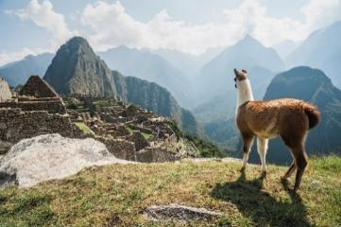
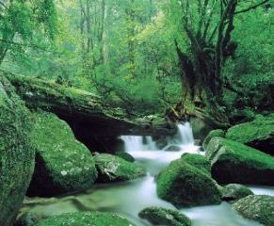
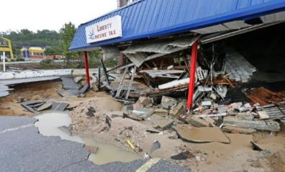
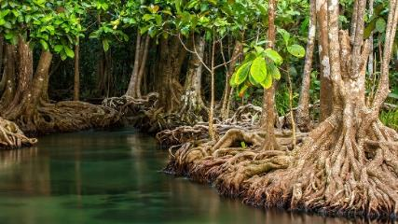
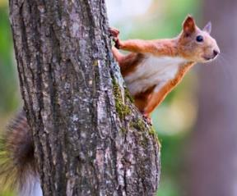
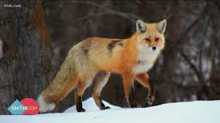
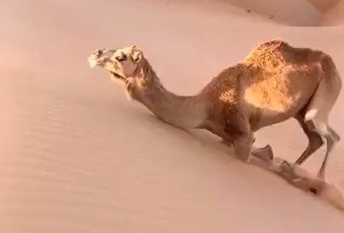
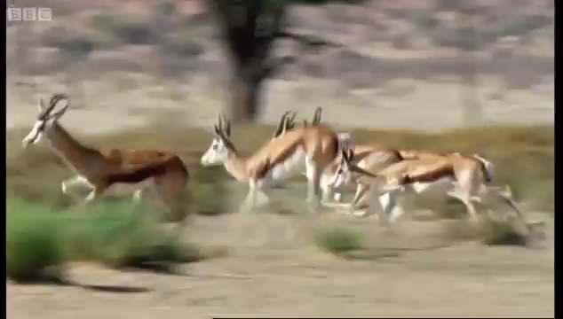
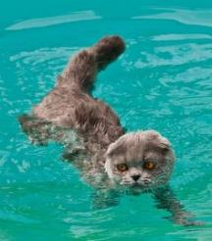
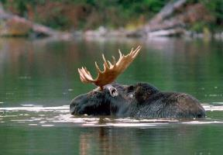
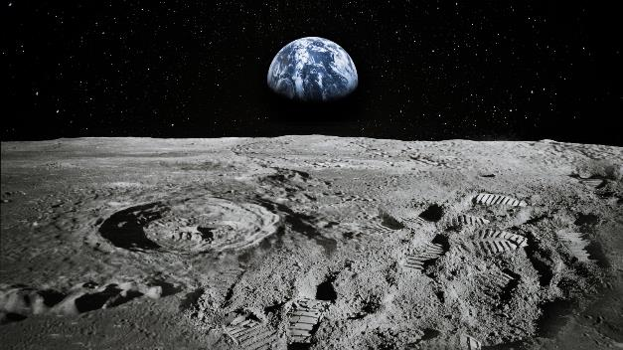
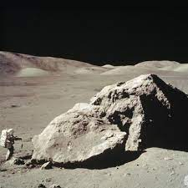
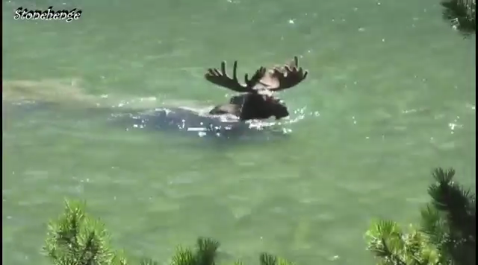
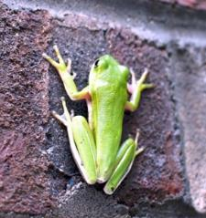

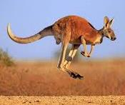
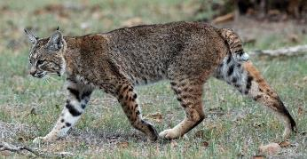
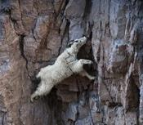
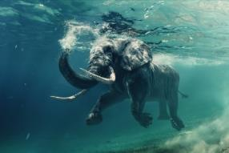
Modal Locomotion Decomposition
Modal Demux
Terrestrial
Scansorial
Resistive Media

Slide 7
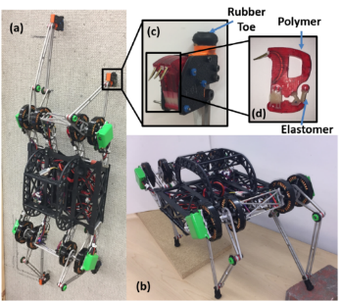
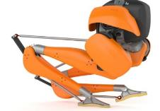
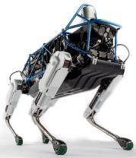
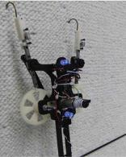
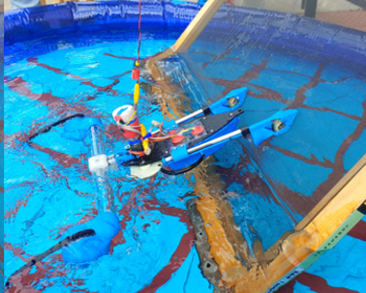
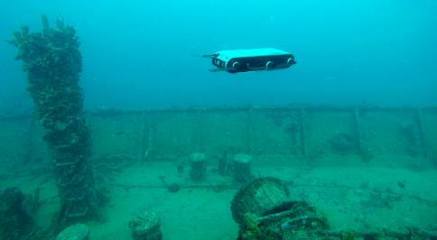
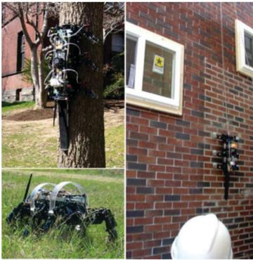
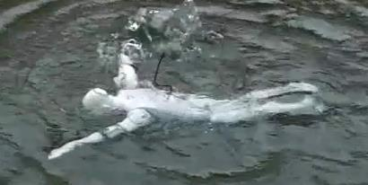
Legged Multimodal Robots
Terrestrial
Scansorial
?
Aquatic

Slide 8
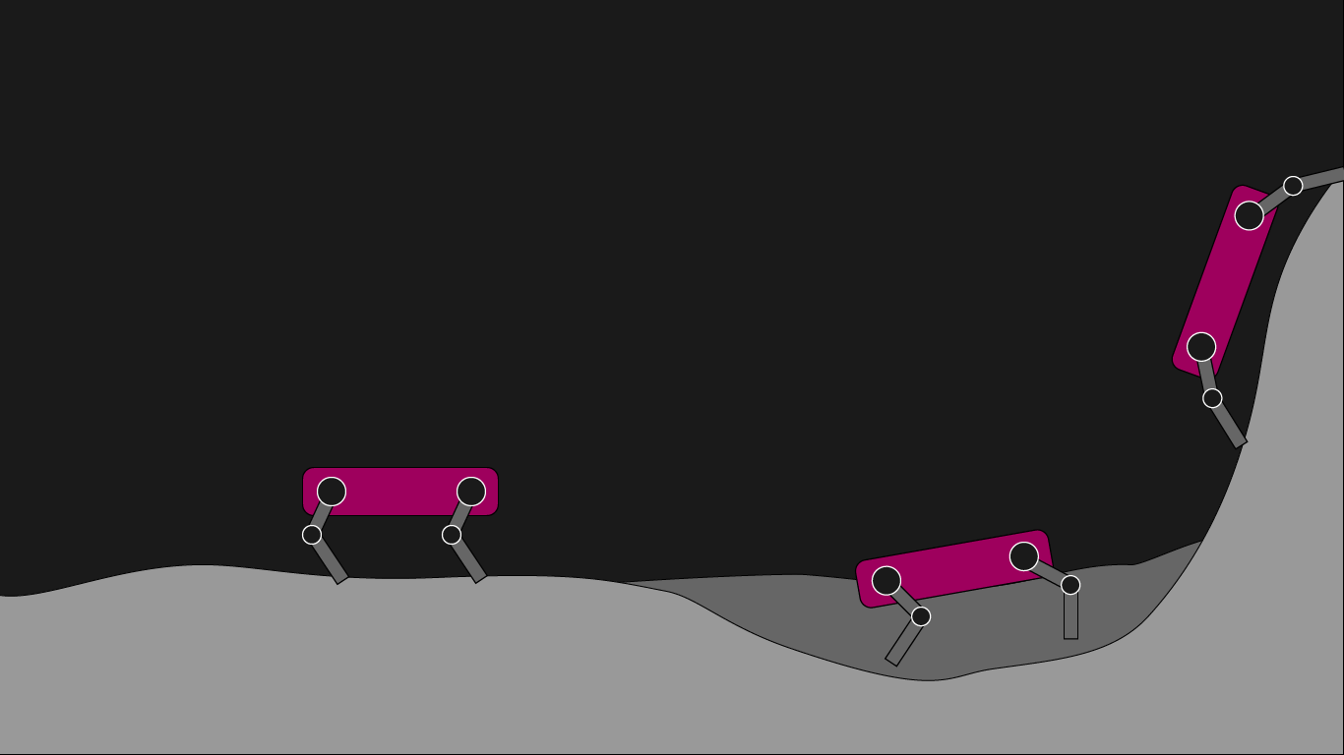
Objective: Build a single robotic platform with animal-like capabilities to address each of these locomotion challenges on the moon

Slide 9

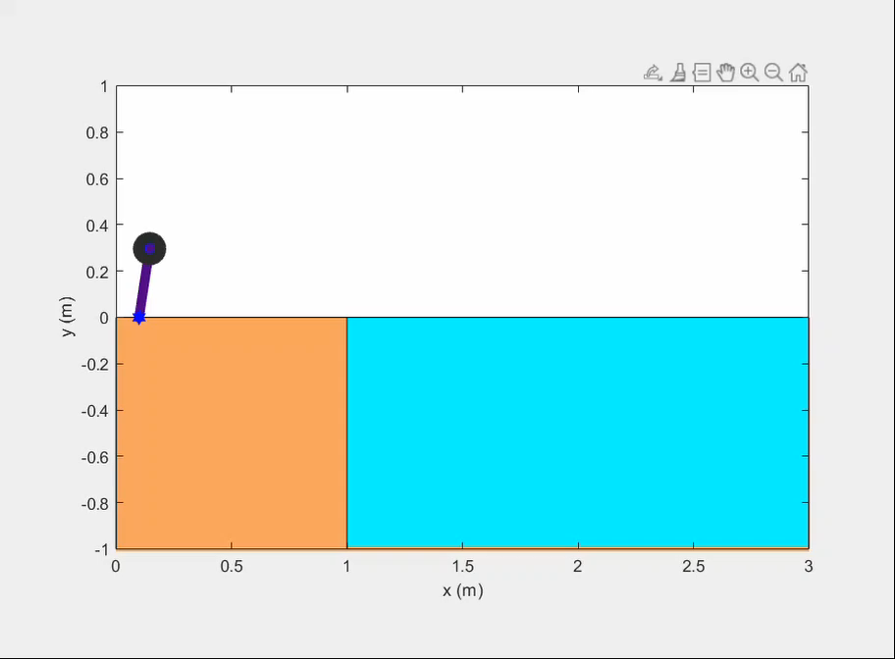
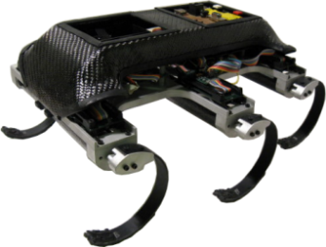
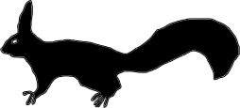
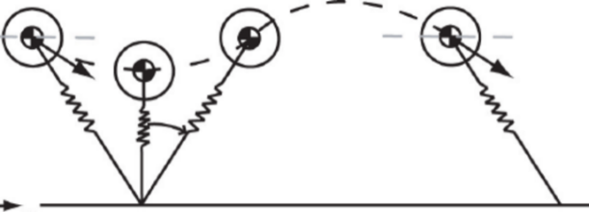



Modeling Methods of Dynamic Legged Locomotion
Reduced Order Modeling Methodology
$$F_{G}$$
$$F_{S}$$
Biological Synthesis
Dimensional Collapse
Robot Design

Slide 10
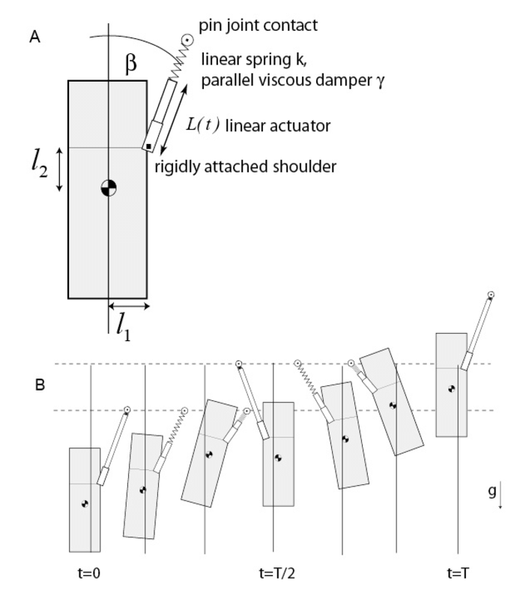
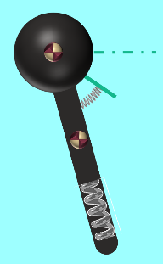
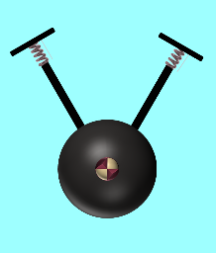
Modeling Methods of Dynamic Legged Locomotion
Terrestrial
Scansorial
Full-Goldman Model
LPS
FF-SLIP
Aquatic
M. Austin et al., "Optimizing Dynamic Legged Locomotion in Mixed, Resistive Media," 2022 IEEE/ASME International Conference on Advanced Intelligent Mechatronics (AIM), 2022, pp. 1482-1488
M. Austin, A. Chase, B. Van Stratum, and J. E. Clark, “Aquaclimber: a limbed swimming and climbing robot based on reduced order models,” Bioinspiration & Biomimetics, 2022.

Slide 11
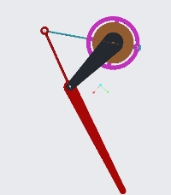
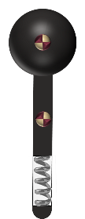
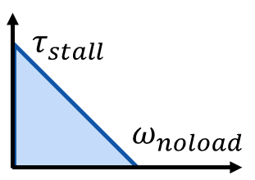

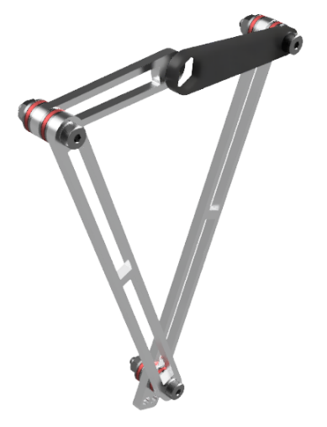
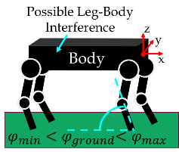






Dyna-Kinematic Leg Design
Optimization
Mapping between the behavior(s) and your achievable design space
Approximation of the robot engaging in the behavior(s)
Possible causes of failure & requisite design features
Task regime: What do you want the robot to do?
Selecting a locally optimal morphology to implement
Optimized Leg
Designer Selected Locomotion
Designer Selected Leg Mophologies
Constraints
Feasible Subset
L₁
Actuator Model
L₂
Kinematic Mapping
Target Dynamics
$$α$$
Concentric drive shafts
L₁
66 mm
$$X,\dot{X},F$$
Mappings
L₂
$$f\left(\overset{⃑}{x}\right)=\overset{⃑}{m}$$
Jacobian
6:1 gear reduction on one link
L₅
$$\left[\begin{matrix}\frac{δm_{1}}{δx_{1}} & ⋯ & \frac{δm_{1}}{δx_{n}} \\ ⋮ & ⋱ & ⋮ \\ \frac{δm_{n}}{δx_{1}} & ⋯ & \frac{δm_{n}}{δx_{n}}\end{matrix}\right]$$
L₃
Geometric symmetry
L₁
L₆
180 mm
L₂
L₄
Austin, M., Brown, J., Nicholson, J., and Clark, J. (November 8, 2022). "Dyno-Kinematic Leg Design for High Energy Robotic Locomotion." ASME. J. Mechanisms Robotics. June 2023; 15(3): 031001.

Slide 12




Foot Design
Terrestrial
Scansorial
Different compliance requirements
Full-Goldman Model
Design Requirements
Anisotropic compliance
Attachment capability for climbing
Sufficient traction for walking
Directional drag for swimming
LPS
FF-SLIP
Aquatic
1x stiffness
2x stiffness
Lemur
RHeX
Aqua

Slide 13



Foot Design
Kurfing allows anisotropic compliance (tuned for walking and climbing)
Flap provides directional drag
Claws grab substrate
High friction ground contact point

Slide 14




Improved Foot Design
Fin increases drag 2.5x
Toes extend independently to grab small asperities
10% mass reduction
More resilient material
AR500 abrasion resistant steel
Embedded hook increases reliability
Increased ground contact for traction

Slide 15

System Overview
2x 4-cell lithium polymer batteries with 2800 A h each.
Full system mass: 7.85 kg
Four hip assemblies with 2x brushless DC motors with Kv of 330 and 1.7 Nm peak torque. Gearing provides 6:1 reduction on one link and coaxial output shafts.
4 Raspberry Pi Model 4b’s provide control at ~230 Hz to 8 motors. Also capable of mapping at ~7 Hz, local planning at 45 Hz, and global planning at ~1 Hz.
Power management board distributes up to 80 A to motors and computation. Measures power consumption.
Body is waterproof to ISO 22810 standards.
Sensor suite: Lidar and depth camera
Skids protext robot underbelly when climbing.

Slide 16

Sensors and Autonomy
4x Raspberry Pi Model 4b for mapping, planning, control, and communications
2D Hokuyu UTM-30LX LiDAR
Sensors
Onboard Network
(roscore)
Motors
LiDAR
Hip Module 1
Rpi 2
(Mapping)
Hip Module 2
RealSense
Depth Camera
map
Hip Module 3
IMU
Rpi 1
(Path Planning)
Hip Module 4
Desired body velocity
Low level control
Vicon MoCap
System
Rpi 3
(Motor Control)
KEY:
Network ROS communication
Serial
CAN
Localization
Realsense d435i stereo depth camera
0.85 kg total
Base Station
Computer
6-axis inertial measurement unit (IMU)/gyroscope and temperature sensor
Goal coordinates

Slide 17


Sensors and Autonomy - Demonstration
Goal Point
Obstacles
Obstacles
Goal Point
Climbable slope
Climbable slope
Planned path
Camera view
Third person view

Slide 18




ET-Quad in Robotics State-of-the-art
Terrestrial
Scansorial
?
Aquatic

Slide 19


Slide 20



Sensors and Autonomy

Slide 21


Ongoing Integrations: Planning for Multimodality
When should the robot walk, climb, or swim?
Climbable slope
Obstacle
Map with path to goal
Colors represent gaits
Not traversible
Climb
Walk
Run

Slide 22



Ongoing Implementation: Planning for Lunar Thermal Challenges
How can we account for temperature variations on the moon?
Plan path through sunny regions
Time varying temperature gradient
Energy efficient paths through moderate temperatures to the goal
Cold regions
Sampling based model predictive optimization (SBMPO)
Hot regions

Slide 23

Review
First legged robot capable of walking, vertical climbing, and swimming
Multimodal legs and feet allow trimodal locomotion without hardware changes
Thermally informed planning allows energy efficient locomotion in changing lunar illumination
3D mapping for multimodal locomotion planning

Slide 24









Thank you!
Derek Vasquez
davasquez@fsu.edu
David Jay
djay@fsu.edu
Michael Dina
mdina@fsu.edu
Shayne McConomy
smcconomy@eng.famu.fsu.edu
Jonathan Clark
clarkj@eng.famu.fsu.edu

