Slide 1
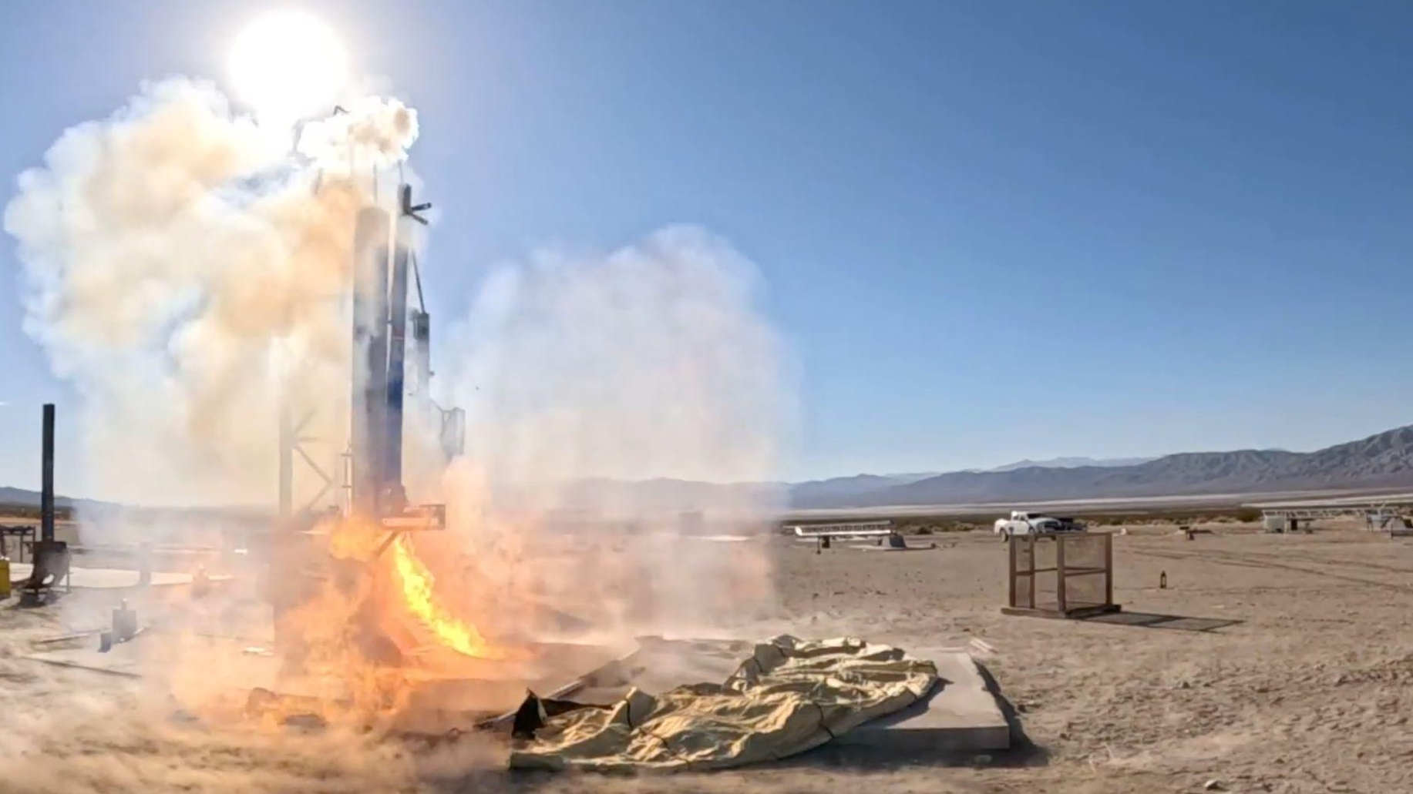
PILLARS: Plume-deployed Inflatable for Launch and Landing Abrasive Regolith Shielding

Slide 2
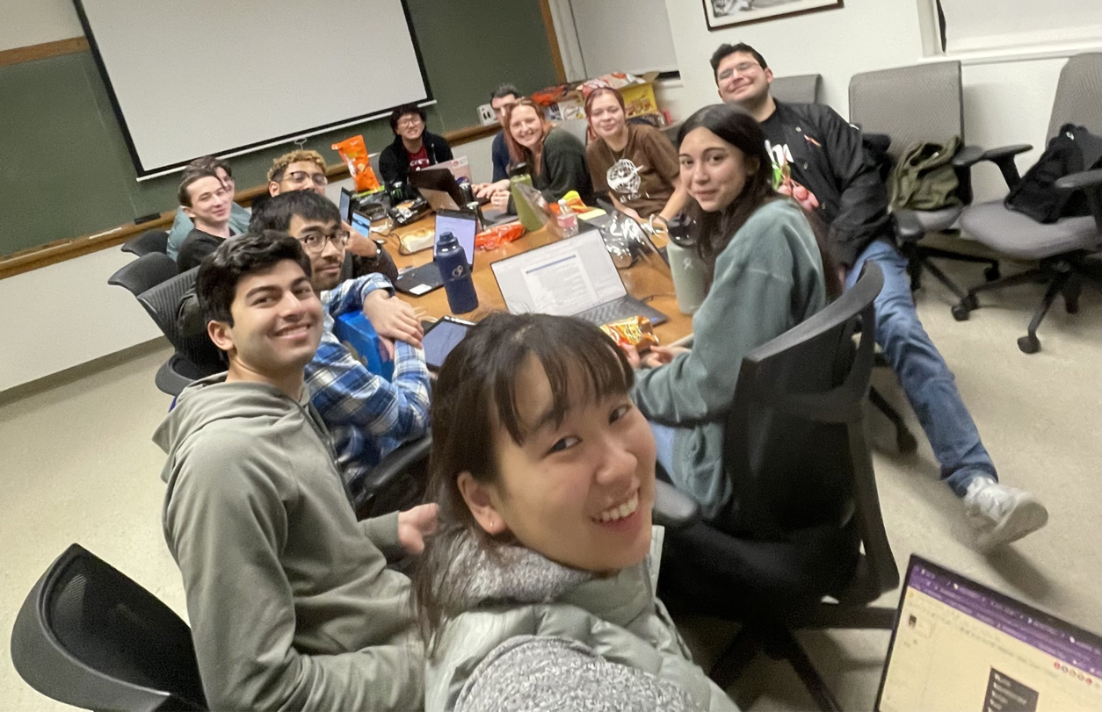
Our Team
NAME
47 Caltech undergraduate students majoring in
Computer Science
Electrical Engineering
Mechanical Engineering
Physics
Chemistry
Math
Applied and Computational Mathematics
Dr. Soon-Jo Chung, Faculty Advisor
Lily Coffin, System Integration Lead
Kevin Gauld, Project Management Lead
Bella Kwaterski, Materials Lead
Trey Scott, Deployment Lead
Emily Xu, Mission Concept Co-Lead
Hannah Ramsperger, Mission Concept Co-Lead
Subsidiary of Caltech Air and Outer Space Club

Slide 3
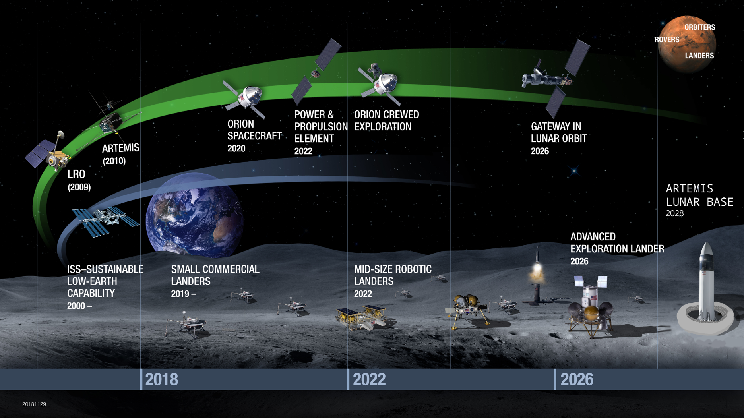
Mission Overview

Slide 4
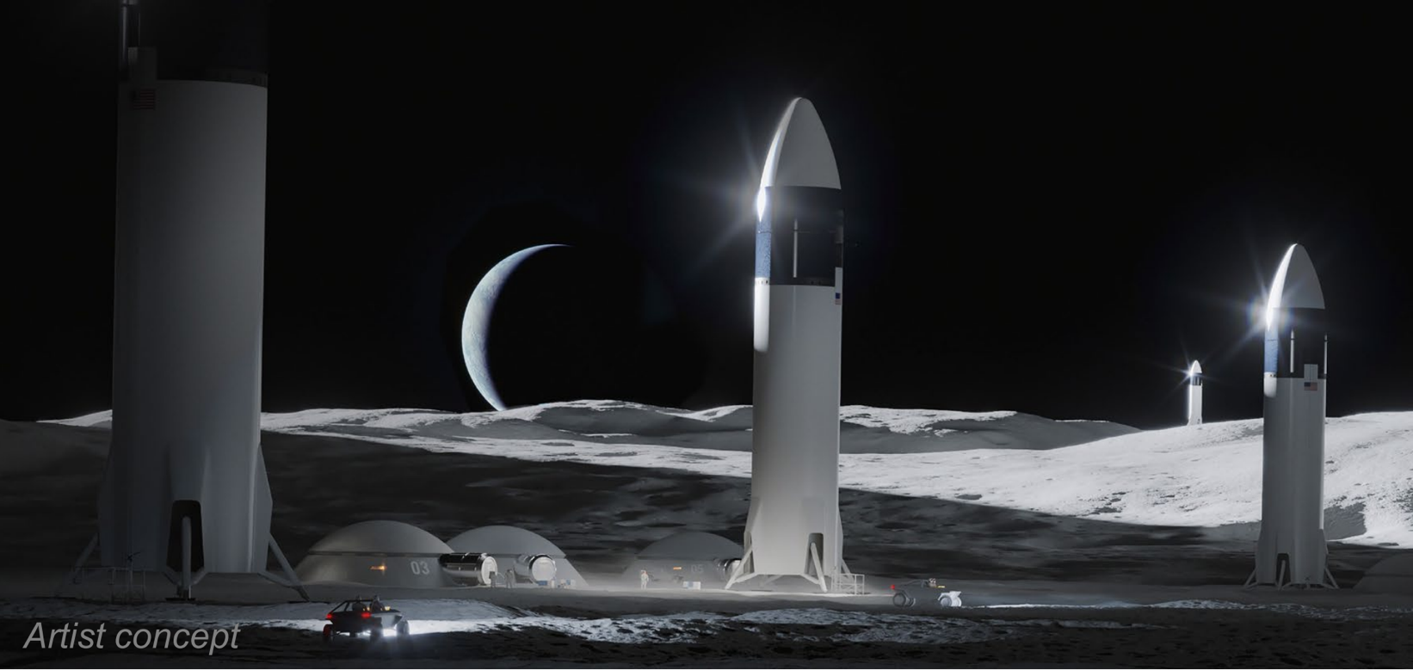
Landers enable sustained lunar activity
Establishing lunar infrastructure requires:
Frequent deliveries of assets via lunar rockets
Wide range of launch sites, payloads, and landers
Cargo transportation access

Slide 5
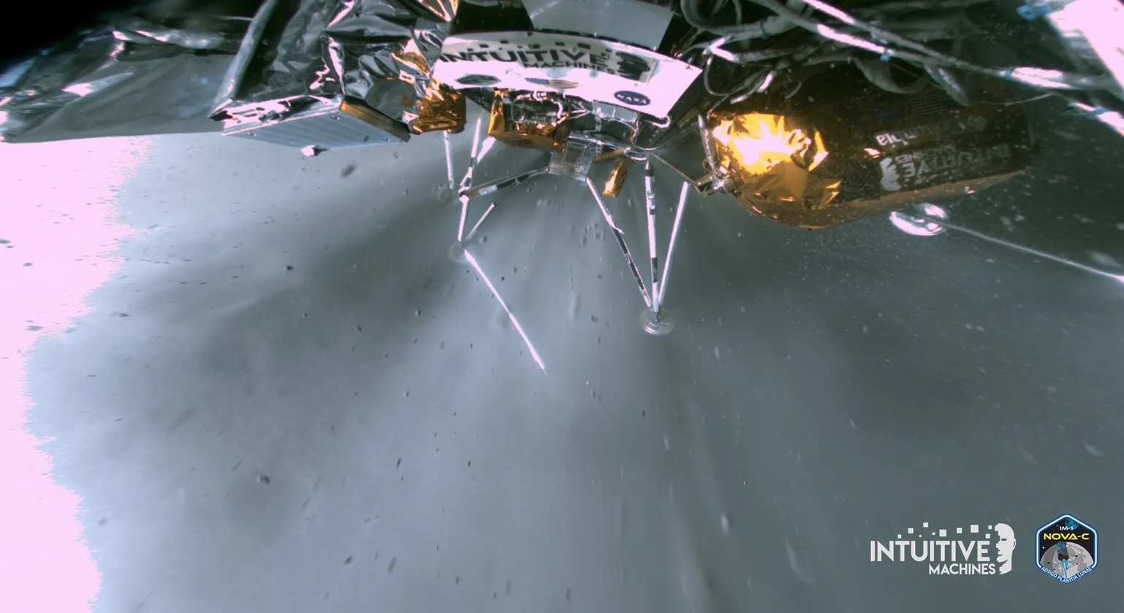
Landing ejecta can destroy infrastructure
Lunar landers kick up lunar dust that is sharp, toxic, and abrasive
Foundational infrastructure will be sandblasted and destroyed if landing ejecta is not mitigated

Slide 6
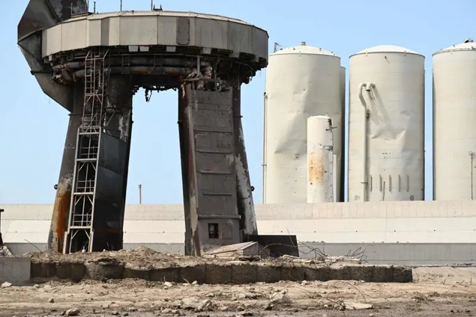
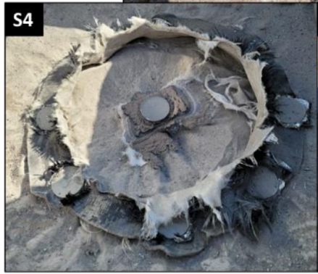
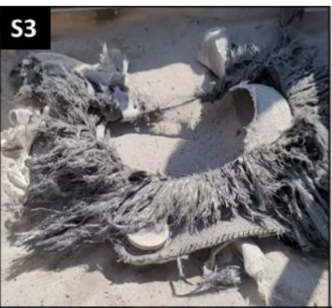
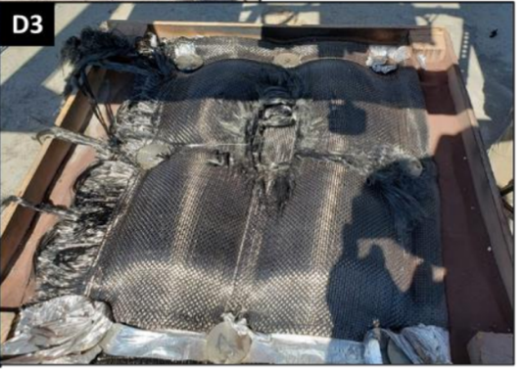
Mitigating ejecta is extremely hard
Rocket plume consists of supersonic flows and extremely high temperatures
Destroys most things in its path
Existing solutions (berms, landing pads) require extensive surface prep

Slide 7
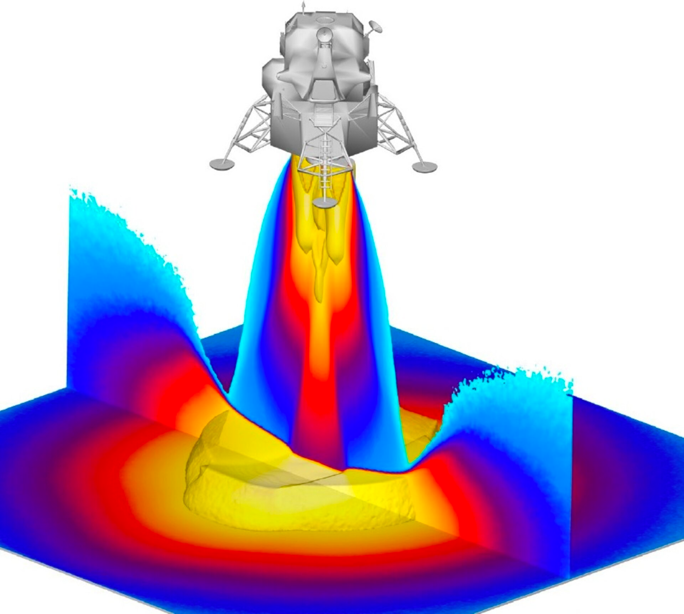
Reframing the Ejecta problem
A landing pad must withstand the most extreme parts of rocket exhaust
Berms avoid this but can make pad access difficult

Slide 8
Reframing the Ejecta problem
A landing pad must withstand the most extreme parts of rocket exhaust
Berms avoid this but can make pad access difficult
What if we could use the exhaust to inflate and activate a temporary berm?

Slide 9
Introducing: PILLARS

Slide 10
System Advantages
By combining the force of the rocket plume with an inflatable we can:
Avoid the harsh rocket exhaust and distribute load across system
Passively deploy and retract a berm structure
Solve the launch/landing dust problem with much less surface prep
Vacuum loss
Side View
Vorticity maintains inflation
Top View
radially symmetric plume uniformly inflates toroid bag to 20m tall
Plume In

Slide 11
System Specifications
Dimensions driven by rocket parameters
PILLARS is highly scalable to different Lunar Rockets
Top View
½ ID
ID
OD

Slide 12
System CONOPS

Slide 13
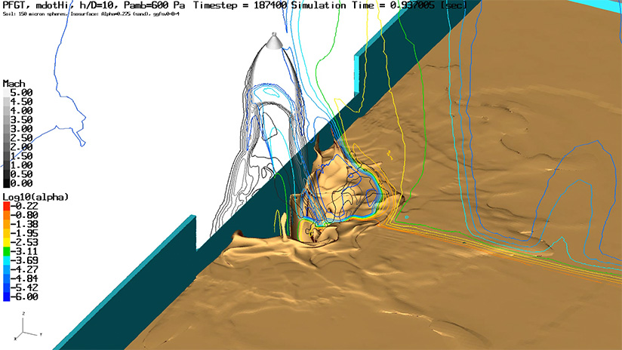
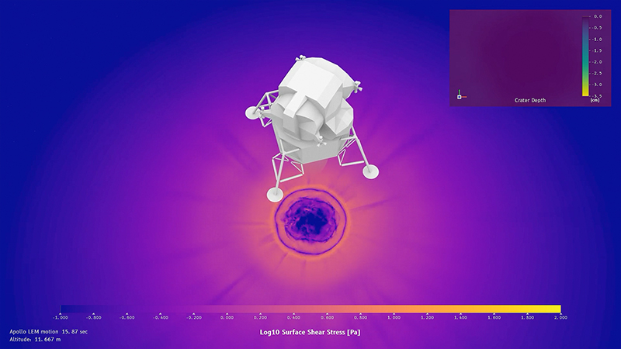
Understanding the Plume

Slide 14
Simulation Problem Overview
High density flow exits the rocket and expands into vacuum, becoming low density
The flow reaches the ground and stagnates, becoming high density again
Our task is to model the transition between high density to low density four times in one simulation

Slide 15
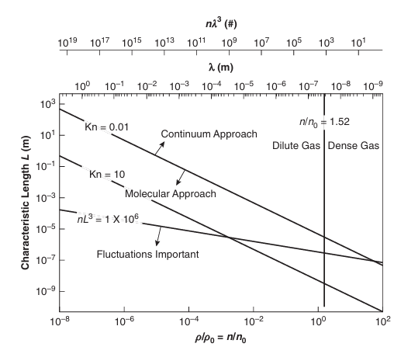
CFD and Modelling Paradigms
With a lunar rocket plume, we see both high density continuum flow and low density molecular flow
There is no one method that can model both scenarios well
We must attempt a joint approach

Slide 16
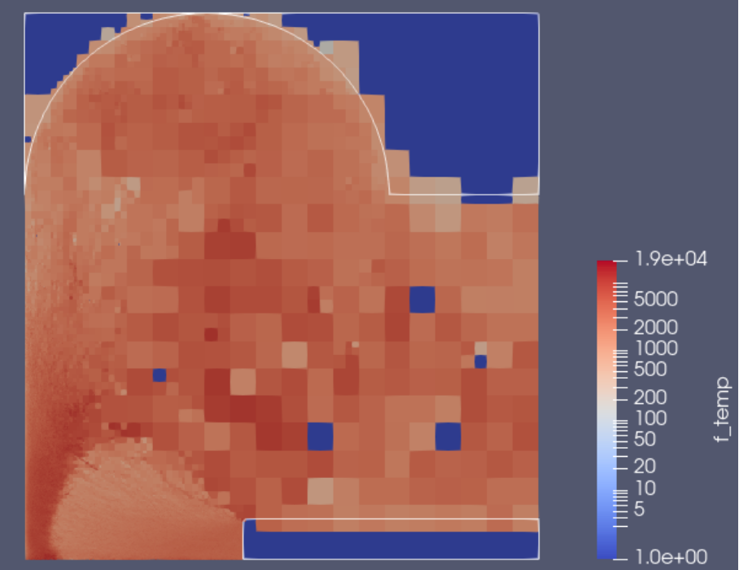
Direct Simulation Monte Carlo ___
DSMC is used to approximate a solution to the Boltzmann Equation when modeling free molecular flow
Models each particle collision individually
Extremely high compute required
Difficult to implement

Slide 17
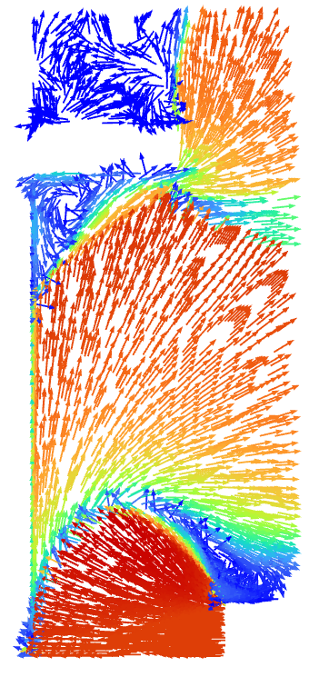
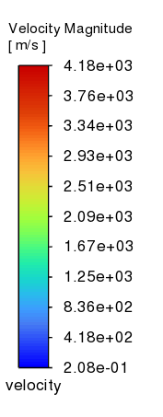
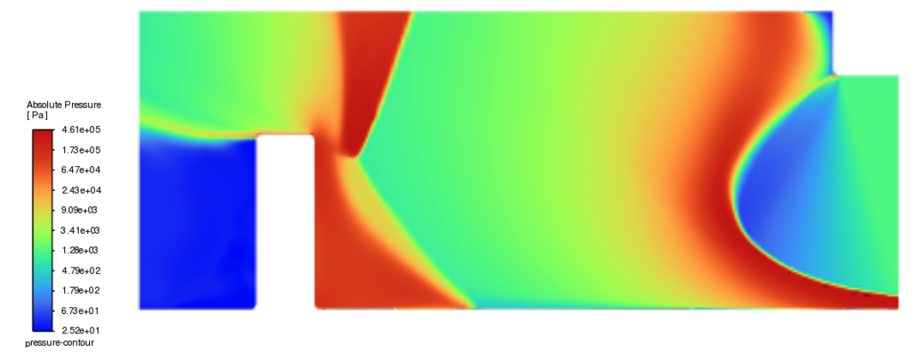
ANSYS
Ansys solves the Navier-Stokes equation for continuum flow
Used for preliminary results primarily due to ease of access, but is inaccurate for low density flow

Slide 18
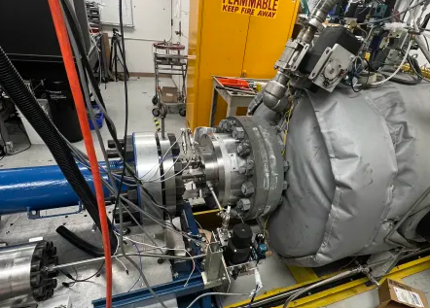
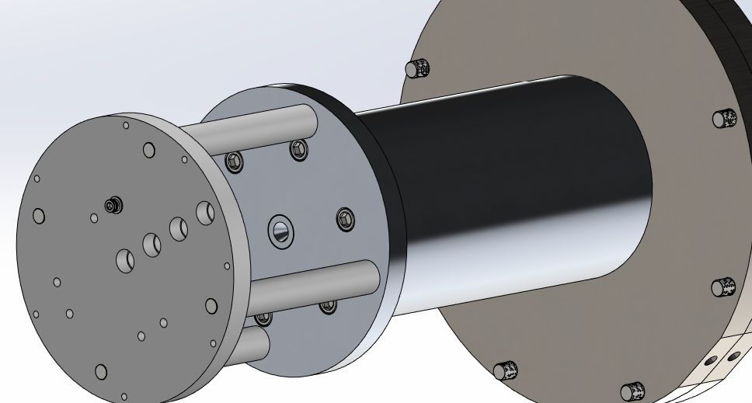
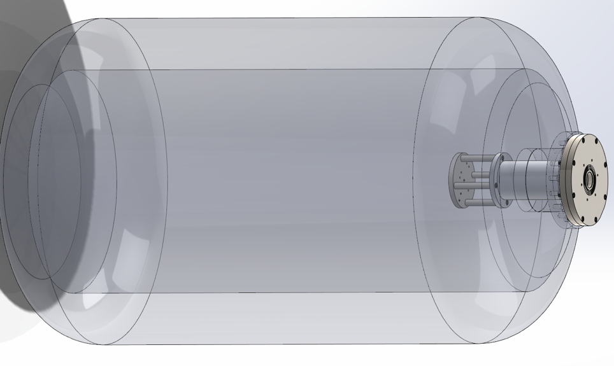
Simulation Validation
In order to bound the error margin of our Ansys simulations, we conducted experiments to get empirical data for plume impingement on a flat surface
Explosion-induced rarefied flow test setup

Slide 19
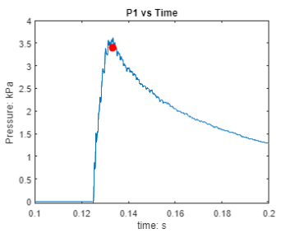
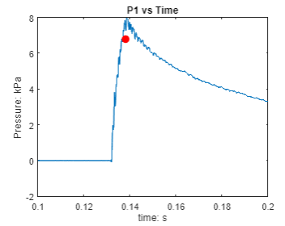
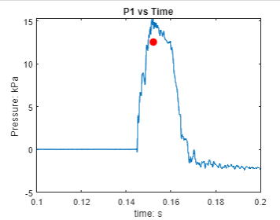
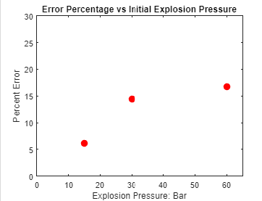
Simulation Validation

Slide 20
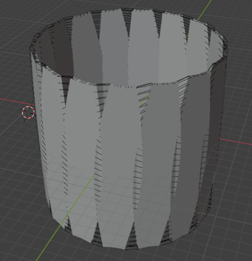
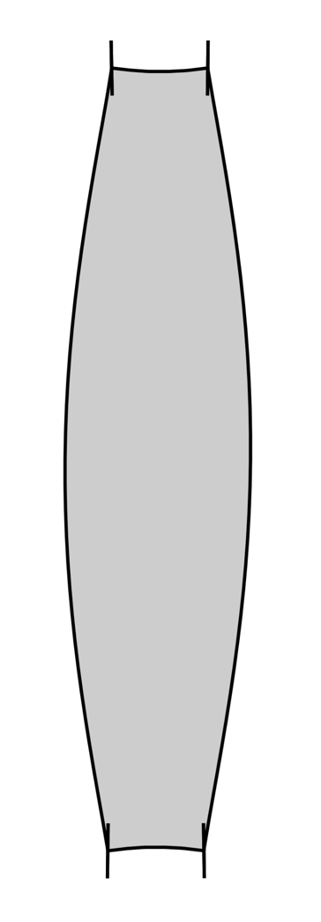
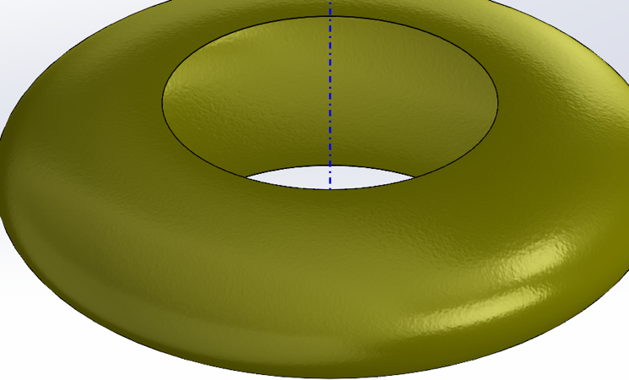
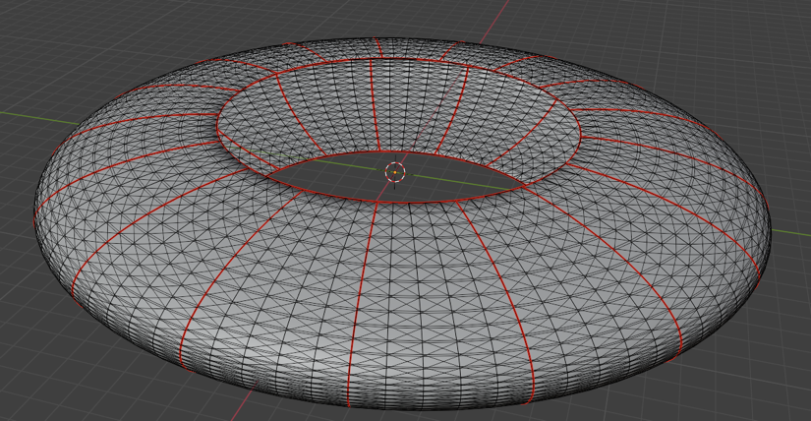
Inflatable Design

Slide 21
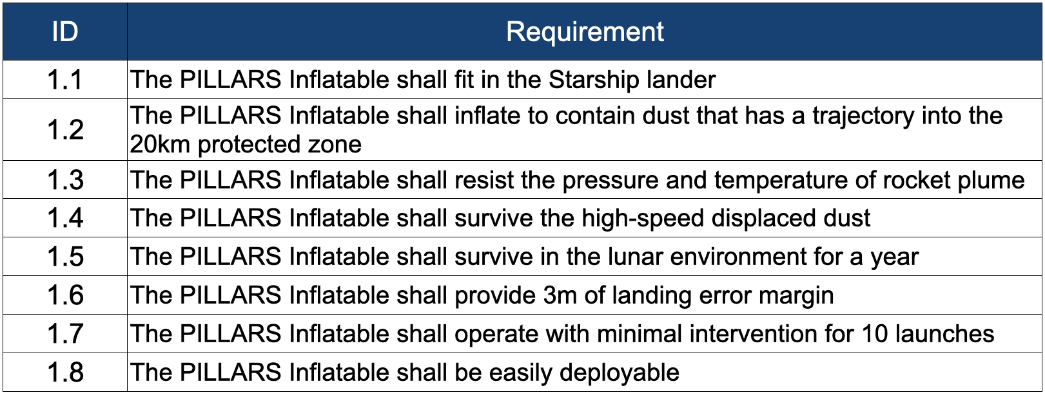
Inflatable Requirements

Slide 22
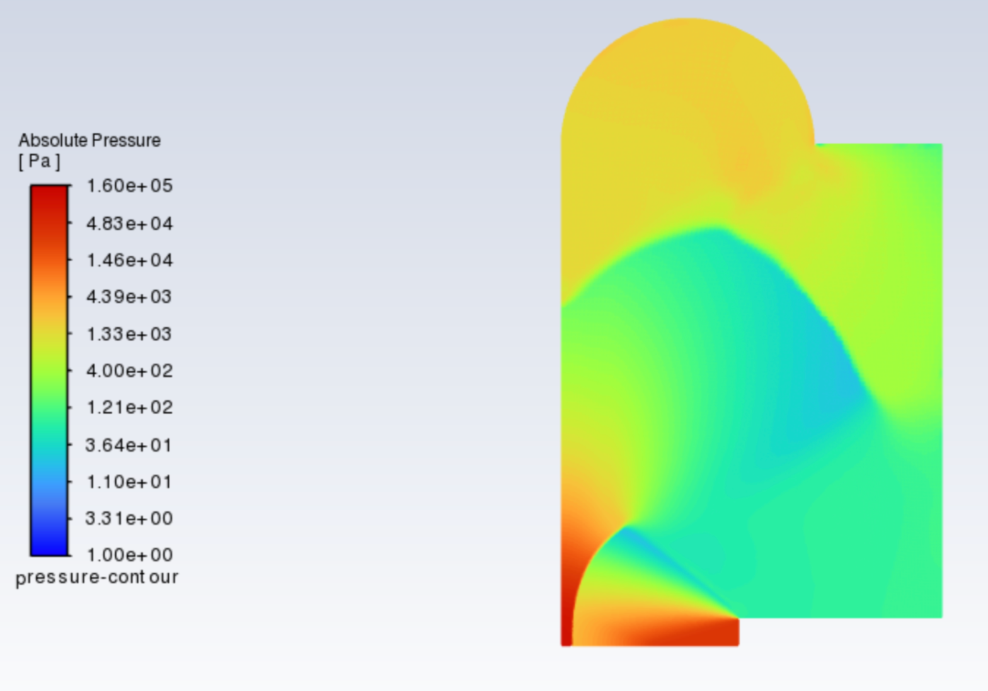
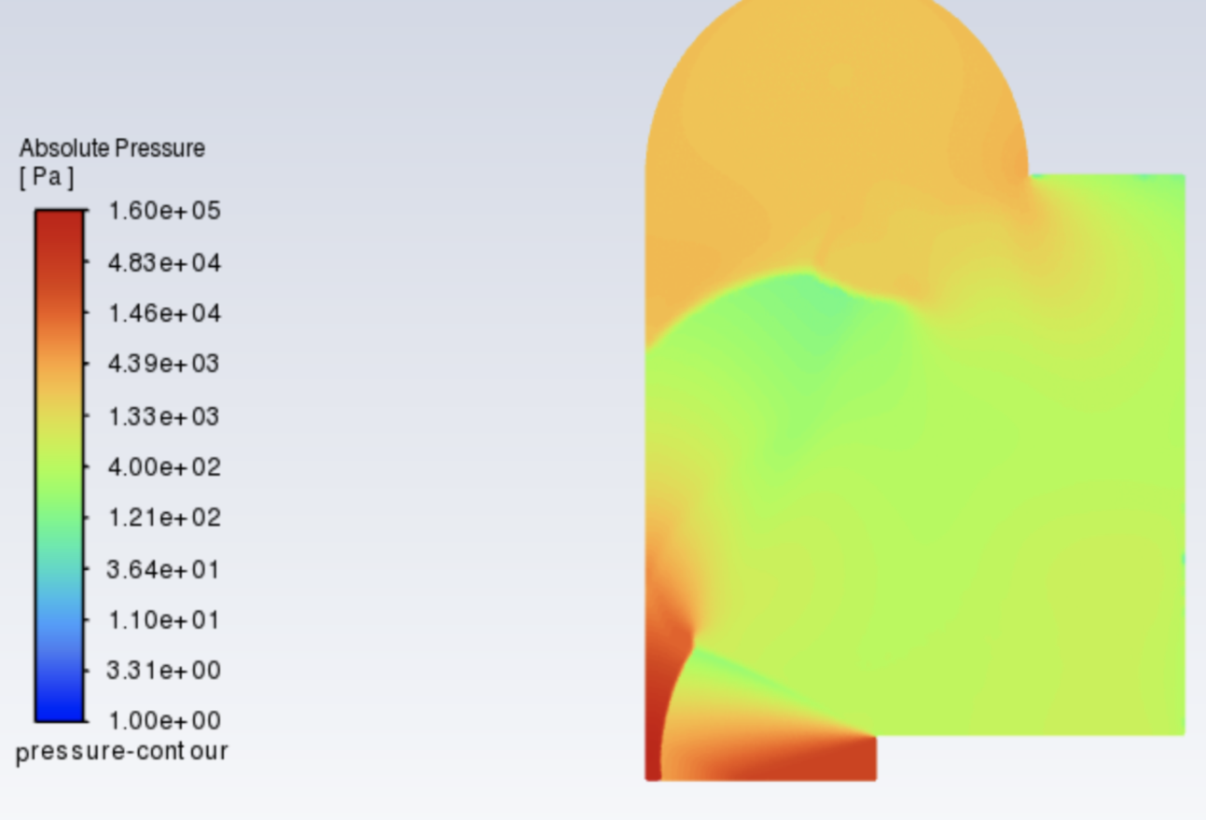
Plume Impingement at Various Shield Radii
We can investigate the optimal shield scaling by simulating the plume impingement force and temperature in Ansys
Shield Radius = 25m
Shield Radius = 20m

Slide 23
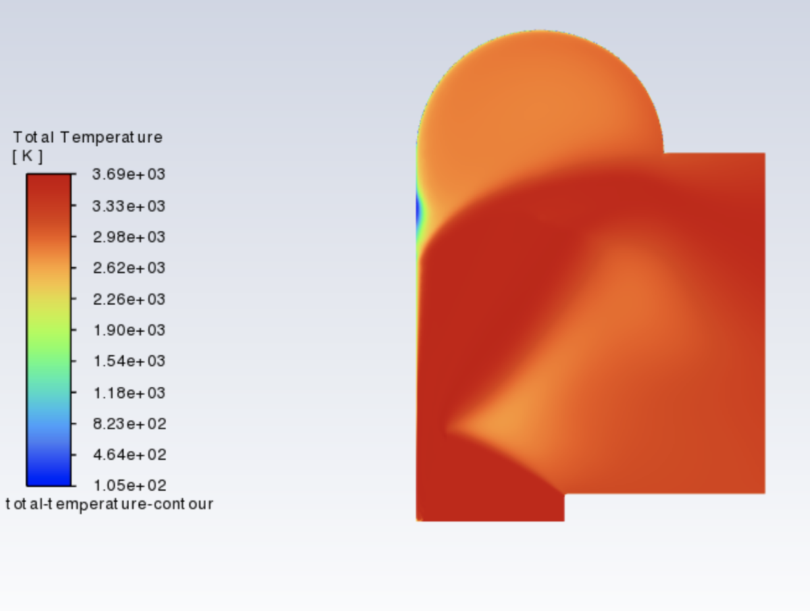
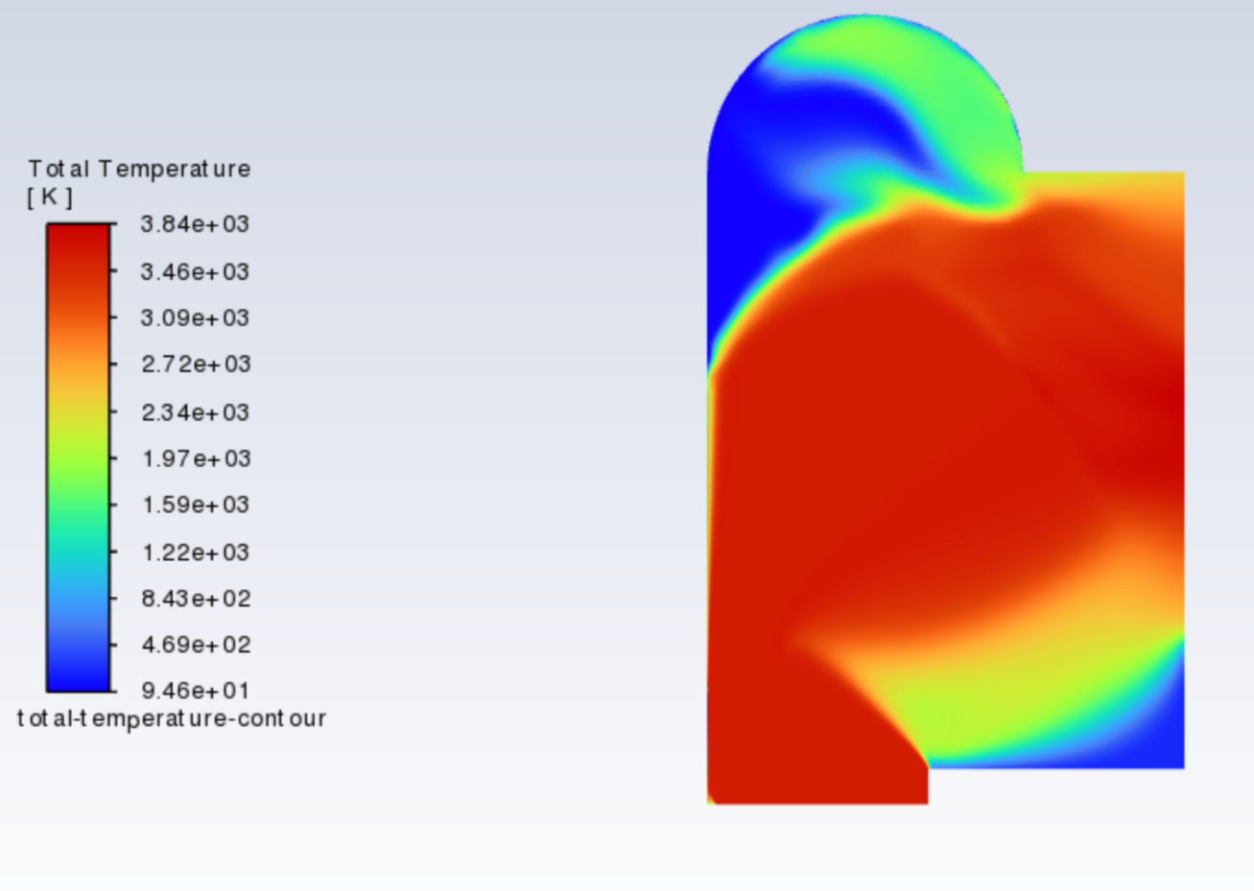
Plume Impingement at Various Shield Radii
This is a problem of heat transfer more so than plume temperature
We can perform tests to understand the rate of heat transfer
Shield Radius = 20m
Survives ~ 7.5s
S
Shield Radius = 25m
Survives ~ 30s

Slide 24
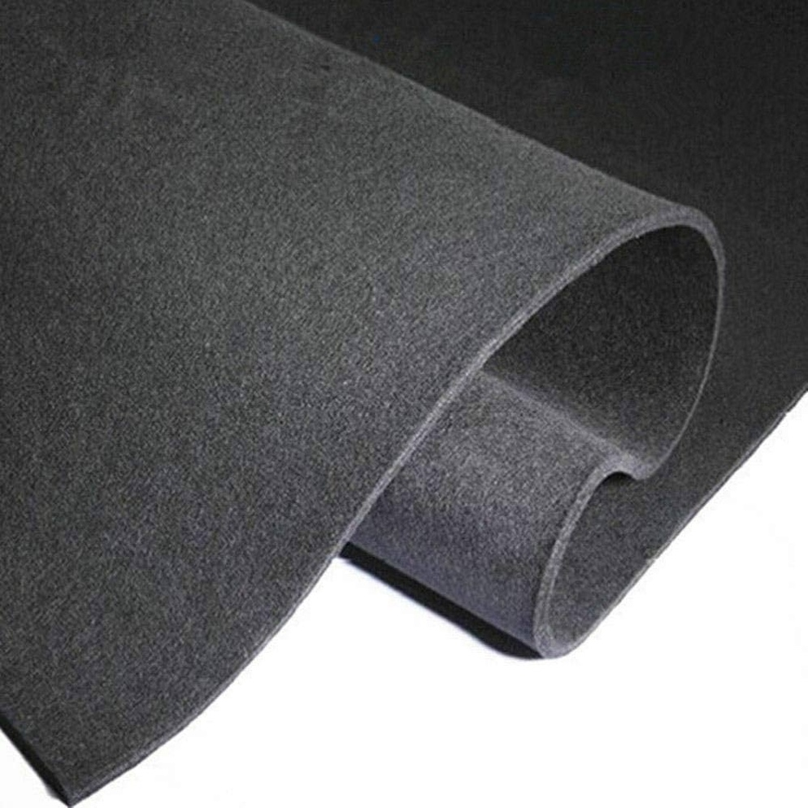
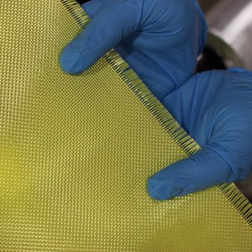
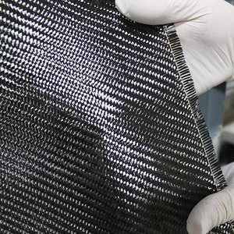
Materials

Slide 25
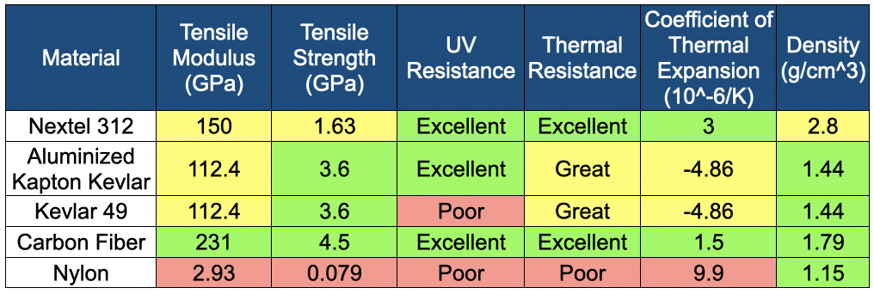
Materials Trade
Kevlar on its own is insufficient due to radiation peaks
Kevlar has been demonstrated to have insufficient tensile strength at high temperatures
We will use Aluminized Kapton Kevlar 49 for a structural layer that won’t degrade under UV, with an interior Carbon Fiber Felt Layer to withstand plume temperatures
Notes:
Given that the lunar environment has radiation peaks two hundred times that of Earth, Kevlar alone is not sufficient
Instead, PILLARS will be constructed with Aluminized Kapton Kevlar
Simulation and testing has shown that Kevlar will not retain sufficient tensile strength at the expected temperature range, and in some cases will reach its melting point.
Adding a layer of carbon fiber felt on the inside of the torus has proven to effectively mitigate heat transfer to the kevlar, allowing PILLARS to withstand plume impingement.
For constructing prototypes, we investigated the physical properties of Kevlar 49, Nextel 312, carbon fiber, and nylon. Being the most cost-effective, nylon was used for the creation of small preliminary prototypes, which did not require high temperature or tensile load capability. For hot fire prototyping, Kevlar 49 was chosen as a structural layer for its high tensile modulus, and higher elastic modulus. It was additionally chosen due to its cost-effectiveness and accessibility, which Nextel 312 lacked. Following initial testing, an inner carbon fiber felt layer was added to larger scale models for added temperature resistance. Additionally, the seal of our inflatable layers must be able to withstand the high temperatures that our inflatable may potentially be exposed to. In these high-temperature conditions, traditional epoxies and adhesives may fail [2], and so stitching layers together with Kevlar thread presents itself as the best option.

Slide 26
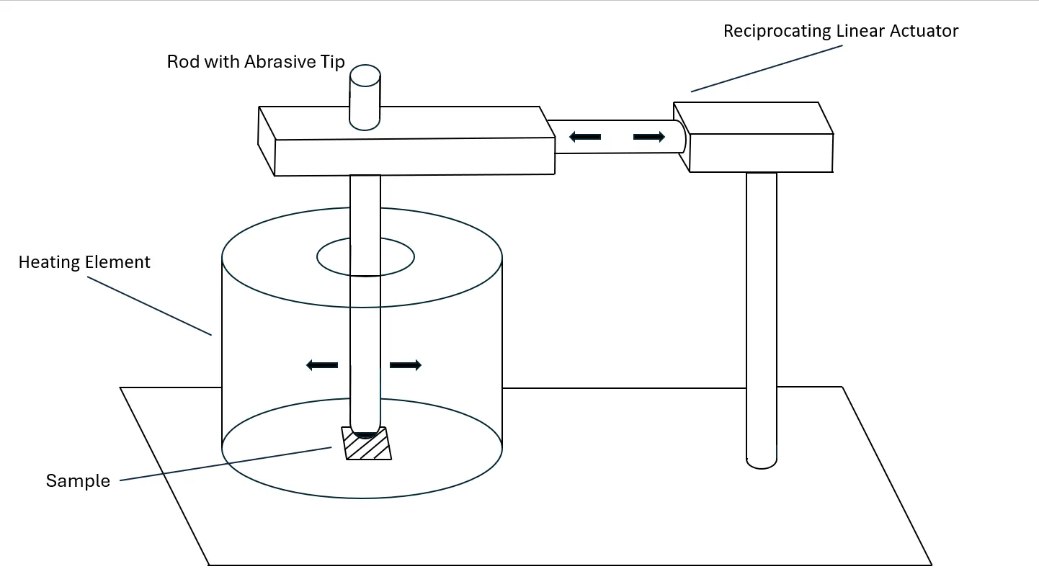
Materials Abrasion Testing Apparatus

Slide 27
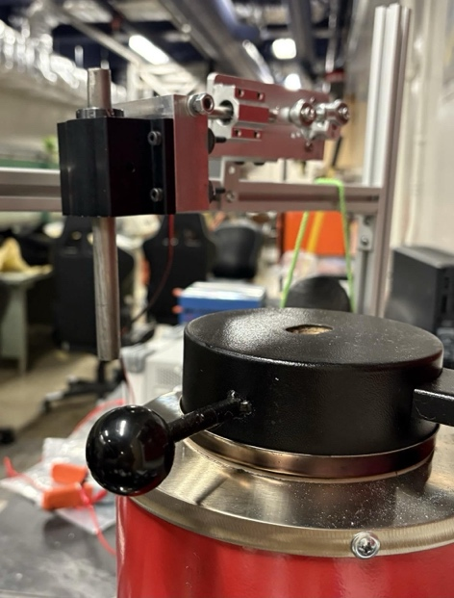
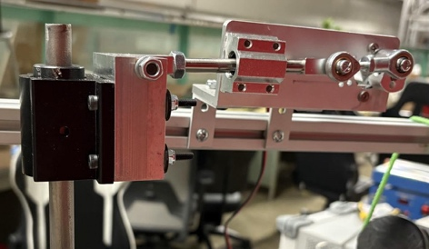
Materials Abrasion Testing
Kevlar samples were subjected to ~5000 abrasion cycles at 300°C, 500°C, and 700°C
Number of abrasion cycles was informed by energy per unit area transferred to PILLARS by high-speed regolith
Energy per unit area derived from estimated volume of regolith displaced by a SpaceX Raptor engine, average regolith grain size, and average velocity of blasted regolith in the lunar atmosphere

Slide 28
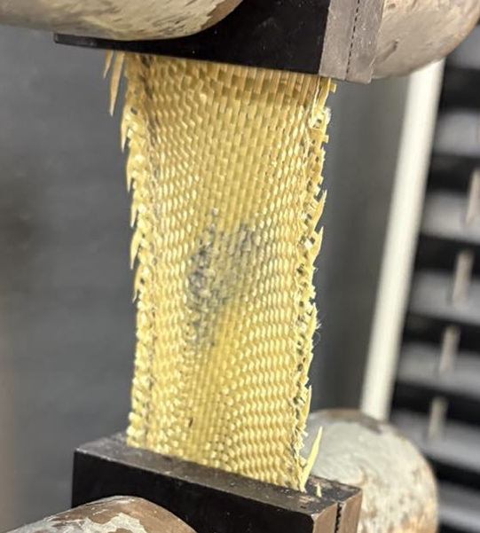
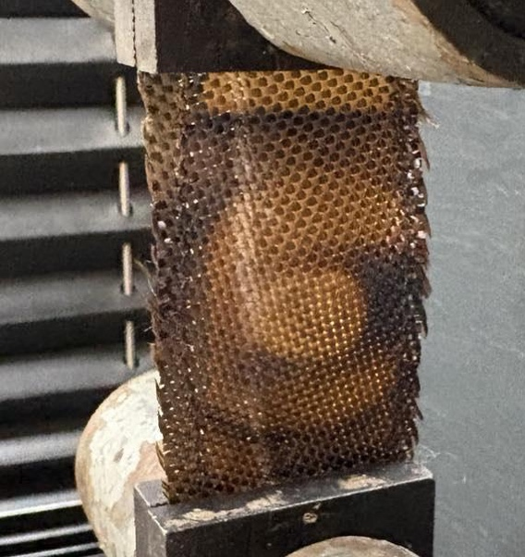
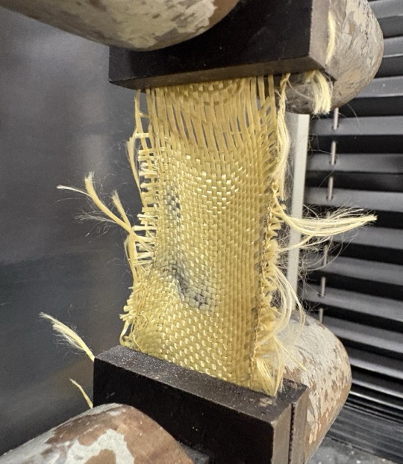
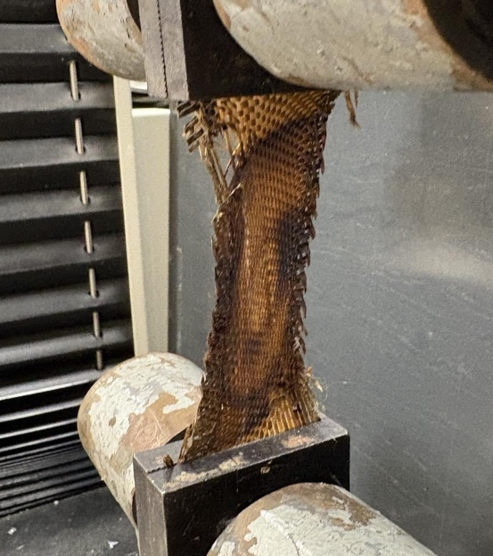
Post-abrasion Tensile Testing
By identifying the maximum force at which each sample begins to fray, we can assess the material's threshold for preventing structural degradation
Point of initial fraying marks the beginning of fiber breakdown
Once fraying initiates, the fabric becomes susceptible to further tearing, creating potential pathways for dust to escape
300°C
700°C

Slide 29
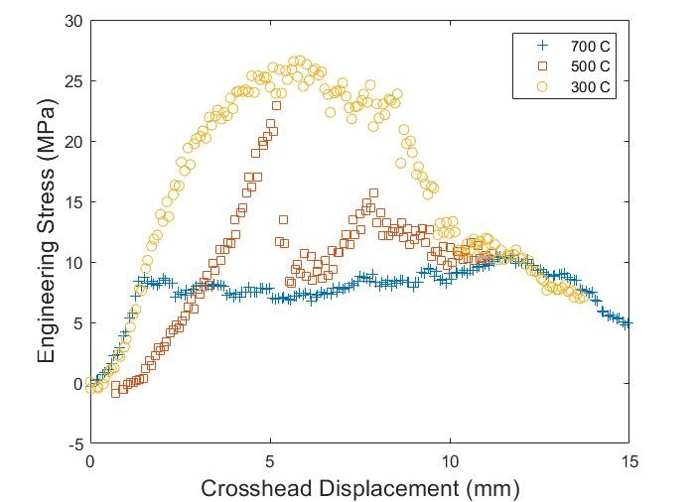
Materials Testing Results
Extreme temperatures result in Kevlar fraying and losing the ability to contain dust
Degradation of Kevlar is more heavily affected by temperature than abrasion
Alternative materials with higher thermal resistance—such as ceramic fiber fabrics—would be better
The tensile strength measured is still greater than the expected tensile load

Slide 30
Rudimentary Inflation Proof of Concept

Slide 31
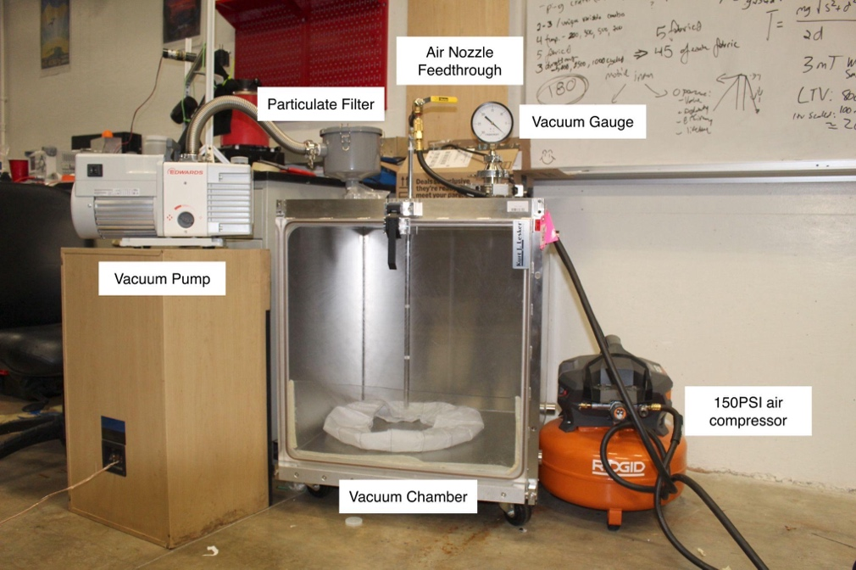
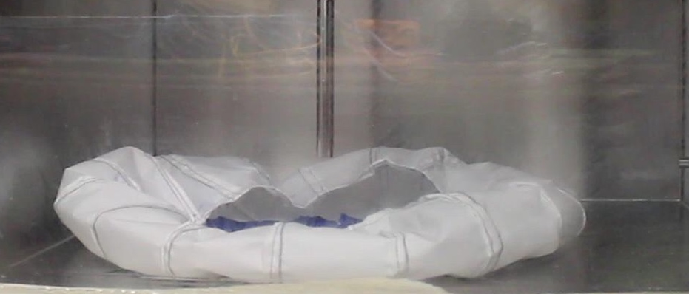
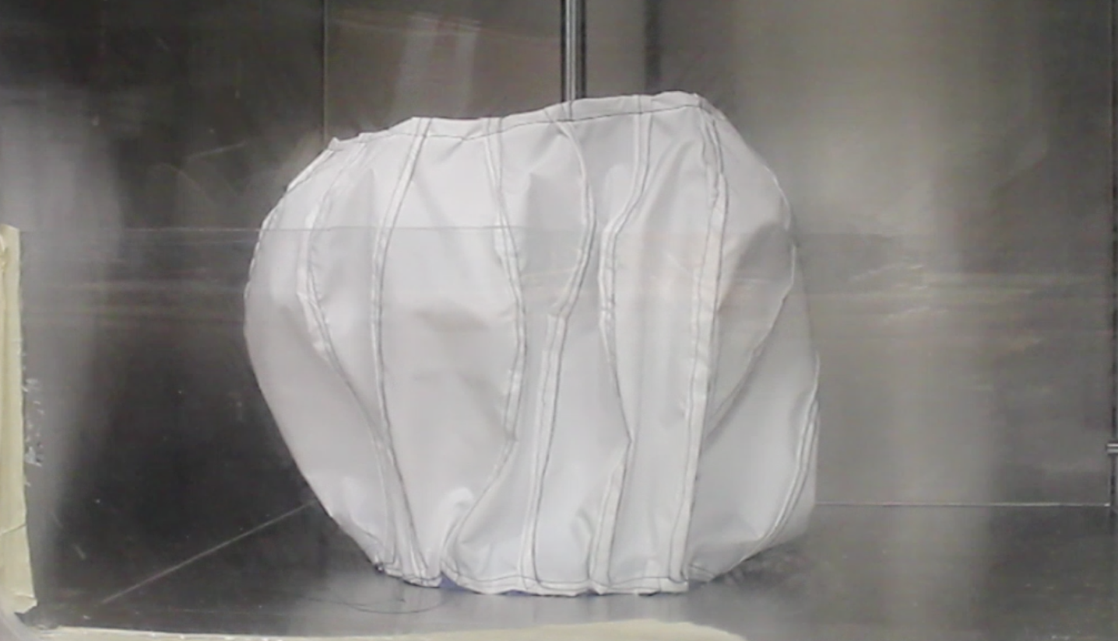
Vacuum Chamber Inflation Testing

Slide 32
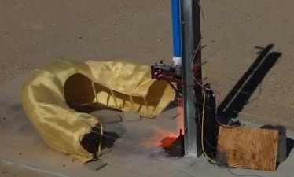
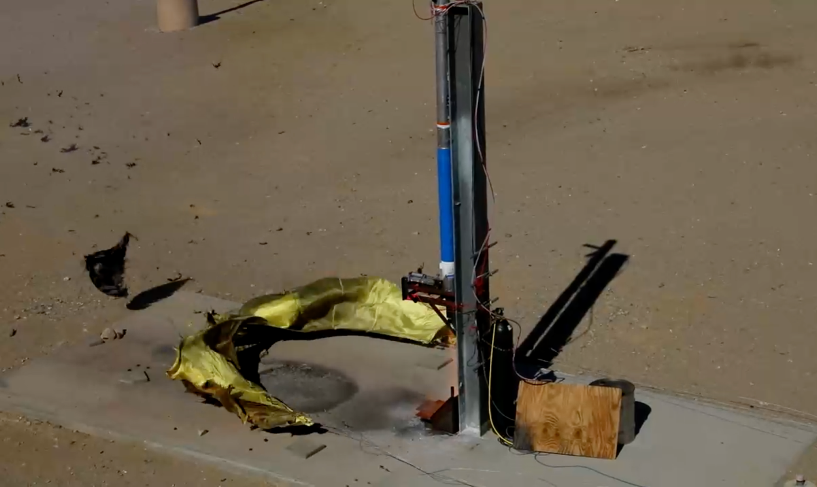
FAR Test 1
8/24/24

Slide 33
FAR Test Overview
500 lbf liquid bi-propellant rocket
2m inner diameter
4m outer diameter
Experimental groups:
bare kevlar
kevlar + carbon fiber felt
kevlar + carbon fiber weave

Slide 34
FAR Test Simulation Expectation
Can we use simulation to design PILLARS to survive a given rocket?
Simulation predicted that the model could survive with an inner radius of 2m for ~10s

Slide 35
Test Video

Slide 36
Results
Load Cell data inconclusive because of cable oscillations
Ground anchoring insufficient
Shield survived <10s, suggesting that the inner radius should be larger
Lessons learned about stitching and seams

Slide 37
FAR Test 2
10/21/24

Slide 38
FAR Test Overview
3m inner diameter
6m outer diameter
Inner layer of Carbon Fiber Felt
Updated anchoring system
Load Cells
Rocket
12’ Concrete Launchpad

Slide 39
New Construction Methods

Slide 40
Test Video

Slide 41
Rocket Failure!
“Rocket science is hard”
The rocket exploded due to a failure in the liquid oxygen regulator valve
We will try again in a few months after FAR rebuilds their rocket!

Slide 42
Deployment

Slide 43
Deployment Overview
Rolled up volume: 4.5 m³
Plume-inflated volume: 160,000 m³
This 7,000 kg shield needs to be unrolled and secured in place before it can be used for plume shielding

Slide 44
Spring Wire System

Slide 45
Inflatable Bladder

Slide 46
Anchoring
Helical Anchors + TRIDENT drill will be used unless load on PILLARS is determined to be very large after CFD.
Jackhammering is beyond the scope of this project

Slide 47
Anchor-Inflatable Interface
FEA results indicate that due to the force of the plume pushing outwards, heavy stress will be placed on PILLARS where the anchor meets the fabric
Reinforce this area using titanium eyelets

Slide 48
LS-Dyna
Modeling the dynamic inflation of PILLARS
Understand lateral anchor loads, especially on off nominal landing
Simulation in progress

Slide 49
Next Steps

Slide 50
TRL Advancement
All components demonstrated in a lab environment
Some components demonstrated in relevant analog environment

Slide 51
Path to Flight
TRL 5
FAR Test #3
Vacuum Dust Test
Anchoring + Deployment Test
TRL 6
Establish lander collaboration
Mojave Test Facilities (AFB, etc.)
SCALPSS Moon Demo
Validate deployment
Robotic Anchoring
Full size unrolling + inflation in vacuum
*Image created with the use of AI

Slide 52
Outstanding Questions
Will our second FAR prototype survive the next test?
How does the system respond to off-nominal landing
What is the dust shielding efficiency of PILLARS
How do other high performance fabrics behave in this environment? (Nextel, high silica, Kevlar/Carbon Fiber composite)
Can PILLARS be deployed on landing rather than before landing?

Slide 53
Closing Remarks
PILLARS is a difficult system to validate, but has the potential to solve a lot of logistical problems for early Artemis
Rocket Science is Hard (and Fun!)
With more simulation and test, PILLARS may prove to be capable of shielding dust ejecta from Starship-sized landers

Slide 54
Acknowledgements
NAME
Advisors
Dr. Soon-Jo Chung (Caltech)
Mr. Kalind Carpenter (JPL)
Mentors
Dr. Joseph Shepherd (Caltech)
Dr. Charles Elachi (Caltech)
Mr. Erik Franks (Cislune)
Partnerships
Cislune
Friends of Amateur Rocketry
Student researchers
8 Project Leads
39 Undergraduate project members

