Slide 3
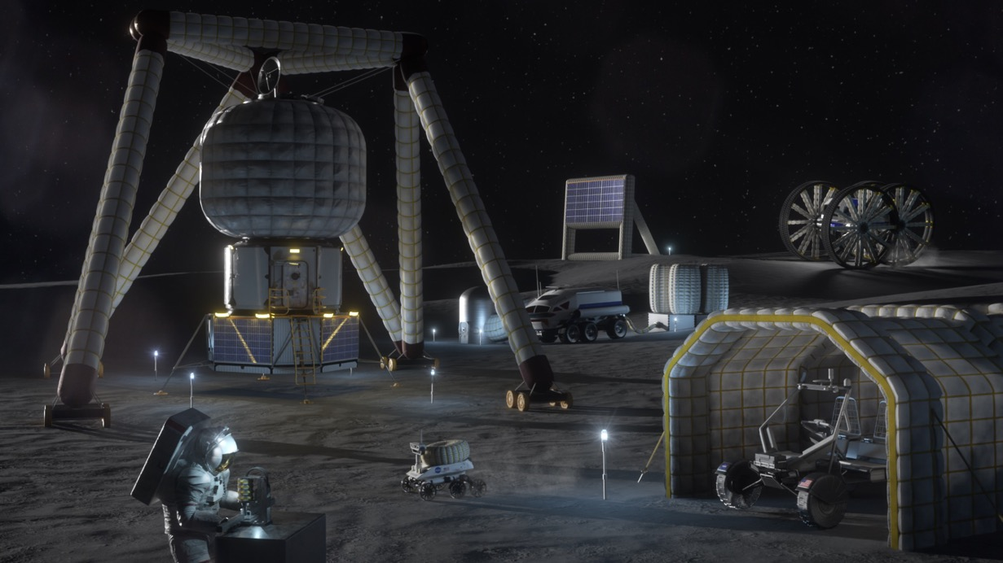
State of the Art: Polymer-Based Inflatables
Maximizes deployed-to-stowed volume
Minimizes mass
Low SWaP technology
Habitats
Towers
Transportation
Shielding
Northwestern University | METALS: Metallic Expandable Technology for Artemis Lunar Structures

Slide 4
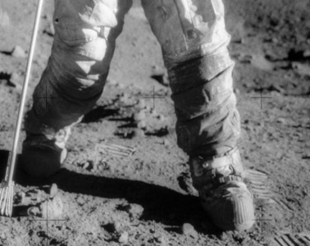
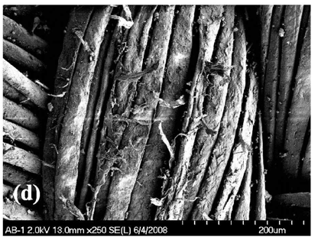
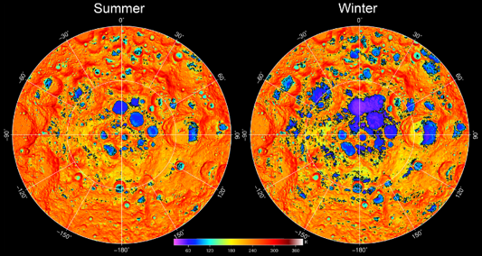
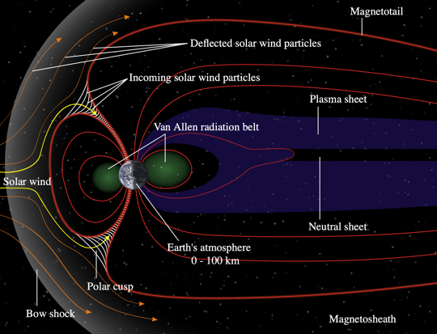
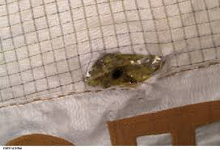
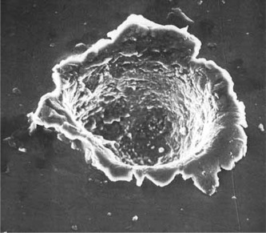
Polymer Inflatables Unsuitable for Harsh Lunar Conditions
Lunar Dust Abrasion
Temperature Extremes, Fluctuations, Sun-Side Heating
→ Embrittlement at low temperatures & fluctuating performance
NASA
NASA
→ Punctures, broken filaments
Jean-Pierre Maillard
Space/Solar Irradiation Embrittlement
Micrometeorite Damage
Degradation, premature failure
Breaking of covalent bonds
ISS Micrometeorite Damage
NASA
NASA
Grier et al.
→ Extremely low repairability, catastrophic failure
NASA
Northwestern University | METALS: Metallic Expandable Technology for Artemis Lunar Structures

Slide 5
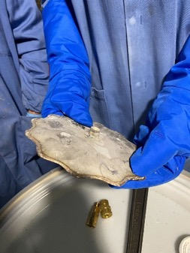
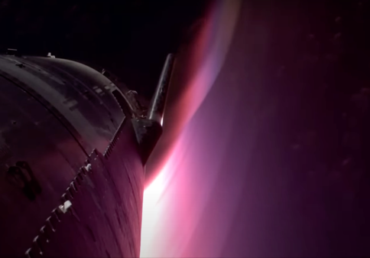
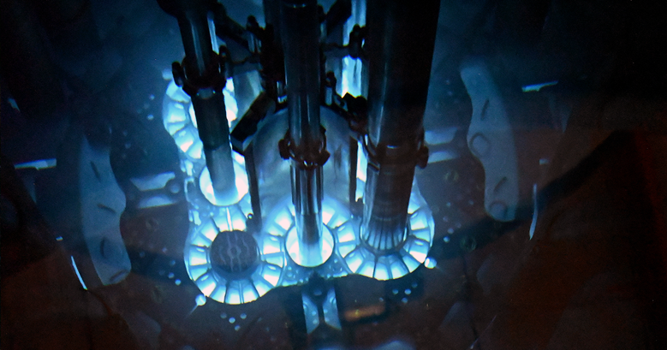
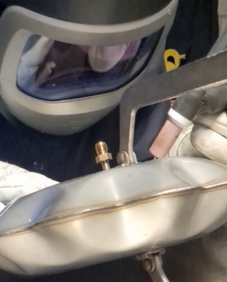
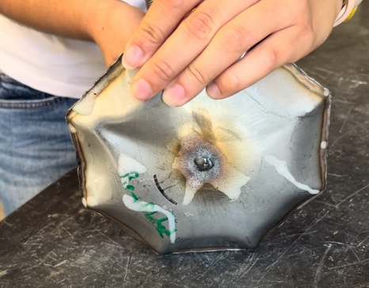
Metal Provides Superior Resilience in the Lunar Environment
Abrasion Resistance
Large Operating Temperature Range
Kennametal
SpaceX
Radiation Resistance
High Repairability/No Critical Failure
DOE
Northwestern University | METALS: Metallic Expandable Technology for Artemis Lunar Structures

Slide 6
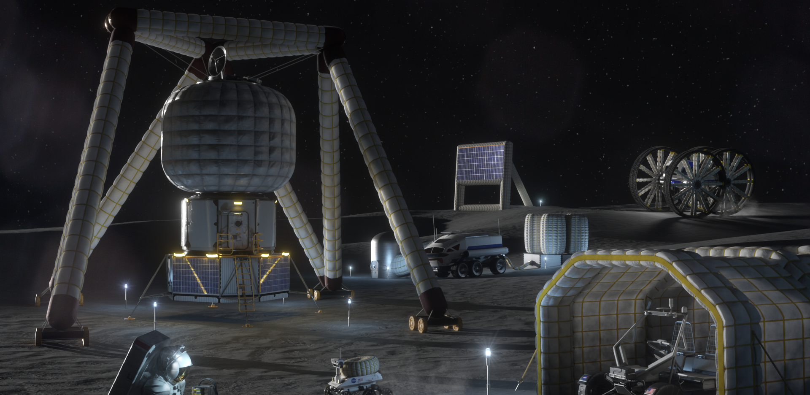
METALS Overview – Difference From Conventional Inflatables
Depressurization or punctures cause catastrophic failure in polymer inflatables
Plastic deformation permanently deploys metal inflatables, even if gas is lost or recovered
Northwestern University | METALS: Metallic Expandable Technology for Artemis Lunar Structures

Slide 7
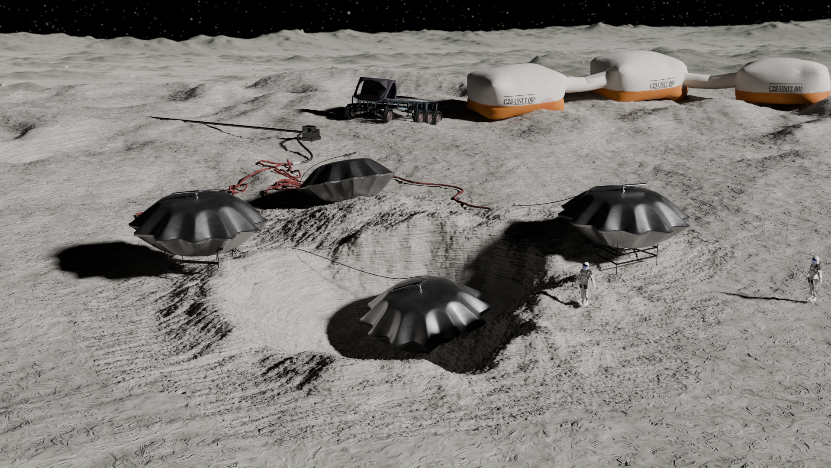
How to Make a Metal Inflatable?

Slide 8
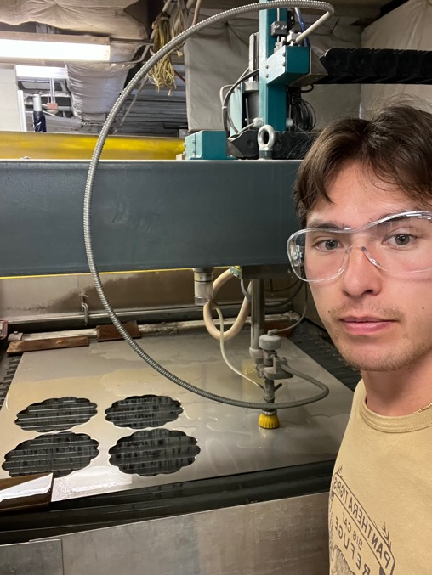
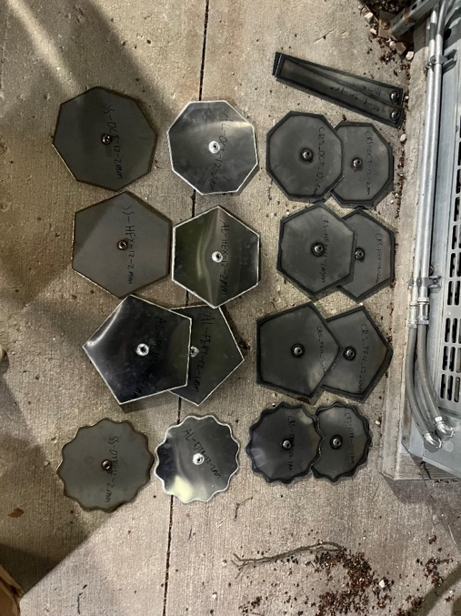
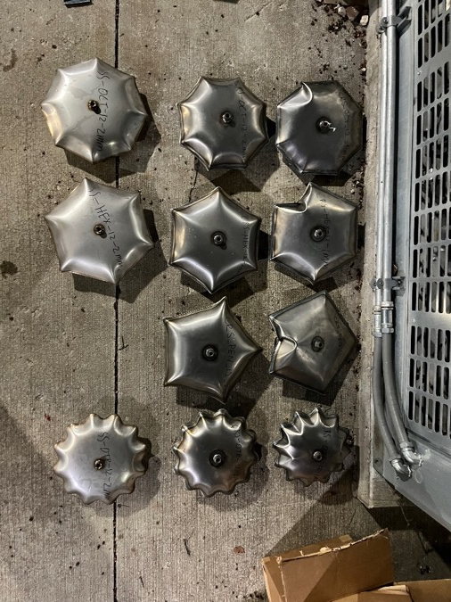
METALS Overview – Simple Manufacturing Process
Handsome team member
Shape is cut out from sheet metal (waterjet or laser)
Edges and valves are welded
2D shape is inflated with air or other fluid
Northwestern University | METALS: Metallic Expandable Technology for Artemis Lunar Structures
Notes:
So now you might be wondering, ubt how you do make a metal inflatable? Well, the process is actually very simple, [simple enough for a undergrad like myself to figure out].
First off, the inflatable geometry is waterjet-cut from sheet metal.
Then, the inflation valve is butt-welded on, followed by edge welding to connect two sheet metal pieces together.
Finally, this 2D shape is pressurized via an air compressor or pressure washer, inflating modules to their 3-dimensional deployed state

Slide 9
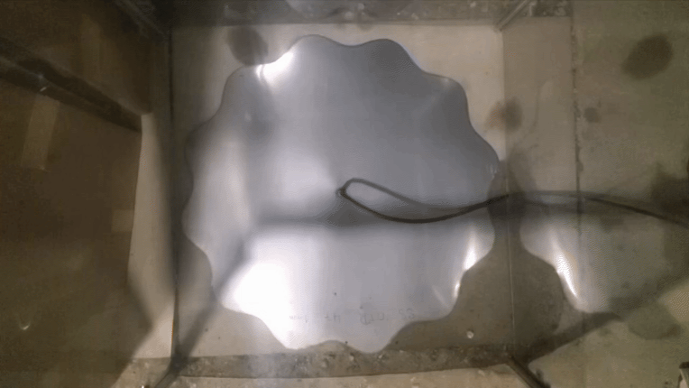
The Final Step: Metal Inflation!
48 in. Diameter
Northwestern University | METALS: Metallic Expandable Technology for Artemis Lunar Structures

Slide 10
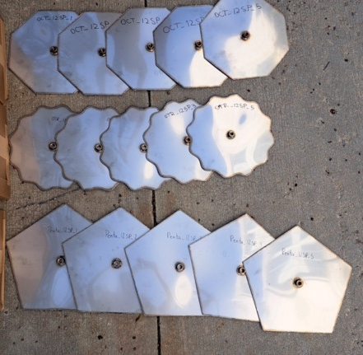
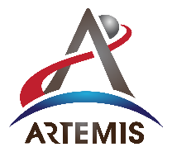
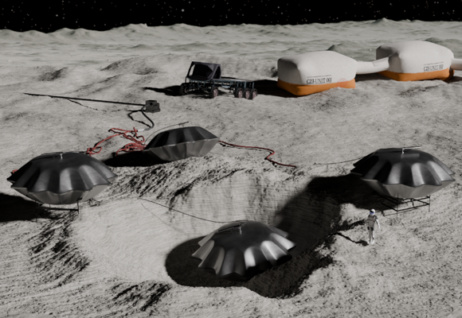
METALS Overview – Simple Manufacturing Process
Simple, reliable, proven manufacturing process
Accelerated
Production Times
Reduced
Fabrication Costs
Accessible Entrance by Commercial Suppliers
Rapid optimization, scalability,
and flight qualification
Simplicity in manufacturing makes METALS a near-term, high value solution relevant for Artemis missions within this decade.
Northwestern University | METALS: Metallic Expandable Technology for Artemis Lunar Structures
Notes:
the simplicity of METALS’ manufacturing method stands in contrast to the complex, highly-specialized manufacturing of traditional polymer-based inflatables, thus enabling METALS to achieve accelerated production times, reduced fabrication costs, and accessible entrance by a plethora of commercial suppliers. These benefits streamline the further scaling, optimization, and flight qualification of metal inflatable technologies, making METALS a near-term, high value solution relevant for Artemis missions within this decade.

Slide 11
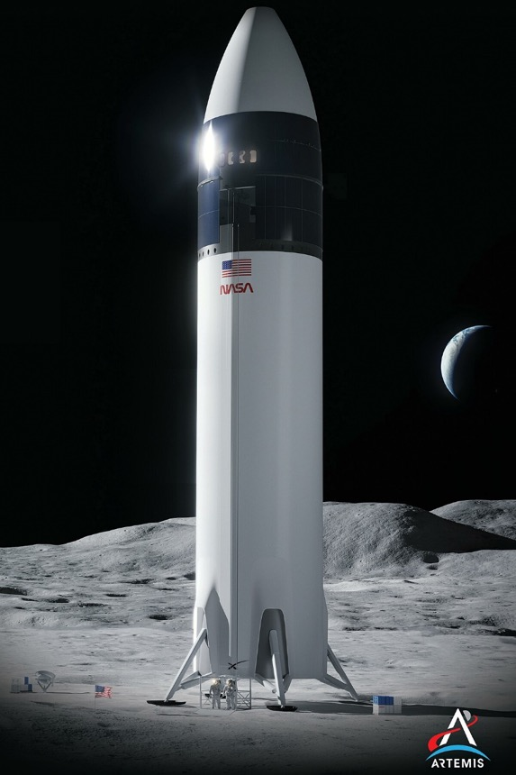
Application: Cryogenic Storage
A sustained human lunar presence requires extensive fluid storage capabilities (especially for cryogenics) with two design criteria:
1.
Scalable deployed storage capacity from compact stowed configuration
2.
Material that retains toughness at cryogenic temperatures
Rigid metal tanks❌
Inflatables✅
Polymers❌
Metals✅
Metal inflatables are the inevitable solution for the Artemis requirement for scalable cryogenic storage
Northwestern University | METALS: Metallic Expandable Technology for Artemis Lunar Structures
Notes:
Oxygen for life support, propellant
Methane for propellant
and no metal- or composite-based fluid storage tanks have been designed to be inflatable/deployable.
Traditional polymer-based inflatables lose their toughness at cryogenic temperatures
Thus, the transport of fixed-shape, rigid tanks constitutes the current SOTA in lunar cryogenic storage → inherently volume-prohibitive
a material class suitable for pressurization at cryogenic temperatures + an inflation capability that enables scalable deployed storage capacity

Slide 12
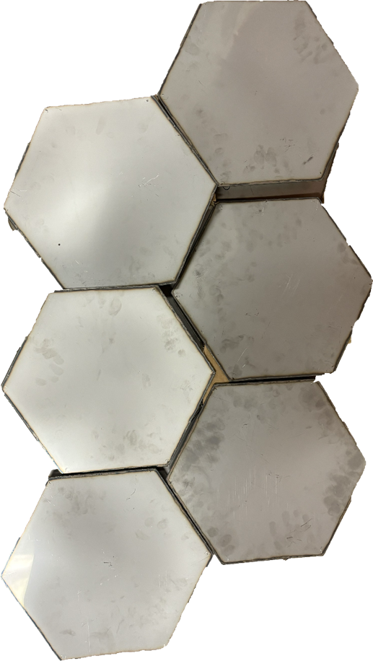
Mission Scenario
Packaging and Deployment
Flat METALS modules densely stacked within payload volume of lunar lander.
Off load from lander.
Inflate with gas under direct sunlight.
Increased ductility and toughness during inflation.
Inflation gas can be heated to amplify this effect.
Gas is recovered and used to inflate other modules.
Northwestern University | METALS: Metallic Expandable Technology for Artemis Lunar Structures

Slide 13
Mission Scenario
1. Lower into hole from autonomous excavator
2. Connect to fluid distribution network
3. Bury under regolith, fill with fluid
Abundant regolith provides:
Protection from day-night fluctuations
Radiation/micrometeorite protection
Exceptionally thermal insulation
…all with zero payload mass penalty.
Northwestern University | METALS: Metallic Expandable Technology for Artemis Lunar Structures
Notes:
Deployed (but empty) module is then lowered into a hole
Connected via piping to cryogenic fluid distribution network
Buried under regolith and filled with cryogenic fluid
Key benefits of burying:
1. Damps periodic temperature fluctuations of day-night cycle
2. Protection from micrometeorites/radiation (just increase depth until desired safety is achieved!)
3. Exceptional thermal insulation performance for long-term cryogenic storage with minimal energy input

Slide 14
Design and Optimization
Variables Defining METALS Design Space
Alloy Selection
Inflation Pressure, $P_{I}$
Sheet Metal Thickness, $t$
2D Shape Cut From Stock Sheet Metal
Optimized design will maximize KPP: m³ of fluid storage per kg of sheet metal
Maximize burst pressure for optimal reliability
Northwestern University | METALS: Metallic Expandable Technology for Artemis Lunar Structures

Slide 15
Design and Optimization
Optimized Shape:
Sinusoidal Edged Circle (SEC)
Discovered thin metal buckles as it’s inflated.
Determined buckling must be controlled.
Carefully designed waves on the edge can ‘guide’ the buckling.
Optimized shape reliably inflates.
$$r=R+Acos(F∗θ)$$
radial distance (r), angle ($θ),$base radius (R), amplitude (A), and frequency (F)
Northwestern University | METALS: Metallic Expandable Technology for Artemis Lunar Structures
Credit to Liam Warlick
Notes:
MAXIMIZE VOLUME AND MINIMIZE STRESS

Slide 16
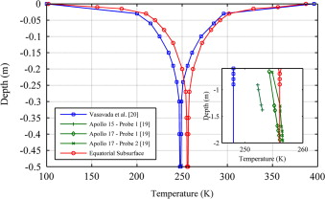
Selection of Burying Depth
Weight of Regolith on Inflatable
Pressure of regolith will counteract pressure of fluid, reducing stress on the inflatable as depth increases.
Weight of regolith is a non-factor (~0.12 PSI per foot of depth).
Internal Pressure
Regolith Pressure
Dampened Temperature Fluctuations
At 40 cm depth, temperature fluctuations are under 10 K
Limits exposure to high daytime temperatures
Malla et. al
Northwestern University | METALS: Metallic Expandable Technology for Artemis Lunar Structures
Notes:
At a depth of 40cm into the lunar surface, thermal fluctuations dampen to less than 10 degrees Kelvin, limiting exposure to high daytime temperatures and making temperature-control more manageable.
The proposed burying depth for METALS inflatables at at a minimum depth of 40 cm under regolith layer. This is intended for exemplary radiation shielding, micrometeorite protection, and thermal insulation without any mass penalty of transporting additional material to the Moon.

Slide 17
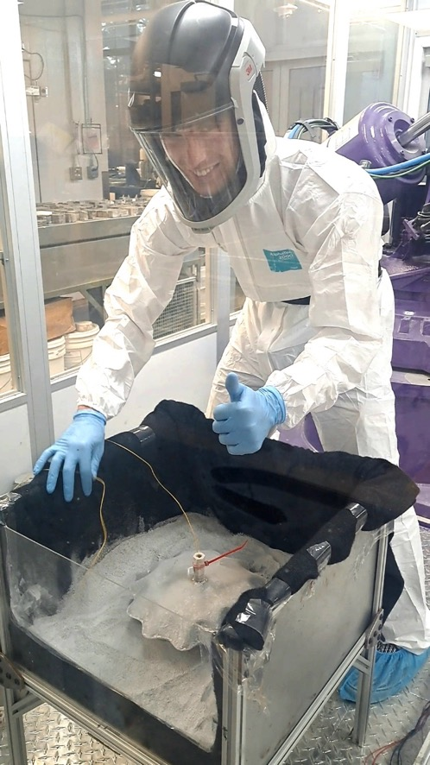
Improved Experimental Setup
Dusty thermal vacuum chamber
Connected cryocooler to achieve steady-state system
Temperature data collection from thermocouples
Regolith Thermal Performance
Attempted Experiment
Bury low-temperature inflatable under regolith
Measure temperature vs time to characterize heat transfer
Experimental Setbacks
Variables were difficult and expensive to control
Initial temperatures, in vacuum, accurate to mission scenario
Preference for Simulation
Offers greater control over realistic parameters of the mission scenario.
Modeled for worst case scenario:
Constant sunlight
Perfect regolith solar absorptivity
Minimum expected fluid storage temperature (70K)
Northwestern University | METALS: Metallic Expandable Technology for Artemis Lunar Structures
Notes:
A physical experiment was initially pursued for characterizing thermal performance of cryogenic METALS modules, as seen on the right. However, it was determined that controlling initial temperatures and applying a vacuum in a test environment compatible with lunar regolith was not within the budget, and our yielded results did not hold significant meaning to the mission scenario.
An improved experimental setup accurate to mission scenario was determined for potential future research, which would take place in a dusty thermal vacuum chamber. A connected cryocooler would maintain cryogenic temperatures within the module, with thermocouples to record temperature over time.
Due to the difficulty and high-cost of this proposed experiment, a thermal model created using finite element analysis was pursued. This allowed us to model the worst-case mission scenario accurately, considering constant sunlight, perfect regolith solar absorptivity, and the minimum expected fluid storage temperature of 70K.

Slide 18
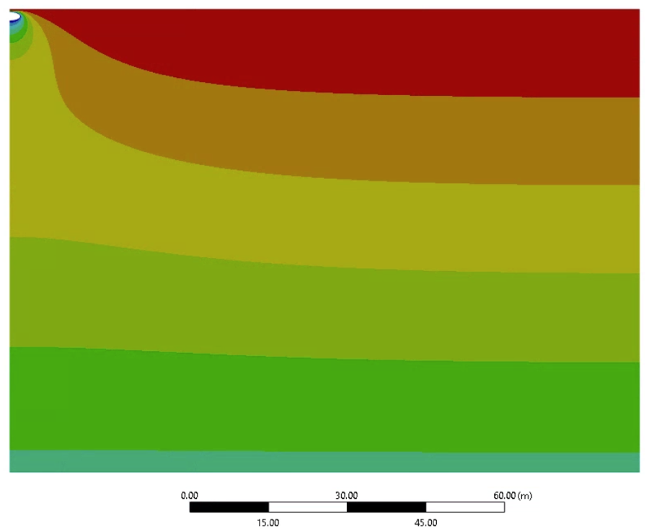
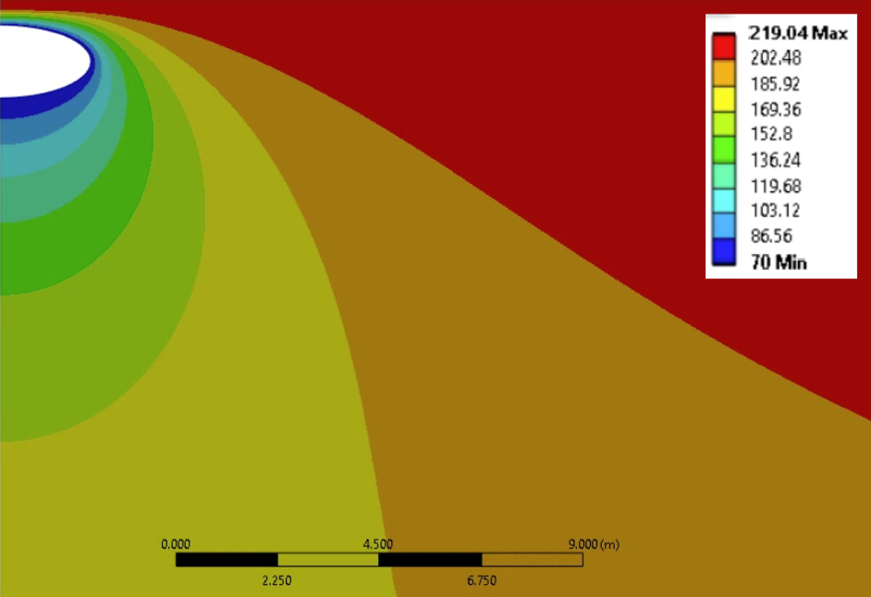
Regolith Thermal Performance
2D FEM Thermal Model
Lunar surface absorbing solar flux
(Kelvin)
Northwestern University | METALS: Metallic Expandable Technology for Artemis Lunar Structures
Notes:
This Ansys Mechanical model simulates an inflatable structure buried under regolith, representing a scenario with high thermal gradients due to direct solar heating at the lunar surface. The model’s two-dimensional axisymmetric geometry centers on an ellipsoidal shape representing a buried inflatable. The top of the model receives a solar flux accurate to 85 degrees latitude, the approximate region where the Artemis base will reside. The temperature field is color-coded on the simulation results, shown in Kelvin.

Slide 19
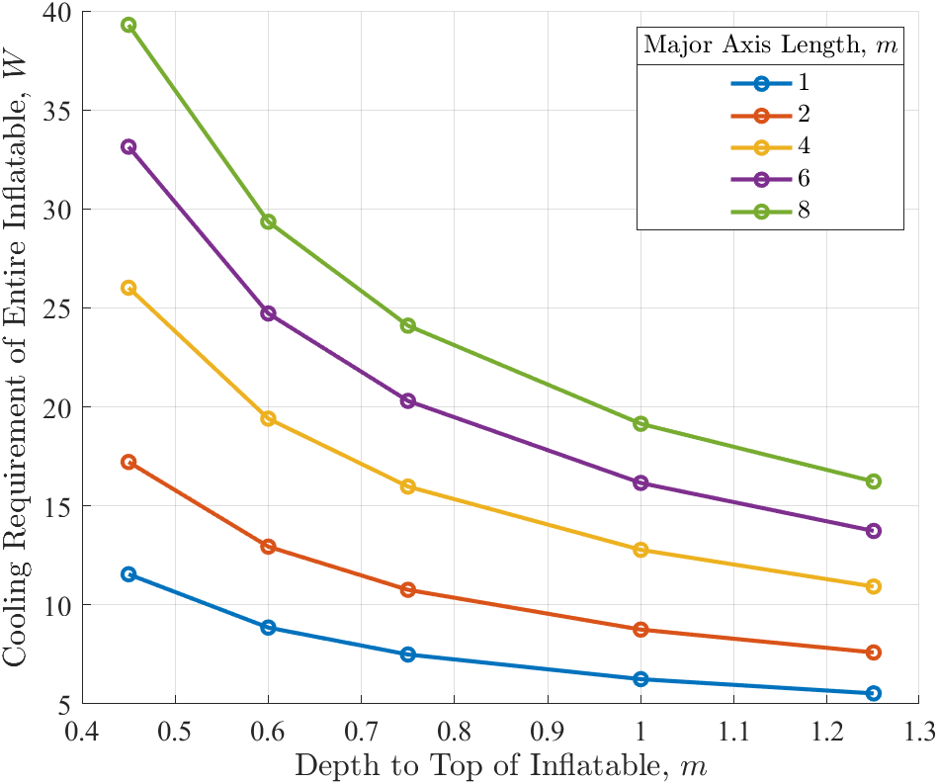
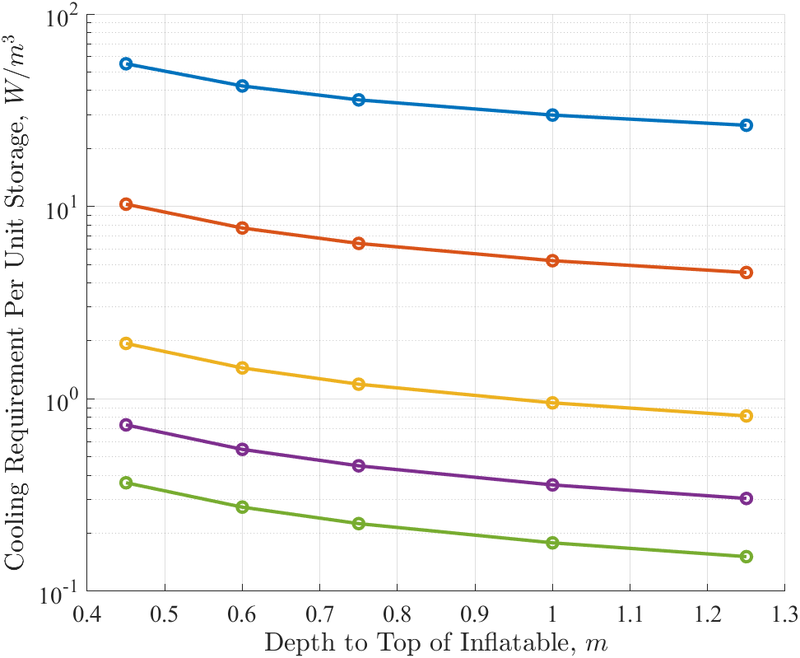
Regolith Thermal Performance – Simulation Results
Cooling Required for Inflatable Versus Depth
Specific Cooling Required Versus Depth
Larger tanks reduce specific cooling requirement ($W/m^{3}$)
Increasing depth reduces cooling requirement
Stores liquid oxygen for <2 W/m³ (depth of 0.45 m, diameter of 4 m)
Starship HLS capacity (1052.6 m³) for <2100 W
Burying METALS modules at least 0.45 meters is more than sufficient to insulate cryogenic fluid
Northwestern University | METALS: Metallic Expandable Technology for Artemis Lunar Structures
Notes:
By solving for steady-state heat transfer, the model showed Burying depths of at least 0.45 meters and inflatables of manufactured diameter of at least 4 meters can maintain cryogenic temperatures for no more than 2 W per cubic meter of liquid oxygen storage. This value is sufficient for storing the entire propellant capacity of Starship HLS (1052.6 m3) for just 2105 Watts. These results confirm that regolith is a highly effective insulator, reducing energy consumption and ensuring long-term, sustainable cryogenic storage.

Slide 20
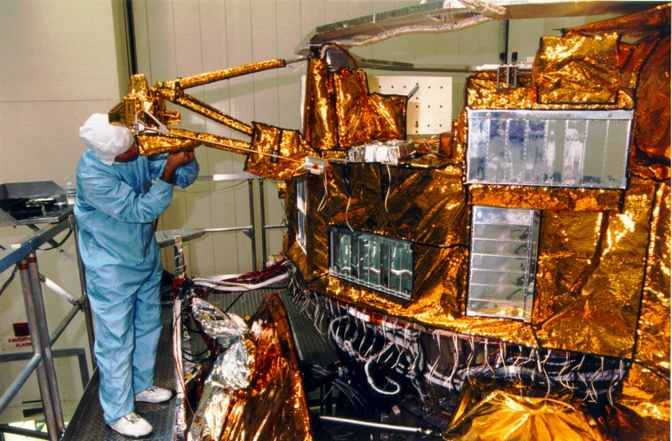
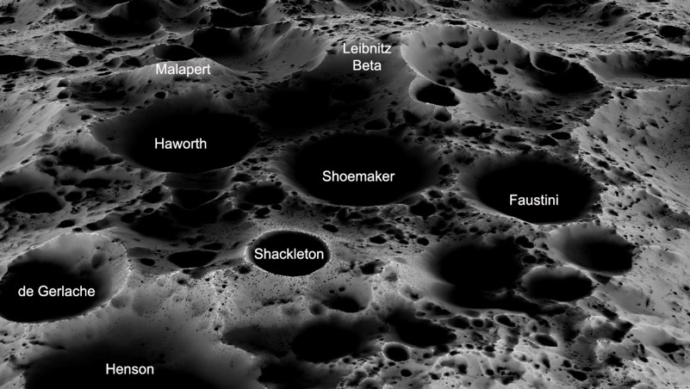
Alternative Approaches for Temperature Control
Permanently Shadowed Regions (Heating)
Aluminized Mylar Shading
Simple, reliable resistive heating
Solid storage when fluid is not in use
Increases storage density
Reduces energy consumption
Placed on surface above buried modules
Reduces absorption of solar energy and resulting regolith temperatures
Solution for above ground storage as well
https://www.lpi.usra.edu/lunar/lunar-south-pole-atlas/
https://science.nasa.gov/mission/cassini/thermal-blankets/
Northwestern University | METALS: Metallic Expandable Technology for Artemis Lunar Structures
Notes:
Further methods for feasible cryogenic storage have been identified to add flexibility of the METALS mission scenario, but must be simulated or experimented in order to quantify thermal benefits, energy consumption, and cost. In conjunction with burying under regolith, a light-weight “tarp” shade of low-emissivity material (such as aluminized Mylar, 0.044) can be constructed above buried modules to block regolith absorption of solar flux, significantly reducing regolith temperatures by up to 60K [10], and thus the rate of heat transfer.
Within Permanently Shadowed Region (PSR) mean temperature of 18K, thermal management becomes an issue of heating, not cooling. This will be safely and reliably accomplished with resistive heating directly in contact with the module. Alternatively, liquid fuel can be pumped to the surface with reasonable efficiency since some energy is recovered on the way down. Additionally, fluid can be stored solid to increase storage density and reduce energy consumption, as heating is only necessary when fluid is to be transferred. This particular mission scenario may be especially energy efficient as continuous energy expenditure is not needed to maintain storage.
(While potentially more logistically challenging to construct/install, storage in a PSR represents the most optimal storage scenario. Active heating is simpler and more reliable, and a loss of power results in solidification, not gasification and loss of stored fluids)

Slide 21
Our testing plan (TRL4-TRL5 readiness)
Standardized inflation pressure
Deformation as a function of pressure
Inflation under vacuum conditions
Study the scalability laws of the metal inflatable design through rapid manufacture and iteration,
Evaluate the reliability of the proposed manufacturing methods through repeatable testing campaigns
Evaluate the inflatable design within a variety of relevant lunar conditions to advance its flight-readiness to TRL 5 status.
Micrometeorite impact resistance
Cryogenic storage feasibility
Strength testing
Reliability of welds
Effect of annealing on carbon steel
Northwestern University | METALS: Metallic Expandable Technology for Artemis Lunar Structures

Slide 22
Testing & Capabilities
Northwestern University | METALS: Metallic Expandable Technology for Artemis Lunar Structures

Slide 23
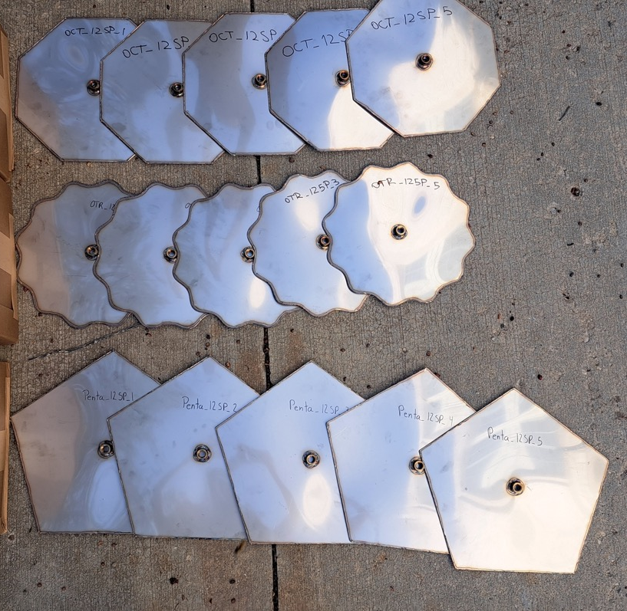
Standardized Inflation Pressure
Overview
Validate the reliability and consistency of three module geometries.
Design Parameters
Geometries: Pentagon, Hexagon, SEC.
Size: 12’’ diameter.
Thickness: 1mm.
Material: Stainless Steel 304.
Volume Measurement Methods
Pressures < 150psi: Submerge modules in water and inflate with air compressor to measure water displacement.
Pressures > 150psi: Inflate with pressure washer, then measure volume by weighting the module with water.
Fifteen Modules utilized for SPI Testing, Pre-Inflation
Northwestern University | METALS: Metallic Expandable Technology for Artemis Lunar Structures

Slide 24
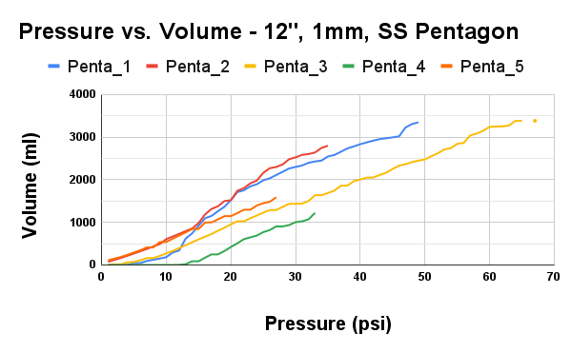
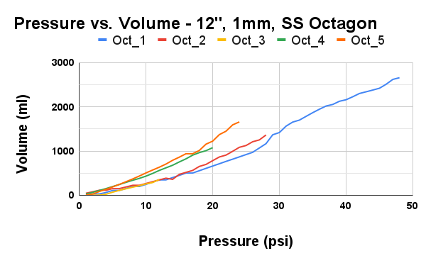
Standardized Inflation Pressure
Five Inflated and Burst Pentagons
Five Inflated and Burst Octagons
Northwestern University | METALS: Metallic Expandable Technology for Artemis Lunar Structures

Slide 25
Standardized Inflation Pressure
Five Inflated and Burst Pentagon Modules
Five Inflated and Burst Octagon Modules
Northwestern University | METALS: Metallic Expandable Technology for Artemis Lunar Structures

Slide 26
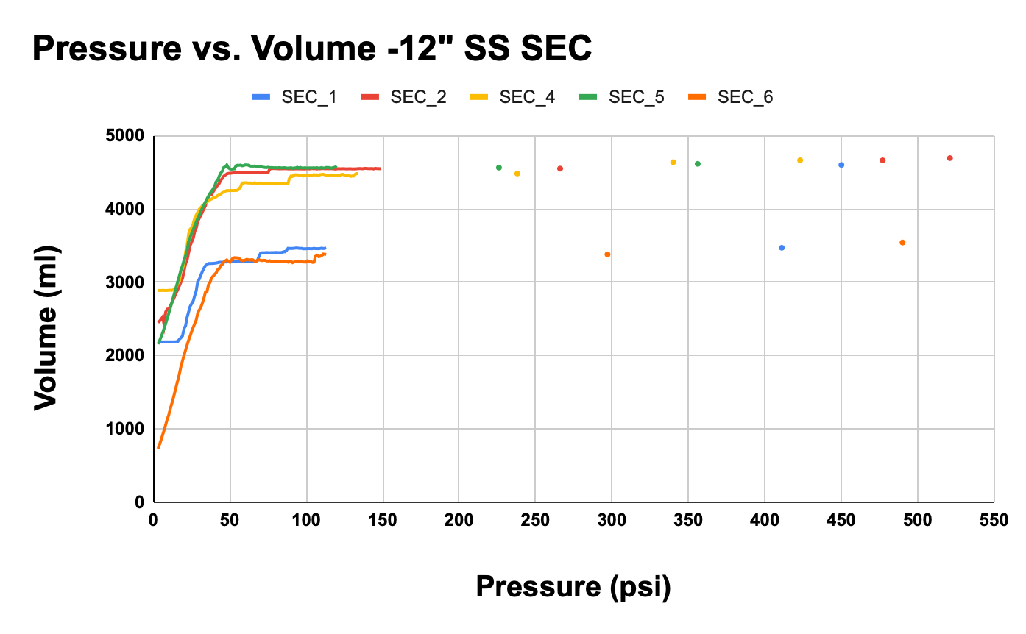
Standardized Inflation Pressure
SEC Results
Continuous deformation.
High initial slope before 50 psi.
Plateaus at 50psi, achieving max volume.
Withstands pressures ~10 times bigger than that of octagon and pentagon geometries.
No buckling.
Five Inflated and Burst SEC Modules
Air Compressor Limit
Northwestern University | METALS: Metallic Expandable Technology for Artemis Lunar Structures

Slide 27
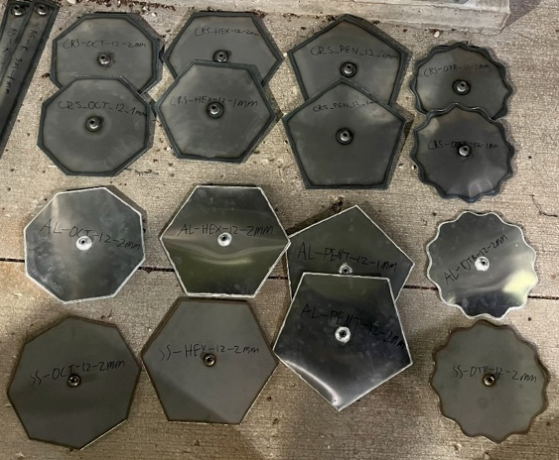
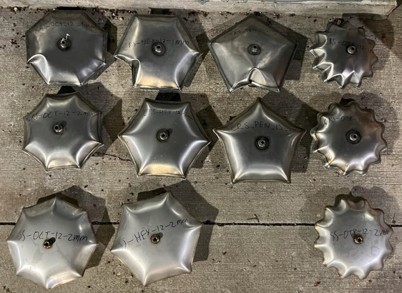
Deformation vs. Pressure
Overview
Analyze relationship between module deformation and inflation pressure across design parameters.
Design Parameters
Thicknesses: 1mm, 2mm.
Materials: Stainless Steel 304, Low-Carbon Steel 1008.
Geometries: Pentagon, Octagon, Hexagon, SEC.
Top – Deformation vs. Pressure Modules Pre-Inflation.
Bottom – Deformation vs. Pressure Modules Post-Inflation.
Northwestern University | METALS: Metallic Expandable Technology for Artemis Lunar Structures

Slide 28
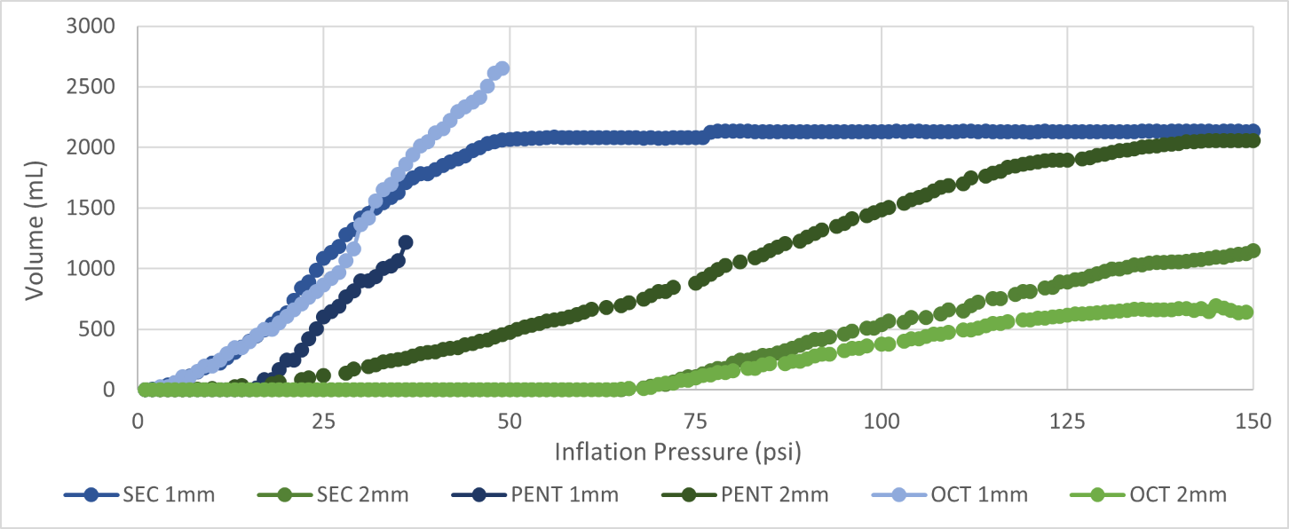
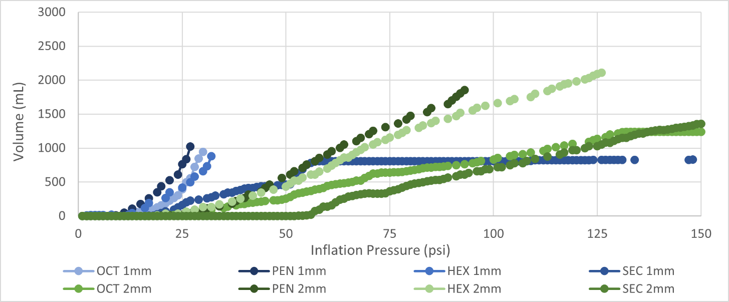
Deformation vs. Pressure
Thickness Selection
Analyze relationship between module deformation and inflation pressure based on material thickness.
Deformation vs. Pressure of Stainless Steel Modules
1mm = 2mm =
Deformation vs. Pressure of Low-Carbon Steel Modules
Northwestern University | METALS: Metallic Expandable Technology for Artemis Lunar Structures

Slide 29
Deformation vs. Pressure
Thickness Selection
Analyze relationship between module deformation and inflation pressure based on material thickness.
1mm Performance:
Bigger expansion, lower burst pressures.
Deformation vs. Pressure of Stainless Steel Modules
1mm = 2mm =
Deformation vs. Pressure of Low-Carbon Steel Modules
Northwestern University | METALS: Metallic Expandable Technology for Artemis Lunar Structures

Slide 30
Deformation vs. Pressure
Thickness Selection
Analyze relationship between module deformation and inflation pressure based on material thickness.
1mm Performance:
Bigger expansion, lower burst pressures.
Deformation vs. Pressure of Stainless Steel Modules
2mm Performance:
Lower expansion, higher burst pressures.
1mm = 2mm =
Deformation vs. Pressure of Low-Carbon Steel Modules
Northwestern University | METALS: Metallic Expandable Technology for Artemis Lunar Structures

Slide 31
Deformation vs. Pressure
Thickness Selection
Analyze relationship between module deformation and inflation pressure based on material thickness.
1mm Performance:
Bigger expansion, lower burst pressures.
Deformation vs. Pressure of Stainless Steel Modules
2mm Performance:
Lower expansion, higher burst pressures.
↑ Thickness = ↓ Expansion = ↑ Burst Pressure
1mm = 2mm =
Deformation vs. Pressure of Low-Carbon Steel Modules
Northwestern University | METALS: Metallic Expandable Technology for Artemis Lunar Structures

Slide 32
Deformation vs. Pressure
Thickness Selection
Analyze relationship between module deformation and inflation pressure based on material thickness.
1mm Performance:
Bigger expansion, lower burst pressures.
Deformation vs. Pressure of Stainless Steel Modules
2mm Performance:
Lower expansion, higher burst pressures.
↑ Thickness = ↓ Expansion = ↑ Burst Pressures
SEC Performance:
Bigger expansion, bigger burst pressures.
1mm = 2mm =
Deformation vs. Pressure of Low-Carbon Steel Modules
Northwestern University | METALS: Metallic Expandable Technology for Artemis Lunar Structures

Slide 33
Deformation vs. Pressure
Material Selection
Material | Shape | Thickness (mm) | Final Volume (mL) | Burst Pressure (psi)
Low-Carbon Steel | SEC | 1 | 4538 | 273
Low-Carbon Steel | SEC | 2 | 5447 | 417
Stainless Steel | SEC | 1 | 4644 | 440
Stainless Steel | SEC | 2 | 5450 | 616
Analyze relationship between module deformation, weld reliability and inflation pressure based on material selection.
Northwestern University | METALS: Metallic Expandable Technology for Artemis Lunar Structures

Slide 34
Deformation vs. Pressure
Material Selection
Material | Shape | Thickness (mm) | Final Volume (mL) | Burst Pressure (psi)
Low-Carbon Steel | SEC | 1 | 4538 | 273
Low-Carbon Steel | SEC | 2 | 5447 | 417
Stainless Steel | SEC | 1 | 4644 | 440
Stainless Steel | SEC | 2 | 5450 | 616
Analyze relationship between module deformation, weld reliability and inflation pressure based on material selection.
Geometry Selection
Analyze relationship between module deformation and inflation pressure based on geometry selection.
Pentagon: ↑ Expansion = ↓ Burst Pressures
Average Deformation vs. Pressure of All 1mm-Thick, Stainless-Steel Modules
Northwestern University | METALS: Metallic Expandable Technology for Artemis Lunar Structures

Slide 35
Deformation vs. Pressure
Material Selection
Material | Shape | Thickness (mm) | Final Volume (mL) | Burst Pressure (psi)
Low-Carbon Steel | SEC | 1 | 4538 | 273
Low-Carbon Steel | SEC | 2 | 5447 | 417
Stainless Steel | SEC | 1 | 4644 | 440
Stainless Steel | SEC | 2 | 5450 | 616
Analyze relationship between module deformation, weld reliability and inflation pressure based on material selection.
Geometry Selection
Analyze relationship between module deformation and inflation pressure based on geometry selection.
Pentagon: ↑ Expansion = ↓ Burst Pressures
Octagon: ↓ Expansion = ↑ Burst Pressures
Average Deformation vs. Pressure of All 1mm-Thick, Stainless-Steel Modules
Northwestern University | METALS: Metallic Expandable Technology for Artemis Lunar Structures

Slide 36
Deformation vs. Pressure
Material Selection
Material | Shape | Thickness (mm) | Final Volume (mL) | Burst Pressure (psi)
Low-Carbon Steel | SEC | 1 | 4538 | 273
Low-Carbon Steel | SEC | 2 | 5447 | 417
Stainless Steel | SEC | 1 | 4644 | 440
Stainless Steel | SEC | 2 | 5450 | 616
Analyze relationship between module deformation, weld reliability and inflation pressure based on material selection.
Geometry Selection
Analyze relationship between module deformation and inflation pressure based on geometry selection.
Pentagon: ↑ Expansion = ↓ Burst Pressures
Octagon: ↓ Expansion = ↑ Burst Pressures
SEC: ↓ Expansion = ↑ ↑ Burst Pressures
Average Deformation vs. Pressure of All 1mm-Thick, Stainless-Steel Modules
Northwestern University | METALS: Metallic Expandable Technology for Artemis Lunar Structures

Slide 37
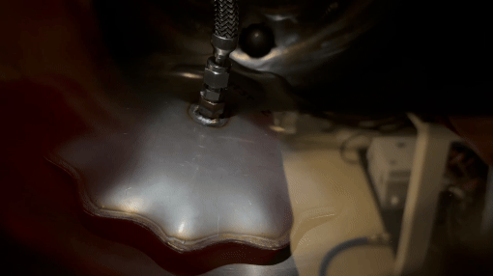
Vacuum Pressure
Vacuum test 1 – SEC 6 in diameter. 40 psi, 0.05 Torr
Northwestern University | METALS: Metallic Expandable Technology for Artemis Lunar Structures

Slide 38
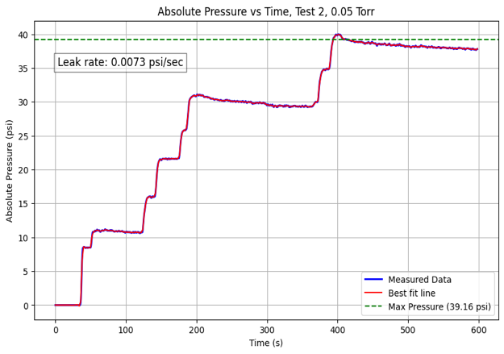
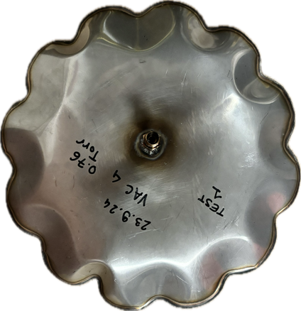
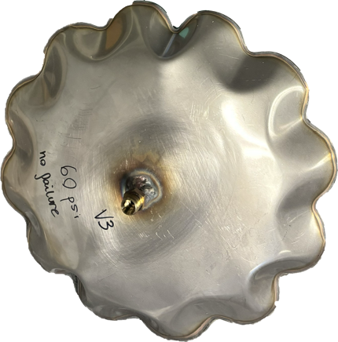
Vacuum Pressure
Overview
Evaluate deformation and operational reliability under vacuum pressures.
Setup
VIM2000 vacuum furnace.
Argon tank.
Pressure Transducer.
Yor-Lok fittings.
Results
Same inflation performance.
Final geometry as atmospheric, no ruptures.
Figures:
Top – Test 2 data, 0.05 Torr, 6 in SEC
Bottom – vacuum test inflatable (left) vs atm pressure inflatable
1mm SS304 SEC
Northwestern University | METALS: Metallic Expandable Technology for Artemis Lunar Structures

Slide 39
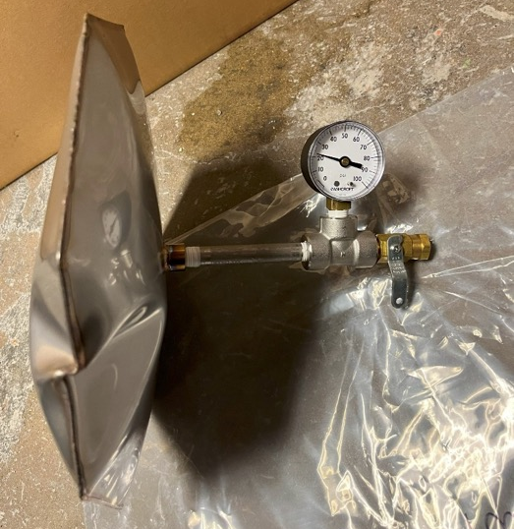
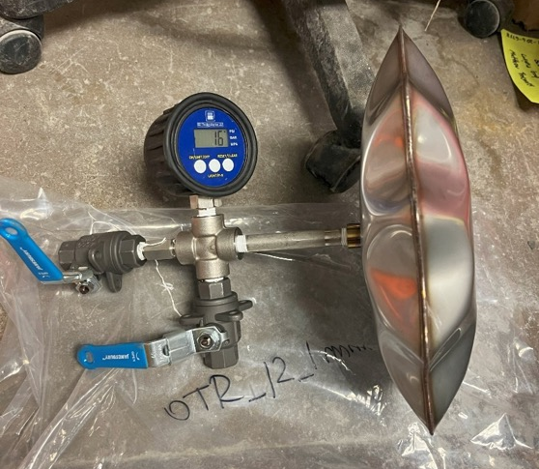
Holding Pressure
Overview
Pressurized Pentagon for
Holding Pressure Testing
Validate pressure-holding capabilities.
Modules
Geometries: SEC and Pentagon.
Thickness: 1mm.
Material: Stainless Steel.
Method
Pressurize to 22 psi.
Daily pressure checks.
Duration of 14 days.
Results
METALS modules can effectively hold pressure when properly sealed.
Pressurized SEC for
Holding Pressure Testing
Northwestern University | METALS: Metallic Expandable Technology for Artemis Lunar Structures

Slide 40
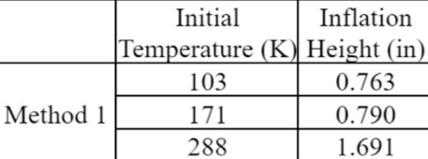
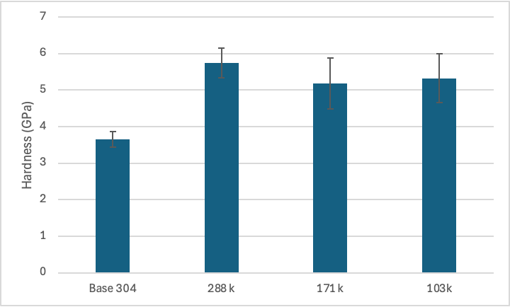
Cryogenic Temperatures
Overview
Evaluate module reliability under cryogenic conditions.
Initial Temperature vs. Final Inflation Height
Experiment 1
Assess the effect of cryogenic temperatures on volumetric expansion and material characteristics of inflatables.
Setup
Modules: 3 x 7’’ SECs (1mm SS 304).
Temperatures: 103K, 171K, 280K.
Pressure: 85 psi.
Method
Measurement of final height and RT nano-indentation.
Results
Hardness of each inflatable measured at room temp
↓ Temperature = ↓ Expansion = ↓ Burst Pressures ≠ Hardness Change
Northwestern University | METALS: Metallic Expandable Technology for Artemis Lunar Structures

Slide 41
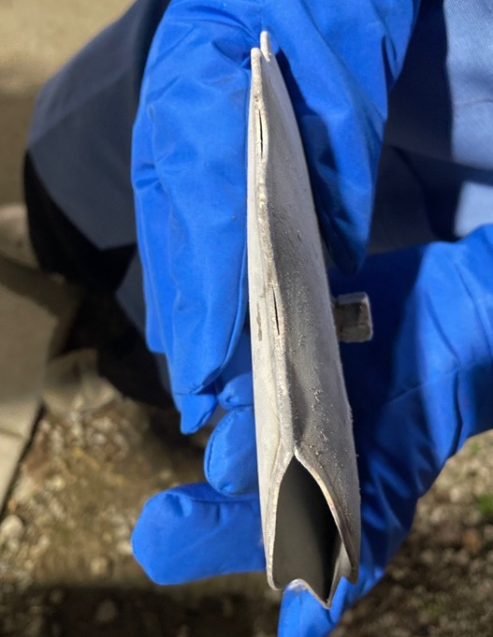
Cryogenic Testing Results
Experiment 2
Assess the effect of cooling after inflation on failure points.
Setup
Modules: 2 x 7’’ SECs (1mm SS 304).
Temperatures: inflated at 280K, one cooled to 171K at 85 psi.
Method
Initial Pressurization: 85 psi.
Cooling of one module to 171K.
Final pressurization: 150 psi.
Results
Cooling after Inflation = ↓ Expansion ≠ Failure Pressure
Figure – Burst SEC Module during Cryogenic Temperature Testing Experiment 1
Table – Initial temperature vs. inflation Height of 2 Modules
Northwestern University | METALS: Metallic Expandable Technology for Artemis Lunar Structures

Slide 42
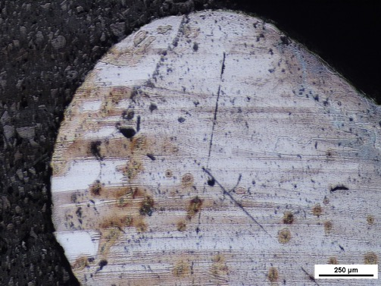
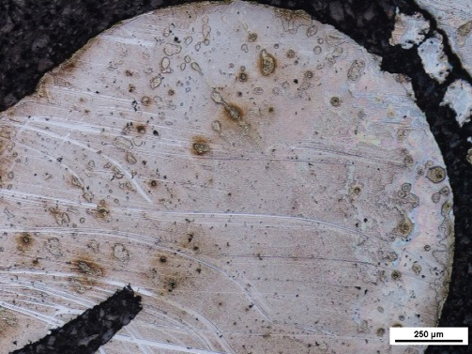
Cryogenic Testing Results
Conclusion:
Room temperature pre-inflated module robust for pressurized cryogenics and unlikely to fail
More ductile metals will deform around the weld interface as opposed to cracking
Ideal inflation time/location is in direct sunlight
Pre inflation
Post-inflation
Change in weld geometry post-inflation in annealed carbon steel
Weld pocket ~2 microns
Weld Pocket ~50 microns
Northwestern University | METALS: Metallic Expandable Technology for Artemis Lunar Structures

Slide 43
Cryogenic Testing Results
Conclusion:
Room temperature pre-inflated module robust for pressurized cryogenics and unlikely to fail
More ductile metals will deform around the weld interface as opposed to cracking
Ideal inflation time/location is in direct sunlight
Final image of cryogenic inflatable demonstrating much sharper interface
Northwestern University | METALS: Metallic Expandable Technology for Artemis Lunar Structures

Slide 44
Repairability
Overview
Develop and test solutions for patching punctures on inflated modules.
Solid-State Solution
TIG welding a 1x1-inch stainless steel patch over a 0.223" puncture
Liquid-State Solution
MIG welding in a spiral pattern
Solid-State Solution Testing
Liquid-State Solution Testing
Northwestern University | METALS: Metallic Expandable Technology for Artemis Lunar Structures

Slide 45
Reliability of Welds
Objective
Standard Side Views of Volume Rendering of Samples 1, 2, and 3
Assess weld reliability to detect internal defects impacting structural integrity.
Method
Samples 1
X-ray micro-computed tomography (microCT) with SkyScan 1276 microCT.
Samples
Materials: 3 samples of Carbon Steel 1008 & Stainless Steel 304 each.
Dimensions: <72mm diameter, <300mm length (for microCT compatibility).
Resolution: 6 µm with 12 mm diameter sample holder.
Samples 2
Samples 3
Northwestern University | METALS: Metallic Expandable Technology for Artemis Lunar Structures

Slide 46
Reliability of Welds
Standard Side Views of Volume Rendering of Samples 1, 2, and 3
Objective
Assess weld reliability to detect internal defects impacting structural integrity.
Samples 1
Method
X-ray micro-computed tomography (microCT) with SkyScan 1276 microCT.
Samples
Materials: 3 samples of Carbon Steel 1008 & Stainless Steel 304 each.
Dimensions: <72mm diameter, <300mm length (for microCT compatibility).
Resolution: 6 µm with 12 mm diameter sample holder.
Samples 2
Scanning Process
Equipment: SkyScan 1276 microCT for high-precision imaging.
Set-up: full 360° rotation with X-ray tube and detector around the sample.
Time per scan: approximately 5 minutes per sample.
Samples 3
Northwestern University | METALS: Metallic Expandable Technology for Artemis Lunar Structures

Slide 47
Reliability of Welds
Sample 1 Slice Views of Volume Rendering of Porosity Defect
Image Analysis with Amira Software
Defect Detection: Isolation of internal defects (e.g., cracks, porosity) within welds.
3D Dataset Alignment: Comparative analysis across samples.
Visualization: High-resolution 3D renderings to assess defect distribution.
High Exposure Side Slice Vie
Results
Sample 1: Porosity defect at the metal joint due to trapped air during welding.
Samples 2 & 3: No detectable defects.
Visuals: 3D renderings and defect snapshots along XYZ planes.
Low Exposure Side Slive View
Properties of Weld Samples
 | Sample 1 (DECA 12-CS1) | Sample 2 (SEC 12-SS1) | Sample 3 (PENTA 12-SS1)
Length (mm) | 34.9 | 42.4 | 19.2
Diameter (mm) | 20.5 | 15.2 | 15.6
Material | Carbon Steel 1008 | Stainless Steel 304 | Stainless Steel 304
Source of Welding | In house welding | IMS Engineered Products | IMS Engineered Products
Double Slive Orthogonal View
Northwestern University | METALS: Metallic Expandable Technology for Artemis Lunar Structures

Slide 48
Strength Testing
Objective
Determine maximum load capacity and reinflation reliability of modules.
Setup
Modules: See Table.
Technology: Universal Testing Machine (UTM)
Method
Geometry | Thickness (mm) | Diameter (in) | Material
Octagon | 1 | 12 | SS 304
Octagon | 2 | 12 | SS 304
SEC | 1 | 18 | CRS 1008
SEC | 2 | 18 | CRS 1008
Pentagon | 1 | 6 | SS 304
Inflate modules.
Compress while depressurized.
Reinflate modules.
Compress until failure.
Figure – Compression of METALS Module.
Table – Summary of Strength-Tested Modules.
Northwestern University | METALS: Metallic Expandable Technology for Artemis Lunar Structures

Slide 49
Strength Testing
Results
Max Load Capacity
Material: SS > CRS
Geometry & Thickness: 2mm thickness exceeded 4,000 lbf.
Diameter: larger diameter achieved higher load capacities.
Reinflation & Post-Inflation Load
Cycles: 6” pentagon reinflated with slight height/load increases.
Durability: Minor weakening from cracks/voids
Pressure vs Height: Slower expansion at higher pressures
Conclusion
Maximum Loads of 12’’ SS OCT and 18’’ CRS SEC with Different Thickness.
Strength: 2mm thickness ↑ load capacity.
Reusability: Reinflation feasible, minor fatigue over cycles.
Northwestern University | METALS: Metallic Expandable Technology for Artemis Lunar Structures

Slide 50
Strength Testing
Results
Max Load Capacity
Material: SS > CRS
Geometry & Thickness: 2mm thickness exceeded 4,000 lbf.
Diameter: larger diameter achieved higher load capacities.
Reinflation & Post-Inflation Load
Cycles: 6” pentagon reinflated with slight height/load increases.
Durability: Minor weakening from cracks/voids
Pressure vs Height: Slower expansion at higher pressures
Conclusion
Strength: 2mm thickness ↑ load capacity.
Reusability: Reinflation feasible, minor fatigue over cycles.
Top – Re-Inflation Heights of SS 6’’ Pentagon Modules.
Bottom – Maximum Loads of SS 6’’ Pentagon Modules.
Northwestern University | METALS: Metallic Expandable Technology for Artemis Lunar Structures

Slide 51
Path-To-Flight
Reliability and Scale Tests
Quality Control Checks
Performance of Larger and Thicker Modules
Lunar Welding
Repairability of METALS on Lunar Surface
Thermal Management and Cryogenics​
Heat Transfer Reduction Methods​
Optimization of Thermal Management​
Installation​
Excavation and Installation​
Integration with Artemis Base
Geometry Optimization​​
Custom Pipe Fittings​
Northwestern University | METALS: Metallic Expandable Technology for Artemis Lunar Structures

Slide 52
Scalability to Lunar Use Case
SEC modules displayed self-similarity in shape once their inflation “plateau” was reached, with $V\sim D^{3}$
No significant dependence on sheet metal material and thickness
SEC Inflation demonstrated pressurization up to 54% of material limit
Estimated by spherical hoop stress, $σ=PD/4t$
Extrapolate to larger diameters to estimate scalability of storage capacity
At $0.05 m^{3}$ of storage per $kg$ of sheet metal, one Starship HLS can carry enough METALS for the capacity of 5
Northwestern University | METALS: Metallic Expandable Technology for Artemis Lunar Structures

Slide 53
Key Accomplishments
Demonstrated affordable, accessible, and reliable processes for manufacturing and repair
Successfully demonstrated scalability up to 48” diameter, creating pathway to scale for Artemis-relevant storage capacities
Optimized Sinusoidal Edge Curve (SEC) design maximizes deployed volume and working pressure
Design performance assessed under lunar conditions of vacuum and cryogenic temperatures
METALS is a high-value, low-risk, low-cost inflatable solution for scalable, sustainable lunar infrastructure within the decade

Slide 54
References & Acknowledgments
S. Mustafi, E. R. Canavan, R. F. Boyle, J. S. Panek, S. M. Riall, and F. K. Miller, “Active Co-storage of cryogenic propellants for lunar exploration,” NASA NTRS 20080039164, 2008.
B. C. Buckles, J. M. Schuler, A. J. Nick, J. D. Smith, and T. J. Muller, “ISRU Pilot Excavator - development of autonomous excavation algorithms,” in Space Resources Roundtable, XXII Meeting, 2022.
R. B. Malla and K. M. Brown, “Determination of temperature variation on lunar surface and subsurface for habitat analysis and design,” Acta Astronaut., vol. 107, pp. 196–207, 2015.
G. Sanders and J. Kleinhenz, “In Situ Resource Utilization (ISRU) Envisioned Future Priorities,” Nasa.gov. [Online]. Available: https://www.nasa.gov/wp-content/uploads/2023/06/live-isru-efp-new-3-21-23-tagged-1.pdf.
S. Mustafi, E. Canavan, R. Boyle, J. Panek, and S. Riall, “Active Co-Storage of Cryogenic Propellants for Lunar Explortation,” Nasa.gov. [Online]. Available: https://ntrs.nasa.gov/api/citations/20210024522/downloads/SLS-SPEC-159%20Cross-Program%20Design%20Specification%20for%20Natural%20Environments%20(DSNE)%20REVISION%20I.pdf. [Accessed: 17-Oct-2024].
L. Hall, “Lunar south pole oxygen pipeline,” NASA, 09-Jan-2023.
B. Ridgeway, “Fission Surface Power,” NASA, 09-May-2023. [Online]. Available: https://www.nasa.gov/tdm/fission-surface-power/.
R. Lawler, “SpaceX’s plan for in-orbit Starship refueling: a second Starship,” Engadget, 29-Sep-2019. [Online]. Available: https://www.engadget.com/2019-09-28-starship-refueling-spacex.html.
X. Xiao, S. Yu, J. Huang, H. Zhang, Y. Zhang, and L. Xiao, “Thermophysical properties of the regolith on the lunar far side revealed by the in situ temperature probing of the Chang’E-4 mission,” Natl. Sci. Rev., vol. 9, no. 11, p. nwac175, 2022.
Northwestern University | METALS: Metallic Expandable Technology for Artemis Lunar Structures

Slide 55
Thank you!
Northwestern University | METALS: Metallic Expandable Technology for Artemis Lunar Structures

Slide 56
Appendix Slide: Heat Transfer Reduction Methods
Outside PSR (Heat Reduction)
Regolith Burying
Shading
Reflective Coatings
Combination of 1, 2, and/or 3
Within PSR (Heat Induction)
Heating Device
Thermal Pathways
Combination of 1 and/or 2
Alternatives
Solid-State Storage (PSR)
Northwestern University | METALS: Metallic Expandable Technology for Artemis Lunar Structures

Slide 57
Appendix Slide: Reliability of Welds – Imaging Parameters
Data Collection
Data Statistics: 5,991 slice images (1,997 per sample) compiled into 3D renderings.
Scanning Statistics: Using the SkyScan 1276 microCT, all samples were scanned at 6 µm resolution through full 360° rotation. The Amira software from Thermo Fisher Scientific (formerly FEI) enabled defect isolation, dataset alignment, and 3D visualization.
Table 8: SkyScan 1276 Micro-Computed Tomography X-Ray Parameters
Voxel Size (µm) | Voltage and Current (kV, µA) | Filters | Exposure (ms) | Averages per Projection | Pixel Binning | Scan Time (minutes)
18.5 | 100, 200 | Al+Cu | 230 | 2 | 2x2 | 30
Northwestern University | METALS: Metallic Expandable Technology for Artemis Lunar Structures

Slide 58
Appendix Slide: Storage Temperatures/Pressures Required
Northwestern University | METALS: Metallic Expandable Technology for Artemis Lunar Structures

